Slide 1

How imbalanced datasets affect score based generative models from an uncertainty perspective

Slide 2

Introduction
Quantifies how close the generated distribution is to the true distribution
Defines an upper bound
How does unbalancing the datasets influence the upper bound?
Project Objective

Slide 3
Agenda
1
Introduction
2
Model Architecture
3
Empirical Bound
4
Datasets
5
Results

Slide 4
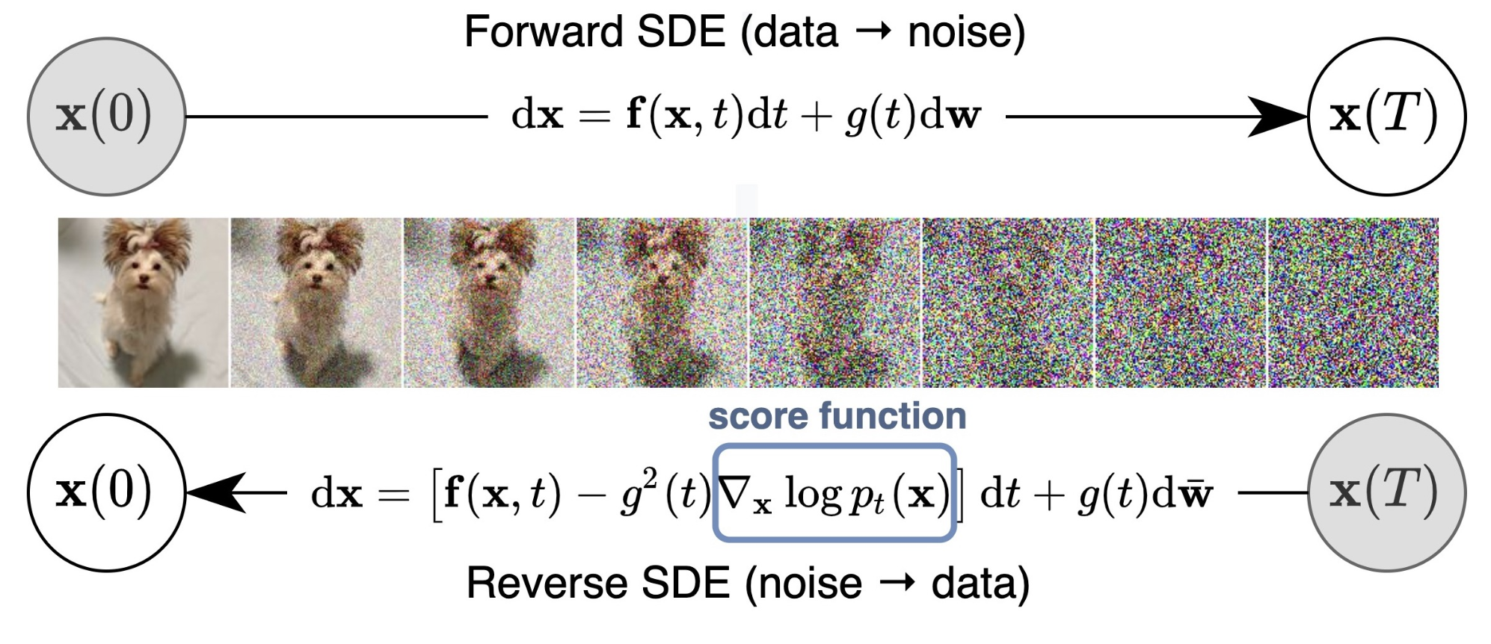
Introduction

Slide 5
Score Estimation
Minimization
Time Sampling
Expectation Over Data Distribution
Expectation Over Noisy Samples
Loss Function (MSE)
Weighting Function

Slide 6
Model Architecture
Image input
x MNIST image
(batch_size, 1, 28, 28)
Add time
h1 += dense1(embed)
(batch_size, 32, 26, 26)
…
Con Layer 1
2D Convolution
(batch_size, 32, 26, 26)
Upsample (Decode)
Transposed Convolution
(batch_size, 1, 28, 28) (final image)
Time Embedding
GaussianFourierProjection
nn.Linear(embed_dim, embed_dim)
Dense(embed_dim, output_channels)

Slide 7
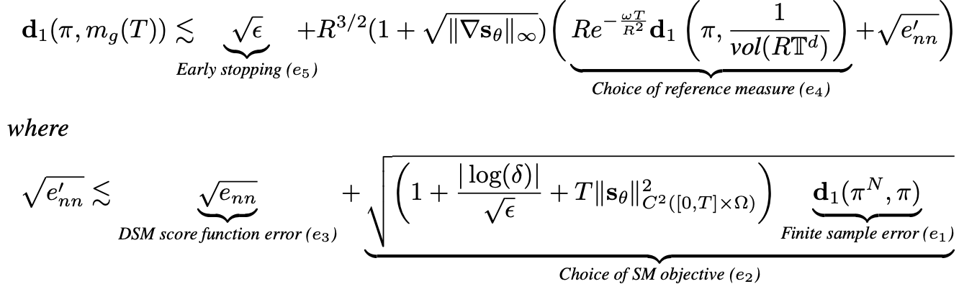
Empirical Bound with DSM Objective

Slide 8

Imbalanced
Modified the dataset by removing X% of data points
Each scenario was imbalanced in the same manner to ensure consistency
Description
Ratio 1.0
Ratio 0.9
Ratio 0.7
Ratio 0.4
Ratio 0.1

Slide 9
Results
DSM Loss
Lipschitz const.
Finite sample error
Bound
Ratio 1.0
15,9335
0,0329
0,0002
5,0646
Ratio 0.9
16,0009
0,0592
0,0005
5,2596
Ratio 0.7
16,2069
0,0602
0,0016
5,3871
Ratio 0.4
16,2186
0,0601
0,0038
5,4057
Ratio 0.1
16,3476
0,2331
0,0075
6,4915

Slide 10
Results

Slide 11
Link to Github Repository and Report
Link

