Slide 1
Building Program Reasoning Tools using LLVM and Z3
--From POPL’20 Tutorial - January 20, 2020
--source : http://rightingcode.org/tutorials/popl20/index.html
Notes:
hello everyone, today I will deliver a presentation from the popl20 tutorial which is mainly about the program reasoning tool , the first one is LLVM and Z3
You could also get the full material from the websites if you are interested.

Slide 2
Full tutorial overview
A Static Dataflow Analyzer(today)
A Symbolic Execution Engine
A Static Assertion Verifier
Notes:
Main focus: how to encode diverse program reasoning tasks via constraints extracted using LLVM and solved using Z3; we will NOT delve into Z3 internals

Slide 3
Why is for program reasoning？
Static Dataflow Analysis
Specifying Fixpoint Constraints in Datalog
Dynamic Symbolic Execution
Verification Condition Generation
Constrained Horn Clauses

Slide 4
My report from here (tutorial part I)
Tools introduction
LLVM IR
Z3
Static dataflow analysis
Reaching definition analysis
Taint analysis
Notes:
this is my outline, firstly I will introduce the LLVM IR and Z3 and then explain how did use them to conduct the static dataflow analysis.
This time I will mainly talk about the introduction of the tool and their theories. Maybe next time after fortnight, I will present more about how to pratically impelement in our really world program and other part of the methods to use.

Slide 5
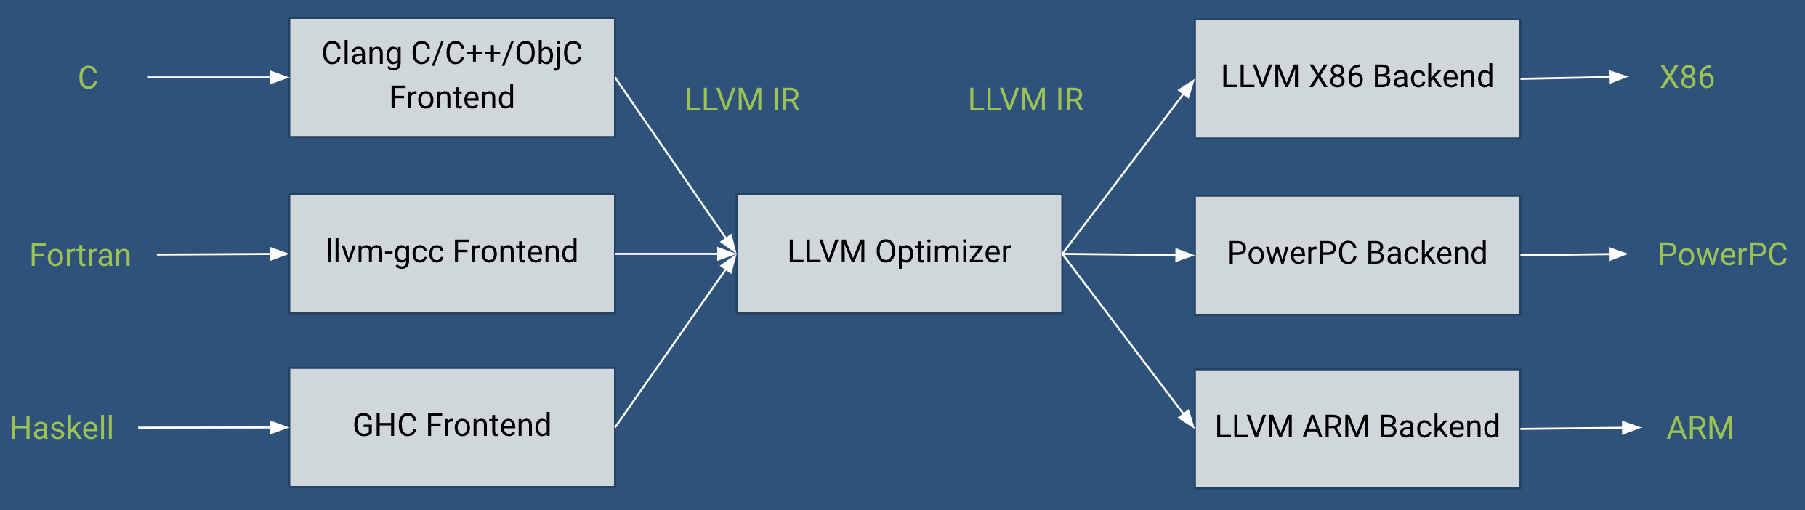
1.1 LLVM Architecture
Tools built as Optimization passes
Notes:
The LLVM compiler infrastructure project is a set of compiler and toolchain technologies,^{[3]} which can be used to develop a front end for any programming language and a back end for any instruction set architecture. LLVM is designed around a language-independent intermediate representation briefly we call it as llvm IR . It serves as a portable, high-level assembly language that can be optimized with a variety of transformations over multiple passes. Our target in this step is to convert the c++ souce code to the llvm IR code. In next slide I will show the detailed passes and how to vonvert the source code to IR code.

Slide 6
1.2 LLVM IR generation
%x = alloca
store 10 %x
%y = alloca
%0 = load %x
%cmp = icmp sgt %0 5
br %cmp %then %else
then:
store 0 %y
br %end
else:
store 1 %y
br %end
end:
%1 = load %y
ret %1
Predicate
Operand 1
Operand 2
int x = 10
int y;
if (x > 5)
y = 0;
else
y = 1;
return y;
%cmp = icmp sgt %0 0
ModulePass
FunctionPass
BasicBlockPass
CallGraphSCCPass
LoopPass
RegionPass
Notes:
The inner optimizer works as a pipelline. After the source code already converd to IR, the IR would be transfer to many different PASS module to be processed.
for modulepass , the full .c file could be seen as a module like the class includes the function, namespace and the declaration for the variable
for functionpass which stored in module as the list . fuctionpass is consist of many basicblocks , which is only has one entry block
Sgt work as prep.
Each instruction is in static single assignment form (SSA), meaning that each variable (called a typed register) is assigned once and then frozen. This helps simplify the analysis of dependencies among variables.

Slide 7
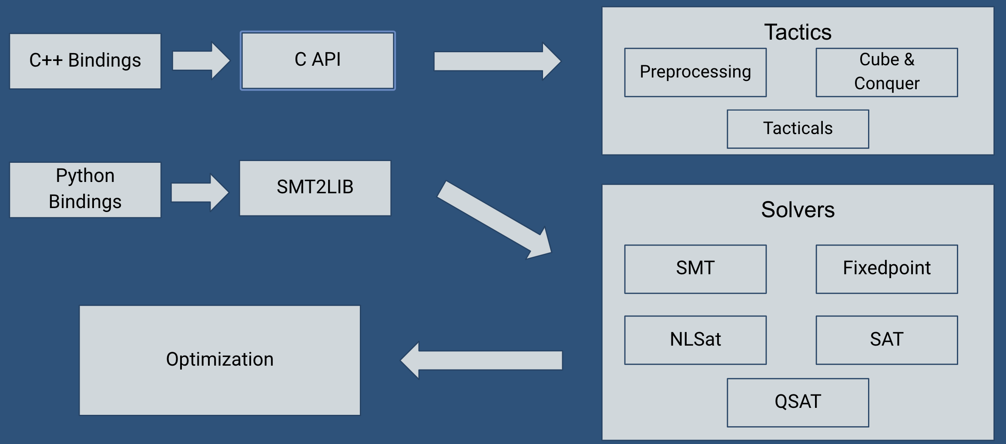
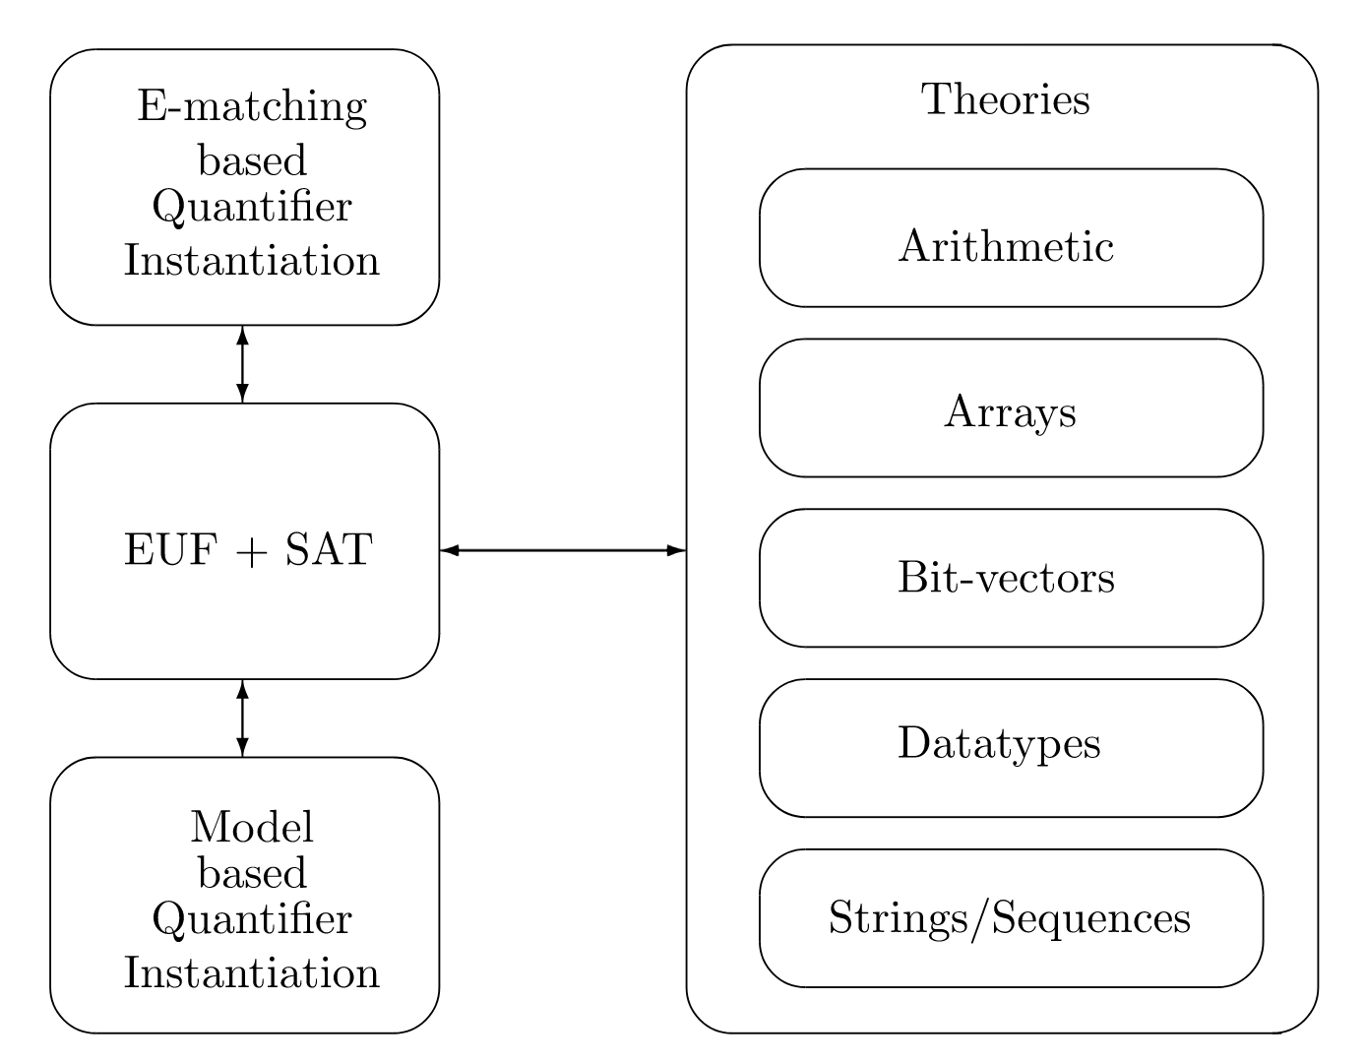
2.1 Z3 Architecture
Notes:
Z3 takes as input simple-sorted formulas that may contain symbols with pre-defined meanings defined by a theory. logical formulas that can be used as input to Z3.
Just like the IR which the perfect furmulated code and repressent the logical
There are five main solvers embedded in Z3. The SMT Solver is a general purpose solver that covers a wide range of supported theories. It is supplemented with specialized solvers for SAT formulas, polynomial arithmetic, Horn clauses and quantified formulas over theories that admit quantifier-elimination
Smt The core is responsible for case splitting, which is handled by a CDCL SAT solver, and for letting each theory learn constraints and equalities that are relevant in the current branch.

Slide 8
2.2 Easy example ：
from z3 import *
x = Real('x’)
y = Real('y’)
s = Solver()
s.add(30*x+15*y==675)
s.add(12*x+5*y==265)
if s.check() == sat:
result = s.model()
print(result)
→ [y = 5, x =20]
Block evaluating
Maximize the satisfying assignment
Bounded model checking [(x1, y1), (x2, y2),..]
Propositional interpolation
http://theory.stanford.edu/~nikolaj/programmingz3.html#sec-intro
Notes:
3 . a bounded model checking procedure [5] that takes a transition system as input and checks if a goal is reachable
Bounded model checking unfolds the transition relation trans until it can establish that the goal is reachable. Bounded model checking diverges if goal is unreachable. The function substitute(e, subst) takes an expression e and a list of pairs subst of the form [(x1, y1), (x2, y2),..] and replaces variables x1, x2,.. by y1, y2,.. in e.
4. A procedure that computes an interpolant for formulas , , where is unsatisfiable proceeds by initializing and saturating a state with respect to the different rules

Slide 9
3 Static Dataflow Analysis
Static analysis reasoning about the flow of data in program
Different kinds of data: constants, variables, expressions, ...
We will use a dominant approach called constraint-based analysis
two parts:
Constraint generation: program text → LLVM → constraints
Constraint resolution: constraints → Z3 → analysis result

Slide 10
3.1 Reaching Definition Analysis
Relations:
Def(X,Y): Variable X is defined at instruction Y
Use(X,Y): Variable X is used at instruction Y
Next(X,Y): Instruction Y is an immediate successor of instruction X
Gen(X,Y): Definition Y is generated by instruction X
Rules:
Kill(I, J) :- Definition I is killed by instruction J
Instruction I
x := y
...
x := 15 + z
Instruction J

Slide 11
Reaching Definition Analysis
Relations:
Def(X,Y): Variable X is defined at instruction Y
Use(X,Y): Variable X is used at instruction Y
Next(X,Y): Instruction Y is an immediate successor of instruction X
Gen(X,Y): Definition Y is generated by instruction X
Rules:
Kill(Y, Z) :- Def(X, Y) & Def(X, Z)
Instruction I
x := y
...
x := 15 + z
Instruction J

Slide 12
Reaching Definition Analysis
Relations:
Def(X,Y): Variable X is defined at instruction Y
Use(X,Y): Variable X is used at instruction Y
Next(X,Y): Instruction Y is an immediate successor of instruction X
Gen(X,Y): Definition Y is generated by instruction X
Rules:
Kill(Y, Z) :- Def(X, Y) & Def(X, Z)
Out(X, Y) :- Gen(X, Y)
Out(X, Y) :- In(X, Y) & !Kill(X,Y)
In(X, Y) :- Definition Y may reach the program point just before instruction X

Slide 13
Reaching Definition Analysis
Relations:
Def(X,Y): Variable X is defined at instruction Y
Use(X,Y): Variable X is used at instruction Y
Next(X,Y): Instruction Y is an immediate successor of instruction X
Gen(X,Y): Definition Y is generated by instruction X
Rules:
Kill(Y, Z) :- Def(X, Y) & Def(X, Z)
Out(X, Y) :- Gen(X, Y)
Out(X, Y) :- In(X, Y) & !Kill(X,Y)
In(X, Y) :- Out(Z,Y) & Next(Z, X)

Slide 14
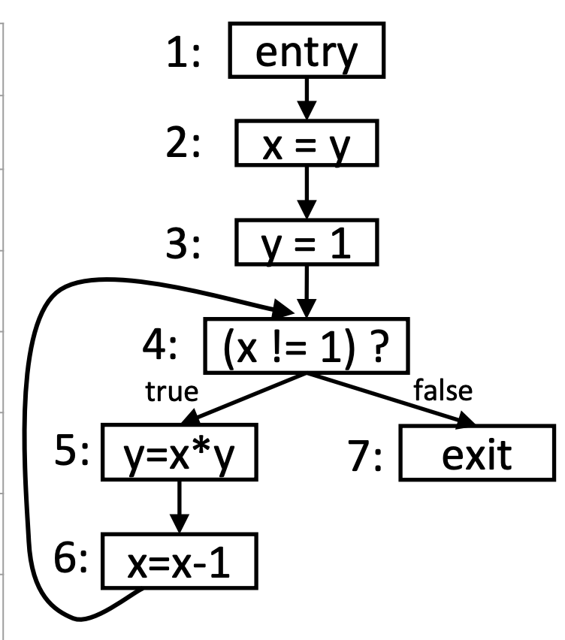
Reaching Definition Analysis
A definition d reaches a point p if there exists a path from d to p such that d is not overwritten along that path
x := y
y := 1
while ( x != 1 ) P1
y := x * y
x := x - 1 P2
Notes:
In briefly way to explain the progress, In this part , I still use the source code to describe how does it work.
But in definition analysis, they all converted to the llvm IR code and every line is represented to the SSA .

Slide 15

Reaching Definition Analysis - Example
n | IN(n) | OUT(n)
1 | -- | {<x,?>,<y,?>}
2 | {<x,?>,<y,?>}
3
4
5
6
7
Notes:
This chart is going to show the reaches points with the variable going in the if conditions contrl flow graph

Slide 16
Reaching Definition Analysis - Example
n | IN(n) | OUT(n)
1 | -- | {<x,?>,<y,?>}
2 | {<x,?>,<y,?>} | GEN(X,2)
3
4
5
6
7
Definition X is generated by node 2

Slide 17
Reaching Definition Analysis - Example
n | IN(n) | OUT(n)
1 | -- | {<x,?>,<y,?>}
2 | {<x,?>,<y,?>} | {<x,2>,<y,?>}
3 | {<x,2>,<y,?>}
4
5
6
7

Slide 18
Reaching Definition Analysis - Example
n | IN(n) | OUT(n)
1 | -- | {<x,?>,<y,?>}
2 | {<x,?>,<y,?>} | {<x,2>,<y,?>}
3 | {<x,2>,<y,?>} | GEN(Y,3)
4
5
6
7

Slide 19
Reaching Definition Analysis - Example
n | IN(n) | OUT(n)
1 | -- | {<x,?>,<y,?>}
2 | {<x,?>,<y,?>} | {<x,2>,<y,?>}
3 | {<x,2>,<y,?>} | {<x,2>,<y,3>}
4 | {<x,2>,<y,3>} and OUT(6)
5
6
7

Slide 20
Reaching Definition Analysis - Example
n | IN(n) | OUT(n)
1 | -- | {<x,?>,<y,?>}
2 | {<x,?>,<y,?>} | {<x,2>,<y,?>}
3 | {<x,2>,<y,?>} | {<x,2>,<y,3>}
4 | {<x,2>,<y,3>} and OUT(6) | {<x,2>,<y,3>} and OUT(6)
5 | {<x,2>,<y,3>} and OUT(6)
6
7

Slide 21
Reaching Definition Analysis - Example
n | IN(n) | OUT(n)
1 | -- | {<x,?>,<y,?>}
2 | {<x,?>,<y,?>} | {<x,2>,<y,?>}
3 | {<x,2>,<y,?>} | {<x,2>,<y,3>}
4 | {<x,2>,<y,3>} and OUT(6) | {<x,2>,<y,3>} and OUT(6)
5 | {<x,2>,<y,3>} and OUT(6) | KILL(Y,5)
6
7
Definition Y is killed by node 5

Slide 22
Reaching Definition Analysis - Example
n | IN(n) | OUT(n)
1 | -- | {<x,?>,<y,?>}
2 | {<x,?>,<y,?>} | {<x,2>,<y,?>}
3 | {<x,2>,<y,?>} | {<x,2>,<y,3>}
4 | {<x,2>,<y,3>} and OUT(6) | {<x,2>,<y,3>} and OUT(6)
5 | {<x,2>,<y,3>} and OUT(6) | GEN(Y,5)
6
7
Definition Y is generated by node 5

Slide 23
Reaching Definition Analysis - Example
n | IN(n) | OUT(n)
1 | -- | {<x,?>,<y,?>}
2 | {<x,?>,<y,?>} | {<x,2>,<y,?>}
3 | {<x,2>,<y,?>} | {<x,2>,<y,3>}
4 | {<x,2>,<y,3>} and OUT(6) | {<x,2>,<y,3>} and OUT(6)
5 | {<x,2>,<y,3>} and OUT(6) | {<x,2>,<y,5>} and OUT(6)
6 | {<x,2>,<y,5>} and OUT(6)
7

Slide 24
Reaching Definition Analysis - Example
n | IN(n) | OUT(n)
1 | -- | {<x,?>,<y,?>}
2 | {<x,?>,<y,?>} | {<x,2>,<y,?>}
3 | {<x,2>,<y,?>} | {<x,2>,<y,3>}
4 | {<x,2>,<y,3>} and OUT(6) | {<x,2>,<y,3>} and OUT(6)
5 | {<x,2>,<y,3>} and OUT(6) | {<x,2>,<y,5>} and OUT(6)
6 | {<x,2>,<y,5>} and OUT(6) | KILL(X,6) and GEN(X,6)
7

Slide 25
Reaching Definition Analysis - Example
n | IN(n) | OUT(n)
1 | -- | {<x,?>,<y,?>}
2 | {<x,?>,<y,?>} | {<x,2>,<y,?>}
3 | {<x,2>,<y,?>} | {<x,2>,<y,3>}
4 | {<x,2>,<y,3>} and OUT(6) | {<x,2>,<y,3>} and OUT(6)
5 | {<x,2>,<y,3>} and OUT(6) | {<x,2>,<y,5>} and OUT(6)
6 | {<x,2>,<y,5>} and OUT(6) | {<y,5>,<x,6>}
7

Slide 26
Reaching Definition Analysis - Example
n | IN(n) | OUT(n)
1 | -- | {<x,?>,<y,?>}
2 | {<x,?>,<y,?>} | {<x,2>,<y,?>}
3 | {<x,2>,<y,?>} | {<x,2>,<y,3>}
4 | {<x,2>,<y,3>} and OUT(6) | {<x,2>,<y,3>} and OUT(6)
5 | {<x,2>,<y,3>} and OUT(6) | {<x,2>,<y,5>} and OUT(6)
6 | {<x,2>,<y,5>} and OUT(6) | {<y,5>,<x,6>}
7

Slide 27
Reaching Definition Analysis - Example
n | IN(n) | OUT(n)
1 | -- | {<x,?>,<y,?>}
2 | {<x,?>,<y,?>} | {<x,2>,<y,?>}
3 | {<x,2>,<y,?>} | {<x,2>,<y,3>}
4 | {<x,2>,<y,3>,<y,5>,<x,6>} | {<x,2>,<y,3>,<y,5>,<x,6>}
5 | {<x,2>,<y,3>,<y,5>,<x,6>} | {<x,2>,<y,5>,<x,6>}
6 | {<x,2>,<y,5>, <x,6>} | {<y,5>,<x,6>}
7

Slide 28
Reaching Definition Analysis - Example
n | IN(n) | OUT(n)
1 | -- | {<x,?>,<y,?>}
2 | {<x,?>,<y,?>} | {<x,2>,<y,?>}
3 | {<x,2>,<y,?>} | {<x,2>,<y,3>}
4 | {<x,2>,<y,3>,<y,5>,<x,6>} | {<x,2>,<y,3>,<y,5>,<x,6>}
5 | {<x,2>,<y,3>,<y,5>,<x,6>} | {<x,2>,<y,5>,<x,6>}
6 | {<x,2>,<y,5>,<x,6>} | {<y,5>,<x,6>}
7 | {<x,2>,<y,3>,<y,5>,<x,6>} | --
Notes:
Continue until we reach a fixed point
the. ahathe the node from theis fats flow n

Slide 29
3.2 Taint Analysis
Any variable that can be set or modified by a user poses a potential security risk
We call these variables tainted
x := input()
y := x
z := 4 / y
The tainted value reaches y and z which are now also tainted

Slide 30
Taint Analysis
Any variable that can be set or modified by a user poses a potential security risk
We call these variables tainted
x := input()
y := x
z := 4 / y
This poses a security risk as attackers could intentionally set x to zero to cause an exploitable divide by zero bug

Slide 31
Taint Analysis Rules
Relations:
Def(X,Y): Variable X is defined at instruction Y
Use(X,Y): Variable X is used at instruction Y
In(X,Y): Instruction Y may reach the program point just before instruction X
Taint(X): There exists a function call at instruction X that reads a tainted input
Sanitizer(X): There exists a function call at instruction X that sanitizes a tainted input
Div(X,Y): There exists a division operation at instruction Y whose divisor is variable X
Rules:
Edge(I, J) :- There exists an immediate data-flow from instruction I to J
x := tainted_input()
y := x

Slide 32
Taint Analysis Rules
Relations:
Def(X,Y): Variable X is defined at instruction Y
Use(X,Y): Variable X is used at instruction Y
In(X,Y): Instruction Y may reach the program point just before instruction X
Taint(X): There exists a function call at instruction X that reads a tainted input
Sanitizer(X): There exists a function call at instruction X that sanitizes a tainted input
Div(X,Y): There exists a division operation at instruction Y whose divisor is variable X
Rules:
Edge(Y, Z) :- Def(X, Y) & Use(X, Z) & In(Z,Y)
Instruction Y
x := tainted_input()
y := x
Instruction Z

Slide 33
Taint Analysis Rules
Relations:
Def(X,Y): Variable X is defined at instruction Y
Use(X,Y): Variable X is used at instruction Y
In(X,Y): Instruction Y may reach the program point just before instruction X
Taint(X): There exists a function call at instruction X that reads a tainted input
Sanitizer(X): There exists a function call at instruction X that sanitizes a tainted input
Div(X,Y): There exists a division operation at instruction Y whose divisor is variable X
Rules:
Edge(Y, Z) :- Def(X, Y) & Use(X, Z) & In(Z,Y)
Path(I, J) :- Edge(I,J) & Taint(I)
Path(I, K) :- Path(I,J) & Edge(J,K) & !Sanitizer(J)
Instruction I
Instruction J
Instruction K
x := tainted_input()
y := x
z := y + 15

Slide 34
Taint Analysis Rules
Relations:
Def(X,Y): Variable X is defined at instruction Y
Use(X,Y): Variable X is used at instruction Y
In(X,Y): Instruction Y may reach the program point just before instruction X
Taint(X): There exists a function call at instruction X that reads a tainted input
Sanitizer(X): There exists a function call at instruction X that sanitizes a tainted input
Div(X,Y): There exists a division operation at instruction Y whose divisor is variable X
Rules:
Edge(Y, Z) :- Def(X, Y) & Use(X, Z) & In(Z,Y)
Path(I, J) :- Edge(I,J) & Taint(I)
Path(I, K) :- Path(I,J) & Edge(J,K) & !Sanitizer(J)
Alarm( I ) :- There exists a potential exploitable divide-by-zero error at instruction I
x := input()
y := x
z := 4 / y
Instruction I
Instruction J
Instruction K
ALARM

Slide 35
Edge("%call = call i32 (...) @tainted_input()", "store i32 %call, i32* %x, align 4")
Edge("store i32 %call, i32* %x, align 4", "%0 = load i32, i32* %x, align 4")
Edge("%0 = load i32, i32* %x, align 4", "store i32 %0, i32* %y, align 4")
Edge("store i32 %0, i32* %y, align 4", "%1 = load i32, i32* %y, align 4")
Edge("%1 = load i32, i32* %y, align 4", "%div = sdiv i32 4, %1")
....
Path("%call = call i32 (...) @tainted_input()", "%div = sdiv i32 4, %1")
....
Query Z3 is there an alarm?
Alarm("%div = sdiv i32 4, %1")
x := input()
y := x
z := 4 / y

Slide 36
Step 1. Writing Analysis Rules
Write the rules we just defined in the initialize function in Extractor.cpp
z3::expr X = C.bv_const("X", 32);
z3::expr Y = C.bv_const("Y", 32);
z3::expr Z = C.bv_const("Z", 32);
z3::expr kill_rule = z3::forall(X, Y, Z, z3::implies(Def(X, Y) && Def(X, Z), Kill(Y, Z)));
If X is defined at instruction Y and X is defined at instruction Z, then the definition at instruction Y is killed by the definition at instruction Z
Solver->add_rule(kill_rule, C.str_symbol("kill_rule"));
Add the kill_rule to the Z3 solver

Slide 37
Step 1. Writing Analysis Rules
Do this for all of the rules
z3::expr kill_rule = z3::forall(X, Y, Z, z3::implies(Def(X, Y) && Def(X, Z), Kill(Y, Z)));
Z3::expr out_rule1 = ...
Z3::expr out_rule2 = ...
Z3::expr in_rule = ...
z3::expr edge_rule = ...
z3::expr path_rule1 = ...
z3::expr path_rule2 = ...
z3::expr alarm_rule = ...
And add them to the Z3 solver!

Slide 38
Step 2. Extract Datalog Facts from LLVM IR
Write the extractConstraints function in Extractor.cpp
int x = 0;
x = alloca i32
store i32 0, i32* x
if (StoreInst *SI = dyn_cast<StoreInst>(I)) {
Value *From = SI->getValueOperand();
Value *To = SI->getPointerOperand();
addGen(InstMap, SI, SI);
addDef(InstMap, To, SI);
addUse(InstMap, From, SI);
}

Slide 39
Step 2. Extract Datalog Facts from LLVM IR
Write the extractConstraints function in Extractor.cpp
int x = 0;
x = alloca i32
store i32 0, i32* x
if (StoreInst *SI = dyn_cast<StoreInst>(I)) {
Value *From = SI->getValueOperand();
Value *To = SI->getPointerOperand();
addGen(InstMap, SI, SI);
addDef(InstMap, To, SI);
addUse(InstMap, From, SI);
}
we provide these functions

Slide 40
Step 2. Extract Datalog Facts from LLVM IR
Write the extractConstraints function in Extractor.cpp
int x = 0;
x = alloca i32
store i32 0, i32* x
if (StoreInst *SI = dyn_cast<StoreInst>(I)) {
Value *From = SI->getValueOperand();
Value *To = SI->getPointerOperand();
addGen(InstMap, SI, SI);
addDef(InstMap, To, SI);
addUse(InstMap, From, SI);
}
we provide these functions
InstMap encodes each LLVM instruction as an integer
initialized in the main function

Slide 41
Step 2. Extract Datalog Facts from LLVM IR
Write the extractConstraints function in Extractor.cpp
int x = 0;
x = alloca i32
store i32 0, i32* x
if (StoreInst *SI = dyn_cast<StoreInst>(I)) {
Value *From = SI->getValueOperand();
Value *To = SI->getPointerOperand();
addGen(InstMap, SI, SI);
addDef(InstMap, To, SI);
addUse(InstMap, From, SI);
}
we provide these functions
Variable From is used at instruction SI
InstMap encodes each LLVM instruction as an integer
initialized in the main function

Slide 42
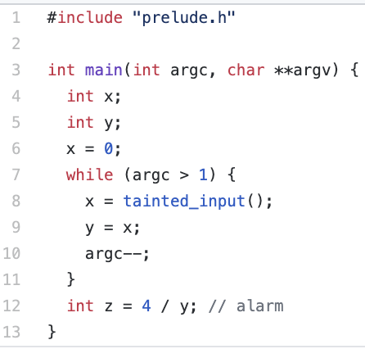
Building and Running the Analysis
$ export LD_LIBRARY_PATH = ex1/build
$ cd ex1/test
$ clang -emit-llvm -S -fno-discard-value-names -c loop0.c
$ ../build/constraint loop0.ll
Output:
Potential divide-by-zero points:
%div = sdiv i32 4, %3

Slide 43
Thanks Q & A
Guanqin
13426770@student.uts.edu.au

