Slide 1
Code Clone Detection
FCCA : Hybrid Code Representation for Functional Clone Detection Using Attention Networks
Wei Hua
2020
www.github.com/preesee/codeclonedetection
REPORT

Slide 2
CONTENTS
01
What is Code clone detection？
02
Recap State-of the-Arts approaches ( ASTNN, Code2Vec, DeepSim)
03
Our Approach ( Motivation)
04
Introduction of Implementation (Token, AST, Graph Embedding [GCN])
05
Conclusion , Future work (Experiment results)

Slide 3
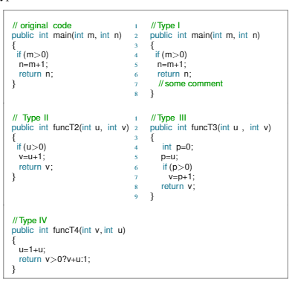
What is Code clone detection？(Problem definition)
Sample code
/01

Slide 4

Why we need to detect code clones?
Project maintenance
Plagiarism & Copyright issues.
Code Consistency
Copy-pastes ruin the structure of software projects.

Slide 5
Problems in code clone detection
Q1: Semantic clones
Q2: Scalability
Q4
Functional clone detection is hard even humans can not distinguish functional clones.
Tons of code snippets
Q3: Logic flow & data flow
recognition
Q3
Q4: Inexplicit features
Text, AST, (Control-flow, data-flow )Graph of source code
Graph structured information is hard to be extracted.
Q2
Q1
2020

Slide 6
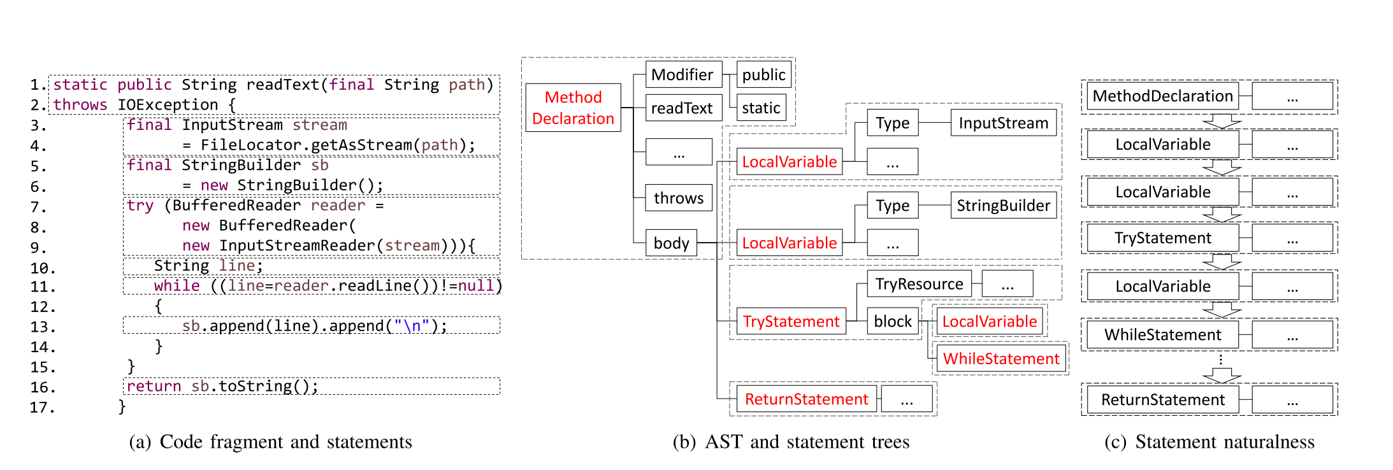

State-of-the-the-Art tools (existing solution)
AST-based representation : ASTNN

Slide 7
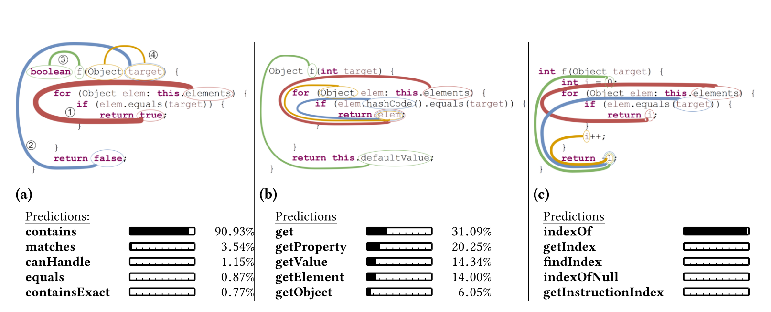
State-of-the-the-Art tools
Attention-based code representation : code2vec

Slide 8
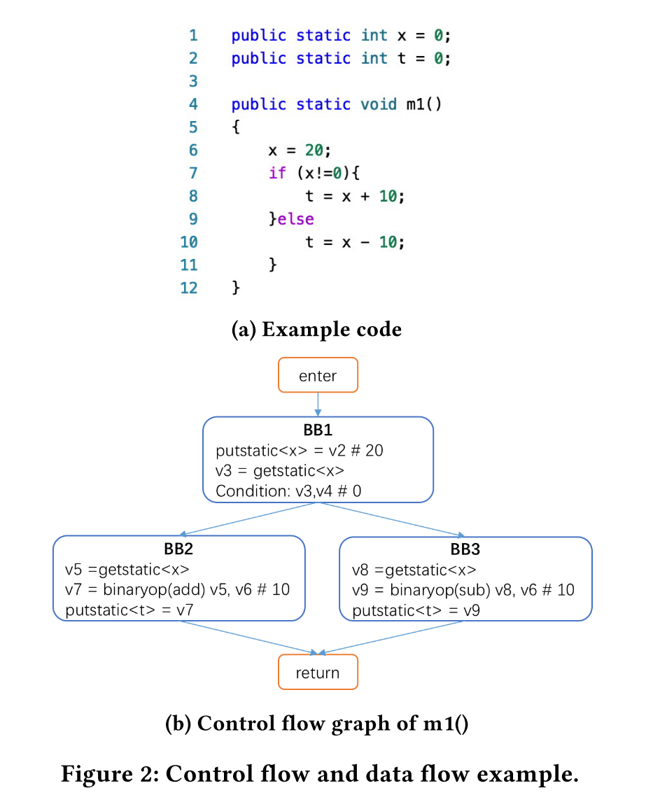
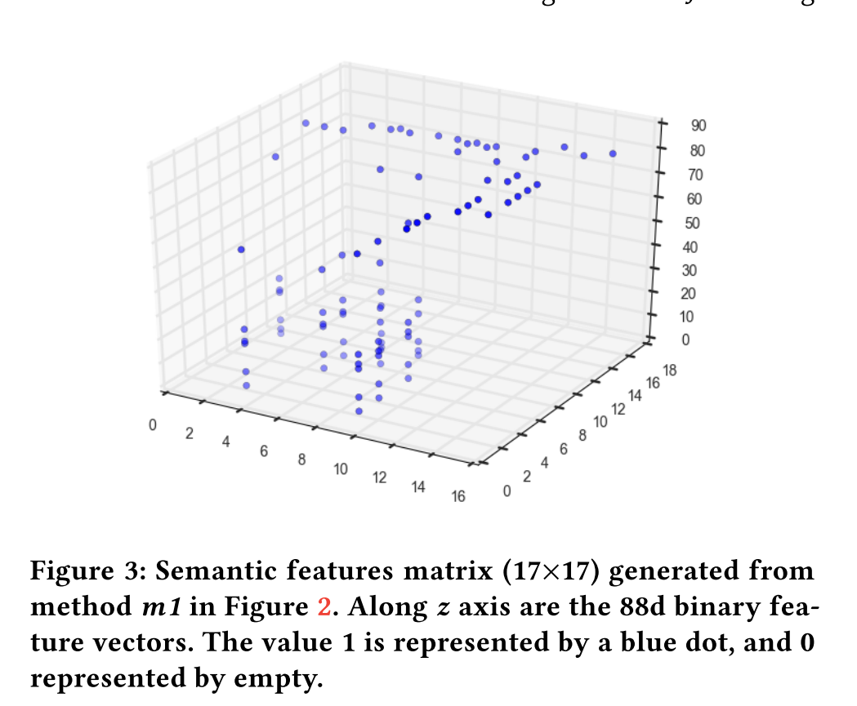
State-of-the-the-Art tools
Byte-code-based representation: DeepSim

Slide 9
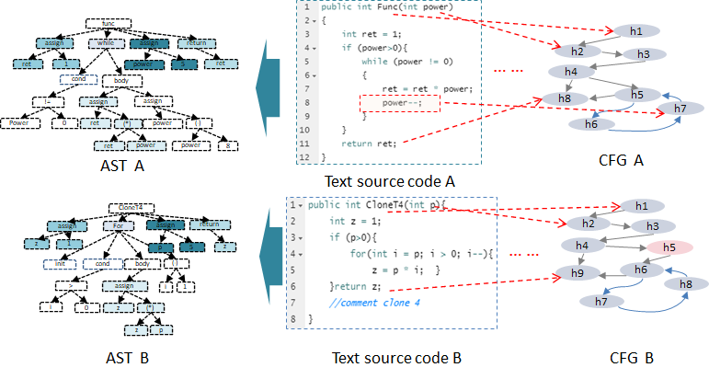
Our Approach: Feature Fusion （Motivation）

Slide 10
Limitations:
Limitation 1: The code sequential and structural information are not fully utilized, which is critical for functional similarity measuring
Limitation 2: single-feature is not comprehensive to reflect code representation.

Slide 11
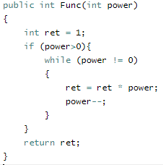
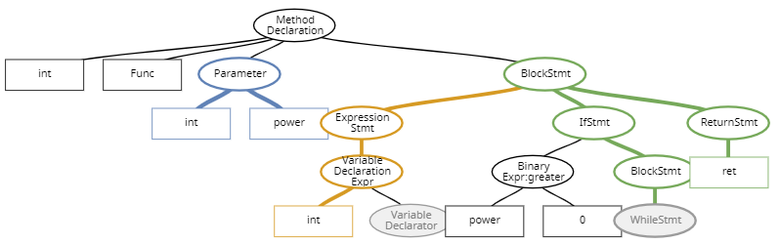
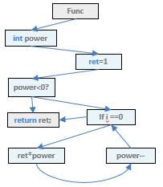




Our Approach: Feature Fusion+ Attention ( Architecture)
Java code pair
(a) Multi- feature code representation
(b) Attention + Fusion
LSTM
Code snippet
A
TEXT
A
1x128
$$vAtxt$$
Attention
AST
A
Tree-LSTM
$$VA$$
1x128
$$vAast$$
Feature Fusion
Attention
CFG
A
Graph-LSTM
1x64
$$vAcfg$$
Graph Attention Network

Slide 12
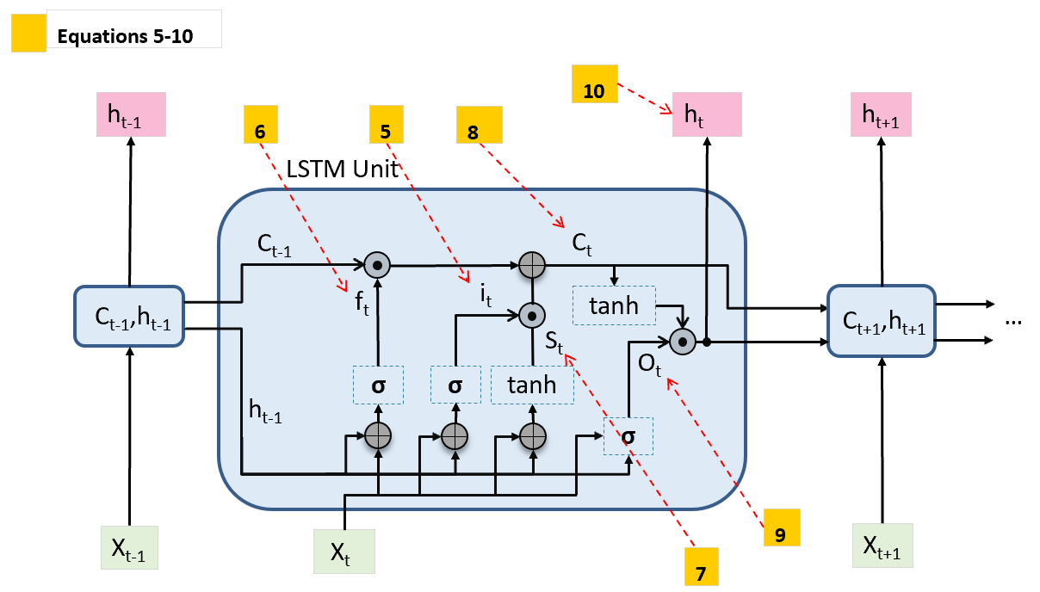
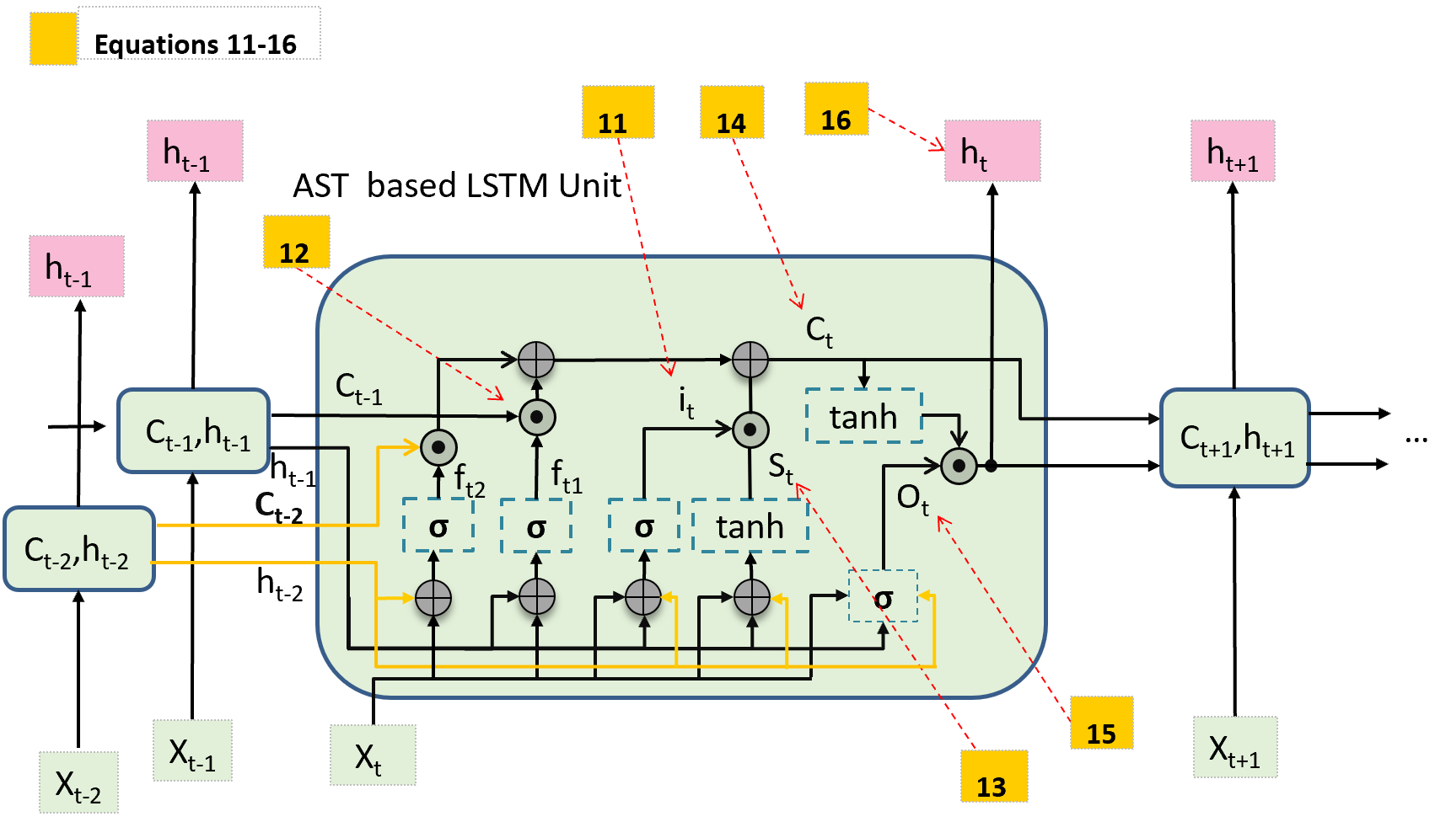
Implementation Details
Tokens: RNN， LSTM
ASTs: Tree-LSTM ， B+Tree LSTM etc

Slide 13
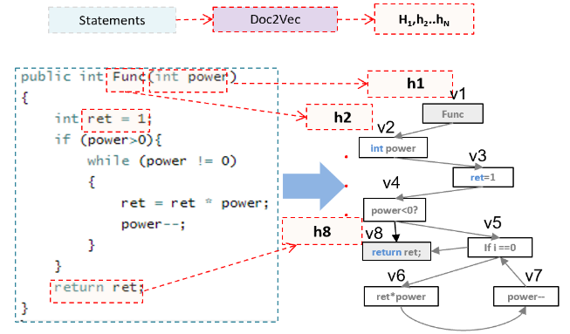
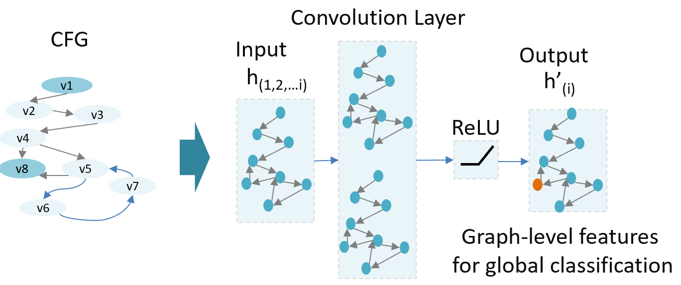

Implementation Details
Graph Embedding: Structure information extraction
h1
h2
h3
h4
h8
h5
h7
h6

Slide 14
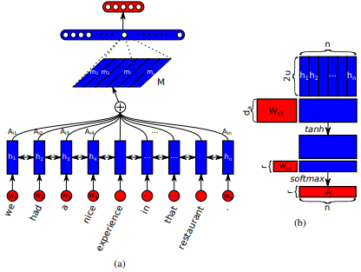
Attention components:

Slide 15
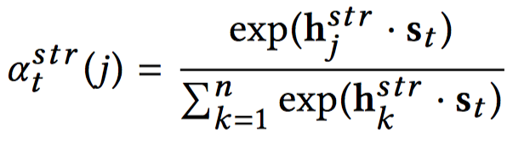
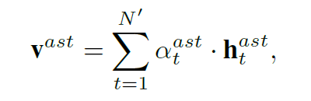

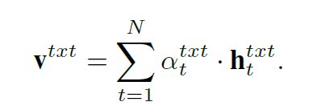
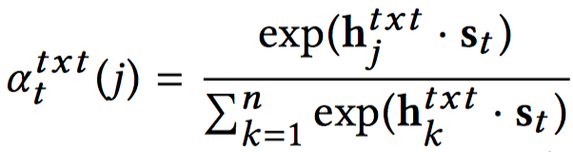

Attention components:
Attention on AST Attention on CFGs
Attention on sequence
Concatenation

Slide 16
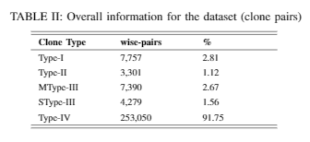

Dataset
BigCloneBench
https://github.com/clonebench/BigCloneBench
How to use the dataset:
Demonstration

Slide 17
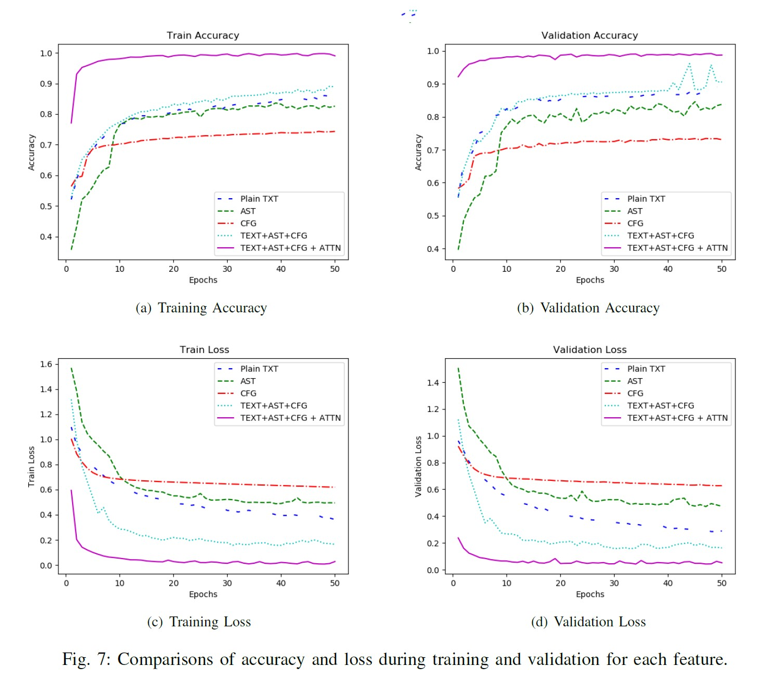
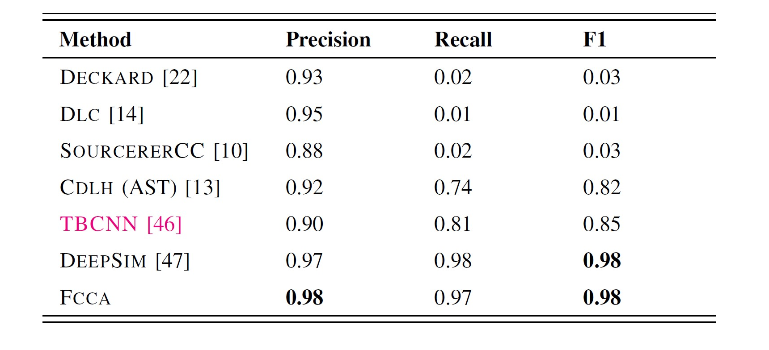
Results
Observations:
our proposed model outperforms best in almost all of evaluation metrics.
attention is effective.
performance of simply encoding the tree structure of code is worse than that of simply encoding the code as sequence.

Slide 18
Threat to Validity
Time cost for training is high.
Arbitrary clone detection is not available.
There is no other datasets available.

Slide 19
Conclusion
Best performance
Feature fusion
Model tuning
Code representations
Balance for Feature weights
RNN, LSTM, AST, Graph
Attention networks
Encoder

Slide 20
Thanks.
Henry (Wei.Hua)

