Slide 1






A Literature Review of Automatic Traceability Links Recovery for Software Change Impact Analysis
Thazin Win Win Aung, Yulei Sui, Huan Huo

Slide 2
Outline
Background and Objectives
Research Methods
Main Findings
Validity Treats
Research Opportunities and Future Works

Slide 3

Background and Objectives
Traceability Links Usage in Change Impact Analysis
Challenges
Previous Works
Objectives
3

Slide 4
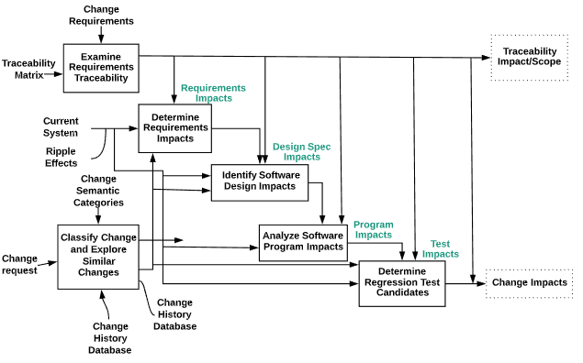
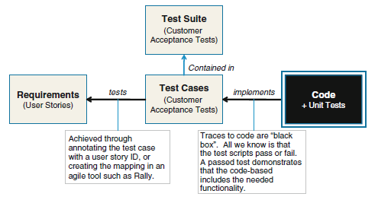
Traceability Links Usage in Change Impact Analysis
Fig 2. A traceability information model for a basic agile project(Cleland-Huang, Gotel, & Zisman, 2012)
Fig 1. Bohner’s Change Impact Sets (Arnold, 1996)
Identify Requirement Impact set
Identify Design Impact Set
Identifying Program Impact Set
Identifying Test Impact Set

Slide 5


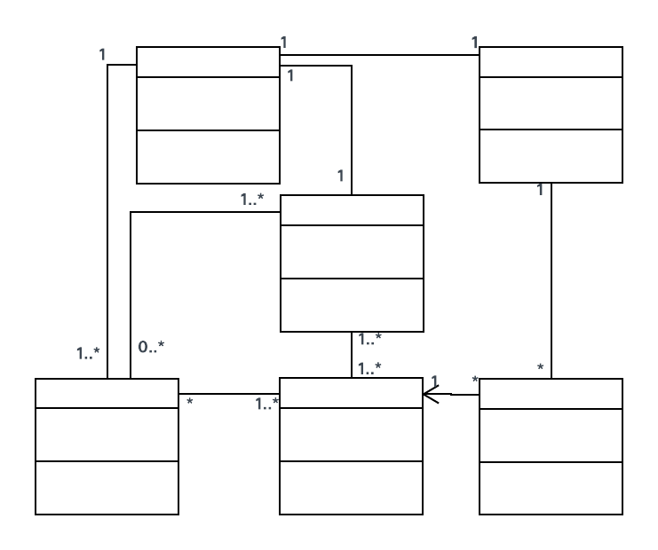
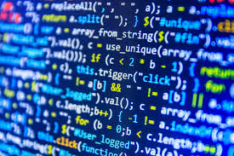


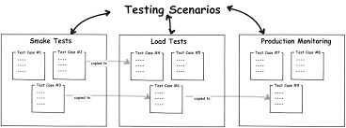
Challenges
Knowledge gap between artifacts
Time-consuming and Error prone to verify the traceability links between the impacted artifacts
It is costly to maintain the trace links manually during software design evolution
Natural Language Artifacts
Code

Slide 6
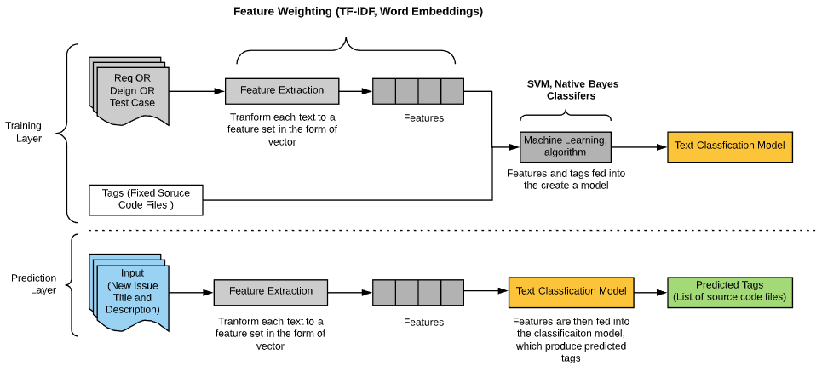
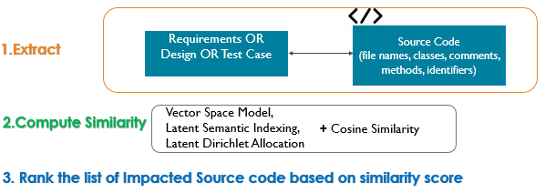
Related Works (1/2)
IR-Based Approach
Machine Learning Based Approach

Slide 7
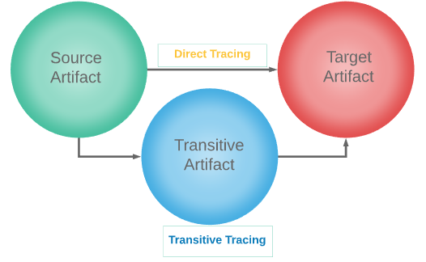
Related Works (2/2)
Direct Or Transitive Tracing Approach
Direct Tracing - create explicit trace links between source and target artifacts
Transitive tracing – recovers traceability links between two artifacts by joining them to a third artifacts. This approach is useful when the source and target artifacts share little textual similarity, as a third artifact can be a transitive artifact to connect the other two.

Slide 8

Objectives
“identify research gaps and report evidence to direct future research”
RQ1. What approaches have been adopted to recover traceability links between artifacts to support CIA?
RQ2. Which change impact sets have been covered?
RQ3. How have studies adopted transitive tracing approaches
8

Slide 9
Research Methods
Methodology
Search Strategy and Data Sources
Study Selection
Quality Assessment & Data Extraction and Analysis
9

Slide 10
Research Methodology
Systematic Literature Review (SLR)
SLR – “form of secondary study that uses a well-defined methodology to identify, analyze and interpret all available evidence related to a specific research question in a way that is unbiased and (to a degree) repeatable”
Step 1 : Planning
Specify research questions
Step 2 : Conducting
Search the relevant literature
Develop the review's protocol
Perform selection of primary studies
Preform data extraction
Assess studies quality
Conduct synthesis of evidence
Step 3 : Reporting
Write up the SLR report/paper
Validate Protocol
(Kitchenham & Charters, 2007)

Slide 11
Search Strategy and Data Sources
Define Search String
Define Data Sources
ABSTRACT: (Abstract: trace*)
AND (Abstract: recover* OR Abstract: maintain OR Abstract: link OR Abstract: establish)
AND (Abstract: requirement OR Abstract: specification OR Abstract: architecture OR Abstract: design OR Abstract: code OR Abstract: implementation OR Abstract: test OR Abstract: bug)
AND (Abstract: change OR Abstract: impact OR Abstract: analysis OR Abstract: system comprehension)
ACM Digital Library
IEEE xplore
Science Direct
SpringerLink
Scopus

Slide 12
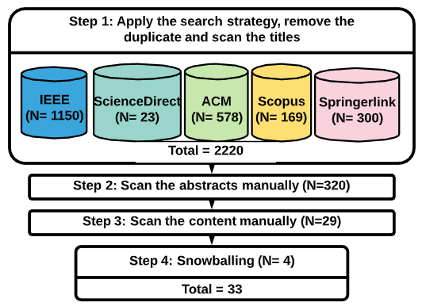

Study Selection
Selection Criteria
Publication Year (2012 – 2019)
The publications are written in English
Research explicitly mention they are targeting trace recovery relating to software maintenance and change impact analysis
Studies contain empirical results (e.g., case study, experiments and surveys)
Scan Title
Scan Abstract
Scan Content
Forward Snowballing

Slide 13
Quality Assessment & Data Extraction and Analysis
Quality Assessment
Data Extraction and Analysis
Assessment of research design : To assess the quality of studies, we reviewed the details of research objectives, design and evaluation
Assessment of publication source and impact : We checked the professional computer science CORE journal/conference ranking site to evaluate the quality of the publications’ sources.
Title
Authors
Type of outlet (journal or conference)
Name of outlet
Publication Year
Type of trace artifacts
Trace direction
Trace recovery technique
Quality of evaluation (e.g., research design)
Ranking
CIA coverage

Slide 14
Main Findings
RQ1. What approaches have been adopted to recover traceability links between artifacts to support CIA?
Traceability Links Recovery Approaches Between Software Artifacts
Traceability tools
Evaluation and Traceability Direction
RQ2. Which change impact sets have been covered?
Support Change Impact Set
RQ3. How have studies adopted transitive tracing approaches
Traceability Links Recovery Methods
14

Slide 15
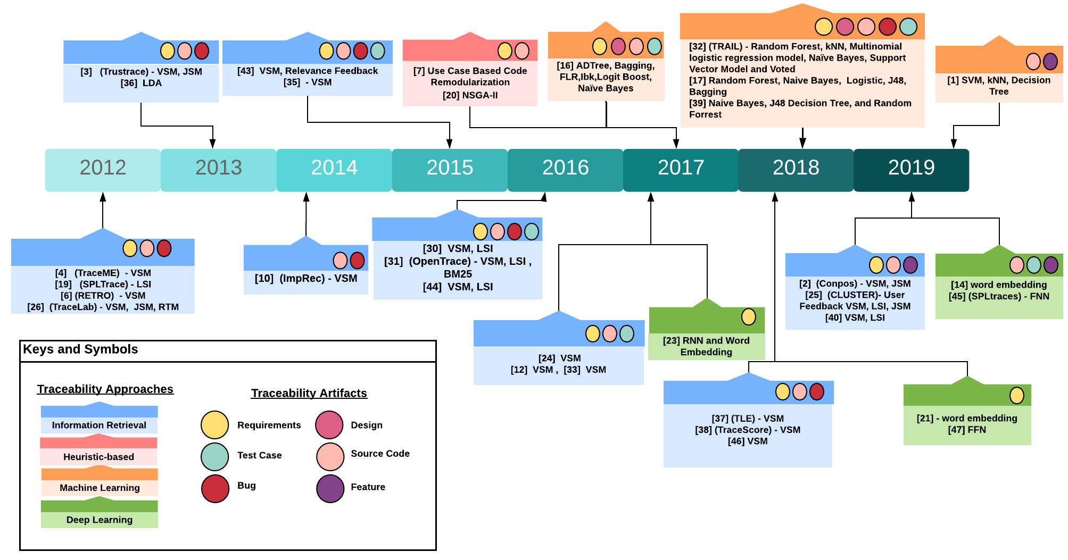
Traceability Links Recovery Approaches Between Software Artifacts (1/4)
Fig. Traceability link recovery publication trends

Slide 16

Information Retrieval –Based Approach
Model - vector space models (VSMs), latent semantic indexing (LSI), Jensen and Shannon models (JSMs), latent Dirichlet allocation (LDA) are the most applied techniques
Metadata – Code (Class, Methods, Identifiers), Requirements, Bug Report Description
Enhancement Strategy
Co-occurrence concept - (e.g., method A and method B are committed to three commit transactions together, which are considered “co-occurrence” methods)
Taxonomy based approach - manually defined query terms and maintained them in a custom taxonomy database
Observe behaviour terms - are texts that describe the misbehavior of a system (e.g., “the menu doesn’t open when I click the button”)
Part of Speech tagging - a constraint-based pruning approach to improve accuracy(i.e., nouns, verbs, adjectives, adverbs and pronouns)
Code Dependencies - based on degrees of direct interaction (e.g., method calls, inheritance and class usage) and indirect interaction (e.g., reading or writing the same data)

Slide 17

Heuristic-Based Approach
Approach based on multiple weighting criteria (e.g., textual similarity scores, frequency of change and recency of change )
Model - non-dominated sorting algorithm (NSGA–II)
Re-modularization - transforming source code syntax into natural language sentences.

Slide 18

Machine Learning Based Approach
Model - Random Forest, k-Nearest Neighbours (kNN), Naïve Bayes, Support Vector Model (SVM), Multinomial Logistic Regression Model, Voted ADTree, Bagging, Fuzzy Lattice Reasoning, Ibk, LogitBoost and ZeroR
Scenarios
Estimation of the number of remaining links (ENRL) and Traceability links classifier (TRAIL) – train the ML classifiers to detect the remaining number of positive trace links from ranked lists generated with IR approaches
Feature-annotation recommendation approach – train the ML classifiers to remind developers to add annotation.

Slide 19

Deep Learning Based Approach
Model – Recurrent Neural Network, Feed-Forward Neutral Network, Word Embedding
Scenario
polysemy issue- - refers to “the coexistence of multiple meanings for a term appearing in different requirements”. Use word-embedding and FNN to identify the lists of polysemy terms in a requirements collection.
Learn representation of requirements and design documents – to capture the semantic structure
Learn the representation of source code (abstract syntax tree structure) – to capture the underline patterns and property of methods and functionalities.

Slide 20
Traceability tools
Special Purpose Tool
General Purpose Tool
Workbench Tool
TraceME - An eclipse-plugin application to recover the traceability links between source code and requirements during software development. The tool supports a graph view to visualise the trace links between source code and requirements.
RETRO - It is a web-based traceability recovery application to establish
trace links between artifacts of different types (i.e., requirements, test case and source code).
SPLTrace- An experimental traceability framework built on four IR models (i.e., Class Vector, Extended Boolean, Latent Semantic index, and BM25) and one deep-learning model (i.e., Feedforward Neural Network). The framework provides the components to recovery traceability links between project features and source code. The application developed using Python.
TraceLab - A Winforms traceability workbench application to experiment with traceability research projects. The framework provides a collection of customizable and configurable IR
components to establish traceability links between various types of textual artifacts of a software project.
OpenTrace- A Winforms experimental traceability workbench application for researchers to perform traceability research projects. The tool supports built-in as well as custom-built traceability components to establish links between different software artifacts.

Slide 21
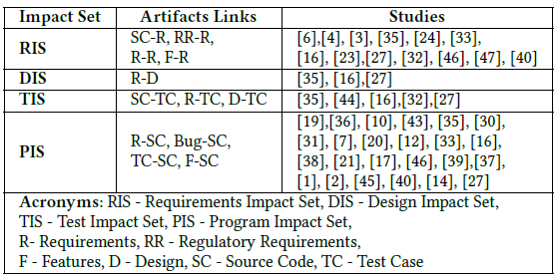
Support Change Impact Set
Change Impact Sets
Findings
Requirements Impact Set-used requirements as target artifacts in their trace-recovery approaches to identify the impact on requirements levels
Design Impact Set -used design artifact as a target artifact
Test Impact Set -studies that used tests as target artifact
Program Impact Set - used source code as a target artifact
RIS (#13), DIS (#3), TIS (#5), PIS (#24)

Slide 22
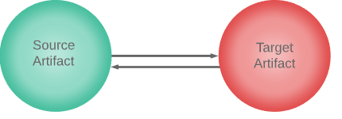
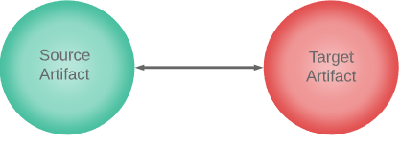
Traceability Direction
Category
Findings
Unidirectional –we included studies that evaluated their approach to recovering trace links from one artifact to another in either direction
Bidirectional –we included studies that evaluated their approach in both forward and backward direction.

Slide 23
Degree of Evaluation
Research Methods
Type of Datasets

Slide 24
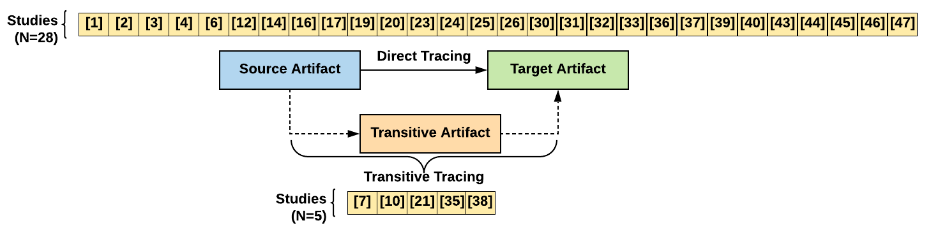
Traceability Links Recovery Methods
Usage
Findings
Direct Tracing – applicable to explicit tracing scenario where the source and target artifacts share high textual similarity.
Transitive Tracing - applicable to indirect/indirect tracing scenario where the source and target artifacts do not have much textual similarity between them (e.g., establishing links between a new bug report and source code using existing bug reports as transitive artifacts).

Slide 25
Threats to Validity
25

Slide 26
Threats to Validity
Internal Validity
External Validity
Constructed our search strings by referring to previous review studies
included all possible keywords to cover abbreviations, synonyms, morphological root forms (e.g., source code, architecture, trace*)
ran our search in five databases to cover a broader scope of concerns
To handle the threats of the relevance of study, second and third authors independently verify the selected studies
Our review focused on automating traceability studies to assist the CIA process, as the scope is tight. We do not claim that our review applies to other areas of impact analysis (e.g., dependency impact analysis)

Slide 27

Future Works
Focus on tool enhancements to support fully automatic traceability-recovery approaches (e.g., machine learning based approach and deep learning-based approach)
Emphasize recovering links between trace artifacts commonly used in modern software development (e.g., user stories, accepted test cases and source code)
Focus on building traceability systems beyond text-based recovery (e.g., recovering traceability links between design images and requirements)
Investigating advanced static program analysis, such as value flow analysis and pointer aliasing analysis to support more precise CIA.
Evaluate industrial datasets and survey practitioners to gain valuable feedback for further improvements
27

Slide 28
THANK YOU, Question?
28

