Slide 1

Concept #17 (still no name.. sorry)
By Charles Doucet

Slide 2
The basic idea
A 2D Platform game that turns into an experience
The player begins in a naïve environment/world
After a while, he falls into a glitch and become stuck into the computer
The world into the computer is much darker and evil
The goal is now to shut down the computer

Slide 3
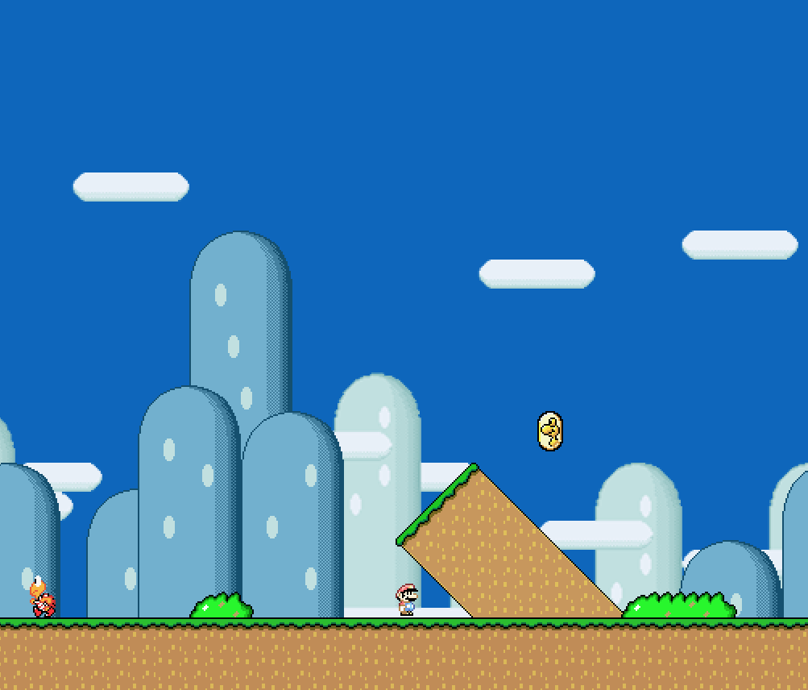
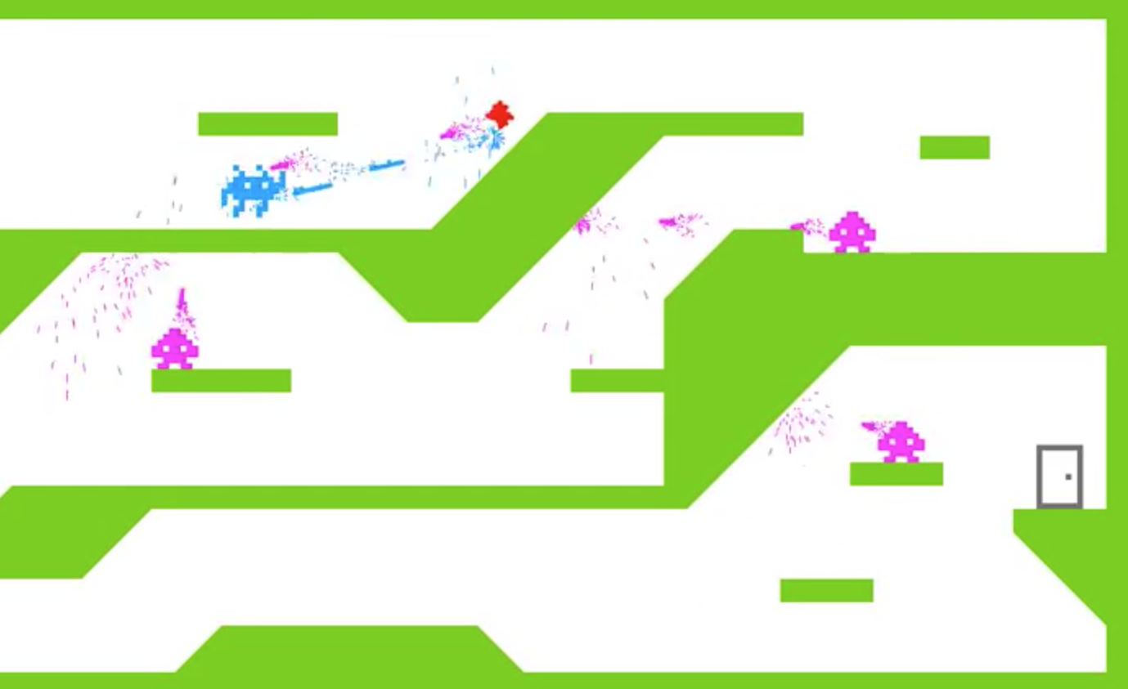
Research
The Mario example made in Processing (Let’s make a Mario Game)
Invader War (Takumus - 年前期のプロセッシングゲーム課題のソースおいておきます。)

Slide 4
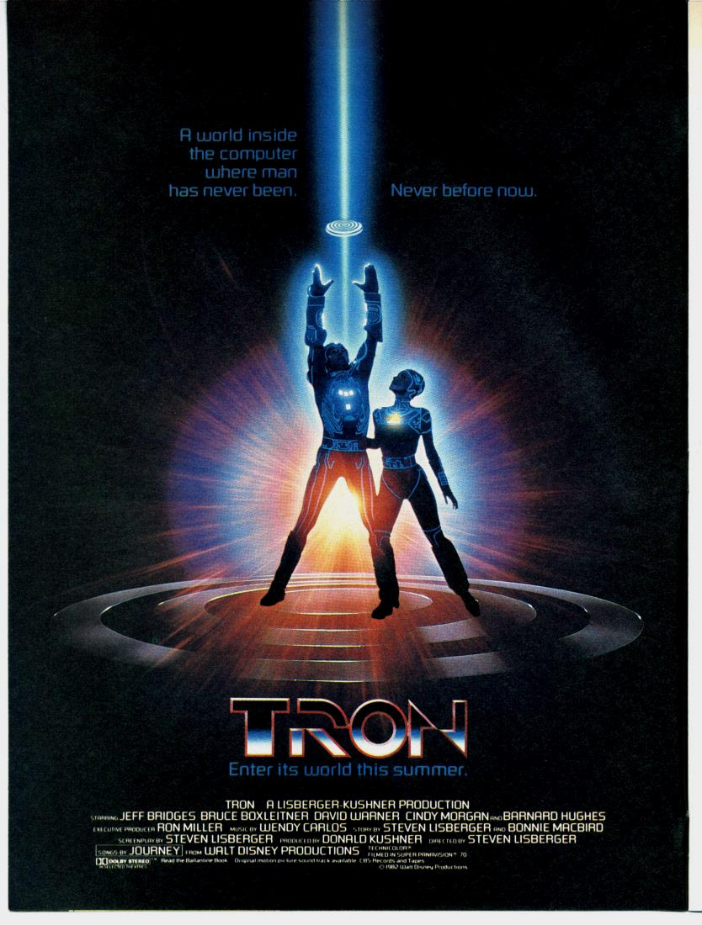
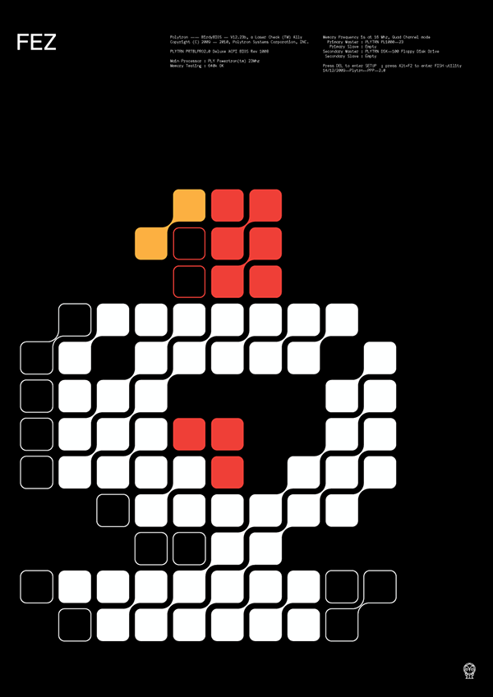
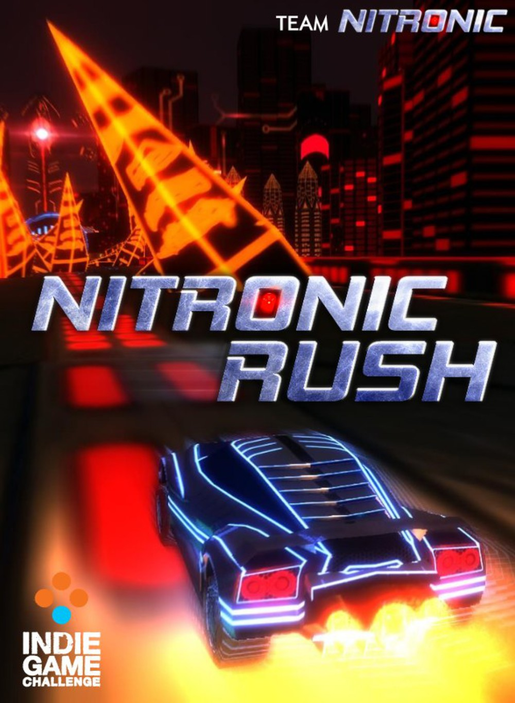
Inspirations
Tron (1982)
Fez (2012)
Nitronic Rush (2011)

Slide 5
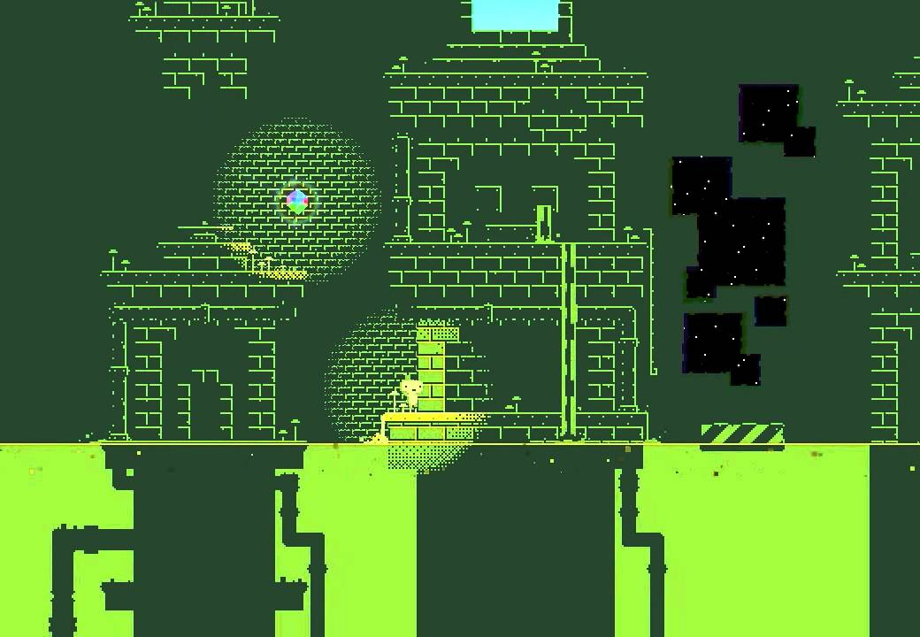
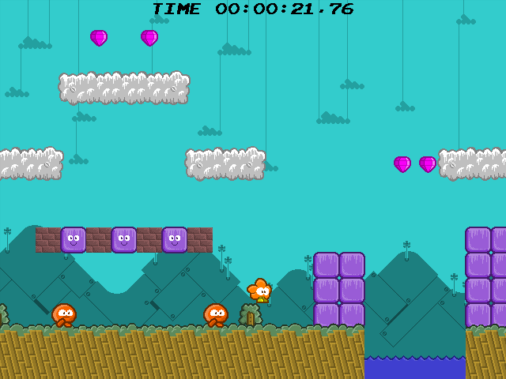
Similar Work
Glitch level in Fez (2012)
Eversion (2008)

Slide 6
Project Scope
In best cases: the whole experience will be at least 10 min long.
If I’m satisfied with the final product, I’ll translate the whole project into Unity over the summer with a larger scope.

Slide 7
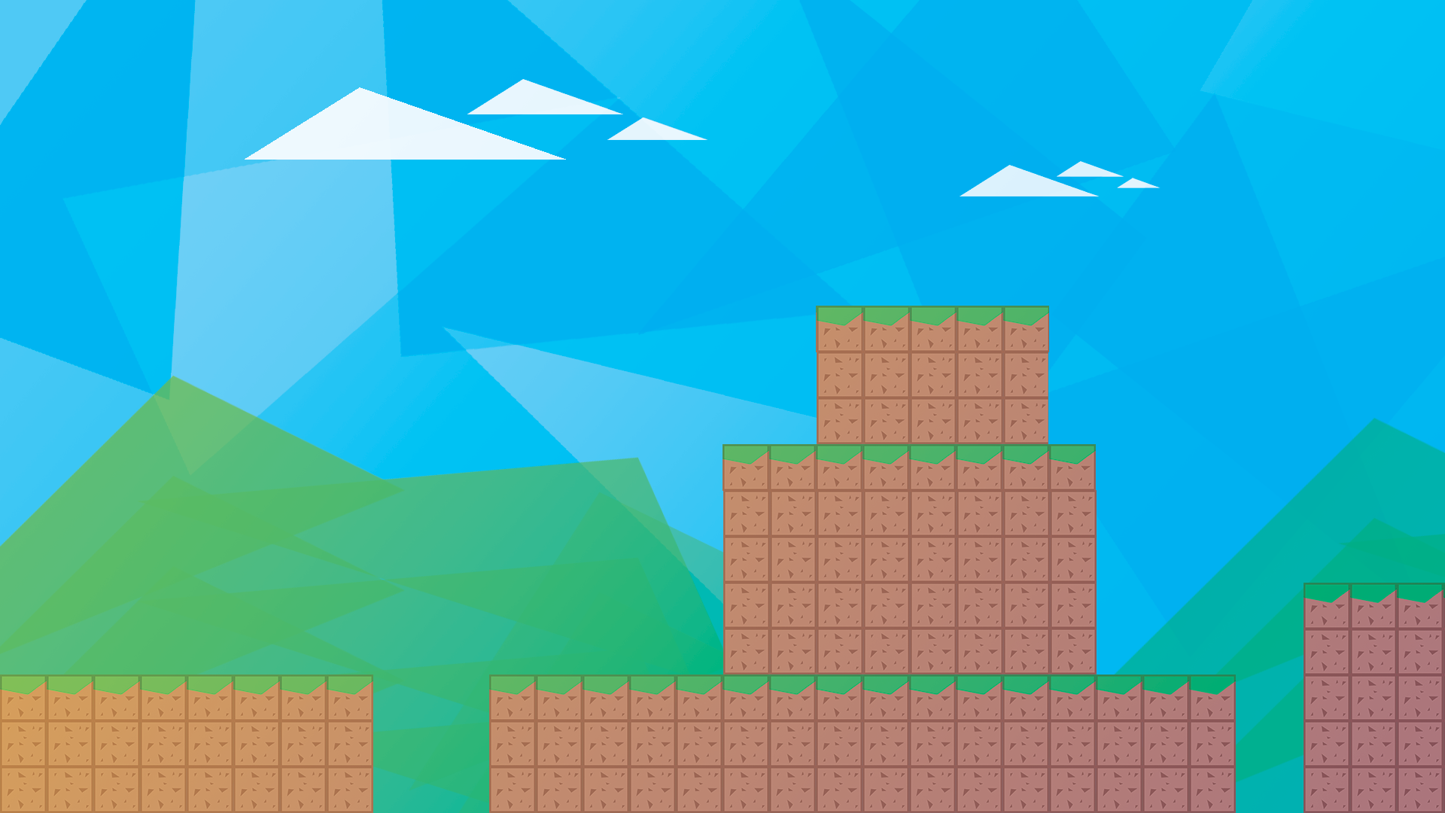
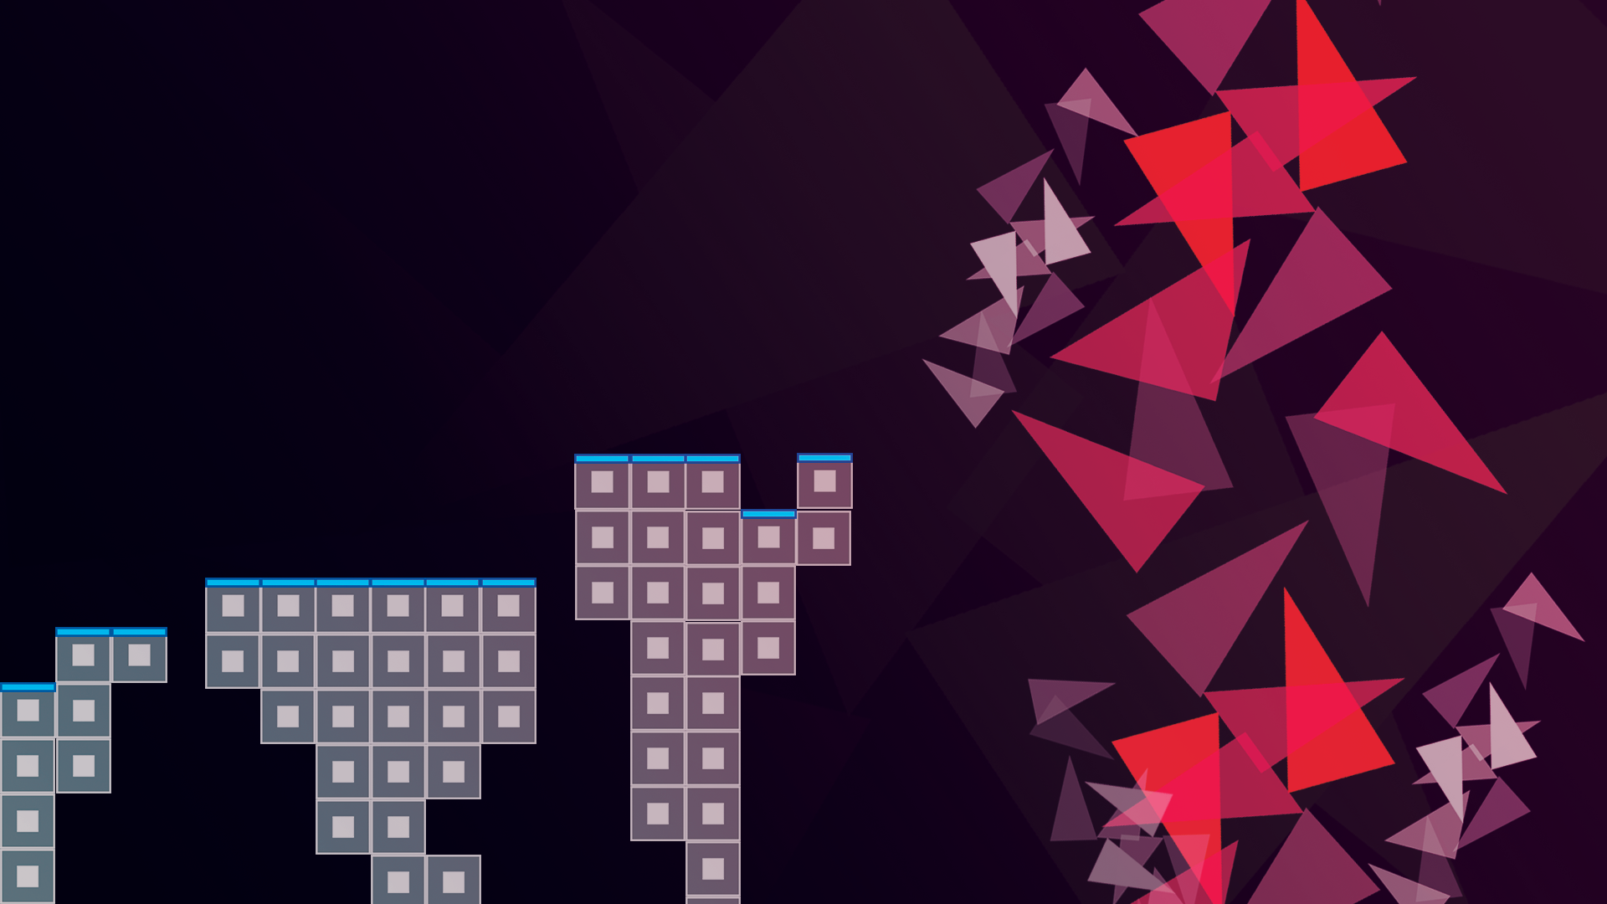
Primitive sketches

Slide 8
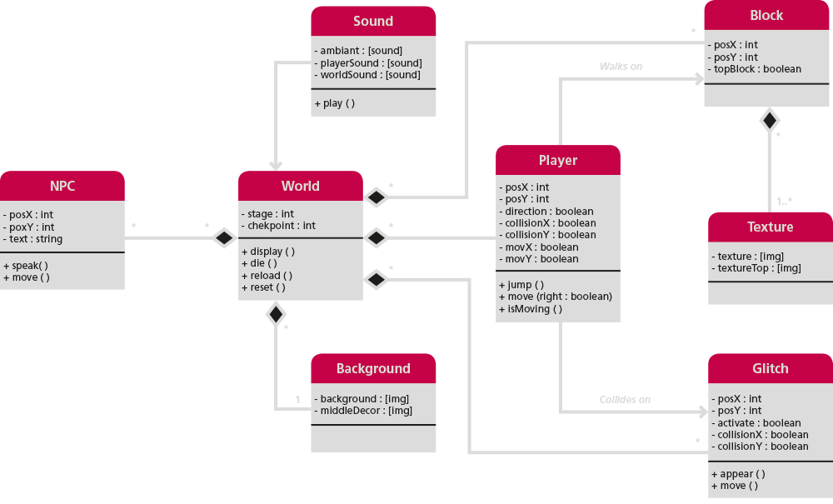
Class Diagram

Slide 9
Wish me luck (pls help me*)

