Slide 1

Shopify
By Charles-Etienne Gauthier
K10 A04 Presentation
May 5th 2021

Slide 2

Why did I choose Shopify?

Slide 3
Overview
Company was created in 2006 by a Canadian man named Tobias Lütke.
The website offers entrepreneurs a platform where they can kickstart and advertise their products.
They offer tools to keep track of your sales, find new customers and good ways to make people want to buy your products.

Slide 4
Technology/Service
The service I want Shopify to provide would be a social space within the website where people can interact with eachother (like EO).
People with more experience could offer their advice to younger people who are new to the Business marketplace
They could also offer each other partnerships
Would ressemble EO

Slide 5
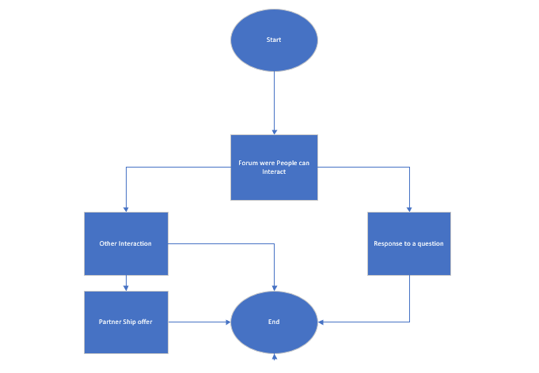
Technology

Slide 6

Conclusion
In conclusion, I can say that shopify is a great company wich offers lots of opportunities for new businesses. I also believe that the service I noted earlier can be very useful and can contribute to Shopify’s fruitful future

Slide 7

Reference
Shopify. (2021). Shopify.com. Retrieved from Shopify.
Organization, E. (2021). eonetwork.org. Retrieved from eonetwork.org.

Slide 8

Any Questianz?

Slide 9

Thank You For listening!

