Slide 1
Cell Therapy Solutions:
Development of an Integrated Software Suite to Facilitate Daily Operations and
Consolidate Information Systems
Mike Y. Zhong, BS
Cell Processing Specialist
The Connell and O’Reilly Families
Cell Manipulation Core Facility (CMCF)
mikey_zhong@dfci.harvard.edu
March 18, 2016

Slide 2
Motivation For Project
-Maintain data accuracy and integrity throughout all phases of processing, from receipt through issue
-Utilize time stamps and signatures to clearly document all stages of processing, ensure concurrency and completion
-As Olive previously mentioned, we currently have too many information systems working independently and not communicating
-Shift from a paper-based means of documentation, to an electronic one, cut down on storage space for archived records and make accessing records easier
-Eliminate the need to enter critical information multiple times, thereby reducing the risk of careless errors and oversight

Slide 3
Pros and Cons and Points to Consider
Pros:
-Improved ability to query data and mine data to make improvements on our processing protocols
-Cut costs across the board by using open-source development and database tools
-Flexible and modular software will allow us to add new protocols, procedures, and functions
-Enter “key” data once, eliminates the likelihood of careless errors
-Enable logging of all data entry and changes
Cons:
-Inability to cGMP paperwork as all processing worksheets will be electronic
-What elements and forms should remain on paper?
-Timeline for development and deployment currently unknown
-The impact of future changes to our facility
-Ensuring software meets standards set by regulatory agencies
-No current plans for built-in QC systems

Slide 4
General View of Database
Users:
-PHS ID
-initials
-email
-permissions
-password
Products:
-DIN
-Product Name/Type
-ABO/Rh
-Volume
-IDM info/results
-Collection Date
-Collection ID
-Receipt Date
-Donor info
-Recipient info
-Processes performed
-Status
-Issue Date
Patients:
-Name
-DF MRN
-Other MRN
-NMDP ID
-ABO/Rh
-Weight
-Protocol/TP
-Physician
-DOB
LN2_locations:
-tank
-rack letter
-rack number
-slot
-DIN
Calculations:
-Sysmex count
-Viability
-Dilution
-Volume
-TNC
-(same setup for flow counts)
Processes:
Too much information for this presentation, will be discussed in detail

Slide 5
Hierarchal View of Software Components
WebApp Landing Page
CRUD operations on patients
CRUD operations on products
Login, begin session
Perform Processing
CRUD operations on processes
Perform Calculations
Update Location

Slide 6
Access and Permission Levels
User Type | Access Level | Permissions
Root | 5 | All
DB Admin | 4 | All
Manager/Supervisor | 3 | CRUD on all tables EXCEPT users. R on all tables
Processing Tech II, III | 2 | CRU on products, processes. R on all tables
Processing Tech I | 1 | CR on products, processes. R on all tables

Slide 7
Design, Implementation, and Testing
-The Software Suite will consist of a web application (written in PHP, HTML, CSS, and Javascript) running on an Apache webserver that connects to a MySQL database.
-During development and testing, the web app will be hosted on a localhost.
-The app will require user login, this will automatically start a session.
-There will be several modules, allowing for CRUD operations on products, patients, LN2 locations, users, and processes. The interface for processes will be designed such that only certain access levels will be able to update the information.
-The database will utilize several tables; the tables will have several one-to-many and one-to-one relationships, these constraints will reduce the amount of data entry required
-Two principles that will drive development:
Don’t Repeat Yourself and Separation of Concerns

Slide 8



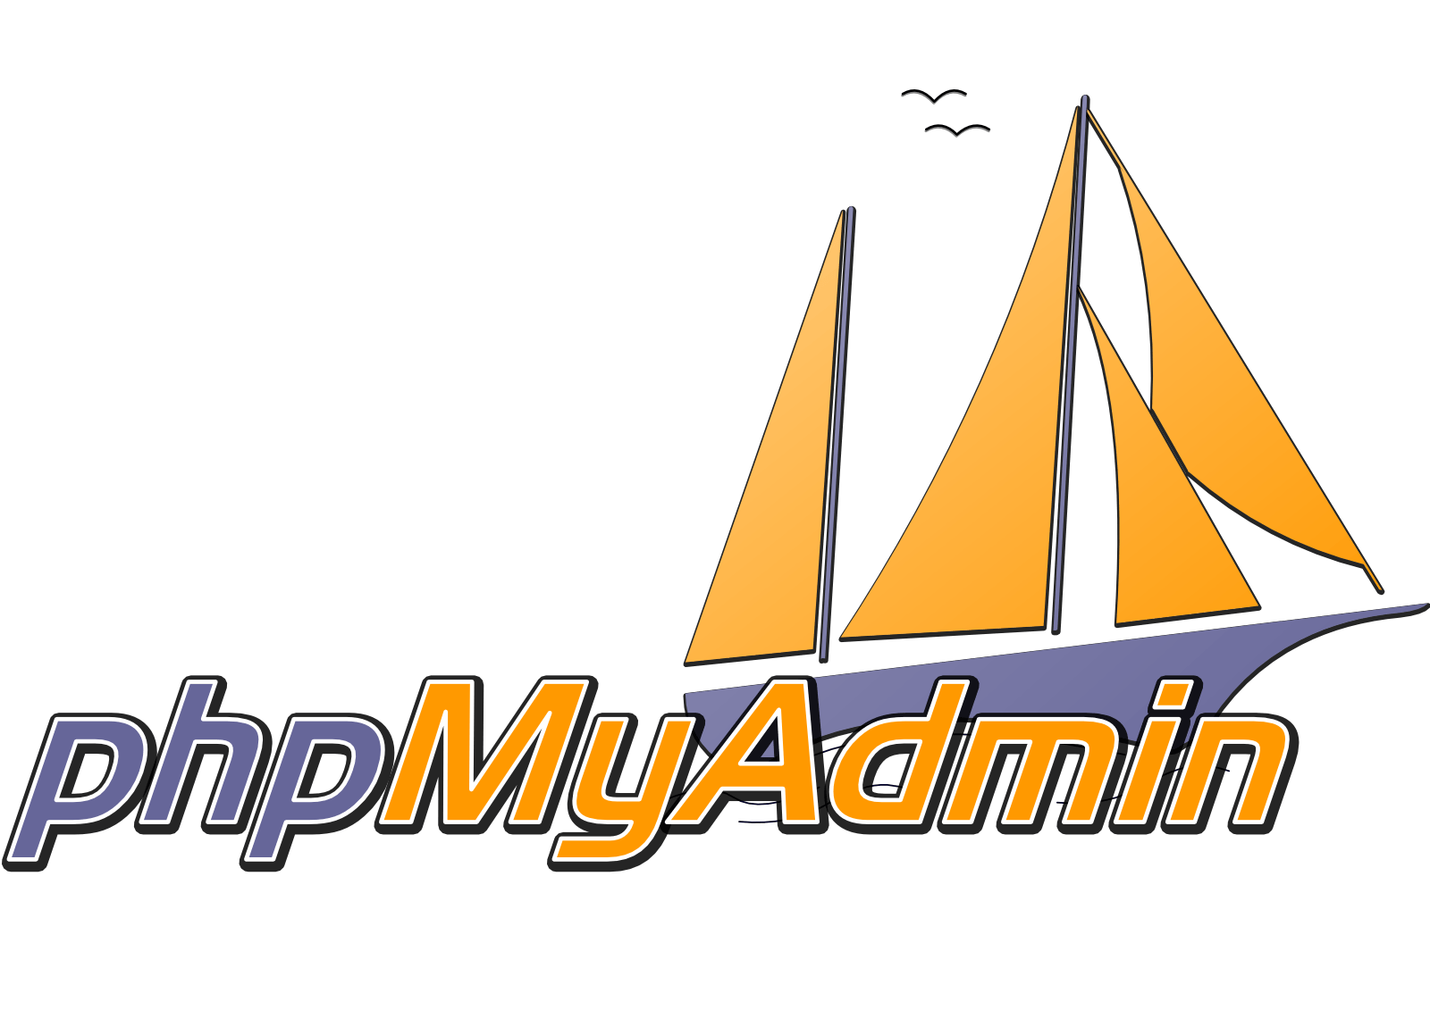


Underlying Technologies

Slide 9
Looking Towards The Future
-While a lot of preliminary design and coding has already been done, I do not
wish to continue development without the approval of management, as well as
the insight and expertise of the individuals of this department
-Encourage open discussion on desired functionality, potential drawbacks and
weaknesses, as well as general design and implementation details (i.e- web
app vs. windows application, hosted on DFCI intranet or via HTTPS on WWW,
etc…)
-Open discussion with someone in DFCI Network Engineering to discuss
deployment logistics
-Timely progress reports and updates, feedback from management and subject
matter experts

Slide 10
Legal, Licensing, and Other Logistics
-Defer any decision making regarding these matters to management.
-Full understanding that anything developed during my time at Dana-Farber is at least partially the property of DFCI.
-Will require a group effort and collaboration to bring ideas and design plans to fruition and create an integrated system.
-Will potentially require input and assistance from outside our department (but still within DFCI) to bring project to full production.
-My motivations for this undertaking are 3 fold:
A desire to improve the information systems and operational workflow of CMCF.
To gain knowledge and hands-on experience of software and web development technologies.
Constantly seek challenges and continuously learn.

