Slide 1
YOLOv8
莊偉真

Slide 2
Contents
What is Yolo8?
The history of YOLO development
How does YOLO work?
The Code and how it works

Slide 3
What is YOLOv8?
YOLOv8 is an object detection algorithm that uses a deep CNN to detect objects in images or video frames. It's implemented in Python using libraries like PyTorch or TensorFlow. You can find open-source implementations on platforms like GitHub, which provide APIs or scripts to load the model, process images or video frames, and get object detection results.

Slide 4
History of YOLO
The YOLO algorithm was initially introduced by Joseph Redmon and Ali Farhadi in 2016. Joseph Redmon, a PhD student at the University of Washington, developed YOLO as an efficient and real-time object detection approach. YOLO revolutionized the object detection field by introducing a single-stage architecture that could detect objects in an image in a single pass. Since the initial release of YOLO, several versions and variants have been developed to improve its accuracy and speed.
The YOLO models are famous for two main reasons: their impressive speed and accuracy and their ability to detect objects in images quickly and dependably.

Slide 5
How Does YOLO work?
The YOLO object detection method detects all the bounding boxes at once by dividing the input image into a grid and predicting B bounding boxes with confidence scores for C classes per grid element.
Each bounding box prediction includes Pc, which reflects the confidence and accuracy of the model. The box and by coordinates are the centers of the box relative to the grid cell, and bh and bw are the height and width of the box relative to the full image.
The output is a tensor of SxSx(Bx 5 + C), which can be followed by non-maximum suppression to remove duplicate detections.

Slide 6
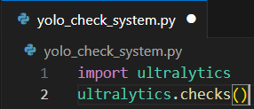
How Does the code work?
The yolo_check_system is used for checking our ultralytics whether it is downloaded or not and checks the version of ultralytics that we have and it also checks our pc cpu, ram, and disk

Slide 7
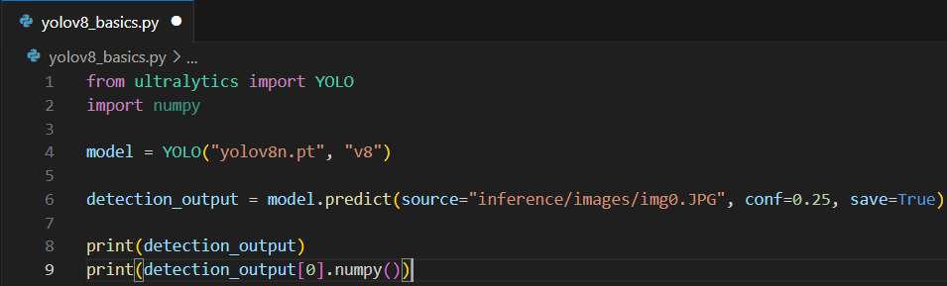

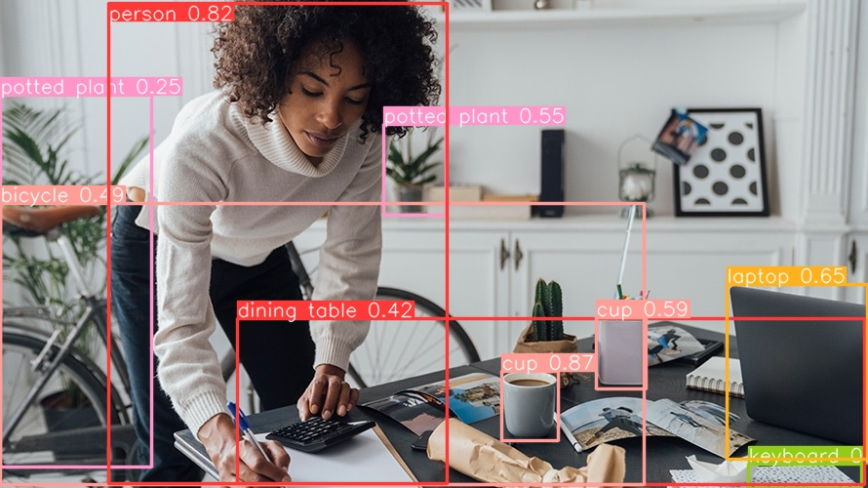
Yolov8_basics is used to predict what object is in the image that we tell the code to predict. In this code we first load the model of the yolo which is yolov8, and we tell it to predict the objects in the “img0.jpg” on line 6. the result of the predict will be saved in runs/detect/predict

Slide 8
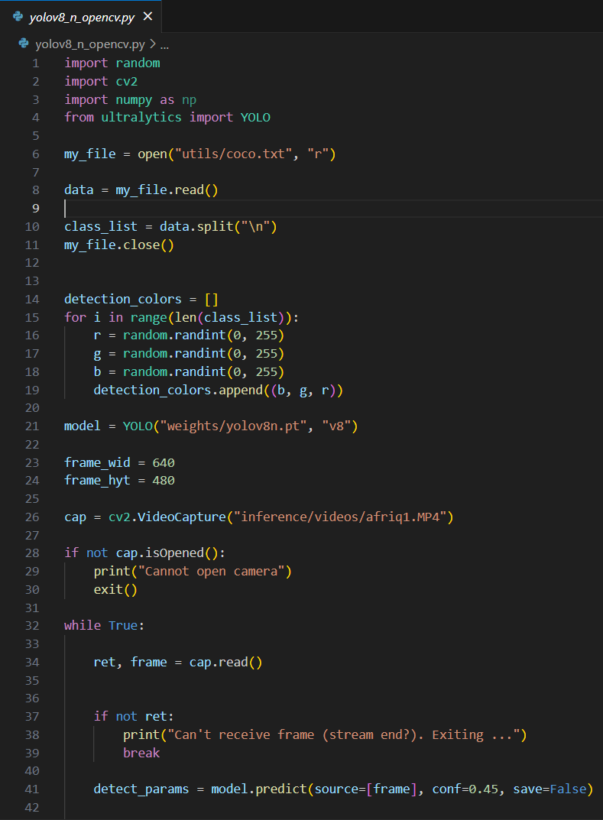
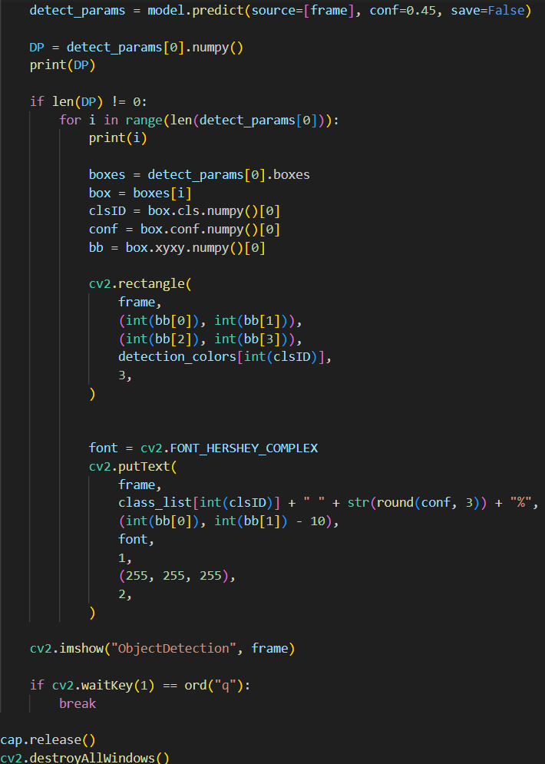
In yolov8_n_opencv we will be using cv2 too to detect objects in a video. First we tell the clast list from the coco.txt that we already prepared, then we randomized a colour for the box that will be drawed so we can see the objects prediction easier. Then the “cap” code is for the input whether we want it to be a video file or live video from our webcam If we want the source to be from our webcam simply change “inference/videos/afriq1.mp4” to (0)

Slide 9


