Slide 1
CLH Mutually Exclusive Lock
Pedro Ramalhete
Andreia Correia
May 2014

Slide 2
What is the CLH
A mutual exclusion lock discovered independently by Travis Craig at the University of Washington (UW TR 93-02-02, February 1993), and by Anders Landin and Eric Hagersten of the Swedish Institute of Computer Science (IPPS, 1994).
http://www.cs.rochester.edu/research/synchronization/pseudocode/ss.html#clh
It is strictly fair: Once a thread does atomic_exchange(), no other thread placed after it will be able to take the lock before it.
It is starvation-free: Assuming the OS or run-time can provide such a kind of guarantee (implies fairness in the thread-scheduler/manager), it guarantees that any given thread holding the lock will eventually run, if none of the previous ones gets a fault.
Uses a very small amount of memory when there is no contention on the lock. Only one pointer, the one for the tail.

Slide 3
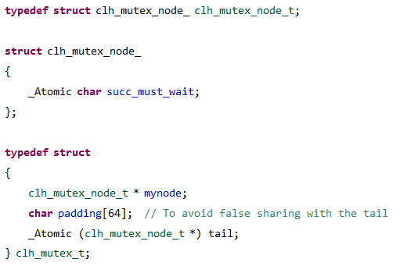
Definitions
Each node contains only one atomic variable, succ_must_wait
The mutex contains an atomic pointer to a node, the tail
In this implementation we have also a mynode, where the current thread holding the lock stores pointer to the current thread’s node.

Slide 4

clh_mutex
Upon initialization, a sentinel node is created and tail will point to it.
Thread 1 calls clh_mutex_lock(), creates a new node with succ_must_wait=1 and does atomic_exchange() on the tail.
Threads 2 and 3 do the same, but they will see succ_must_wait=1 on their previous node so they need to wait.
Notice that each thread has two pointers to nodes: one to the node it created and another pointer to the previous node.
sentinel
node
Thread 1’s node
Thread 2’s node
Thread 3’s node
must_wait 1
must_wait 0
must_wait 1
must_wait 0
must_wait 0
must_wait 1
tail
1
2
3

Slide 5
Source code
C11 implementation available on github
https://github.com/pramalhe/ConcurrencyFreaks/blob/master/C11/locks/clh_mutex.c
https://github.com/pramalhe/ConcurrencyFreaks/blob/master/C11/locks/clh_mutex.h

