Slide 1
CLH – Reader-Writer Lock
Pedro Ramalhete
Andreia Correia
June 2014

Slide 2
What is it?
It’s a Reader-Writer Lock based on the CLH lock (one of its variants) and the C-RW-NP described in this paper:
https://blogs.oracle.com/dave/resource/ppopp13-dice-NUMAAwareRWLocks.pdf
It is strictly fair: Once a thread does atomic_exchange(), no other thread placed after it will be able to take the lock before it.
It is starvation-free: Assuming the OS or run-time can provide such a kind of guarantee (implies fairness in the thread-scheduler/manager), it guarantees that any given thread holding the lock will eventually run, if none of the previous ones gets a fault.
Uses a very small amount of memory when there is no contention on the lock. Only one pointer, the one for the tail, and one counter for the readers, readers_counter.

Slide 3
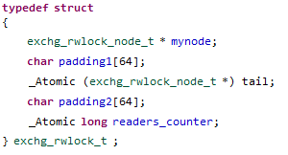
Each node contains only one atomic variable, succ_must_wait
The mutex contains an atomic pointer to a node, the tail
In this implementation we have also a mynode, where the current thread holding the lock stores pointer to the current thread’s node.
There is a counter of the readers currently holding the lock, the readers_counter

Slide 4
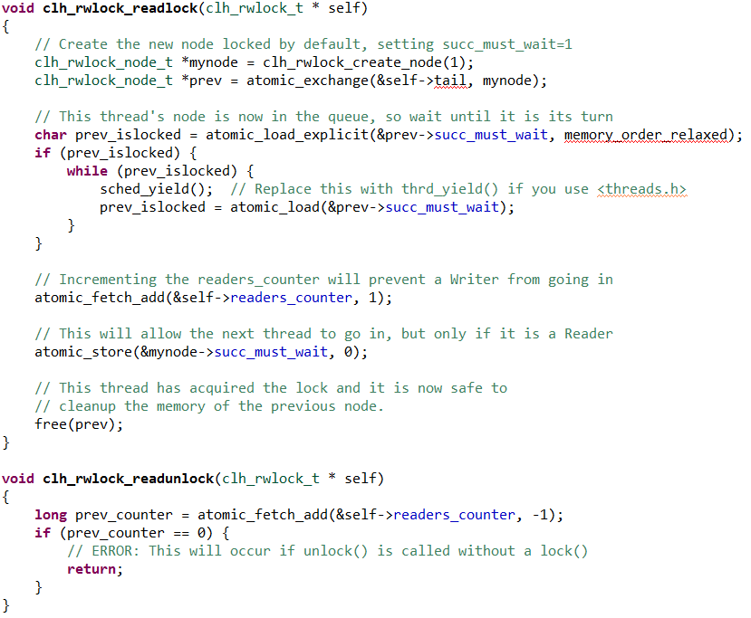
clh_rwlock_readlock()
Upon initialization, a sentinel node is created and tail will point to it, and readers_counter is set to zero.
The readlock() operation consists of inserting into the logical queue, incrementing the readers_counter, and then setting the succ_must_wait to 0 so that the next thread can go in, assuming it is a Reader.
The readunlock() only has to decrement the readers_counter

Slide 5
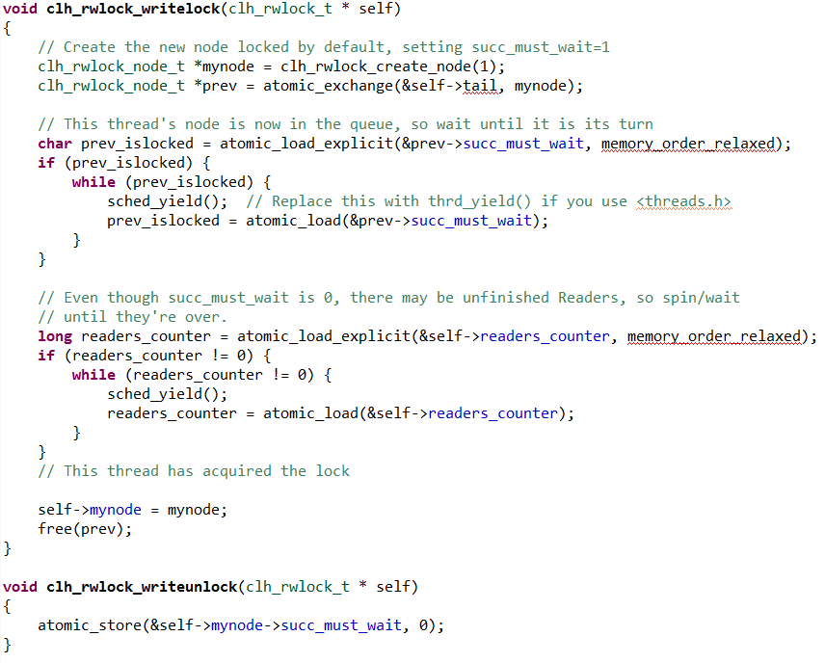
clh_rwlock_writelock()
There are two while loops in the lock() for the Writers.
The Writer has to wait for its previous node to set succ_must_wait to zero. If the previous is a Writer, then this will happen only when the Writer calls unlock(), but if the previous is a Reader then it will set succ_must_wait to zero before it lets go of the lock, so the Writer must wait also for the readers_count to reach zero.

Slide 6

Reader-Reader-Writer-Writer-Reader
Read-only operation
Modify operation
sentinel
node
Reader1 node
Reader2 node
smw 0
smw 1
smw 0
smw 1
tail
smw is succ_must_wait
readers_counter =
1
2
0
R
R
W
W
R

Slide 7
Reader-Reader-Writer-Writer-Reader
Read-only operation
Modify operation
R
Reader2 node
Writer3 node
islocked 0
smw 1
smw 0
smw 1
tail
readers_counter =
2
R
W
W
R

Slide 8
Reader-Reader-Writer-Writer-Reader
Read-only operation
Modify operation
R
R
Writer3 node
Writer4 node
smw 1
smw 1
tail
1
W
0
readers_counter =
2
W
R

Slide 9
Reader-Reader-Writer-Writer-Reader
Read-only operation
Modify operation
W
W
Writer3 node
Writer4 node
Reader5 node
smw 0
smw 1
smw 1
smw 1
tail
readers_counter =
0
R

Slide 10
Reader-Reader-Writer-Writer-Reader
Read-only operation
Modify operation
W
Writer4 node
Reader5 node
R
smw 0
smw 0
smw 1
smw 1
tail
0
readers_counter =
1

Slide 11
Source code
C11 implementation available on github
https://github.com/pramalhe/ConcurrencyFreaks/blob/master/C11/locks/clh_rwlock.c
https://github.com/pramalhe/ConcurrencyFreaks/blob/master/C11/locks/clh_rwlock.h
Post on Concurrency Freaks:
http://concurrencyfreaks.com/2014/06/clh-reader-writer-lock.html
CLH lock (slide 45)
http://www.cs.rice.edu/~vs3/comp422/lecture-notes/comp422-lec19-s08-v1.pdf
C-RW-NP
https://blogs.oracle.com/dave/resource/ppopp13-dice-NUMAAwareRWLocks.pdf

