Slide 1
Relaxed traversals in ConcurrentLinkedQueue
Pedro Ramalhete
Andreia Correia
November 2014

Slide 2
Recommended prior knowledge
What is lock-free
http://concurrencyfreaks.blogspot.fr/2013/05/lock-free-and-wait-free-definition-and.html
http://concurrencyfreaks.blogspot.fr/2014/07/lock-free-definitions-galore.html
What is Linearizability and weak consistency
What are Relaxed atomics http://en.cppreference.com/w/cpp/atomic/memory_order
The JVM atomicity guarantees for references
http://docs.oracle.com/javase/specs/jvms/se5.0/html/Threads.doc.html
Must read the “Out-Of-Thin-Air” paper by Hans Boehm and Brian Desmky http://static.googleusercontent.com/media/research.google.com/en//pubs/archive/42967.pdf
We’ll use the terms “volatile load” and “acquire-load” interchangeably.
It will help to have seen how the CLLElectedUnlink works, and why it is safe to do relaxed traversals on it.
http://concurrencyfreaks.blogspot.fr/2014/06/cllelectedunlink-lock-free-list-with.html
http://concurrencyfreaks.blogspot.fr/2014/07/cllelectedunlink-lock-free-list-with.html

Slide 3
java.util.concurrent. ConcurrentLinkedQueue
The ConcurrentLinkedQueue (CLQ) of Java uses a modified version of Michael and Scott’s algorithm for a lock-free queue/list http://www.research.ibm.com/people/m/michael/podc-1996.pdf
CLQ uses two acquire-loads per node when doing a traversal of the list, one to access the item, and another to access the next:
private static class Node<E> {
volatile E item;
volatile Node<E> next;
}

Slide 4
CLLElectedUnlink What is it?
The CLLElectedUnlink is a linked list created to take advantage of relaxed loads for traversal. Each node contains a reference to the item, a reference to the next node, and a state which can be VALID or REMOVED.
Disadvantages: Compared with CLQ, for large lists and many removal operations, CLLElectedUnlink is not as GC friendly and can consume a large amount of memory temporarily and cause heavy churn on the GC. This is due to the fact that only one thread at a time is doing unlinking operations in the list. Also, each node has an extra bool or int to store the state indicating logical removal, which uses up more memory than the CLQ’s node.
Advantages: Easier to reason about than CLQ, and we can apply the relaxed traversal optimization
Java source code is available on github:
https://github.com/pramalhe/ConcurrencyFreaks/blob/master/Java/com/concurrencyfreaks/list/CLLElectedUnlink.java
private static class Node<E> {
final E item;
Node<E> next;
int state;
}

Slide 5
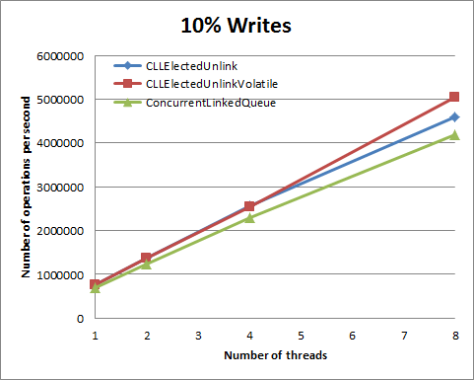
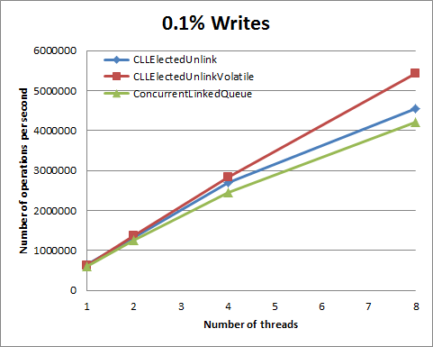
CLLElectedUnlink Performance plots on x86
We measured the performance of CLLElectedUnlink versus the same algorithm with volatile loads (CLLElectedUnlnkVolatile) and versus CLQ. The plots below show results on an x86 Intel Core i7-3740QM (8 hyper threads) for a list with 1000 elements.
We tried with lists of other sizes and different ratios of write/read operations with similar results.
There is no noticeable performance difference between the three lock-free lists.

Slide 6
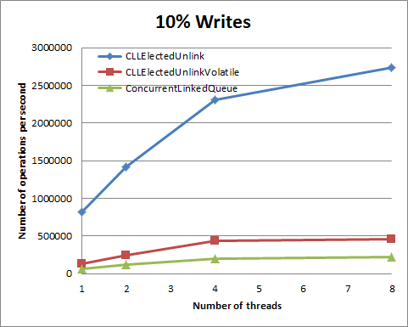
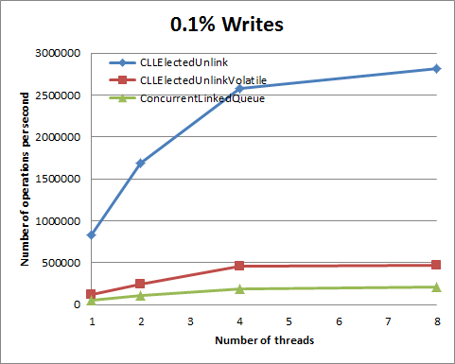
CLLElectedUnlink Performance plots on PowerPC (8 cores)
The same benchmarks as on the previous slide were repeated on the RunAbove cloud of PowerPC instances with 8 cores
This time there is a significant difference in performance between CLLElectedUnlink and the other two lock-free lists. Gain in throughput goes up to 15x more than CLQ.
Notice that the only difference between CLLElectedUnlink and CLLElectedUnlinkVolatile is the usage of volatile loads for list traversal during lookups and removals.

Slide 7
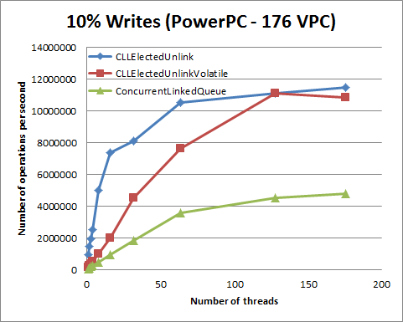
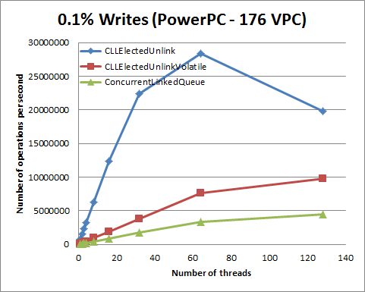
CLLElectedUnlink Performance plots on PowerPC (176 VPC)
The same benchmarks as on the previous slide were repeated on the RunAbove cloud of PowerPC instances with 176 Virtual processors
Performance gains are not as high as the number of threads increase, but can still go up to at least 2x

Slide 8
Can we change ConcurrentLinkedQueue to use relaxed list traversal?

Slide 9
CLQ with relaxed traversals Changes in Node
We can use the same technique we used on CLLElectedUnlink to make a few modifications to CLQ and provide the same kind of performance increase on PowerPC.
To minimize the code changes, instead of removing the volatile keyword from item and next, we add two new methods to the class Node to provide for relaxed loads for each of these variables. We named them getRelaxedItem() and getRelaxedNext().
The two methods where we are interested in applying this optimization are contains() and remove() but it is also possible to apply it to size() and maybe others.
E getRelaxedItem() {
E localitem = (E)UNSAFE.getObject(this, itemOffset);
return localitem == null ? item : localitem;
}
Node<E> getRelaxedNext() {
return (Node<E>)UNSAFE.getObject(this, nextOffset);
}

Slide 10
State machine for item
There are only two possible state for item: either a valid non-null object, or null
When the value of item transitions to null it can no longer go back.
When the item is read using a relaxed load, three things can happen:
if it is null, then it means that this node has been logically removed, but under special circumstances, there may be re-ordering of instructions, so we need to check again with an acquire-load that it is really null;
if it is non-null and it does not match the item we’re looking for, we don’t care and can continue to the next node;
If it is non-null and it matches the item we’re looking for, it may happen that this node has been already marked for removal but the relaxed load is not enough to see the latest state, so we must re-load the item using an acquire-load to determine if it is still non-null.
Actually, there is another state before the non-null item, before the constructor of Node sets the variable item, but this state is never visible to other threads.
non-null item
null

Slide 11
State machine for item and relaxed loads when searching for item Z
item A
Relaxed load of item returns an item not Z.
Possible states are the item read or null
item B
null
item C
Relaxed load of item returns item Z.
Possible states are item Z or null.
We must re-load to if is it really Z.
…
Relaxed load of item returns null.
Possible states are any.
We must re-load with volatile to see if it is Z.
item Z

Slide 12
State machine for next
When a node is created, its next is at null, and it is then appended to the tail of the list using a CAS operation.
When a new node is inserted, it will change the next of the previous node (with a CAS operation) to point to the new node (a forward node in the list).
The process of unlinking a forward node from the list implies modifying the next of the current node, but it will always be changed using a CAS, and the new next will be referencing another node forward in the list.
After a node is logically removed by poll() from the beginning of the list, to help the GC, in the CLQ we set the next to reference the node itself, and this is the final state, from which there is no further transition.
null
forward node
self

Slide 13
CLQRelaxed succRelaxed()
We implemented a helper function to traverse the list until null is read from an acquire-load.
Notice that when a node with next is found to be null, we must still check that it is really so, using an acquire-load (see second line, when p.next is loaded)
final Node<E> succRelaxed(Node<E> p) {
Node<E> next = p.getRelaxedNext();
if (next == null) next = p.next;
return (p == next) ? head : next;
}

Slide 14
CLQRelaxed contains()
For contains(), we must now traverse the list until a non-null load-acquire is done on next, and we do a load-acquire on item, but only after o.equals(item) matches
public boolean contains(Object o) {
if (o == null) return false;
for (Node<E> p = first(); p != null; p = succ(p)) {
E item = p.item;
if (item != null && o.equals(item))
return true;
}
return false;
}
CLQ
public boolean contains(Object o) {
if (o == null) return false;
for (Node<E> p = first(); p != null; p = succRelaxed(p)) {
E item = p.getRelaxedItem();
if (item != null && o.equals(item) && p.item != null)
return true;
}
return false;
}
CLQRelaxed

Slide 15
CLQRelaxed remove()
For remove(), we change even less code.
Notice that the logical removal is done with a CAS expecting an item that was read with a relaxed load, which is fine because if it is not up-to-date the CAS will simply fail and the usual code path will be taken for that scenario.
CLQ
CLQRelaxed
public boolean remove(Object o) {
if (o == null) return false;
Node<E> pred = null;
for (Node<E> p = first(); p != null; p = succ(p)) {
E item = p.item;
if (item != null &&
o.equals(item) &&
p.casItem(item, null)) {
Node<E> next = succ(p);
if (pred != null && next != null)
pred.casNext(p, next);
return true;
}
pred = p;
}
return false;
}
}
public boolean remove(Object o) {
if (o == null) return false;
Node<E> pred = null;
for (Node<E> p = first(); p != null; p = succRelaxed(p)) {
E item = p.getRelaxedItem();
if (item != null &&
o.equals(item) &&
p.casItem(item, null)) {
Node<E> next = succ(p);
if (pred != null && next != null)
pred.casNext(p, next);
return true;
}
pred = p;
}
return false;
}
}

Slide 16
CLQRelaxed Progress Conditions and Consistency Model
As in CLQ, the methods contains() and remove() are lock-free. As can be seen from the previous slides, there has been no significant change to the algorithms of these two methods that could cause the progress condition to change.
As in CLQ, the methods contains() and remove() are linearizable. This is a bit trickier to reason about, but it goes like this:
contains():
Nodes and items inserted through add()/offer() become visible to a thread calling contains() when a relaxed load or acquire load of next allows access to the node (through the call of succRelaxed());
Items removed through remove()/poll() become logically removed when the value of item is read on line 3 of contains() when p.getRelaxedItem() returns null or on line 4 when reading p.item with an acquire load;
remove():
Nodes and items inserted through add()/offer() become visible to a thread calling contains() when a relaxed load or acquire load of next allows access to the node (through the call of succRelaxed());
Items removed through remove()/poll() become logically removed when the value of item is read on line 4 with p.getRelaxedItem() returning null, or when the CAS fails on line 7;

Slide 17
CLQRelaxed Out-Of-Thin-Air
If you read Hans Boehm and Brian Demsky paper you will see a common problem in algorithms using relaxed atomics which they named “Out-Of-Thin-Air”.
http://static.googleusercontent.com/media/research.google.com/en//pubs/archive/42967.pdf
Notice that these issues occur when using relaxed stores (and maybe branching/speculation?). The optimizations used in CLQRelaxed and CLLElectedUnlink have no relaxed stores, only relaxed loads, and therefore, should not be subject to this kind of issue (apart from the special case of item being null when read with a relaxed load).

Slide 18
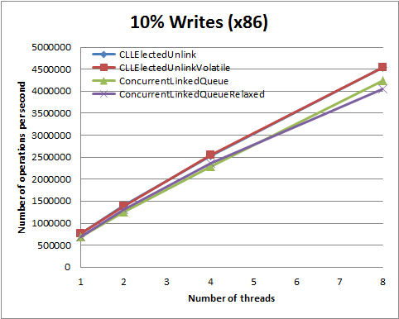
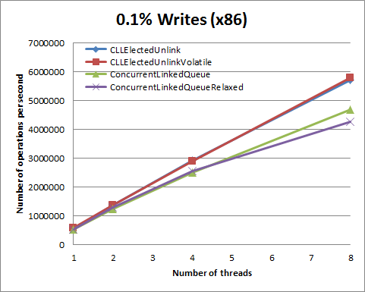
CLQRelaxed Performance plots – x86
No relevant difference in performance between CLQ and CLQRelaxed when running on x86 for our microbenchmark

Slide 19
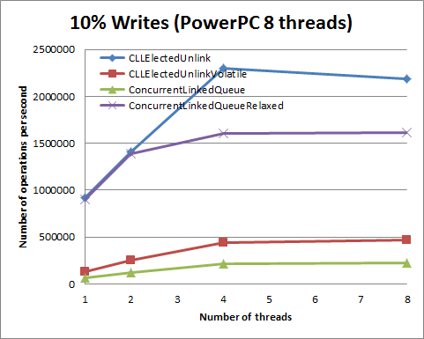
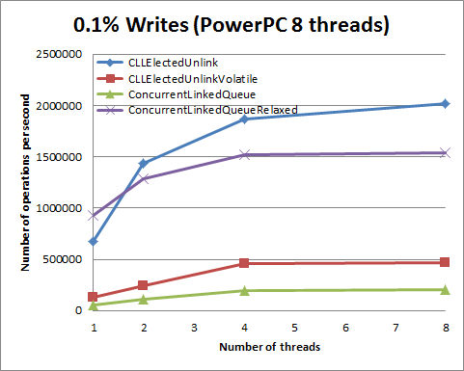
CLQRelaxed Performance plots – PowerPC 8
When comparing CLQRelaxed with CLS we see a throughput increase on PowerPC that one our microbenchmarks can range from 5x to 16x increase (not all plots shown)

Slide 20
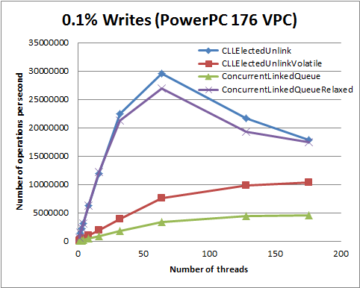
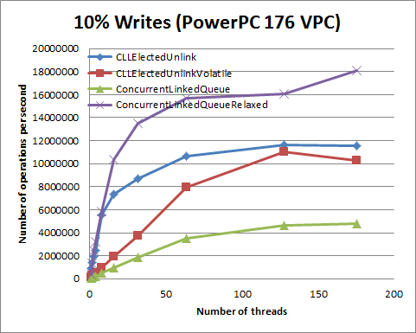
CLQRelaxed Performance plots – PowerPC 176
We run the microbenchmark also on a PowerPC with 176 virtual processors and the performance ranges from equal to 14x of CLQRelaxed over CLQ (not all plots shown).
It is expected that as the number of threads (assuming enough cores) increases, the performance of CLQ approaches that of CLQRelaxed. This happens because on this benchmark each “write operation” consists of one remove() and one add(), which means that even if we increase the throughput of remove(), at some point there will be a bottleneck on the add() method call due to the contention on the tail and the last node.

Slide 21
Summary
We can do the relaxed traversal optimization on ConcurrentLinkedQueue with only small code changes, and increase the performance on PowerPC significantly, without impacting x86 (from 5x to 16x in our microbenchmark). This performance is noticeable even if a single thread is being used.
This optimization affects only the contains() and remove() methods, and these methods remain linearizable and lock-free.
We expect these changes to provide some performance improvement on other CPU architectures, such as ARMv8.
All microbenchmark results should be considered carefully, and the best is to measure performance for your specific application. Having said that, we do not expect to exist any scenario where CLQRelaxed performs worse than CLQ.
CLQRelaxed is available on github:
https://github.com/pramalhe/ConcurrencyFreaks/blob/master/Java/com/concurrencyfreaks/list/ConcurrentLinkedQueueRelaxed.java

Slide 22
END

Slide 23
Backup slides

Slide 24
CLQRelaxed Ops/sec for 176 VPC PowerPC
0.0% Writes | CLLElectedUnlink | CLLElectedUnlinkVolatile | ConcurrentLinkedQueue | ConcurrentLinkedQueueRelaxed | CLQR/CLQ
1 | 696394 | 121541 | 56923 | 723171 | 12.7
2 | 1360847 | 241814 | 113058 | 1357789 | 12.0
3 | 2033036 | 362159 | 169839 | 2121102 | 12.5
4 | 2691334 | 482030 | 226271 | 2789689 | 12.3
8 | 5386805 | 967860 | 453424 | 5583287 | 12.3
16 | 10791476 | 1925703 | 904713 | 10702230 | 11.8
32 | 20538130 | 3853456 | 1785997 | 19787903 | 11.1
64 | 30536061 | 7589819 | 3448729 | 28561286 | 8.3
128 | 42610049 | 9973855 | 4471423 | 34171880 | 7.6
176 | 44906922 | 10160386 | 4518803 | 34073347 | 7.5
0.1% Writes | CLLElectedUnlink | CLLElectedUnlinkVolatile | ConcurrentLinkedQueue | ConcurrentLinkedQueueRelaxed
1 | 685747 | 121323 | 56887 | 693309 | 12.2
2 | 1486443 | 241738 | 113516 | 1532997 | 13.5
3 | 2266162 | 362247 | 169769 | 2366689 | 13.9
4 | 3077490 | 484111 | 226592 | 3149848 | 13.9
8 | 6245061 | 970149 | 453500 | 6331177 | 14.0
16 | 11962285 | 1925951 | 904019 | 12142477 | 13.4
32 | 22507764 | 3861832 | 1788639 | 21310245 | 11.9
64 | 29573440 | 7644533 | 3460840 | 26880260 | 7.8
128 | 21666612 | 9850980 | 4459109 | 19298012 | 4.3
176 | 17825209 | 10426877 | 4607989 | 17440788 | 3.8

Slide 25
CLQRelaxed Ops/sec for 176 VPC PowerPC
10.0% Writes | CLLElectedUnlink | CLLElectedUnlinkVolatile | ConcurrentLinkedQueue | ConcurrentLinkedQueueRelaxed | CLQR/CLQ
1 | 915498 | 132127 | 60920 | 336517 | 5.5
2 | 1451662 | 258395 | 119603 | 1343882 | 11.2
3 | 1961757 | 382141 | 179371 | 2489670 | 13.9
4 | 2472260 | 499733 | 238491 | 3191904 | 13.4
8 | 5569461 | 974084 | 477360 | 5822433 | 12.2
16 | 7348665 | 1906399 | 949875 | 10321200 | 10.9
32 | 8705901 | 3752426 | 1848165 | 13536031 | 7.3
64 | 10641255 | 7955213 | 3517673 | 15700781 | 4.5
128 | 11594220 | 11043087 | 4621635 | 16071444 | 3.5
176 | 11548721 | 10302052 | 4811348 | 18073375 | 3.8
100.0% Writes | CLLElectedUnlink | CLLElectedUnlinkVolatile | ConcurrentLinkedQueue | ConcurrentLinkedQueueRelaxed | CLQR/CLQ
1 | 1089611 | 231185 | 123020 | 1397469 | 11.4
2 | 1936942 | 275978 | 234659 | 1013428 | 4.3
3 | 2387094 | 495365 | 352454 | 1293668 | 3.7
4 | 1663250 | 1290325 | 438389 | 2470213 | 5.6
8 | 1451900 | 1501607 | 825457 | 3286411 | 4.0
16 | 1321902 | 1363470 | 1718899 | 2964169 | 1.7
32 | 1465595 | 1314857 | 2803448 | 2942679 | 1.0
64 | 1262876 | 1296454 | 3111288 | 2984793 | 1.0
128 | 1239412 | 1217489 | 3104939 | 3051667 | 1.0
176 | 1359406 | 1102734 | 3069154 | 2967809 | 1.0

Slide 26
Relaxed atomics
At a lack of a better name, we used the term “relaxed atomics” to named non-volatile references in Java. The JVM Memory Model does not give the exact same guarantees for references as the C++1x Memory Model gives for relaxed atomics, but they are similar in behavior when it comes to the way we’re using them for these optimizations (we only do loads), so at a lack of a better name, we call them “relaxed atomics” as well.
Relaxed atomics give atomicity guarantee.
Just keep in mind that relaxed reference loads on the JVM and relaxed pointer loads on C++1x memory model are not exactly the same.

Slide 27
Why do we need an acquire-load when item is null? (1/2)
Imagine the following scenario where we start with a list which contains item Z and there is a volatile variable that is modified before the remove(Z) operation is done (this implies not just sequentially consistency but an happens-before relationship).
volatile bool beforeZRemoval = false;
Thread 1:
beforeZRemoval = true;
list.remove(Z);
Thread 2:
bool lz = list.contains(Z);
bool lb = beforeZRemoval;
If the removal is sequentially consistent (with atomics) then Thread 2 would be able to observe only the following states for lz and lb:
lz = true, lb = false; // Z is in the list and beforeZRemoval has not yet been toggled
lz = true, lb = true; // Z is in the list and beforeZRemoval has already been toggled to true
lz = false, lb = true; // Z is no longer in the list and beforeZRemoval has already been toggled to true

Slide 28
Why do we need an acquire-load when item is null? (2/2)
The problem is if we use a relaxed load on the item, it can "travel" to below the load of beforeZRemoval and give rise to an unexpected state (non sequentially consistent). The flow is like this, from top to bottom:
Thread 1 | Thread 2
 | 1. Inside list.contains(Z) there is a relaxed load of 'item' which is speculated to be null (due to a cache miss) when in fact it is still Z
 | 2. The list is traversed until the end and Z is not found. A volatile load is done on the 'next' of the last node
 | 3. bool lb = beforeZRemoval; // This means lb = false
4. beforeZRemoval = true;
5. list.remove(Z);
 | 6. The cache miss finally returns and the value is indeed null (because list.remove(Z) has completed), which means lz = false
The state lb = false and lz = false is not sequentially consistent.

