Slide 1
Reducing acquire-loads on list/array-based ReadIndicators
Pedro Ramalhete
Andreia Correia
December 2014

Slide 2
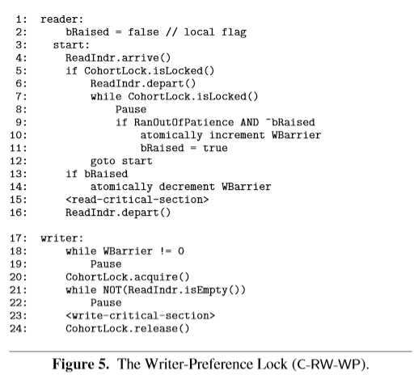
What are ReadIndicators used for
The optimizations we are going to discuss should be valid for any of the “scalable” ReadIndicators, i.e. LongAdder, LongAdderExt, Array of counters (DCLC), NUMA-aware array of counters, CLQ+Array+Finalizers, etc.
In this example we’ll talk about the algorithm for C-RW-WP (Scalable RWLock) but it also applies to other algorithms, like for example the Left-Right pattern.

Slide 3
C-RW-WP (Writer)
On the right side we can see the atomic operations that ReadIndr.isEmpty() does.
All operations are loads with acquires which means that they can not be re-ordered with each other.
The last load with acquire (on array[7]) prevents any code from being re-ordered from below to above, which means that there can be no code from the write-critical-section entering the isEmpty() method.
load-acquire array[0]
load-acquire array[1]
load-acquire array[2]
load-acquire array[3]
ReadIndr.isEmpty()
load-acquire array[4]
load-acquire array[5]
load-acquire array[6]
load-acquire array[7]
regular load x
regular store y
regular load z
write-critical
-section

Slide 4
C-RW-WP (Writer) Relaxed (does not work)
If we use relaxed loads in the middle of the isEmpty(), they can’t be re-ordered to be above the load-acquire of array[0], but they can be re-ordered to be below the load-acquire array[7], which would place them in the middle of the write-critical-section, which would be incorrect.
An example is that the relaxed load on array[6] is done after the regular store on y and by the time the load is done, it is indeed zero (empty) but it wasn’t so if it had been read before the load-acquire of array[7] (the load of array[6] was a speculative load) which means we no longer have mutual exclusion!
load-acquire array[0]
relaxed load array[1]
relaxed load array[2]
relaxed load array[3]
ReadIndr.isEmpty()
relaxed load array[4]
relaxed load array[5]
relaxed load array[6]
load-acquire array[7]
regular load x
regular store y
regular load z
write-critical
-section

Slide 5
C-RW-WP (Writer) Relaxed with release – C11/C++1x
If we add a release fence before the last load with acquire, we prevent the relaxed loads from descending, and the last load acquire prevents the regular code of the critical section to ascend
Notice that a release and an acquire fences can not be re-ordered with each other in the memory_order_seq_cst memory model
load-acquire array[0]
relaxed load array[1]
relaxed load array[2]
relaxed load array[3]
ReadIndr.isEmpty()
relaxed load array[4]
relaxed load array[5]
relaxed load array[6]
release
load-acquire array[7]
regular load x
regular store y
write-critical
-section
regular load z

Slide 6
C-RW-WP (Writer) Relaxed with loadFence() – Java version
Unlike C11/C++1x in Java there is no release barrier, but there is Unsafe.loadFence()
If we add a loadFence() before the last relaxed load, we prevent the relaxed loads from descending, and the loadFence() itself prevents the regular code of the critical section from ascending http://openjdk.java.net/jeps/171
Notice that we are assuming that Unsafe.loadFence() will not be reordered to be below a relaxed/regular load in the Java Memory Model. And btw, if this was not a valid optimization, then StampedLock.validate() would be broken.
volatile load array[0]
relaxed load array[1]
relaxed load array[2]
relaxed load array[3]
ReadIndr.isEmpty()
relaxed load array[4]
relaxed load array[5]
relaxed load array[6]
relaxed load array[7]
Unsafe.loadFence()
regular load x
regular store y
write-critical
-section
regular load z

Slide 7
DCLCRelax

Slide 8
DCLCRelax microbenchmarks
We ran a microbenchmark with two scenarios:
Mixed Readers and Writers: Half the threads are Readers (DCLC.sum()) and half the threads are Writers (DCLC.increment());
Single Reader: One thread is a Reader and all others are Writers;
Readers are threads that do only calls to DCLC.sum() and Writers are threads that do only calls to DCLC.increment().
Source code can be found here:
https://github.com/pramalhe/ConcurrencyFreaks/blob/master/Java/com/concurrencyfreaks/counter/DistributedCacheLineCounterRelax.java
https://github.com/pramalhe/ConcurrencyFreaks/blob/master/Java/com/concurrencyfreaks/counter/DistributedCacheLineCounter.java
https://github.com/pramalhe/ConcurrencyFreaks/blob/master/Java/com/concurrencyfreaks/counter/TestCounters.java
Keep in mind that microbenchmarks portrait very specific use-cases, and are subject to subtle effects that can skew results.

Slide 9
DCLCRelax Results on intel i7-3740QM

Slide 10
DCLCRelax Results on AMD Opteron 32 cores

Slide 11
DCLCRelax Results on PowerPC 8 cores RunAbove

Slide 12
Links
This presentation https://github.com/pramalhe/ConcurrencyFreaks/tree/master/Presentations
DCLC and Relaxed DCLC https://github.com/pramalhe/ConcurrencyFreaks/tree/master/Java/com/concurrencyfreaks/counter
Microbenchmark https://github.com/pramalhe/ConcurrencyFreaks/blob/master/Java/com/concurrencyfreaks/counter/TestCounters.java
RunAbove cloud service with PowerPC instances https://cloud.runabove.com/

Slide 13
Backup

Slide 14
LongAdder Changes to sum()
As mentioned before, the same kind of optimization can be applied to Java’s LongAdder, namely, in the sum() method
For some reason, there is no consistent performance improvement when using this technique in LongAdder. It could be due to the overhead of calling Unsafe, or just that it doesn’t give any benefit on ppc… we’re still trying to figure it out.
// This is added to the Cell class
long getRelaxValue() { return UNSAFE.getLong(this, valueOffset); }
public long sum() {
Cell[] as = cells; Cell a;
long sum = base; // 'base' is volatile, this is the starting volatile load
if (as != null) {
for (int i = 0; i < as.length; ++i) {
if ((a = as[i]) != null)
sum += a.getRelaxValue();
}
UNSAFE.loadFence();
}
return sum;
}

