Slide 1
Data Visualization Project 6: Simulation Dashboard

Slide 2
Project 6:
Task
Simulate the “Blowup Game” as a Monte Carlo simulation
Create a dashboard visualization in Javascript with the D3 library. The dashboard should show how good the selected strategy is, allow for insightful interactive analysis of what is happening.
Input parameters must be able to be modified.

Slide 3
Project 6: Due in 3 weeks (3/26)
Build a webpage containing the “Blowup Game” Monte Carlo simulation in JavaScript that runs when any slider control changes (after button up or as the slider changes)
Required input parameters to display on the page (can be altered by user and feedback on the value of each)
Percent of Total Capital to Bet
Percent Chance of Blowup (like 10%, where there is a 10% chance to lose the entire bet)
Percent of Bet to Blowup (normally 100%, but it will be interesting to have this and try 80%)
Win Multiplier (amount to multiply bet by if don’t blowup, like 1.5)
Number of Trials (number of times to place a bet, like 10, 100, or more)
Number of Simulations (simulate N trials this many times, like 1000 or 100,000)
Number of Bins (passed into the kernel density estimator in the link below)
Kernel Epanechnikov (this is the value passed into the function kernelEpanechnikov in the link below)
Display one graph showing the distribution of the summary statistics
Distributions should be shown as a density plot (https://www.d3-graph-gallery.com/graph/density_slider.html) with a jittered distribution of the actual final capital values overlayed on top (jittered to avoid overdraw).

Slide 4
Grading: Total is 10% of final grade
50% Simulation works and is graphed appropriately with density graph
30% Jittered overlay of actual data to give more insight into the simulation
10% Smooth animation of the density graph when the input changes (jittered points should not animate since it would look weird)
10% Include readme.txt with 3 paragraphs of commentary discussing:
What did you learned or what insight did you gained about simulation dashboards?
What is your experience with D3? What went well? What did not go well?
Given 1.5x multiplier and 10% chance of blowing up each trial, if you had $100,000 (multiply input/output numbers by 1000 in your head) what percent of your money would you bet in each of 20 trials? Why?

Slide 5
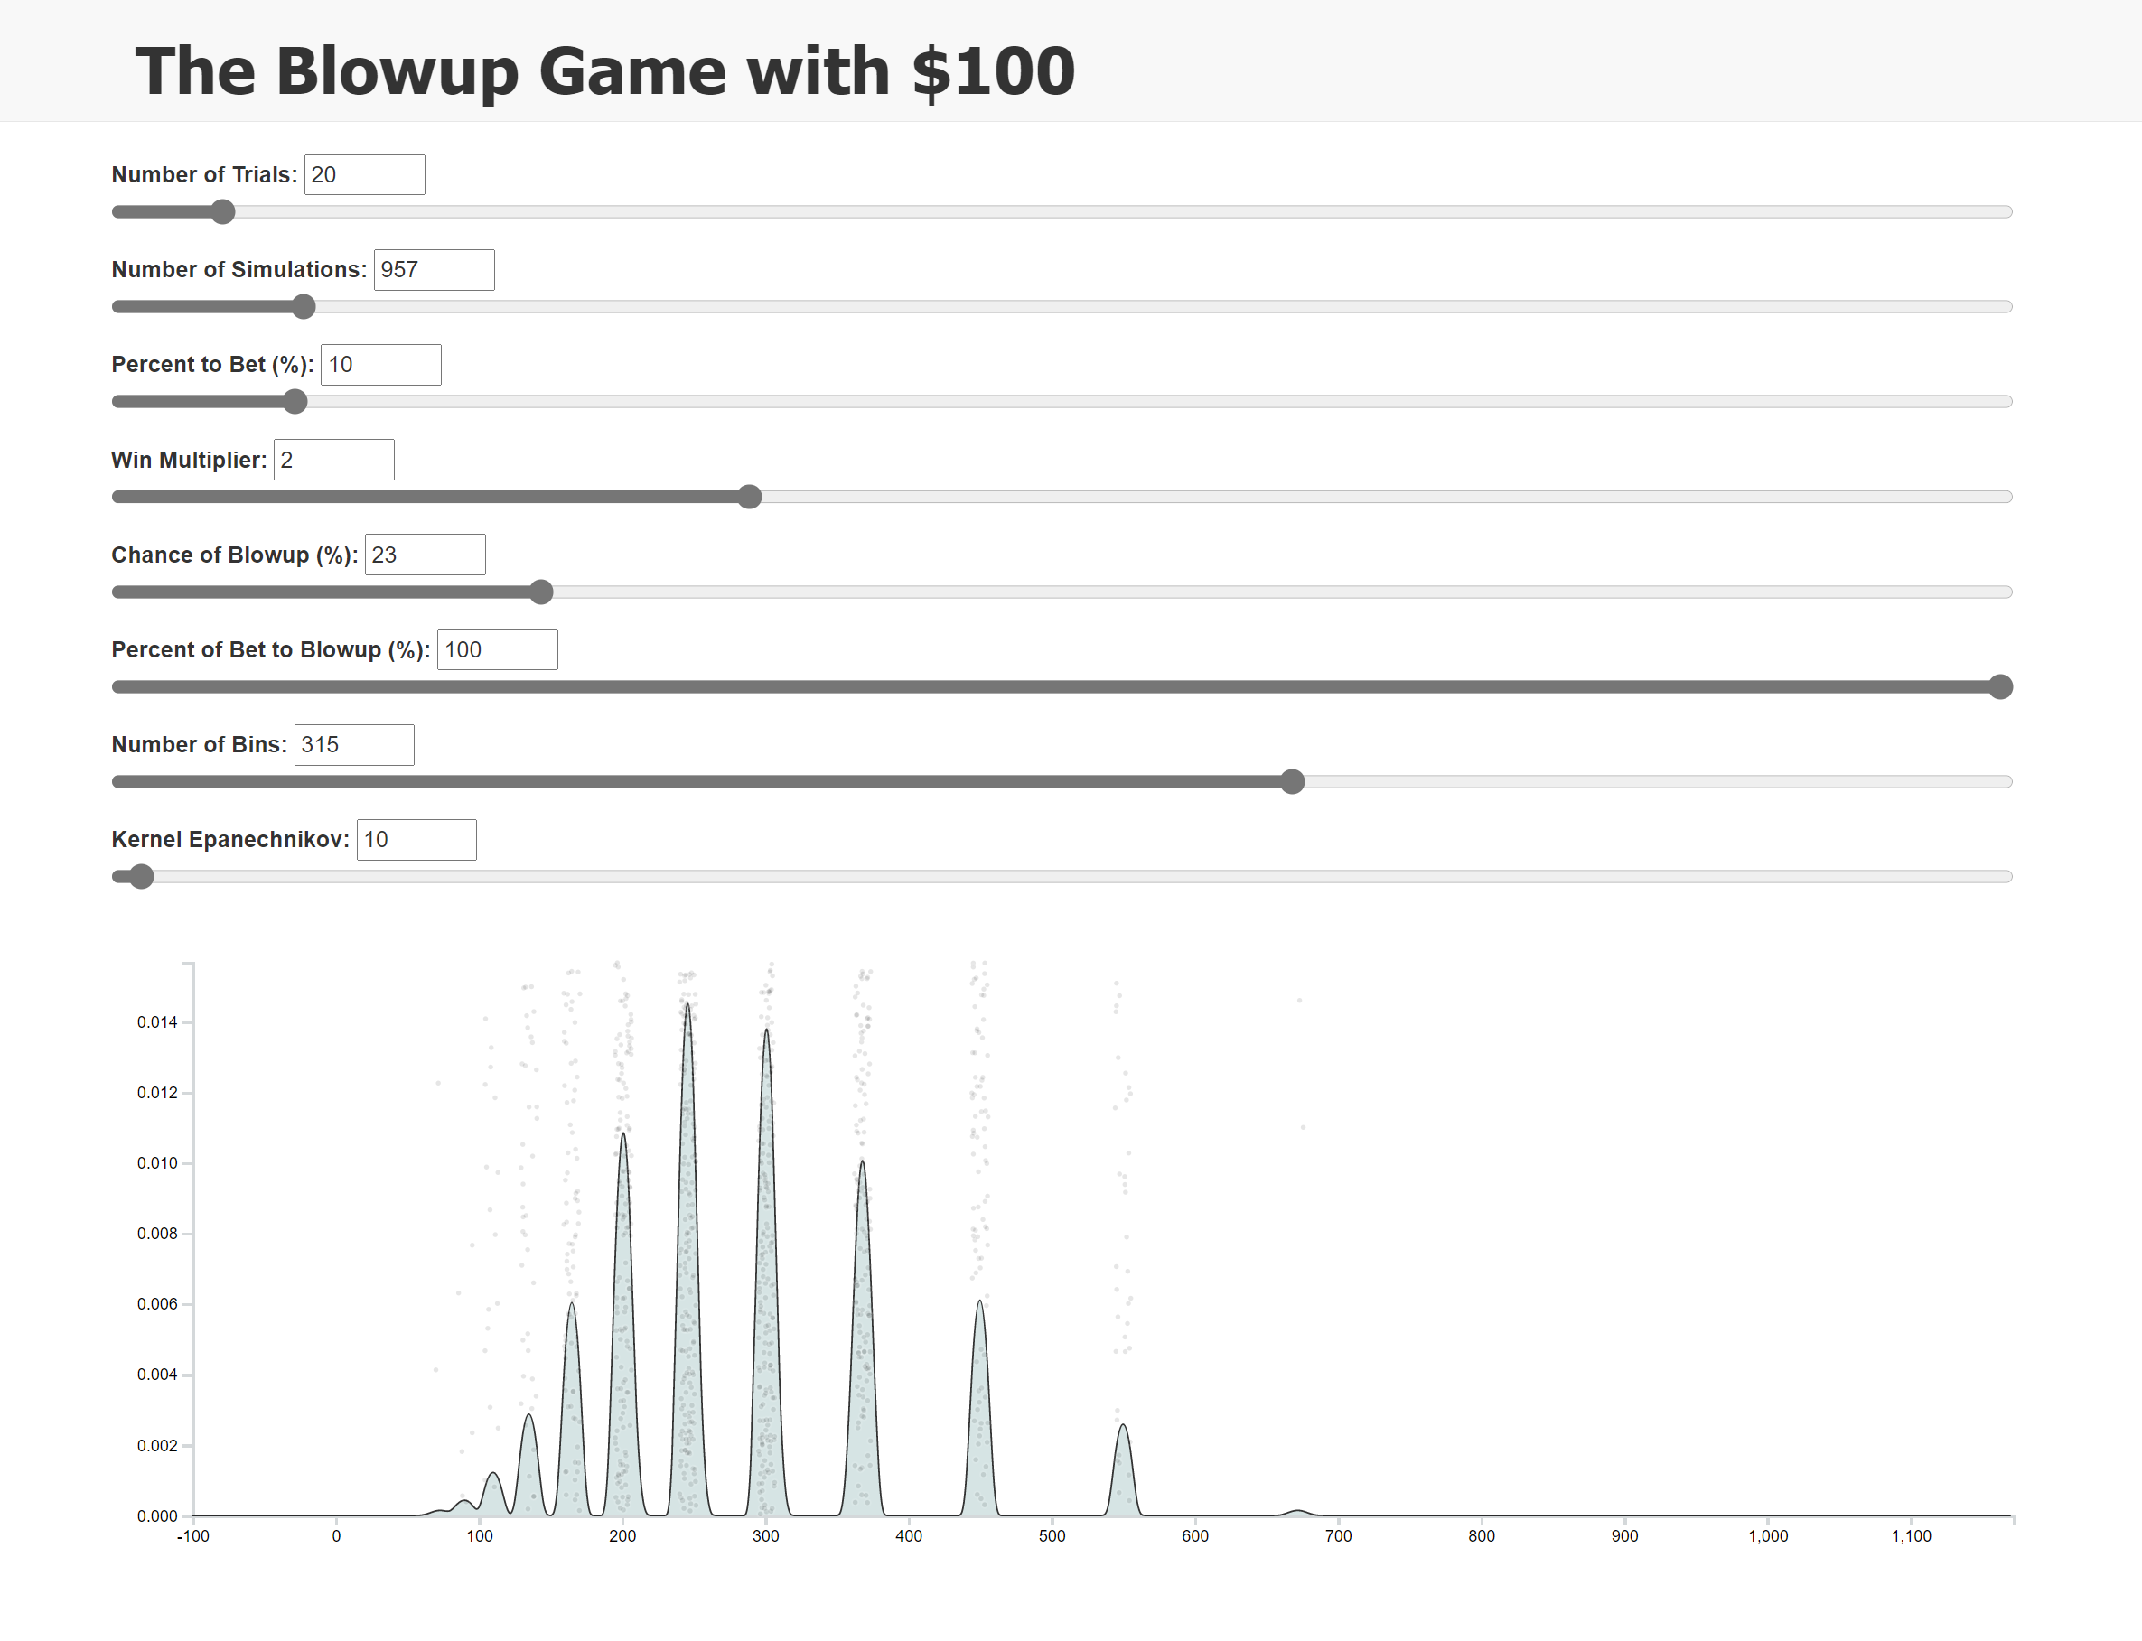
NOTE:
EXAMPLE

Slide 6
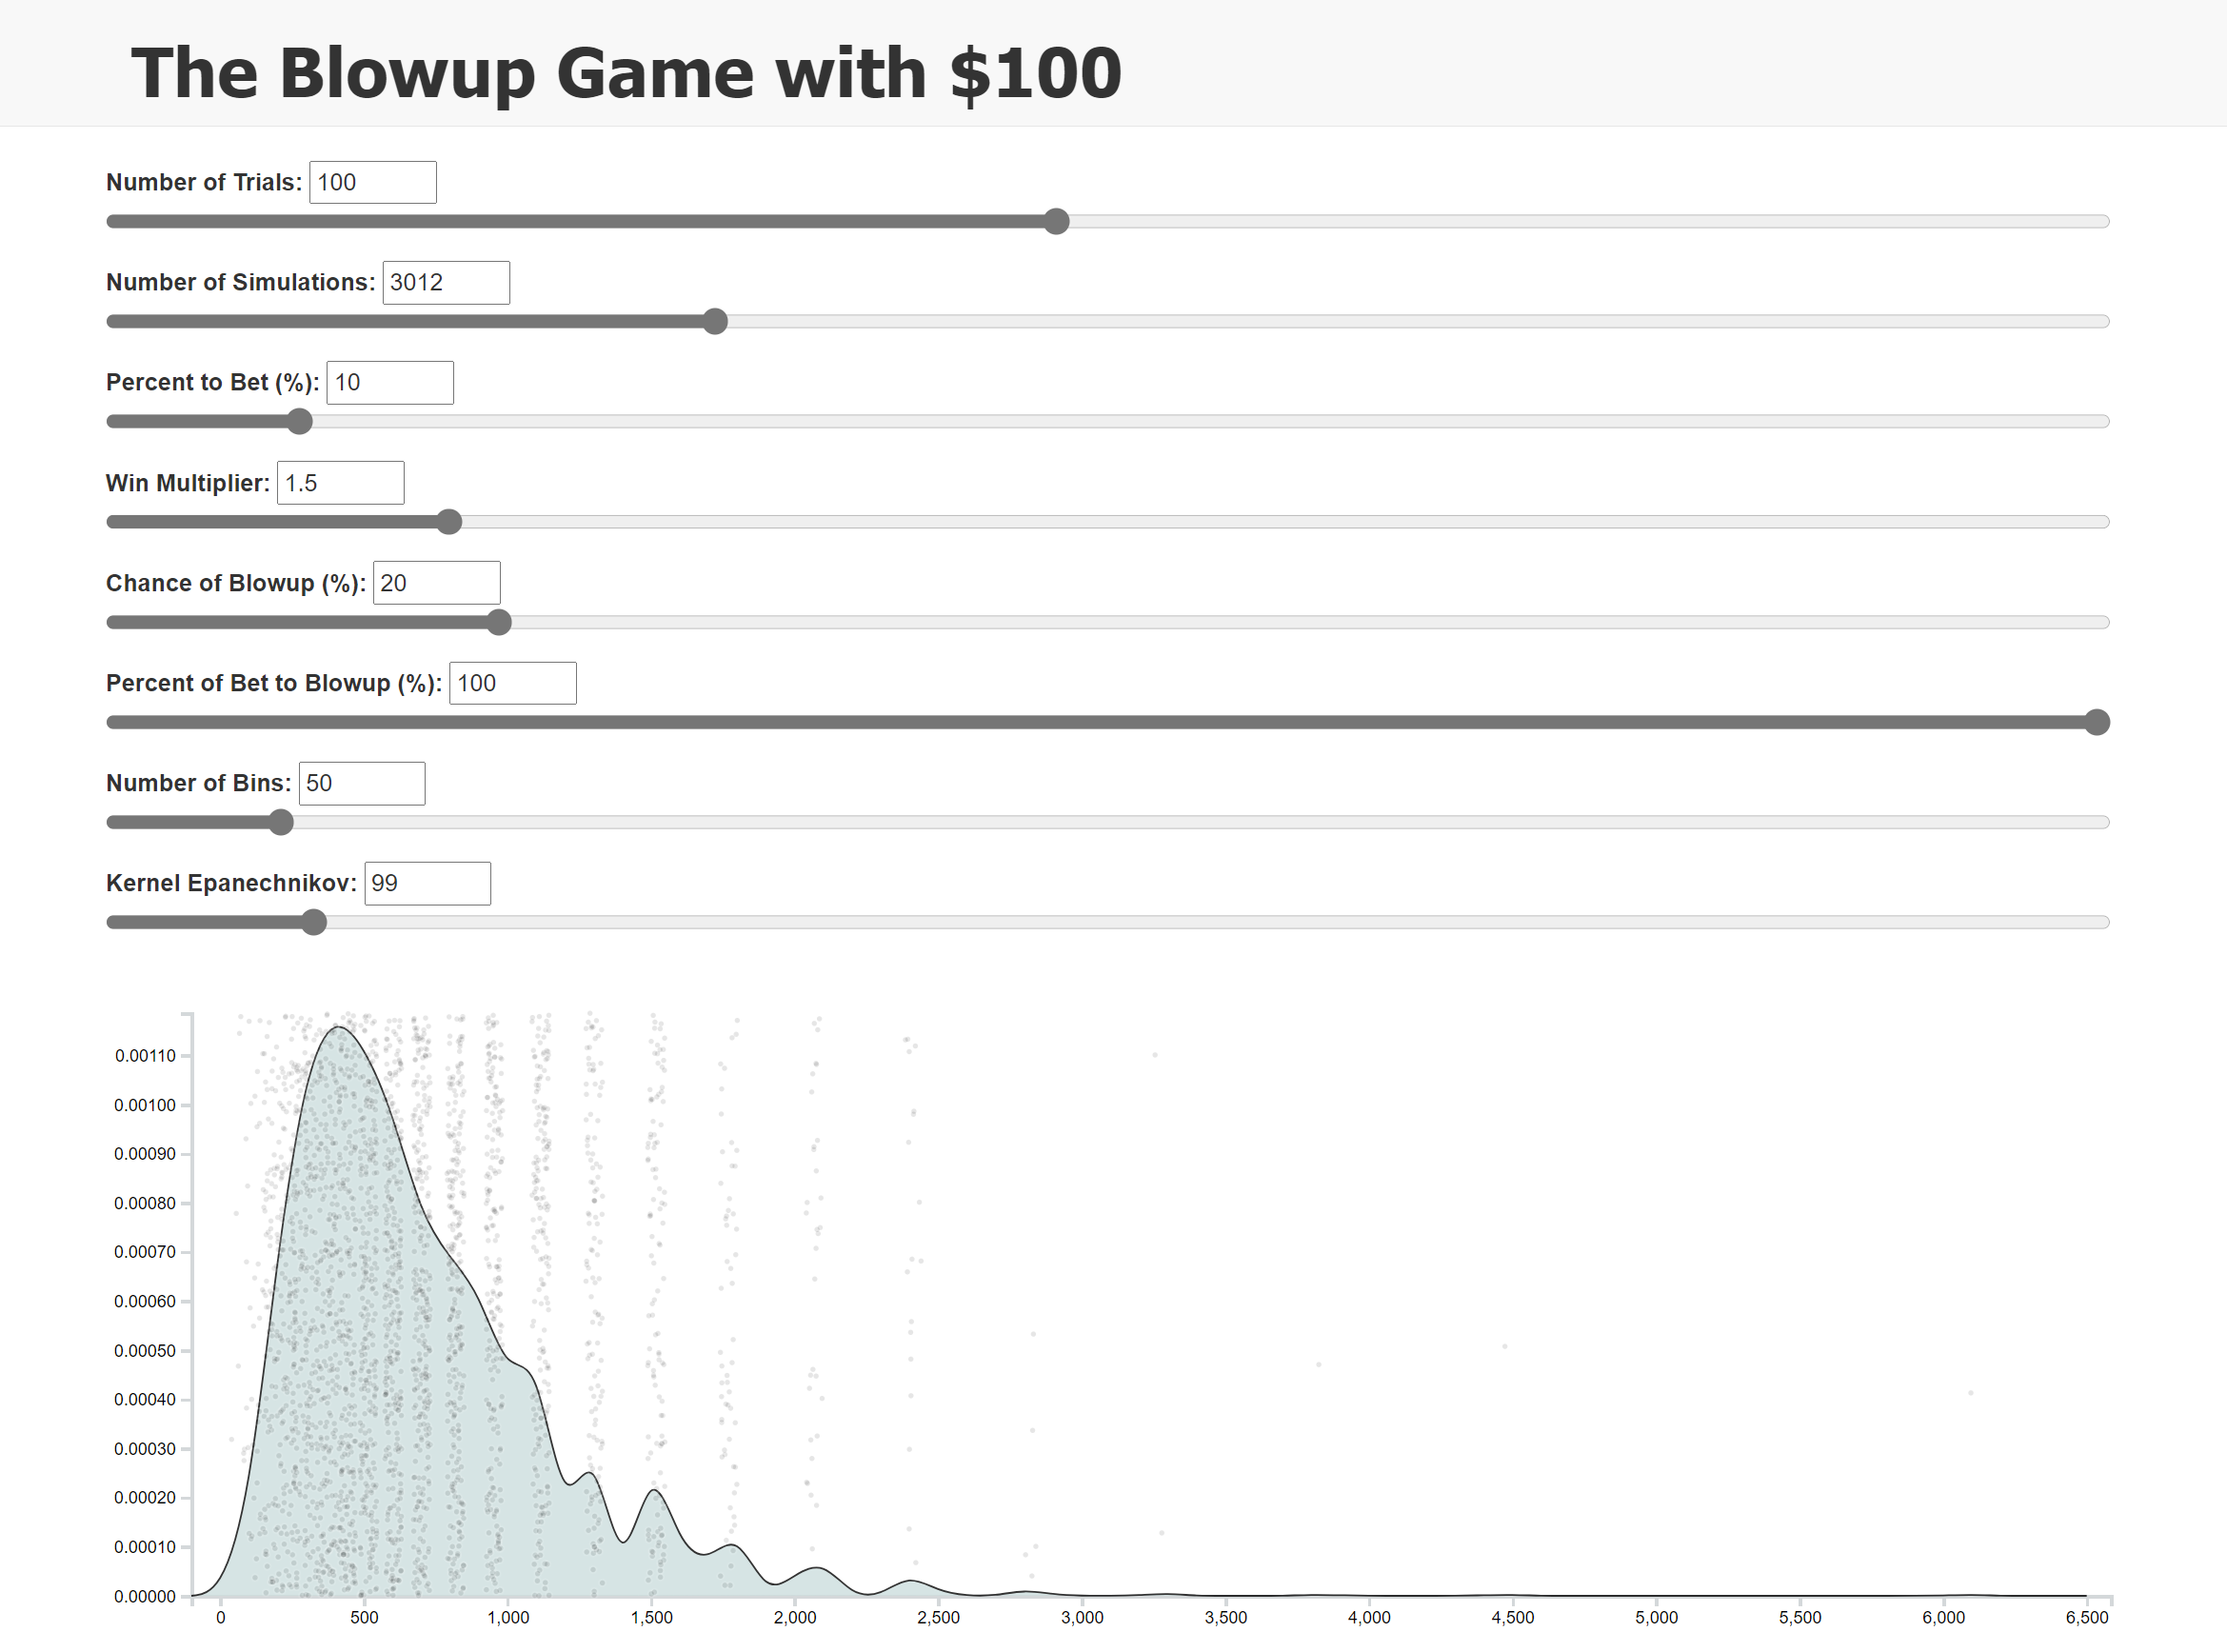
NOTE:
EXAMPLE

Slide 7
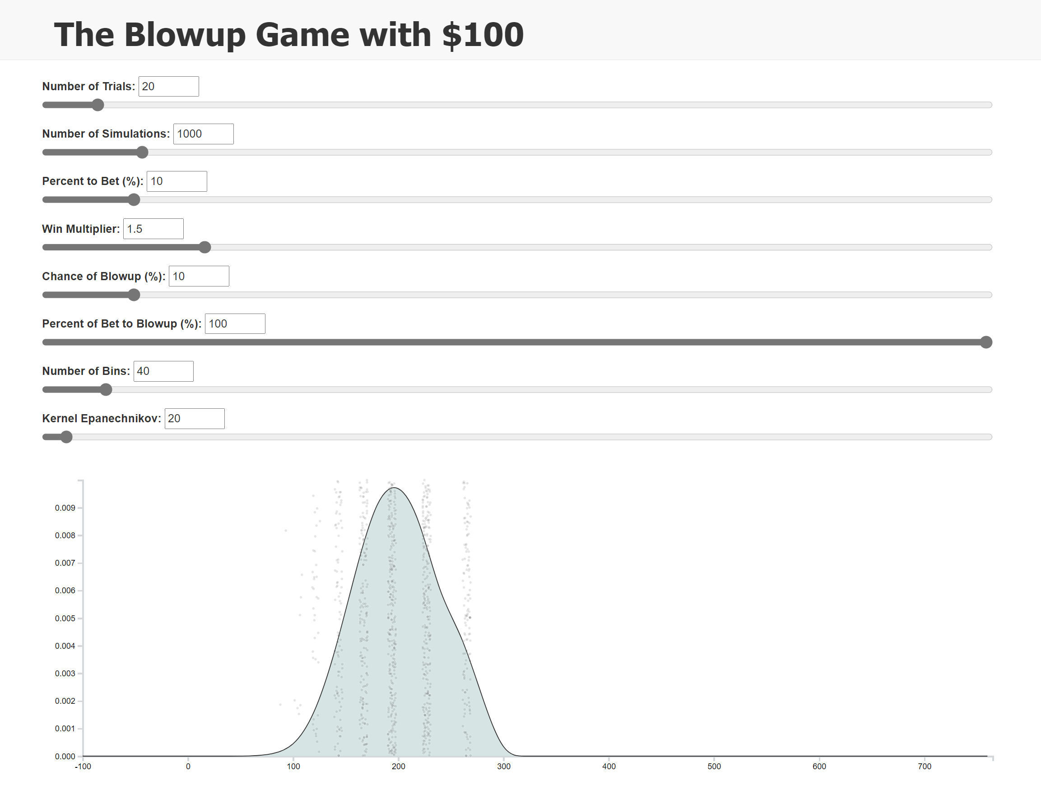
NOTE:
DEFAULT VALUES

Slide 8
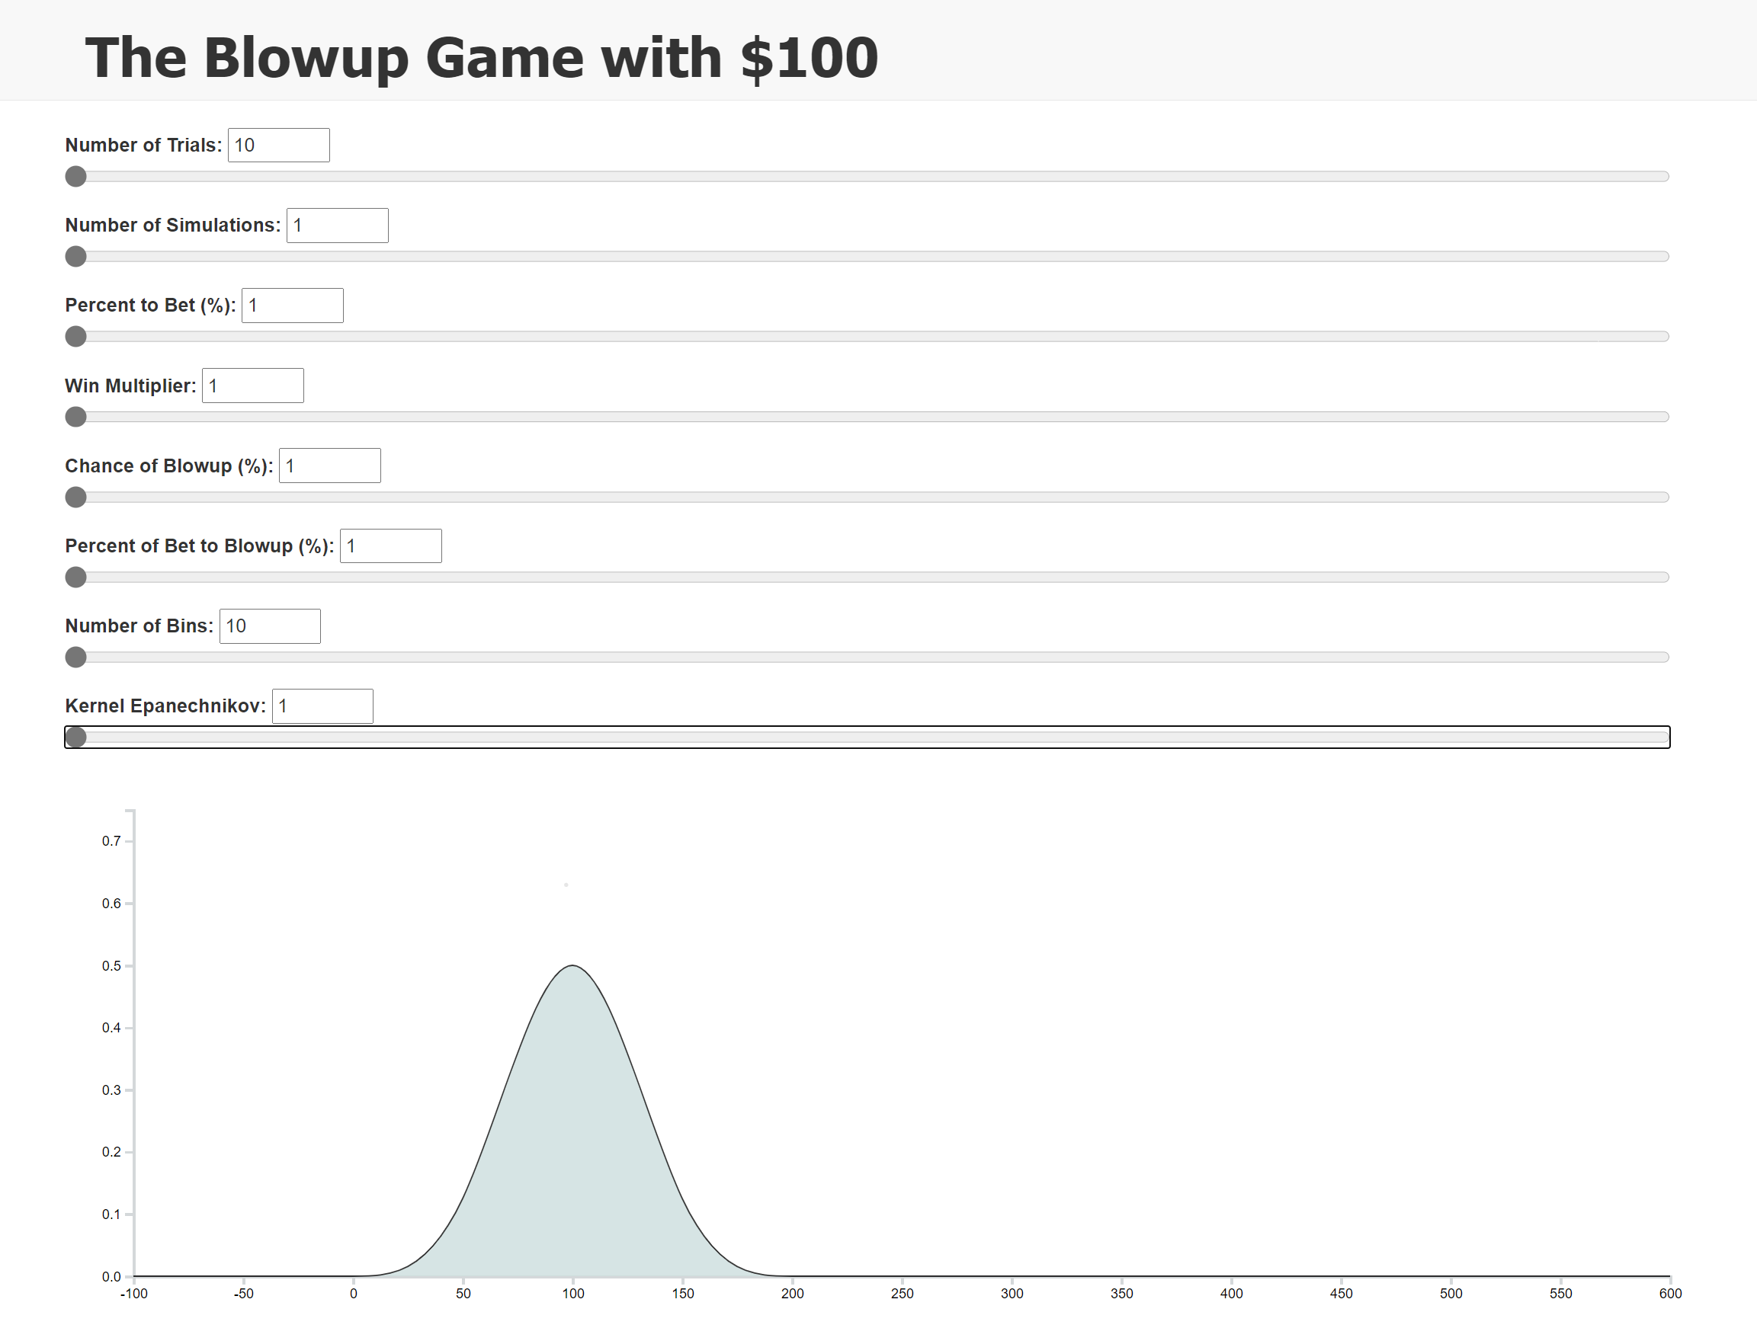
NOTE:
MIN VALUES

Slide 9
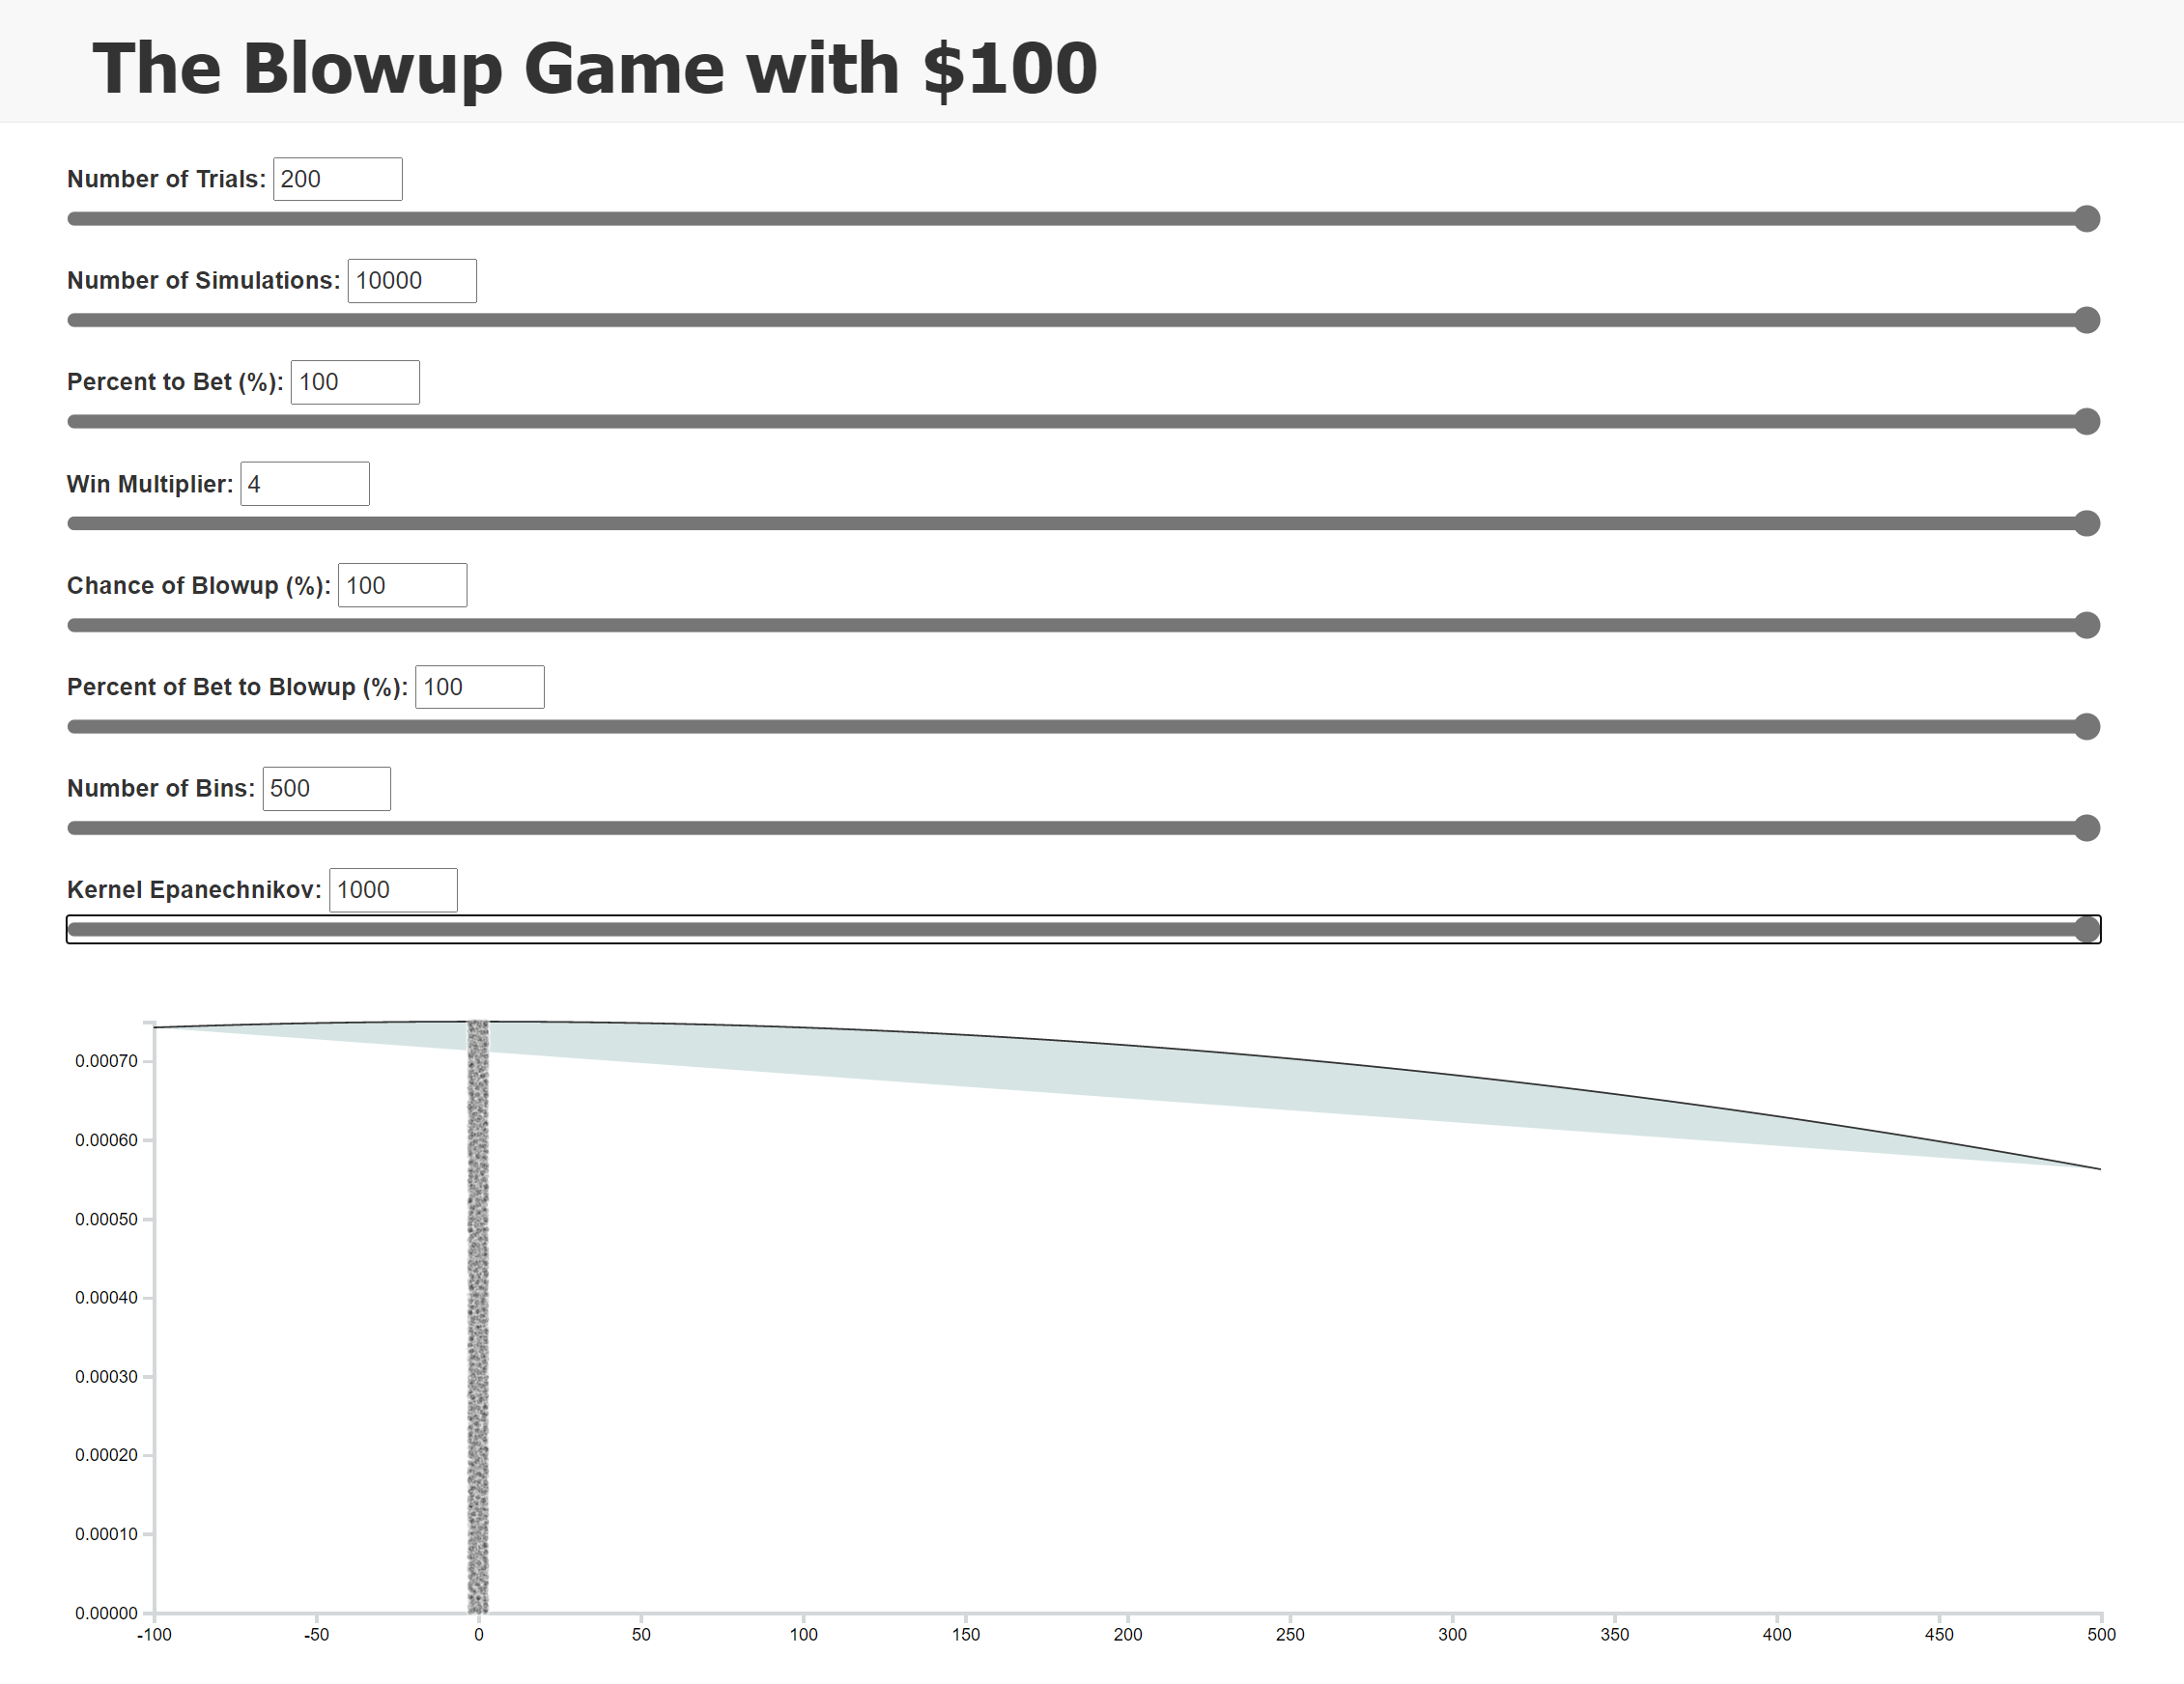
NOTE:
MAX VALUES

Slide 10
Slider Controls in index.html
(use jquery base code with the attached “index.html”)
<!-- Bootstrap grid setup -->
<div class="container">
<div id="selections" class="row">
<div class="form-group">
<label for="formControlRange">Number of Trials: </label>
<input id="numTrialsLabel" type="text" size="5"/>
<input type="range" class="form-control-range" name="numTrials" id="numTrials" min="10" max="200" value="20" step=“1" onmousemove="printValue('numTrials','numTrialsLabel')">
</div>
</div>
<div class="row">
<div id="chart-area"></div>
</div>
</div>
<!-- Custom JS -->
<script>
function printValue(sliderID, textbox) {
var x = document.getElementById(textbox);
var y = document.getElementById(sliderID);
x.value = y.value;
}
window.onload = function() {
printValue('numTrials','numTrialsLabel');
}
</script>

Slide 11
How to use Slider Controls in the Javascript file
// Listen to numTrials slider
d3.select("#numTrials").on("change", function(d){
numberOfTrials = this.value
updateSimulation()
updateChart()
});
// Listen to binNumbers slider
d3.select("#binNumbers").on("change", function(d){
binNumber = this.value
updateChart()
});

Slide 12
UpdateSimulation
function updateSimulation()
{
For(numSimulations)
{
For(numTrials)
{
}
}
}
Tips:
Store the final capital amount in an array.
Round down the final capital amount to the nearest dollar: Math.floor()
Make sure your numbers make sense (output using console.log(), then comment out so it doesn’t slow down the simulation)

Slide 13
Resizing the graph after each change
Tips for x-axis:
You’ll need to recalculate the largest amount of capital seen (after every change in the simulation) and make the width of the graph about $500 more than that.
Make the left edge of the graph -$100 so that it helps the density graph not clip funny.
Tips for y-axis:
You’ll need to recalculate the largest density seen on the y-axis after every change in the simulation.

Slide 14
Jittered Data
Tips:
Jitter height = height of graph as defined in the d3 y.range.
Jitter width = 10 (so each point is ±5 offset from actual x location)
I grabbed the circles from (https://www.d3-graph-gallery.com/graph/violin_jitter.html) and made them smaller, colored black, and very translucent (opacity set to 0.2).
Other insight into updating points can be seen here: www.d3-graph-gallery.com/graph/scatter_basic.html
When the graph changes, remove all points with “.remove()” and then add the new points. If you create the points like: var points.svg … then you can do points.remove() later to destroy them.
Create the jittered points after the density curve so they sit on top.

Slide 15
Ideas for going beyond
Look at the dashboard and ask, “What would I like to know?”
What percentage of the simulations lose money? (<$100)
When there are outliers to the far right, can something be added to ignore them (like clamping the largest x-axis value)?
Would a histogram be better? How?
What if I start with $100,000?
Is there a better way to see the raw data than the jitter?
Is there a better way to visualize the probable outcomes that is more meaningful?
Could the inputs take up less space?
Does the density plot need to be fine-tuned or is there some automatic way to do it?
Every simulation had a max drawdown that would concern investors (the lowest percentage loss). What was it for each simulation and how can you show it?

