Slide 1
Visualizing the Physics Engines of Godot
By Charles Boudousquie and Timothy Hew

Slide 2
Goal: Measure the timings of Godot’s physics engines.
We decided to measure the timings of Godot’s physics engines. The default engine and the new Jolt engine.
We spawn a large collection of colliding objects into the world and record the time each physics step takes for 4 seconds.
The number of objects for any recording ranges from 512 to 1331.
There are 2 variables for our comparisons:
1. The physics engine: Default or Jolt
2. The type of object: Cube or Sphere

Slide 3
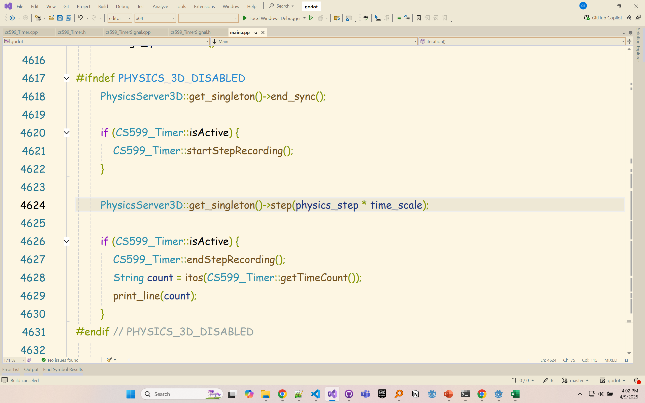
How was it implemented:
Since Godot is open source we were able to write a small library (cs599_Timer.h) and inject that code into Godot (as a module) to directly time its physics engine steps.
Godot allows you to create modules where you can store your custom code. You have free access to any part of the engine since it is open source.

Slide 4
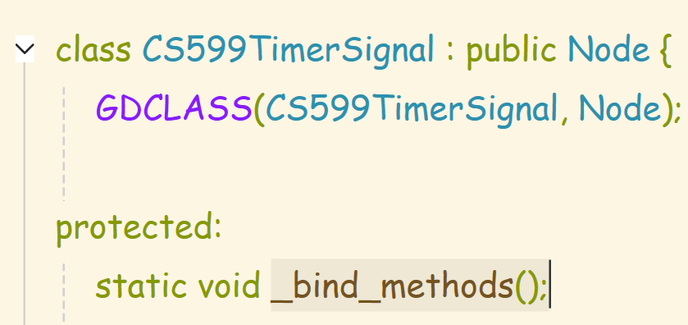
Communication between GDScript and C++
Godot’s main scripting language is GDScript.
When our script spawns in the colliding objects we needed to tell our timer inside the engine to start recording.
To expose your engine code to GDScript your classes must inherit from Node.
Then you can expose your classes’ functions to GDScript by overriding _bind_methods().

Slide 5
Signaling the engine
Once your methods are binded you can instantiate an instance of your class and call upon its methods.

Slide 6
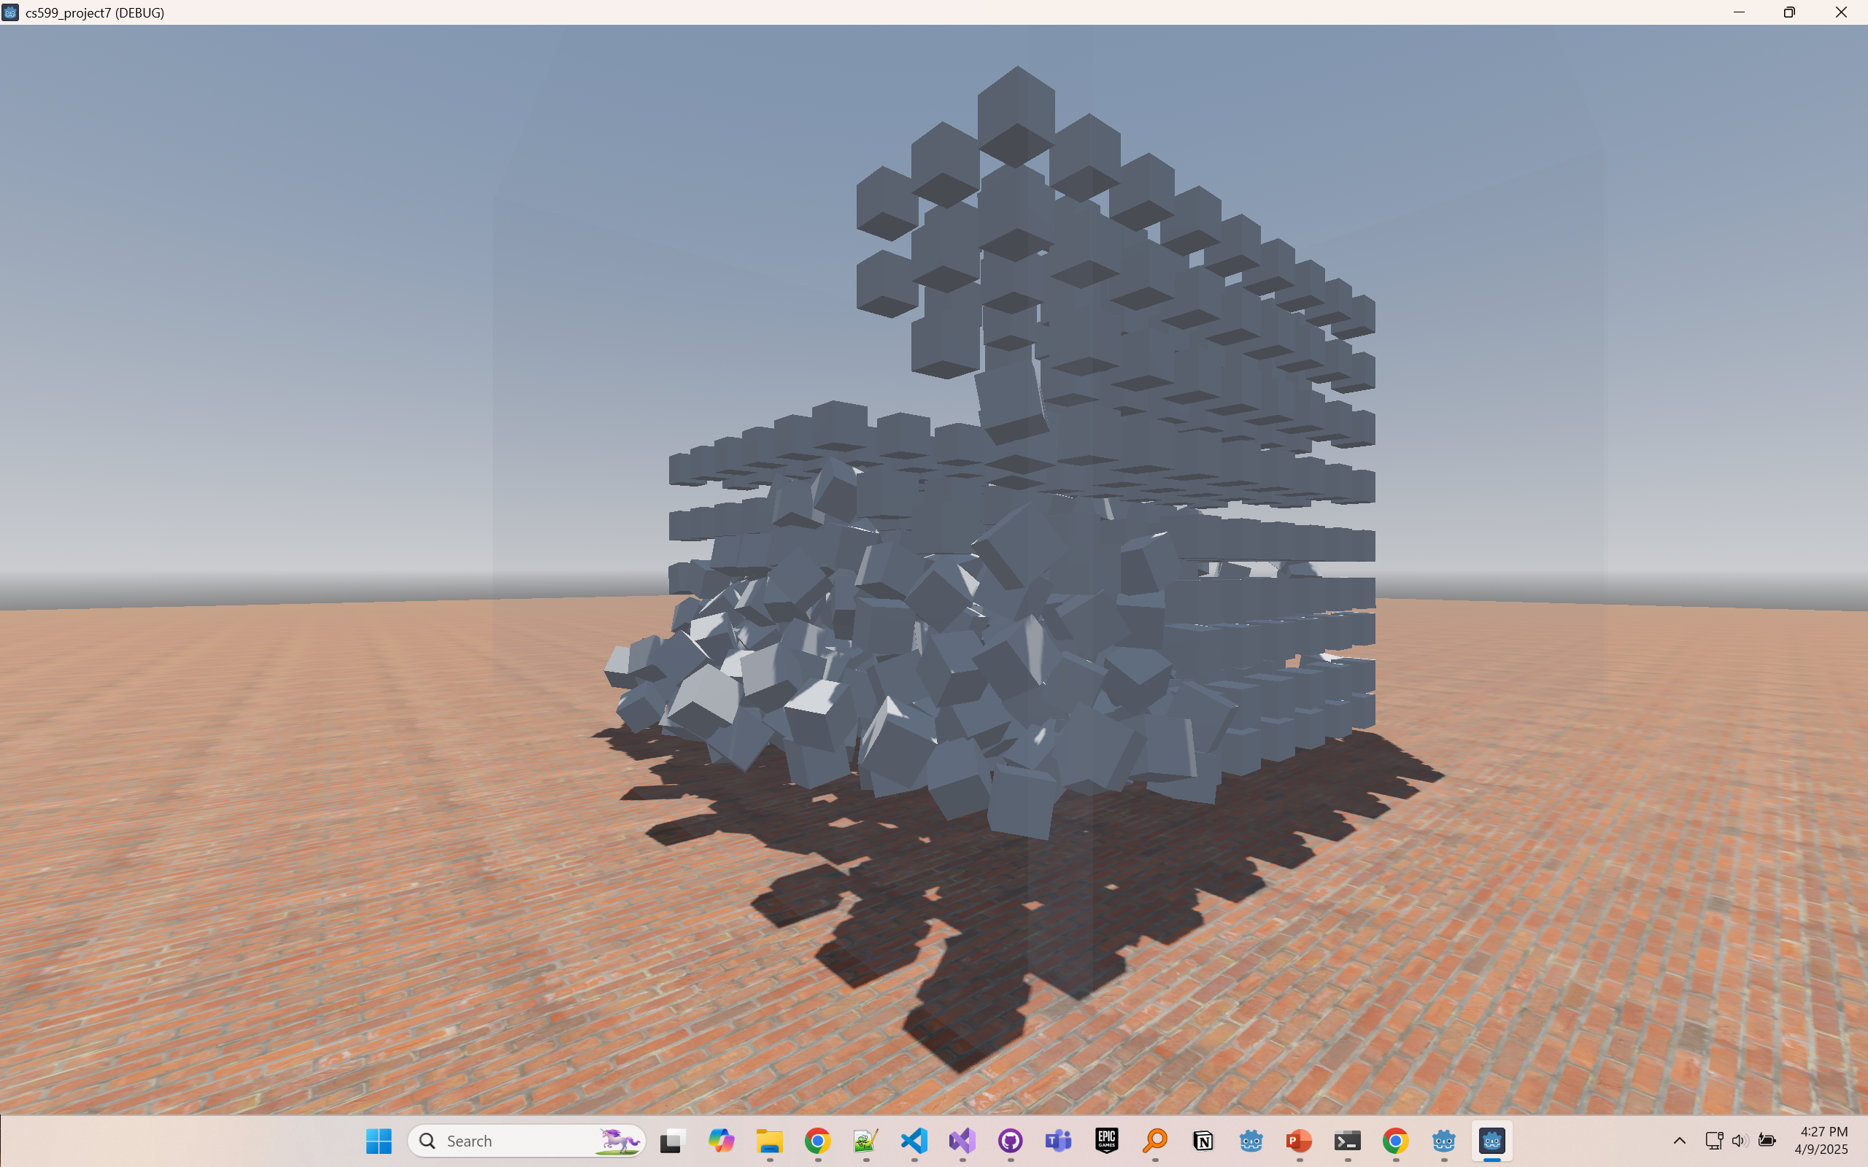
Screenshot of colliding cubes

Slide 7
Timings
Timings are recorded to csv files and then displayed in a D3 line chart.
Longest Tick Results:
Default engine with cubes: 33 milliseconds
Default engine with spheres: 13 milliseconds
Jolt engine with cubes: 28 milliseconds
Jolt engine with spheres: 47 milliseconds(spike occurred at beginning of simulation when loading 1331 spheres)!

Slide 8
Demonstration!

