Slide 1
PPPoE Server impl. using DPDK
KOM lab – SoSe - 2016
Govind Singh (govind.singh@stud.tu-darmstadt.de)
Puneet Arora (puneet.arora@stud.tu-darmstadt.de)
Sooraj Mandotti (sooraj.mandotti@stud.tu-darmstadt.de)
MSc. (Informatik) 3rd Semester

Slide 2
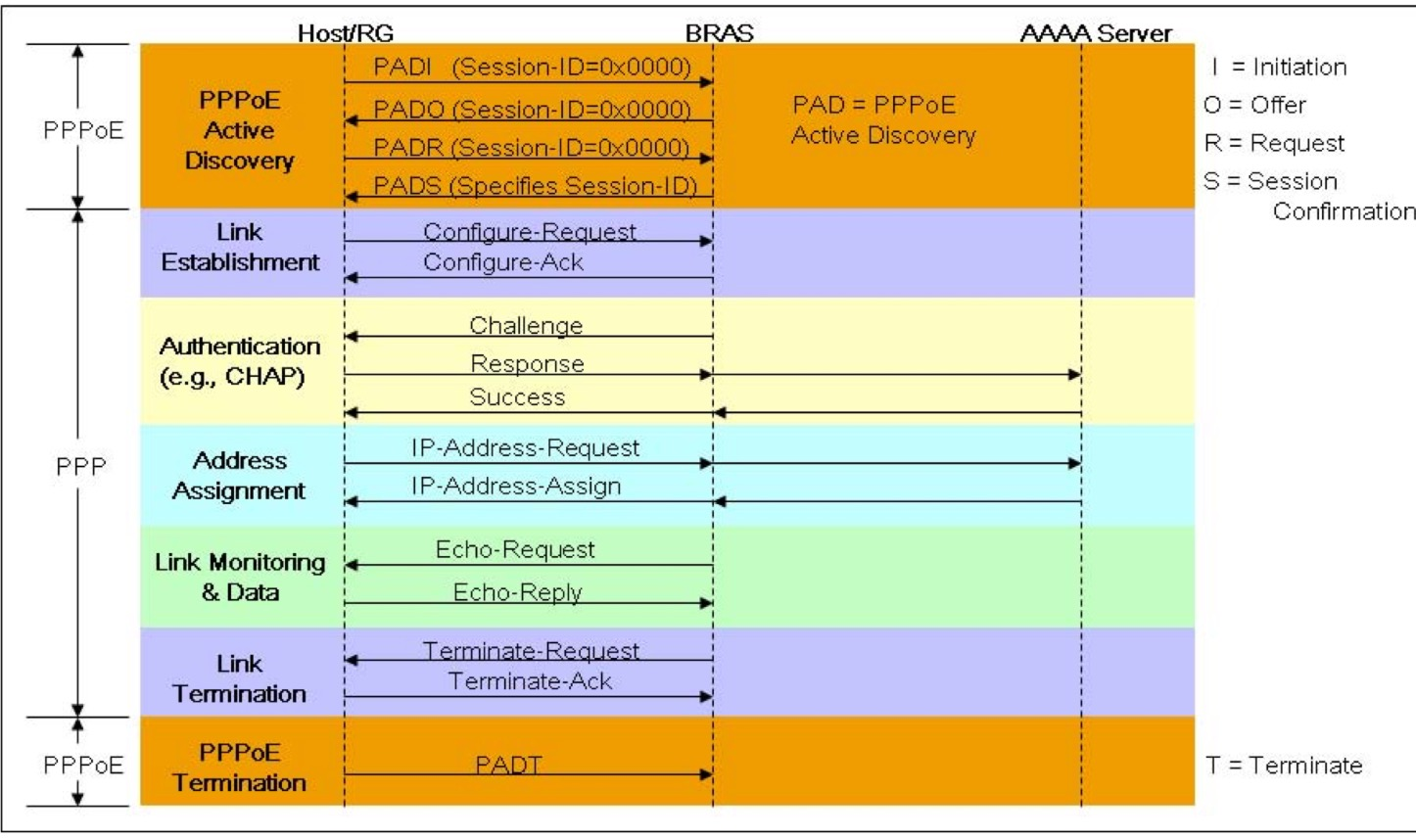
PPPoE in detail - Design
Different phases involved:
Discovery stage - Allow host to discover all Access Concentrator and then select one.
PPP session – Once PPP session is established, authentication & resource allocation happens.

Slide 3
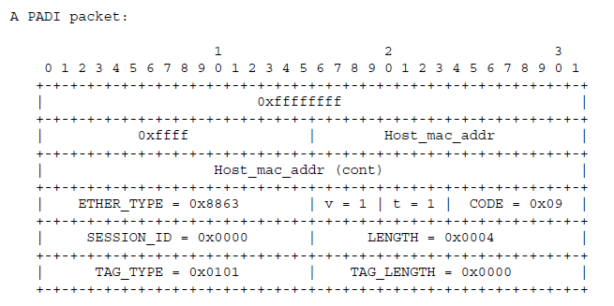
PPPoE in detail - Discovery
There are four steps to the Discovery stage:
The PPPoE Active Discovery Initiation (PADI) packet
The PPPoE Active Discovery offer (PADO) packet
The PPPoE Active Discovery Request (PADR) packet
The PPPoE Active Discovery Session-confirmation (PADS) packet
Our Approach:
Identify PADI packet (using CODE field in above figure) from host using DPDK packet modification functions.
Modify packet to send to host a PADO packet and wait for PADR from host.
Reply with PPP session cconfirmation packet.

Slide 4
PPPoE in detail - Authentication
Peer needs to authenticate itself before allowing network-layer protocol packets to be exchanged.
Our Approach:
Use Password Authentication protocol (PAP)
Server reads from a file containing username and password.
When Authenticated server proceeds with further steps in PPP
When failed server proceeds to Link termination phase.

Slide 5
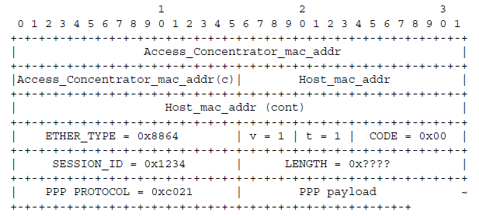
PPPoE in detail – Session Maintenance
Once the PPPoE session begins, PPP data is sent as PPP encapsulation.
All Ethernet packets are unicast.
ETHER_TYPE =0x8864 PPPoE CODE = 0x00 SESSION_ID = value assigned in Discovery stage and must not change for the entire PPPoE session
Our Approach:
Generate a session ID ( Peer ethernet address + session ID define PPPoE session uniquely)
Maintain a table that stores following tuple: <SESSION_ID, Host ETHERNET_ADDR, Host IP_ADDR>

