Slide 1
Blockchain and Cryptocurrencies
[CS-2361]
Harpreet Virk
Vir Jhangiani
Varsheel Deliwala

Slide 2
Introduction
No one should be able to cast their vote more than once in the same election. (Double Spend Problem)
The identity of every voter remains anonymous throughout the process. (Privacy Guarantee)
Every voter should be eligible to vote before casting their ballot.
Election results should be publicly visible to the entire network to ensure transparency, with voters allowed to verify if their votes were correctly casted. (Voter’s identity will still be anonymous).
Votes should not be modifiable once cast.
HyperVoter is a Blockchain based Distributed E-Voting application implemented on Hyperledger Fabric.
Notes:
Why we chose to do this
How it works – outside user view – demo
Deployment and technology tools
Chain code
Thank you

Slide 3
Overview
HyperVoter
EC Dashboard
Voters Dashboard
Public Bulletin
Notes:
Why we chose to do this
How it works – outside user view – demo
Deployment and technology tools
Chain code
Thank you

Slide 4
Overview
EC Dashboard
Set Time
Add Voters
Add Candidates
Authentication
Notes:
Explain what happens when you add voter/candi or set time

Slide 5
Overview
Voters Dashboard
Log In
Cast Vote
Register
Notes:
Why we chose to do this
How it works – outside user view – demo
Deployment and technology tools
Chain code
Thank you

Slide 6
Overview
Public Bulletin
Voter Turnout
Query All Votes
(which have been casted)
Election Results
Query Vote by Id
Notes:
Why we chose to do this
How it works – outside user view – demo
Deployment and technology tools
Chain code
Thank you

Slide 7
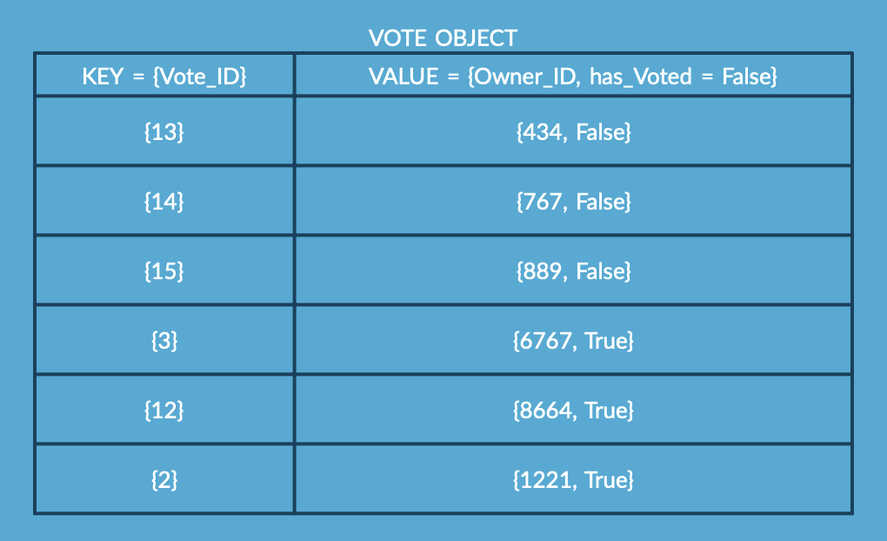
ChainState

Slide 8
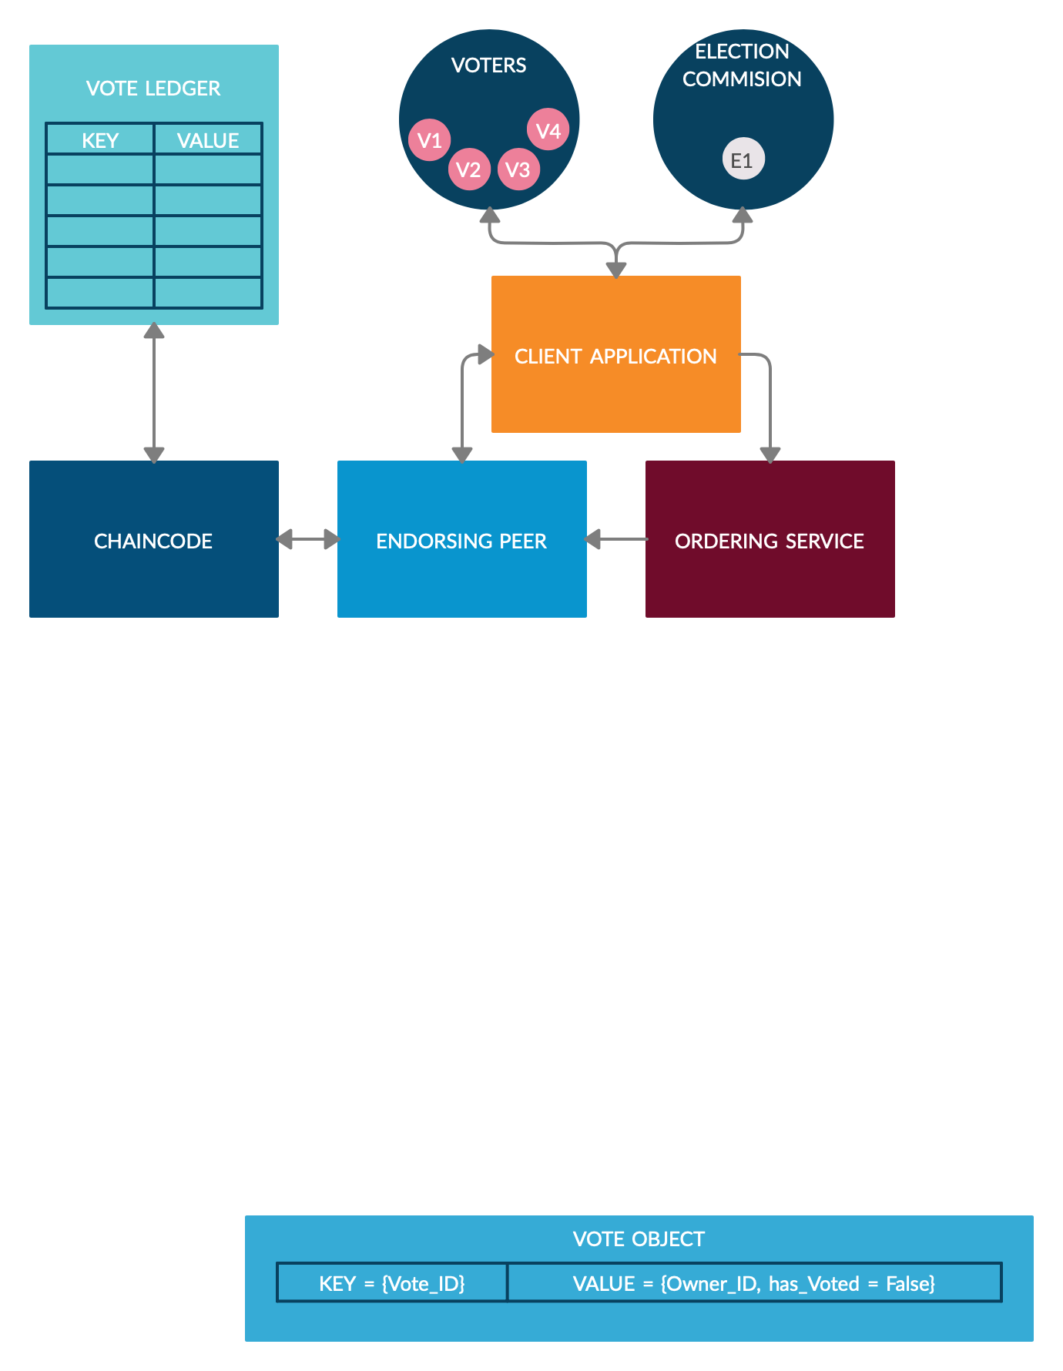
Architecture

Slide 9
DEMO
http://localhost:5000/

Slide 10
Chaincode
Chaincode functions:
InitLedger(ctx)
setEndTime(ctx, endTimeVal)
createVoteObj(ctx, sendTo)
sendVoteObj(ctx, userId, sendTo)
getResults(ctx)
voterTurnout(ctx)
queryVote(ctx, voteObjId)
queryAllVote(ctx)
Notes:
Why we chose to do this
How it works – outside user view – demo
Deployment and technology tools
Chain code
Thank you

Slide 11







Slide 12

Thank you!

