Slide 1
Unix Profiling Tools for C gprof and gcov applied to
Conway's Game of Life
Charles L. Capps
Portland State University
CS 510: Mastery in Programming
August 3rd, 2011

Slide 2
Goal of Project
Get a better understanding of gprof and gcov
See how optimisation levels affect performance
  Measure this performance with gprof/gcov/time
See how optimisation affects gprof/gcov results
Get tangible results by analysing changes to Game of Life code
  Use basic statistics to validate results

Slide 3
Gosper Glider Guns
Sample input is a Gosper glider gun
Found in 1970, smallest known configuration with linear growth in time.
Creates gliders with a regular period
(Show game of life) :-)

Slide 4
Four versions of code
Modified function to count the no. of neighbors
  Torus topology, wraps around
Version 1: naïve implementation
Version 2: Constant loop bounds
Version 3: Reduced checking, improved logic
Version 4: Single malloc call for 2d array

Slide 5
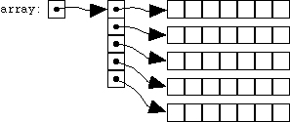
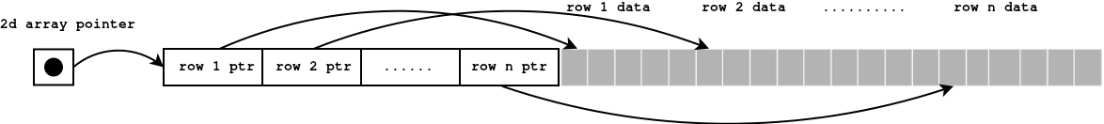
Malloc strategies
Malloc array of pointers for rows, then malloc every row:
Malloc all data in one call, then point each row to the right chunk of data:

Slide 6
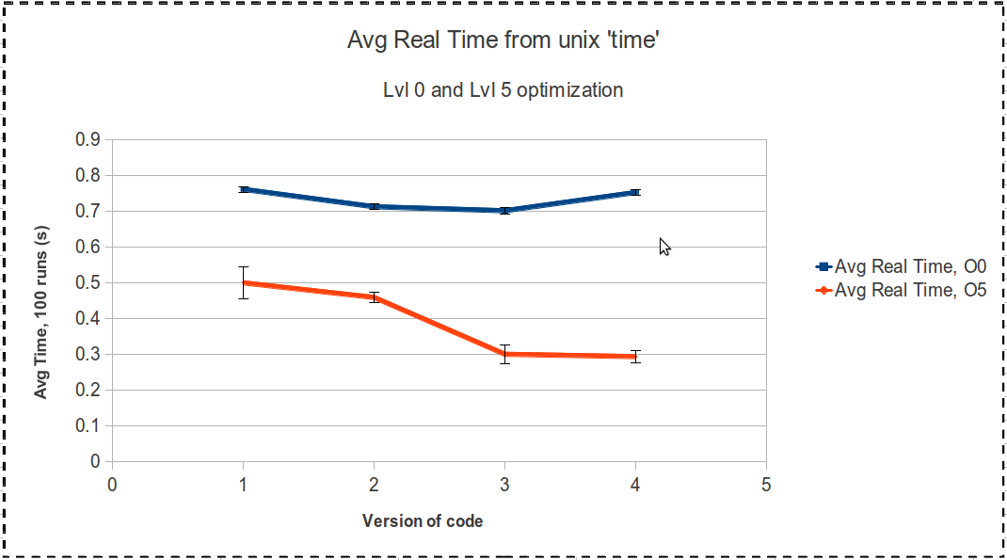
Results: Real Time

Slide 7
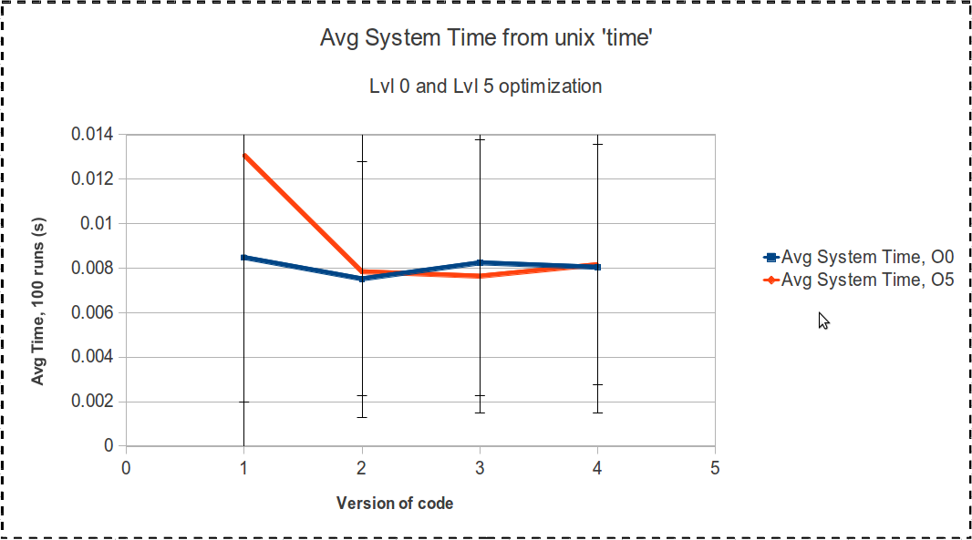
Results: System Time

Slide 8
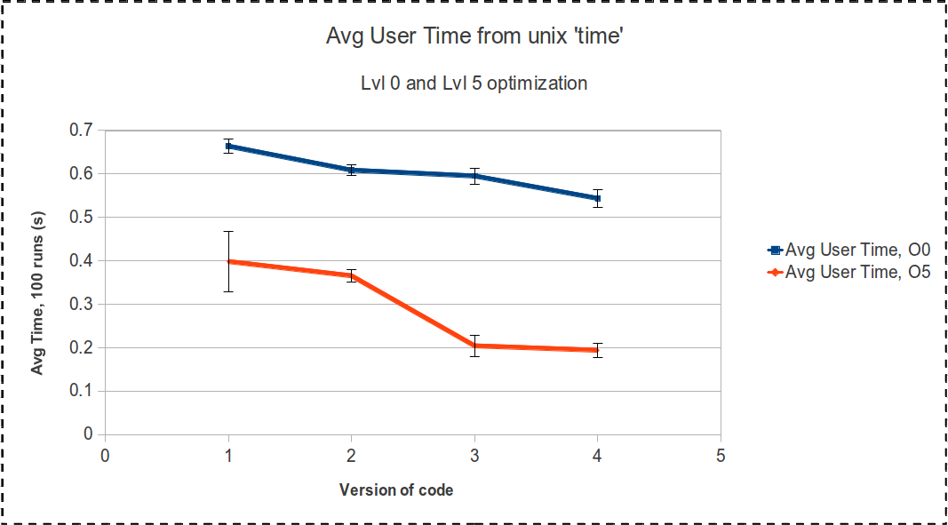
Results: User Time

Slide 9
Some important lessons
Best to not use optimisation for profiling
Functions may be inlined, not listed in gprof
Logical branches may be combined
  Less information in gcov

