Slide 1
Edit Distance
張智星 (Roger Jang)
jang@mirlab.org
http://mirlab.org/jang
多媒體資訊檢索實驗室
台灣大學 資訊工程系

Slide 2
Edit Distance
Edit distance
  The minimum total cost of the basic operations (delete with cost 1, insert with cost 1, substitute with cost 2) that are required to convert a string into another.
  Used in “diff” command of unix.

Slide 3
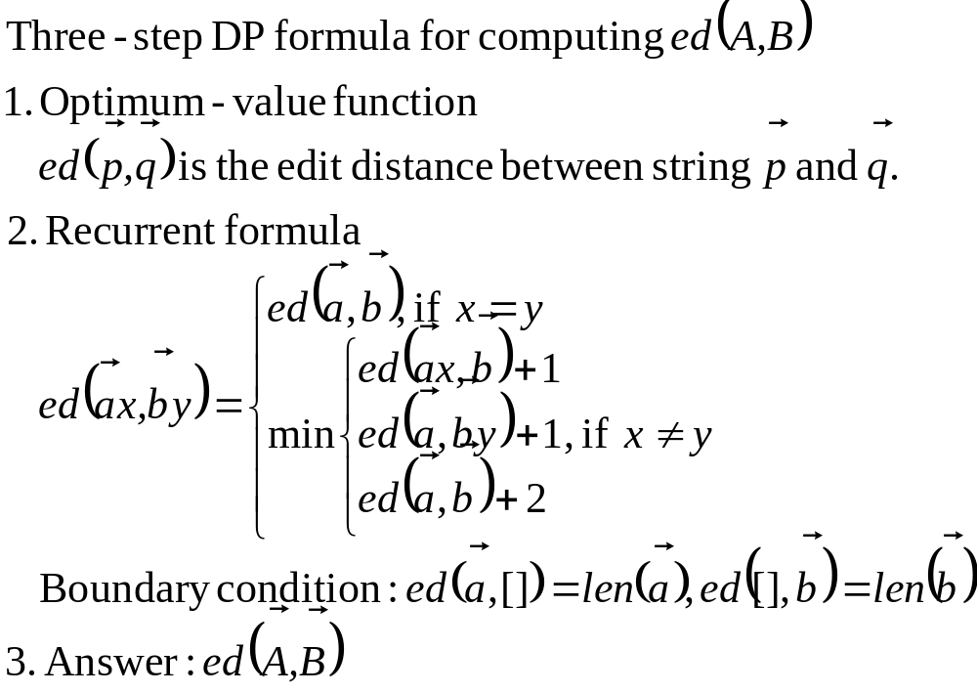
DP for Edit Distance: 3-step Formula
Quiz!

Slide 4
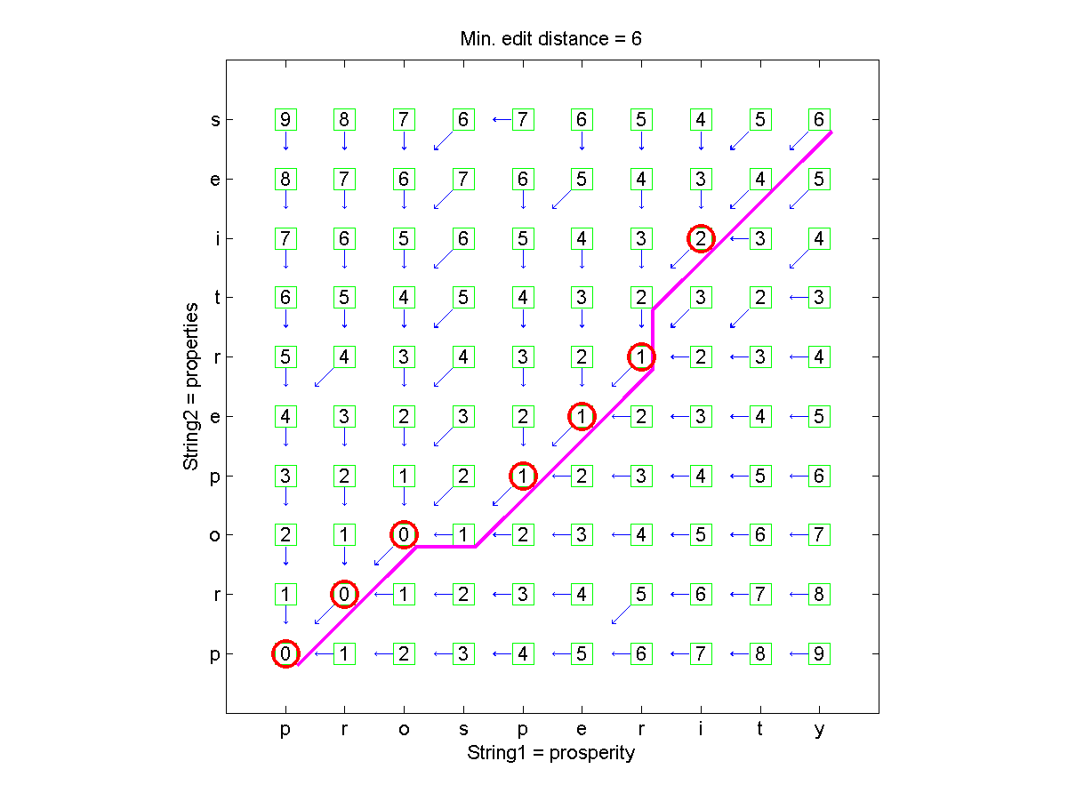
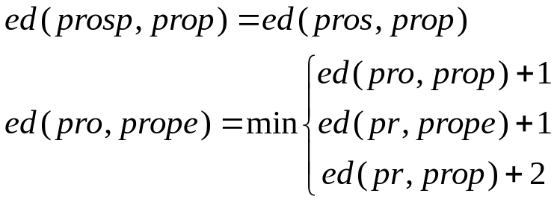
DP for Edit Distance: Table Filling (1/2)

Slide 5
DP for Edit Distance: Table Filling (2/2)
To create this plot
  Download Machine Learning Toolbox
  Run editDistance('prosperity', 'properties', [2 1 1], 1) under MATLAB
  A 45-degree back-tracking path indicates a “substitute” or “equal”.

Slide 6

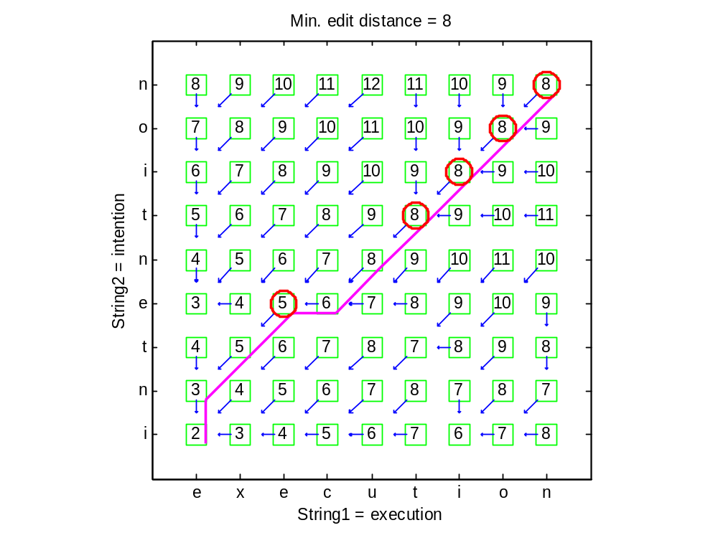
DP for Edit Distance: Quiz for Table Filling
Hints
  Create a (m+1)*(n+1) matrix for table filling
  Fill row 0 and column 0 first to establish the base cases of boundary conditions
  Fill all the other elements in a layer-by-layer manner.

