Slide 1
Longest Common Subsequence (LCS)
張智星 (Roger Jang)
jang@mirlab.org
http://mirlab.org/jang
多媒體資訊檢索實驗室
台灣大學 資訊工程系

Slide 2
Longest Common Subsequence
Subsequence
  Given a string, we can delete some elements to form a subsequence:
    s1=uvwxyz ➔ s2=uwyz (after deleting v and x)
    s2 is a subsequence of s1.
Longest common subsequence (LCS)
  The similarity of two string can be define as the length of the LCS between them.
  Example: abcdefg and xzackdfwgh have acdfg as a longest common subsequence
For word suggestion!

Slide 3
Brute-Force Approach to LCS
A brute-force solution
  Enumerate all subsequences of X
  Test which ones are also subsequences of Y
  Pick the longest one.
Analysis:
  If X is of length n, then it has 2^{n} subsequences
  This is an exponential-time algorithm!

Slide 4
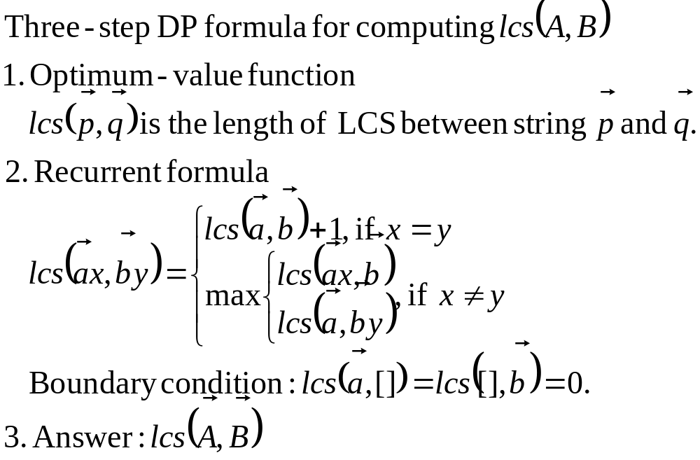
DP for LCS: 3-step Formula
Quiz!

Slide 5
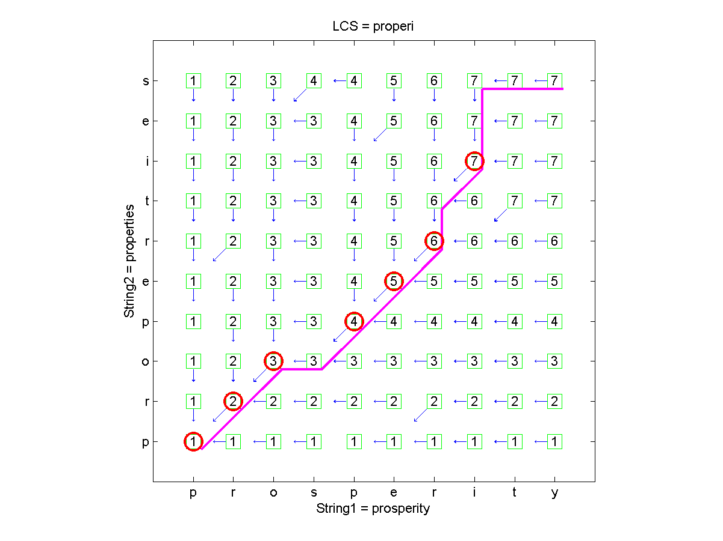
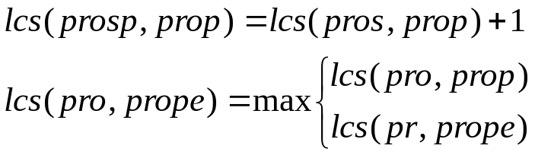
DP for LCS: Table Filling (1/2)

Slide 6
DP for LCS: Table Filling (2/2)
Observations
  LCS=‘properi’ or ‘propert’ (which is obtained by keeping multiple back-tracking paths)
  A match occurs when the node has a 45-degree back-tracking path

Slide 7

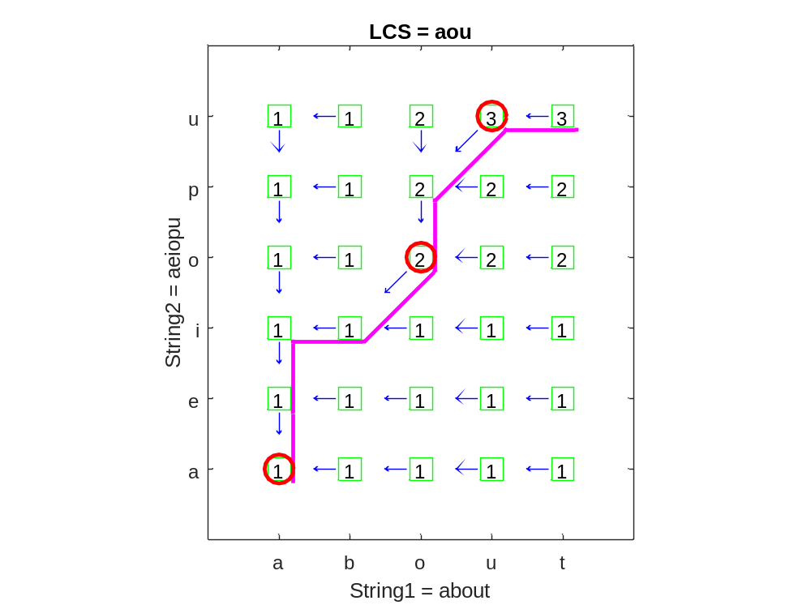
DP for LCS: Quiz for Table Filling
Quiz!
Hints
  Create a (m+1)*(n+1) matrix for table filling
  Fill row 0 and column 0 with 0 first to establish the base cases of boundary conditions
  Fill all the other elements in a layer-by-layer manner.

Slide 8
Quiz Solution
To create this plot
  Download Machine Learning Toolbox
  Run lcs('about', 'aeiopu', 1) under MATLAB

Slide 9
LCS In Terms of Path Finding
Note that all DP problem can be visualized as path finding…

