Slide 1
Matrix Chain Product
張智星 (Roger Jang)
jang@mirlab.org
http://mirlab.org/jang
多媒體資訊檢索實驗室
台灣大學 資訊工程系

Slide 2
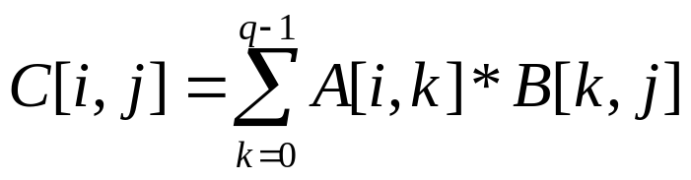
Matrix Chain Products (MCP)
Review: Matrix Multiplication.
  C = A*B
  A is p × q and B is q × r
  O(pqr ) time
r
j
B
q
q
for (i=0; i<p; i++)
for (j=0; j<r; j++){
c[i,j]=0;
for (k=0; k<q; k++)
c[i,j]+=a[i,k]*b[k,j];
}
A
C
p
i
i,j
p
r

Slide 3
Matrix Chain-Products
Problem definition
  Given n matrices A₀, A₁, …, A_{n-1}, where A_{i} is of dimension d_{i}×d_{i+1}
  How to parenthesize A₀*A₁*…*A_{n-1} to minimize the overall cost?

Slide 4
Example of MCP
  The product A (2×3), B (3×5), C (5×2), D (2×4) can be fully parenthesized in 5 distinct ways:
    (A (B (C D))) ➔ 5×2×4 + 3×5×4 + 2×3×4 = 124
    (A ((B C) D)) ➔ 3×5×2 + 3×2×4 + 2×3×4 = 78
    ((A B) (C D)) ➔ 2×3×5 + 5×2×4 + 2×5×4 = 110
    ((A (B C)) D) ➔ 3×5×2 + 2×3×2 + 2×2×4 = 58
    (((A B) C) D) ➔ 2×3×5 + 2×5×2 + 2×2×4 = 66
The way the chain is parenthesized can have a dramatic impact on the cost of evaluating the product.

Slide 5
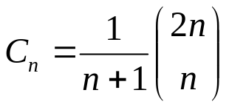
An Enumeration Approach
Matrix Chain Product Alg.:
  Try all possible ways to parenthesize A=A₀*A₁*…*A_{n-1}
  Calculate total number of operations for each way
  Pick the one that is best
Running time:
  The number of ways of parenthesizations is equal to the number of binary trees with n leave nodes
  It is called the Catalan number, and it is almost 4^{n} ➔ exponential!
((A₀(A₁A₂))A₃)➔binary tree
Dynamic Programming

Slide 6
Observations Leading to DP
Define subproblems:
  Find the best parenthesization of A_{i}*A_{i+1}*…*A_{j}.
  Let N_{i,j} denote the minimum number of operations required by this subproblem.
  The optimal solution for the whole problem is N_{0,n-1}.
Subproblem optimality: The optimal solution can be defined in terms of optimal subproblems
  There has to be a final multiplication (root of the expression tree) for the optimal solution.
  Say, the final multiply is at index i: (A₀*…*A_{i})*(A_{i+1}*…*A_{n-1}).
  Then the optimal solution N_{0,n-1} is the sum of two optimal subproblems, N_{0,i} and N_{i+1,n-1} plus the time for the last multiply.

Slide 7
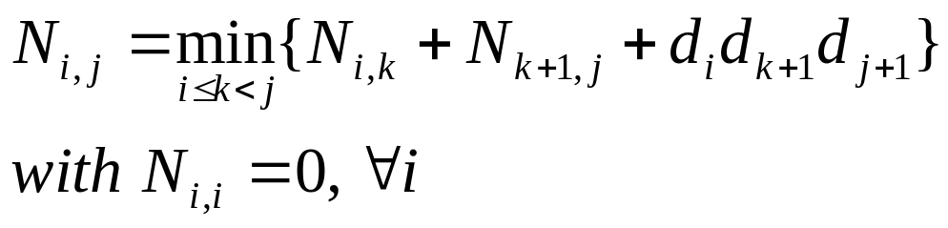
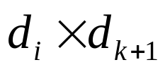
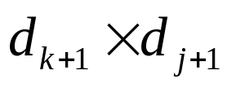
Three-Step DP Formula
To solve matrix chain-product with DP
  Optimum-value function
    N_{i,j}: the minimum number of operations required by parenthesizing A_{i}*A_{i+1}*…*A_{j}.
  Recurrent equation
  Answer
    N_{0, n-1}
(A_{i}*A_{i+1}*…*A_{k})(A_{k+1}*A_{k+2}*…*A_{j})

Slide 8
Subproblem Overlap
0..3
(A₀)( A₁A₂A₃)
(A₀A₁A₂)(A₃)
(A₀ A₁)( A₂A₃)
0..0
1..3
0..1
2..3
0..2
3..3
1..1
2..3
1..2
3..3
0..0
1..1
2..2
3..3
...
2..2
3..3
1..1
2..2
Due to the overlap,
we need to keep track
of previous results

Slide 9
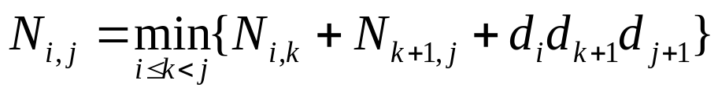
Table Filling for DP
The bottom-up approach fills in the upper-triangle of the n×n array by diagonals, starting from N_{i,i}’s.
N_{i,j} gets values from pervious entries in row i and column j.
Filling in each entry in the N table takes O(n) time ➔ Total time O(n³)
Actual parenthesization can be found by storing the best “k” for each entry
N
0
1
2
j
…
n-1
Answer!
0
1
…
i
n-1
Easy for back tracking
Hint: IJ-mode vs. XY-mode

Slide 10
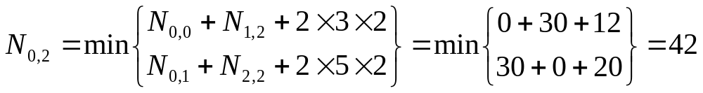
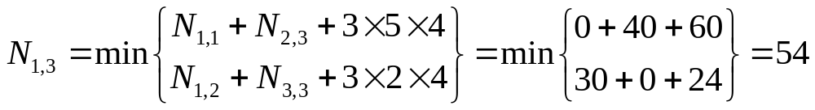
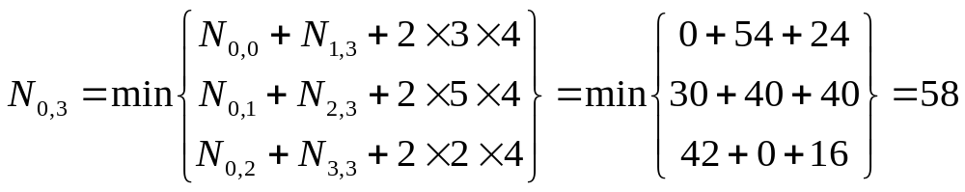
Walkthrough of an MCP Example
Quiz!
Product of A₀ (2×3), A₁ (3×5), A₂ (5×2), A₃ (2×4)
A₀
2×3
A₁
3×5
A₂
5×2
A₃
2×4
A₀
2×3
0 2×3 | 30 2×5 k=0 | 42 2×2 k=0 | 58 2×4 k=2
 | 0 3×5 | 30 3×2 k=1 | 54 3×4 k=2
 |  | 0 5×2 | 40 5×4 k=2
 |  |  | 0 2×4
A₁
3×5
A₂
5×2
A₃
2×4
Optimum value of k
(for back tracking)
Solution (after back tracking) ➔
(A₀A₁A₂)(A₃)=(A₀(A₁A₂))(A₃)

Slide 11
Exercise
Quiz!
Product of A₀ (2×3), A₁ (3×5), A₂ (5×2), A₃ (2×4), A₄ (4×1)
A₀
2×3
A₁
3×5
A₂
5×2
A₃
2×4
A₄
4×1
A₀
2×3
0 2×3 | 30 2×5 k=0 | 42 2×2 k=0 | 58 2×4 k=2 | 2×1 k=
 | 0 3×5 | 30 3×2 k=1 | 54 3×4 k=2 | 3×1 k=
 |  | 0 5×2 | 40 5×4 k=2 | 5×1 k=
 |  |  | 0 2×4 | 2×1 k=3
 |  |  |  | 0 4×1
A₁
3×5
A₂
5×2
A₃
2×4
A₄
4×1
Solution ➔

