Slide 1
Graphs
1843
ORD
SFO
802
337
1743
LAX
1233
DFW
Graphs
Notes:
Graphs

Slide 2
Graphs
A graph is a pair (V, E), where
  V is a set of nodes, called vertices
  E is a collection of pairs of vertices, called edges
Example:
  A vertex represents an airport and stores the three-letter airport code
  An edge represents a flight route between two airports and stores the mileage of the route
849
PVD
1843
ORD
142
SFO
802
LGA
337
1743
1387
HNL
2555
1099
LAX
1233
DFW
1120
MIA
Graphs

Slide 3
Edge Types
Directed edge
  ordered pair of vertices (u,v)
  first vertex u is the origin or source
  second vertex v is the destination
  e.g., a flight number
Undirected edge
  unordered pair of vertices (u,v)
  e.g., a flight mileage
Directed graph (digraph)
  all the edges are directed
Undirected graph
  all the edges are undirected
flight
AA 1206
ORD
PVD
849
miles
ORD
PVD
Graphs

Slide 4
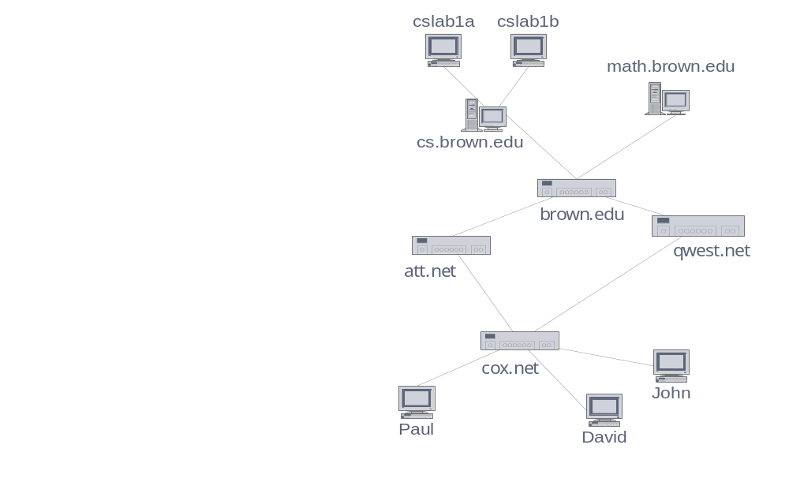
Applications
Electronic circuits
  Printed circuit board
  Integrated circuit
Transportation networks
  Highway network
  Flight network
Computer networks
  Internet
Social networks
  Facebook, line, etc.
Databases
  Entity-relationship diagram
六度分隔理論
Six degrees
of separation
Graphs

Slide 5
Terminology
End vertices (or endpoints) of an edge
  U and V are the endpoints of a
Edges incident on a vertex
  a, d, and b are incident on V
Adjacent vertices
  U and V are adjacent
Degree of a vertex
  X has degree 5
Parallel edges
  h and i are parallel edges
Self-loop
  j is a self-loop
V
a
b
h
j
U
d
X
Z
c
e
i
W
g
In-degree and out-degree
for digraphs
f
Y
Graphs

Slide 6
Terminology (cont.)
Path
  sequence of alternating vertices and edges
  begins with a vertex
  ends with a vertex
  each edge is preceded and followed by its endpoints
Simple path
  path such that all its vertices and edges are distinct
Examples
  P₁=(V,b,X,h,Z) is a simple path
  P₂=(U,c,W,e,X,g,Y,f,W,d,V) is a path that is not simple
V
a
b
P₁
d
U
X
Z
P₂
h
c
e
W
g
f
Y
Graphs

Slide 7
Terminology (cont.)
Cycle
  circular sequence of alternating vertices and edges
  each edge is preceded and followed by its endpoints
Simple cycle
  cycle such that all its vertices and edges are distinct
Examples
  C₁=(V,b,X,g,Y,f,W,c,U,a,↵) is a simple cycle
  C₂=(U,c,W,e,X,g,Y,f,W,d,V,a,↵) is a cycle that is not simple
V
a
b
d
U
X
Z
C₂
h
e
C₁
c
W
g
f
Y
Graphs

Slide 8
Properties
Property 1
  Σ_{v} deg(v) = 2m
  Proof: each edge is counted twice
Property 2
  In an undirected graph with no self-loops and no multiple edges
  m ≤ n (n − 1)/2
  Proof: each vertex has degree at most (n − 1)
What is the bound for a directed graph?
Notation
  n number of vertices
  m number of edges
  deg(v) degree of vertex v
Example
  n = 4
  m = 6
  deg(v) = 3
Graphs

Slide 9
Main Methods of the Graph ADT
Update methods
  insertVertex(o): insert a vertex storing element o
  insertEdge(v, w, o): insert an edge (v,w) storing element o
  eraseVertex(v): remove vertex v (and its incident edges)
  eraseEdge(e): remove edge e
Iterable collection methods
  incidentEdges(v): list of edges incident to v
  vertices(): list of all vertices in the graph
  edges(): list of all edges in the graph
Vertices and edges
  are positions
  store elements
Accessor methods
  e.endVertices(): a list of the two endvertices of e
  e.opposite(v): the vertex opposite of v on e
  u.isAdjacentTo(v): true iff u and v are adjacent
  *v: reference to element associated with vertex v
  *e: reference to element associated with edge e
Graphs

Slide 10
Data Structures for Graphs
Edge-list structure
Adjacency-list structure
Adjacency-matrix structure
Graphs

Slide 11
Edge-List Structure
Node
  element
  reference to position in node list
Edge
  element
  origin node
  destination node
  reference to position in edge list
Node list
  list of links to nodes
Edge list
  list of links to edges
u
a
c
b
d
v
w
z
Note list
u
v
w
z
Edge to
Node only
a
b
c
d
Edge list
Graphs

Slide 12
Adjacency-List Structure
Adjacency list
u➔v
v➔u➔w
w➔v
Incidence list for each node
  list of links to incident edges
Augmented edge
  references to positions in incidence list of end nodes
a
v
b
u
w
Note list
u
v
w
Incidence list
for each node
a
b
Graphs
Edge list

Slide 13
Adjacency-Matrix Structure
Augmented nodes
  Integer index associated with node
Adjacency matrix
  Reference to edge for adjacent nodes
The “old fashioned” matrix just has 0 for no edge and 1 for edge
a
v
b
u
w
0
u
1
v
2
w
 | 0 | 1 | 2
0 | ∅ |  | ∅
1 |  | ∅
2 | ∅ |  | ∅
a
b
Graphs

Slide 14
Performance
We shall stick to this structure!
n vertices, m edges no parallel edges no self-loops | Edge List | Adjacency List | Adjacency Matrix
Space | n + m | n + m | n²
v.incidentEdges() | m | deg(v) | n
u.isAdjacentTo(v) | m | min(deg(u), deg(v)) | 1
insertVertex(o) | 1 | 1 | n²
insertEdge(v, w, o) | 1 | 1 | 1
eraseVertex(v) | m | deg(v) | n²
eraseEdge(e) | 1 | 1 | 1
Assume V & E are stored in doubly linked lists
Create a new matrix
Graphs

