Slide 1
Heaps
2
5
6
9
7
© 2010 Goodrich, Tamassia
Heaps
Notes:
Heaps

Slide 2
Comparison
Stack
Queue
Priority queue
Heaps

Slide 3
Priority Queue ADT
A priority queue (PQ) stores a collection of entries
Typically, an entry is a pair
(key, value), where the key indicates the priority
Main methods of the Priority Queue ADT
  insert(e) inserts an entry e
  removeMin()
  removes the entry with smallest key
Additional methods
  min(), size(), empty()
Applications:
  Standby flyers
  Auctions
  Stock market
© 2010 Goodrich, Tamassia
Heaps

Slide 4

PQ Sorting
We use a priority queue
  Insert the elements with a series of insert operations
  Remove the elements in sorted order with a series of removeMin operations
The running time depends on the priority queue implementation:
  Unsorted sequence using selection sort: O(n²) time
  Sorted sequence using insertion sort: O(n²) time
Can we do better?
Algorithm PQ-Sort(S, C)
  Input sequence S, comparator C for the elements of S
  Output sequence S sorted in increasing order according to C
  P ← priority queue with comparator C
  while ¬S.empty ()
  e ← S.front(); S.eraseFront()
    P.insert (e, ∅)
  while ¬P.empty()
  e ← P.removeMin()
    S.insertBack(e)
© 2010 Goodrich, Tamassia
Heaps

Slide 5
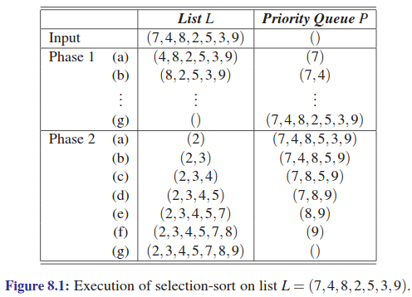
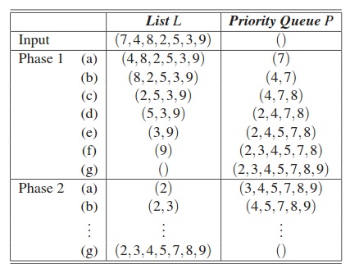
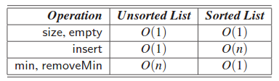
Two Paradigms of PQ Sorting
PQ via selection sort
PQ via insertion sort
Time complexity
© 2010 Goodrich, Tamassia
Heaps
Quiz!

Slide 6
Heaps
A heap is a binary tree storing keys at its nodes and satisfying the following properties:
Heap order: for every internal node v other than the root,
key(v) ≥ key(parent(v))
Complete binary tree: let h be the height of the heap
  for i = 0, … , h−1, there are 2^{i} nodes of depth i
  at depth h−1, the internal nodes are to the left of the external nodes
The last node of a heap is the rightmost node of maximum depth
Min heap
2
5
6
9
7
Be aware of complete BT
vs. perfect BT
last node
© 2010 Goodrich, Tamassia
Heaps
Notes:
Heaps

Slide 7

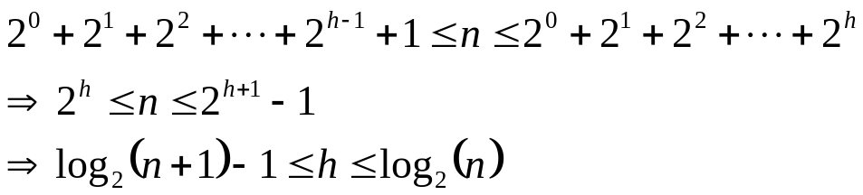
Height of a Heap
Theorem: A heap storing n keys has height O(log n)
Proof: (we apply the complete binary tree property)
  Let h be the height of a heap storing n keys
  There are 2^{i} keys at depth i = 0, … , h − 1 and at least one key at depth h ➔ n ≥ 1 + 2 + 4 + … + 2^{h−1} + 1 = 2^{h} ➔ h ≤ log n
Quiz!
depth
keys
0
1
1
2
h−1
2^{h−1}
h
1
© 2010 Goodrich, Tamassia
Heaps

Slide 8
Heaps and Priority Queues
We can use a heap to implement a priority queue
We store a (key, element) item at each internal node
We keep track of the position of the last node
For easy insertion
and deletion
(2, Sue)
(5, Pat)
(6, Mark)
(9, Jeff)
(7, Anna)
© 2010 Goodrich, Tamassia
Heaps

Slide 9
Insertion into a Heap
Three steps to insert an item of key k to the heap:
  Find the insertion node z (the new last node)
  Store k at z
  Restore the heap-order property (discussed next)
2
5
z
6
9
7
insertion node
2
5
6
z
9
7
1
© 2010 Goodrich, Tamassia
Heaps

Slide 10
Upheap
After insertion, the heap-order property may be violated
Algorithm upheap restores the heap-order property by swapping k along an upward path from the insertion node
Upheap terminates when the key k reaches the root or a node whose parent has a key smaller than or equal to k
Since a heap has height O(log n), upheap runs in O(log n) time
2
1
5
1
5
2
z
z
9
7
6
9
7
6
© 2010 Goodrich, Tamassia
Heaps

Slide 11
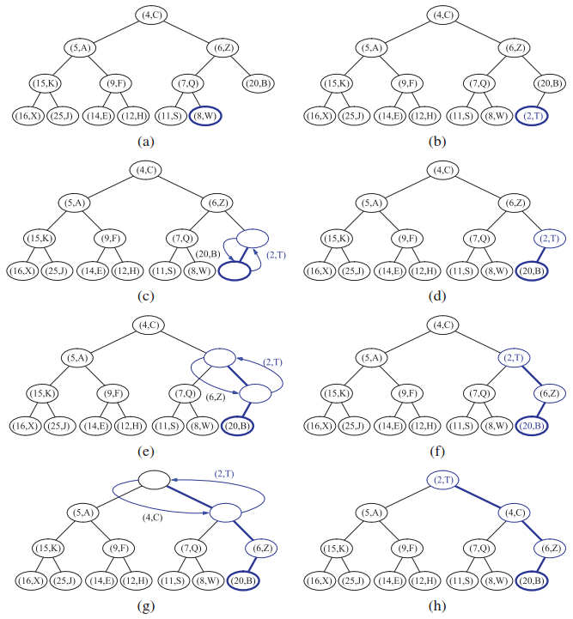
Upheap: More Example
Quiz!
Newly added node
Original last node
Up-heap
bubbling
© 2010 Goodrich, Tamassia
Heaps

Slide 12
Removal from a Heap (§ 7.3.3)
Three steps to remove the minimum from a heap:
  Replace the root key with the key of the last node w
  Remove w
  Restore the heap-order property (discussed next)
2
5
6
w
9
7
last node
7
5
w
6
9
new last node
© 2010 Goodrich, Tamassia
Heaps

Slide 13
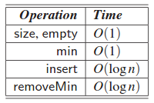
Downheap
After replacing the root key with the key k of the last node, the heap-order property may be violated
Algorithm downheap restores the heap-order property by swapping key k along a downward path from the root
Downheap terminates when key k reaches a leaf or a node whose children have keys greater than or equal to k
Since a heap has height O(log n), downheap runs in O(log n) time
7
5
5
w
6
7
w
6
9
9
Quiz!
© 2010 Goodrich, Tamassia
Heaps

Slide 14
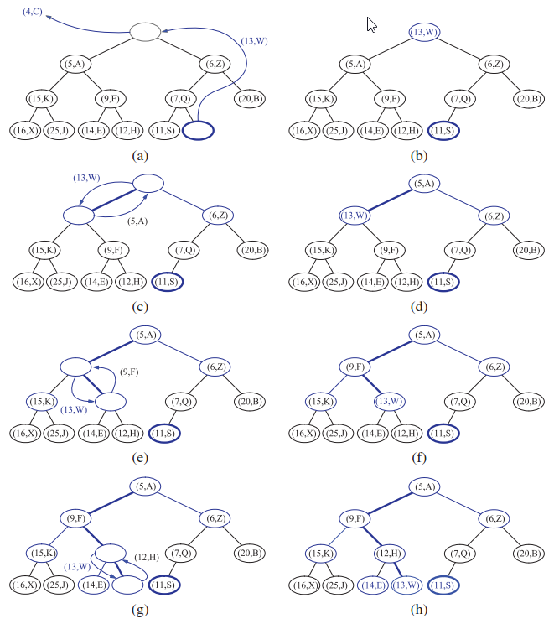
Downheap: More Example
Quiz!
Move the last
to top
Down-heap
bubbling
© 2010 Goodrich, Tamassia
Heaps

Slide 15
Summary of Basic Principle
For both “insertion” and “remove min”
  Keep heap as complete binary tree
  Restore heap order
Heaps

Slide 16
Quiz
Draw the min-heap tree after each operations:
  insert 7
  insert 4
  insert 1
  insert 5
  delete-min
  insert 9
  insert 2
  insert 3
  delete-min
  delete-min
Heaps

Slide 17
Locating the Node to Insert
For linked list based implementation of trees, the inserted node can be found by traversing a path of O(log n) nodes
  Go up until a left child or the root is reached
  If a left child is reached, go to the right child
  Go down left until a leaf is reached
Similar algorithm for updating the last node after a removal
This is easy for
vector-based heaps!
© 2010 Goodrich, Tamassia
Heaps

Slide 18

Heap Sort
Consider a priority queue with n items implemented by a heap
  the space used is O(n)
  methods insert and removeMin take O(log n) time
  methods size, empty, and min take time O(1) time
Heap-sort
  Sort a sequence of n elements in O(n log n) time using a heap-based PQ
  Much faster than quadratic sorting algorithms, such as insertion-sort and selection-sort
© 2010 Goodrich, Tamassia
Heaps

Slide 19
Vector-based Heap Implementation
We can represent a heap with n keys by means of a vector of length n + 1
For the node at index i
  the left child is at index 2i
  the right child is at index 2i + 1
Links between nodes are not explicitly stored
The cell of at index 0 is not used
Operation insert corresponds to inserting at index n+1
Operation removeMin corresponds to removing at index 1
Yields in-place heap-sort
2
5
6
9
7
2
5
6
9
7
0
1
2
3
4
5
© 2010 Goodrich, Tamassia
Heaps

Slide 20
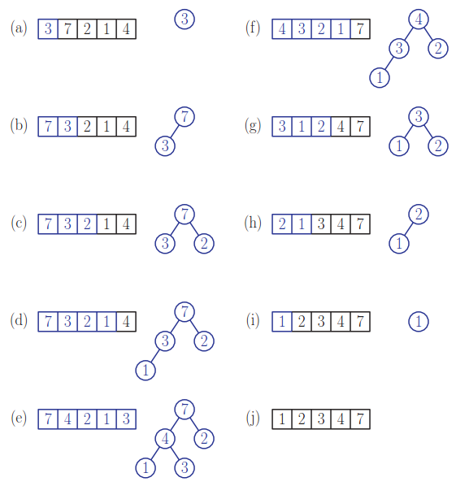
In-place Heap Sort
Quiz!
In heap
Sorted
Stage 1:
Heap
construction
Stage 2:
output
In heap
Sorted
Trick: It’s easier to
draw the tree first!
In heap
Sorted
In heap
Sorted
© 2010 Goodrich, Tamassia
Heaps
Max heap

Slide 21
Quiz
How to perform in-place heap sort for a given vector x=[3 8 5 1 9]
Heaps

Slide 22
Heap Sort Demo
Interactive demo of heap sort
  http://algoviz.org/OpenDSA/Books/OpenDSA/html/Heapsort.html#
Heaps

Slide 23
How to Merge Two Heaps
Given two heaps and a key k
Create a new heap with the root node storing k and the two heaps as subtrees
Perform downheap to restore the heap-order property
3
2
8
5
4
6
7
3
2
8
5
4
6
2
3
4
8
5
7
6
© 2010 Goodrich, Tamassia
Heaps

Slide 24

Bottom-up Heap Construction
Goal: Construct a heap of n keys using a bottom-up method with O(n) complexity
In phase i, pairs of heaps with 2^{i} −1 keys are merged into heaps with 2^{i+1}−1 keys
2^{i} −1
2^{i} −1
2^{i+1}−1
Only for linked list
based heaps!
© 2010 Goodrich, Tamassia
Heaps

Slide 25
Example
16
15
4
12
6
9
23
20
© 2010 Goodrich, Tamassia
Heaps

Slide 26
Example (contd.)
25
5
11
27
16
15
4
12
6
9
23
20
15
4
6
20
16
25
5
12
11
9
23
27
© 2010 Goodrich, Tamassia
Heaps

Slide 27
Example (contd.)
7
8
15
4
6
23
16
25
5
12
11
9
27
20
4
6
15
5
8
23
16
25
7
12
11
9
27
20
© 2010 Goodrich, Tamassia
Heaps

Slide 28
Example (end)
10
4
6
15
5
8
23
16
25
7
12
11
9
27
20
4
5
6
15
7
8
23
16
25
10
12
11
9
27
20
© 2010 Goodrich, Tamassia
Heaps

Slide 29

Analysis via Visualization
Cost of combining two heaps = Length of the path from the new root to its inorder successor (which goes first right and then repeatedly goes left until the bottom of the heap)
The path to inorder successor may differ from the downheap path.
Each node is traversed by at most two such paths ➔ Total number of nodes of the paths is 2(2^{h}-1)-h = O(n) ➔ Bottom-up heap construction runs in O(n) time
Faster than n successive insertions and speeds up the first phase of heap-sort
No. of internal nodes = 2^{h}-1
© 2010 Goodrich, Tamassia
Heaps

Slide 30
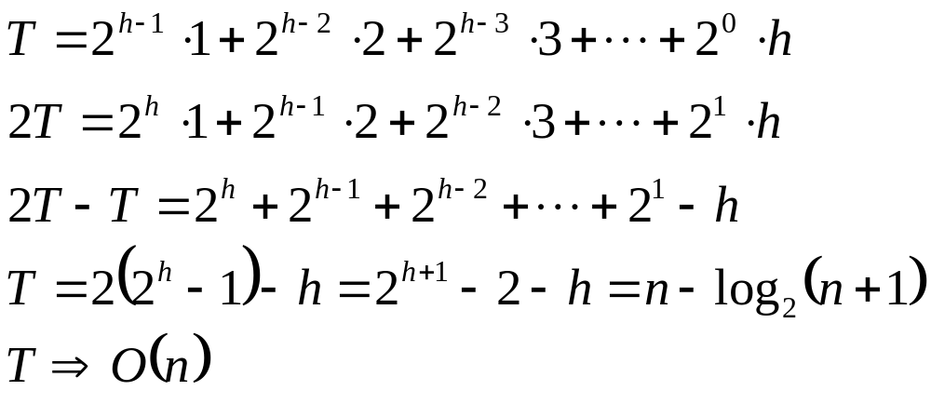
Analysis via Math
d=0
d=1
d=2
d=h-1
d=h
n=2^{h+1}-1
h=log₂(n+1)-1
© 2010 Goodrich, Tamassia
Heaps

Slide 31
Adaptable Priority Queues
New functions for
  Delete an arbitrary node
    Replace with the last one in heap
    Bubble down
  Update the key of an arbitrary node
    Bubble down or up depending on
      Difference in keys
      Min or max heaps
Heaps

