Slide 1
Hash Tables
0
∅
1
025-612-0001
2
981-101-0002
3
∅
4
451-229-0004
© 2010 Goodrich, Tamassia
Hash Tables
Notes:
Dictionaries

Slide 2
Maps in STL
Two types of maps in STL
  #include <map>
    Sorted keys
    Implementation based on trees
    Complexity in search: O(log(n))
  #include <unordered_map>
    Unsorted keys
    Implementation based on hash tables
    Complexity in search: O(1)
Aka associative arrays
© 2010 Goodrich, Tamassia
Hash Tables

Slide 3

Hash Functions and Hash Tables
Strings or numbers
Hash functions/tables: A common way to implement maps
A hash function h maps keys to integers in an interval [0, N - 1]
  Example: h(x) = x mod N is a hash function for integer keys
  The integer h(x) is called the hash value of key x
A hash table for a given key type consists of
  A hash function
  An array (aka bucket array, or table) of size N where we can store item (k, o) at index i = h(k)
Key
Data
© 2010 Goodrich, Tamassia
Hash Tables

Slide 4
Example
We design a hash table for a map storing entries as (SSN, Name), where SSN (social security number) is a ten-digit positive integer
Our hash table uses an array of size N = 10,000 and the hash function
h(x) = last four digits of x
0
∅
1
025-612-0001
2
981-101-0002
3
∅
4
451-229-0004
…
9997
∅
9998
200-751-9998
9999
∅
Another example:
Dispatch of quiz exam sheets
© 2010 Goodrich, Tamassia
Hash Tables

Slide 5

Hash Functions
Quiz!
A hash function is usually specified as the composition of two functions:
Hash code:
h₁: keys → integers
Compression function:
h₂: integers → [0, N − 1]
The hash function is then specified as h(x) = h₂(h₁(x)).
Goals of the hash function
  To “disperse” the keys as much as possible.
  To compute the result ASAP
Words for a dictionary
Size of the hash table
© 2010 Goodrich, Tamassia
Hash Tables

Slide 6
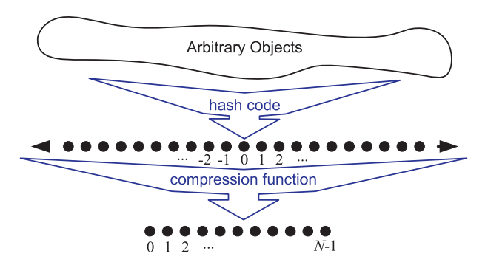
Two Steps in a Hash Function
Convert to an integer
Limit its range
In both steps, we need to avoid collision!
© 2010 Goodrich, Tamassia
Hash Tables

Slide 7

Hash Codes
Integer cast:
  Reinterpret the bits of the key as an integer
  Suitable for keys of length less than or equal to the number of bits of the integer type (e.g., byte, short, int and float in C++)
Component sum:
  Partition the bits of the key into components of fixed length (e.g., 16 or 32 bits) and sum the components (ignoring overflows)
  Suitable for numeric keys of fixed length greater than or equal to the number of bits of the integer type (e.g., long and double in C++)
???
tomorrow
tomorrow
Collisions from simple sum:
stop, tops, pots, spot
© 2010 Goodrich, Tamassia
Hash Tables

Slide 8
Hash Codes (cont.)
Polynomial hash code
  Partition the key into a vec. of components of fixed length (e.g., 8, 16 or 32 bits)
  a₀ a₁ … a_{n−1}
  Evaluate the polynomial
  p(z) = a₀+a₁ z +a₂ z²+ … +a_{n−1}z^{n−1}
  at a value z, ignoring overflow
  Especially suitable for strings (e.g., the choice z = 33 gives at most 6 collisions on a set of 50,000 English words)
Polynomial p(z) can be evaluated in O(n) time using Horner’s rule:
  Successively computation from the previous one in O(1) time
  p₀(z) = a_{n−1}
  p_{i} (z) = a_{n−i−1} + zp_{i−1}(z)
  (i = 1, 2, …, n −1)
  p(z) = p_{n−1}(z)
Quiz!
‘csie’ ➔ 99+115z+105z²+101z³
‘csie’ ➔ 99+(115+(105+101z)z)z
© 2010 Goodrich, Tamassia
Hash Tables
Ignore overflow!

Slide 9

Compression Functions
Most commonly used! (Quiz!)
Division method:
  h₂ (y) = |y| mod N
  The size N of the hash table is a prime to avoid collisions
  The reason has to do with number theory and is beyond the scope of this course
Multiply, Add and Divide (MAD):
  h₂ (y) = |ay + b| mod N
  a and b are nonnegative integers such that
  a mod N ≠ 0
  Otherwise, every integer would map to the same value b
What if y={200, 205, 210, 215, …, 600}
and N=100?
© 2010 Goodrich, Tamassia
Hash Tables

Slide 10

Collision Handling
Quiz!
Definition of collisions
  Different keys mapped to the same index
Two methods for collision handling
  Separate chaining
  Open addressing
Separate chaining
0
∅
1
025-612-0001
2
∅
Quiz!
3
∅
4
451-229-0004
981-101-0004
Each cell points to a linked list
➔ Requires extra memory
Quiz!
© 2010 Goodrich, Tamassia
Hash Tables

Slide 11
Map with Separate Chaining
Delegate operations to a list-based map at each cell:
Algorithm find(k):
return A[h(k)].find(k)
Algorithm put(k,v):
t = A[h(k)].put(k,v)
if t = null then {k is a new key}
n = n + 1
return t
Algorithm erase(k):
t = A[h(k)].erase(k)
if t ≠ null then {k was found}
n = n - 1
return t
© 2010 Goodrich, Tamassia
Hash Tables

Slide 12
Open Addressing
Open addressing: Place colliding item in another table cell
  Linear probing: Place in the next (circularly) available cell ➔ Tends to create lump causing a longer sequence of probes
  Quadratic probing
  Double hashing
Example of linear probing:
  h(k) = k mod 13
  Insert keys 18, 41, 22, 44, 59, 32, 31, 73
Quiz!
0
1
2
3
4
5
6
7
8
9
10
11
12
41
18
44
59
32
22
31
73
0
1
2
3
4
5
6
7
8
9
10
11
12
© 2010 Goodrich, Tamassia
Hash Tables

Slide 13

Search with Linear Probing
Consider a hash table A that uses linear probing
find(k)
  We start at cell h(k)
  We probe consecutive locations until one of the following occurs
    An item with key k is found, or
    An empty cell is found, or
    N cells have been unsuccessfully probed
Algorithm find(k)
i ← h(k)
p ← 0
repeat
c ← A[i]
if c = ∅
return null
else if c.key () = k
return c.value()
else
i ← (i + 1) mod N
  p ← p + 1
  until p = N
return null
© 2010 Goodrich, Tamassia
Hash Tables

Slide 14
Updates with Linear Probing
To handle insertions and deletions, we introduce a special marker object, called AVAILABLE, which replaces deleted elements
erase(k)
  Search for an entry with key k
  If such an entry (k, o) is found, replace it with the special item AVAILABLE and return element o
  Else, return null
put(k, o)
  Throw an exception if the table is full
  Start at cell h(k)
  Probe consecutive cells until one of the following occurs
    A cell i is found that is either empty or stores AVAILABLE ➔ put(k, o)
    N cells have been unsuccessfully probed ➔ Throw an exception
© 2010 Goodrich, Tamassia
Hash Tables

Slide 15

Double Hashing
Use a secondary hash function d(k) and handles collisions by placing an item in the first available cell of the series
(i + j*d(k)) mod N
for j = 0, 1, … , N − 1
The secondary hash function d(k) cannot have zero values
Common choice of the secondary hash function:
  d(k) = q − k mod q, where
  q is a prime and q < N
  The possible values for d(k) are 1, 2, … , q
i = h(k) = original hash value
© 2010 Goodrich, Tamassia
Hash Tables

Slide 16
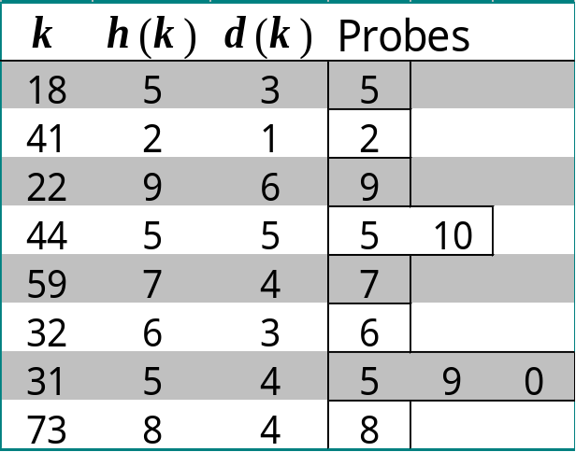
Example of Double Hashing
Consider a hash table storing integer keys that handles collision with double hashing
  N = 13
  h(k) = k mod 13
  d(k) = 7 − k mod 7
Insert keys 18, 41, 22, 44, 59, 32, 31, 73
(h(k)+1*d(k))
mod 13
(h(k)+1*d(k))
mod 13
HERE
(h(k)+2*d(k))
mod 13
0
1
2
3
4
5
6
7
8
9
10
11
12
Quiz!
31
41
18
32
59
73
22
44
0
1
2
3
4
5
6
7
8
9
10
11
12
© 2010 Goodrich, Tamassia
Hash Tables

Slide 17
Comparison of Collision Handling
Separate chaining
Open addressing
  Linear probing
    A[(i+j) mod N], j=0, 1, 2…
  Quadratic probing
    A[(i+j²) mod N], j=0, 1, 2…
  Double hashing
    A[(i+j*d(k)) mod N], j=0, 1, 2…
Most commonly use
if memory is big
i = h(k) = original hash value
© 2010 Goodrich, Tamassia
Hash Tables

Slide 18

Performance of Hashing
In the worst case, searches, insertions and removals on a hash table take O(n) time, which occurs when all the keys inserted into the map collide
The load factor α = n/N affects the performance of a hash table
Assuming that the hash values are like random numbers, it can be shown that the expected number of probes for an insertion with open addressing is 1/(1 − α)
The expected running time of all the dictionary ADT operations in a hash table is O(1)
In practice, hashing is very fast provided the load factor is not close to 100%
Applications of hash tables:
  small databases
  browser caches
Quiz!
© 2010 Goodrich, Tamassia
Reference
Hash Tables

Slide 19
Summary
Hash table
  Hash function
    Hash code
    Compression function
  Bucket array
Collision handling
  Separate chaining
  Open addressing
    Linear probing
    Quadratic probing
    Double hashing
© 2010 Goodrich, Tamassia
Hash Tables

