Slide 1
Shallow Copy
Jyh-Shing Roger Jang (張智星)
CSIE Dept, National Taiwan University

Slide 2
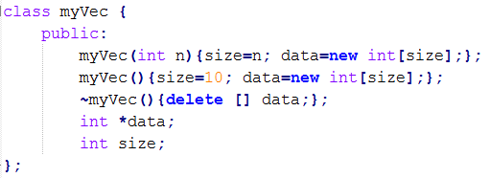

Memory Allocation in Classes
myVec b = a;
myVec b(a);
copy constructor
Common programming errors when using “new” for memory allocation in classes
Default copy constructor and assignment operator are based on “shallow copy”, which leads to errors easily.
We need to design our own constructor/operator.
Function overloading!
Double deletion!
Default copy constructor invoked
➔ Shared memory & double deletion! Quiz(Midterm)
Default assignment operator invoked
➔ Share memory, memory leak, and double deletion!
Quiz(Midterm)

Slide 3
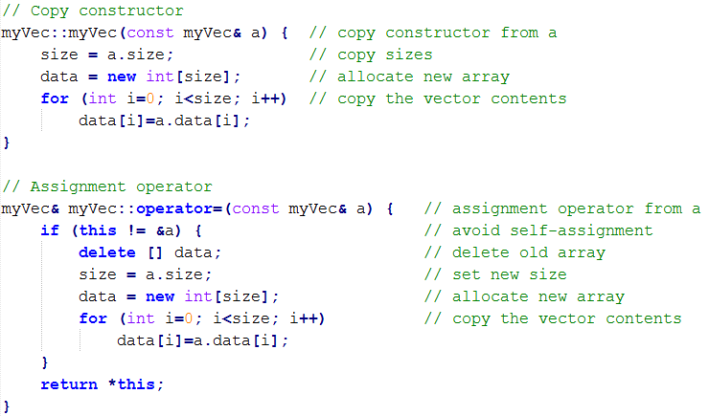
How to Fix “Shallow Copy”?
myVec& myVec::operator=() …
-> myVec& means return the reference of the “whole object”
To fix the problem of “shallow copy”
Define our own copy constructor
Define our own assignment operator
Avoid memory leak

Slide 4
Examples Which Fix “Shallow Copy”
Examples
shallowCopy00.cpp: Demo of shallow copy
deepCopy00.cpp: Use new copy constructor only
deepCopy01.cpp: Use new assignment operator only
deepCopy02.cpp: Use both
Lesson learned
If a class allocates memory via “new” (or the likes, such as “malloc” or “calloc”), we should provide a new copy constructor and a new assignment operator to allocate new memory for the created copy.

Slide 5
Q & A
Questions
How to avoid the error message (due to double deletion) in shallowCopy00.cpp?
If we use STL vectors, do we still the problem of “shallow copy”? ➔ Please give examples and post to FB.
Further studies
How to check memory leak?
Tools: Purify (Windows), Valgrind (Unix/Linux), Dr. Memory (both)
Please post on FB if you know other good tools to identify memory leak.
How to avoid memory leak?
Use STL (standard template library)

Slide 6
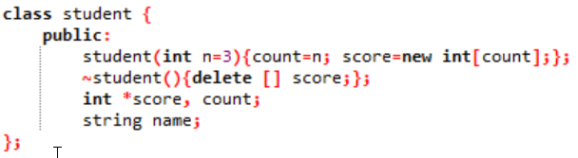
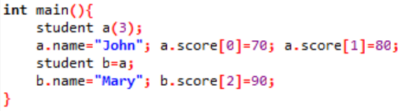
Quiz
A program is used to record each student’s quiz scores
Class definition:
Main program:
Quiz:
What are the contents of a and b?
What are the two potential problems of this program?
Shared memory & double deletion

Slide 7
const 放在變數前面或 function 外面
Inline 好處

