Slide 1
Standard Template Library: Vectors
Jyh-Shing Roger Jang (張智星)
CSIE Dept, National Taiwan University

Slide 2
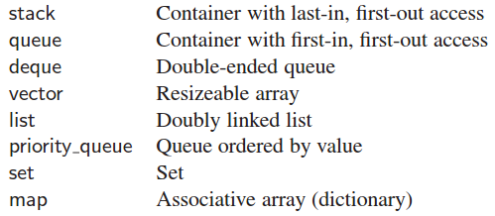
Intro. to Standard Template Library
Standard Template Library (STL)
A collection of useful classes for common data structures
STL provides data structures for standard containers
Each type of STL can store objects of any kinds.
FAQ for STL
http://cs.smu.ca/~porter/csc/ref/stl/faq.html

Slide 3
Strength and Weakness of STL vectors
Quiz!
Advantages of STL vectors (over standard C/C++ arrays)
Flexible element access
vec[i] ➔ No range check, but more efficient
vec.at(i) ➔ With range check
Dynamic growth of arrays
Memory are automatic allocated (and reallocated)
Less likely to have memory leak
No need to delete/free memory explicitly
Built-in methods for common array operations
Disadvantages of STL vectors
Not as efficient as standard C/C++ arrays
Comprehensive comparison
http://cs.smu.ca/~porter/csc/ref/stl/tutorial_intro.html

Slide 4
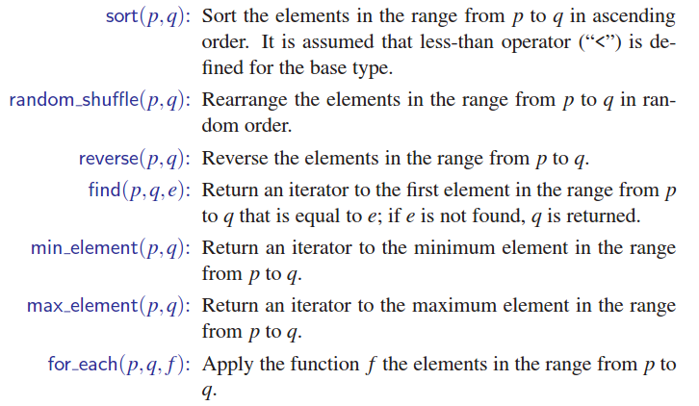
STL Vectors and Algorithms
#include <algorithm>

Slide 5
Examples of STL Vectors
Some example of STL vectors is here:
http://mirlab.org/jang/courses/dsa/example
Memory of STL vectors is allocated implicitly
You can reserve a vector of size n by “x.reserve(n)”.
You can keep on pushing back to go beyond n.
Once it go explodes, a new size of k*n is allocated implicitly.
Quiz: Given an STL vector x…
What does "x.reserve(25)" mean?
What is the difference between x[i] and x.at(i)?
What is the difference between x.size() and x.capacity()?
Compiler dependent!
Quiz!
Notes:
std::vector::reserve ➔ Request a change in capacity
http://www.cplusplus.com/reference/vector/vector/reserve/
std::vector::size ➔ Returns the number of elements in the vector.
http://www.cplusplus.com/reference/vector/vector/size
std::vector::capacity
➔ Returns the size of the storage space currently allocated for the vector, expressed in terms of elements.
http://www.cplusplus.com/reference/vector/vector/capacity/

Slide 6
Resources & References
Member functions of STL vectors
http://www.cplusplus.com/reference/vector/vector/
Algorithms that can be used for STL vectors
http://www.cplusplus.com/reference/algorithm
http://en.cppreference.com/w/cpp/algorithm
A comprehensive site for STL
http://cs.smu.ca/~porter/csc/ref/stl/
Check the list before you go!
Don’t reinvent the wheel!

