Slide 1
From C to C++
Jyh-Shing Roger Jang (張智星)
CSIE Dept, National Taiwan University

Slide 2
Enhancement of C++
Some features of C++ that are not part of C
Reference types
Function/operator overloading
Function/class templates
Exception handling
Default function arguments
Object-oriented programming
…
C++ shares C’s ability to deal efficiently with hardware at the level of bits, bytes, words, addresses, etc. ➔ C++ has grown to be a complex programming language!
It takes years to be a savvy C/C++ programmer!

Slide 3
Our First Few C++ Programs
First several examples of C++ programs of this course
http://mirlab.org/jang/courses/dsa/example
Let’s check out some examples…
More examples via Google
Google “c++ example vector unique”
Choices of compilers
Unix/Linux: g++
Mac: g++
Windows
Window’s bash (g++)
Dev C++ (g++.exe)
MS Visual Studio (cl.exe)
Examples are very important!

Slide 4
Pointers and Arrays
Do you know pointers in C?
Very dangerous! (But convenient!)
What could go wrong?
Confusing grammar
int* x, y, z; ➔ int *x, y, z;
Delete memory that has not been allocated
Double deletes are not allowed!
Check the availability of allocated memory
Memory leak (see next page)
Out-of-bound indexing for arrays (example)
For efficiency, C/C++ does not perform boundary checking!
Use STL vectors and vec.at() for safe (but inefficient) access.

Slide 5
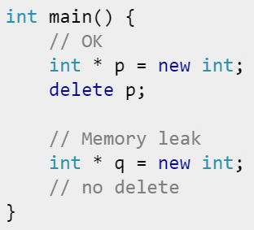
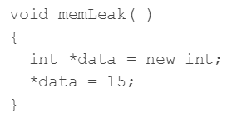
Memory Leak
Quiz!
Definition of memory leak
A memory leak occurs when you call “new” without calling a corresponding “delete” later.
How to avoid it?
C++: “new” and “delete” must appear in pairs!
C: “malloc” (or “calloc”, or “realloc”) and “free” must appear in pairs!
Example
Sometimes it’s not so obvious!
(See “shallow copy”.)
More examples!
Notes:
What is a memory leak in C++, and provide an example?
A memory leak occurs when a piece (or pieces) of memory that was previously allocated by a programmer is not properly deallocated by the programmer. Even though that memory is no longer in use by the program, it is still “reserved”, and that piece of memory can not be used by the program until it is properly deallocated by the programmer. That’s why it’s called a memoryleak – because it’s like a leaky faucet in which water is being wasted, only in this case it’s computer memory.
What problems can be caused by memory leaks?
The problem caused by a memory leak is that it leaves chunk(s) of memory unavailable for use by the programmer. If a program has a lot of memory that hasn’t been deallocated, then that could really slow down the performance of the program. If there’s no memory left in the program because of memory leaks, then that could of course cause the program to crash.

Slide 6
How to Tackle Memory Leak?
Good programming style
Delete/free pairs should appear in the same scope
Do not allocate memory in a function and free it outside.
Avoid shallow copy
…
Libraries
STL vectors
Smart pointers
…
Tools for debugging
Windows: Purify
Unix/linux: Valgrind
Google “avoid memory leak”…

Slide 7
Online Tutorials for C++
There are quite a few good online tutorials on C++
C++ tutorial at www.cplusplus.com
C++ tutorial at www.cprogramming.com
Do you think you know C/C++ already?
Deep C

