Slide 1
Two-Dimensional Arrays
Jyh-Shing Roger Jang (張智星)
CSIE Dept, National Taiwan University

Slide 2


Dynamically Allocated Matrices
How to create and delete a dynamically allocated matrix of n by m:
Create
Delete
Using STL vectors instead
Declare
Delete: do nothing
A 2D matrix of 3x5

Slide 3
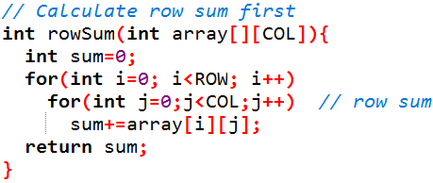
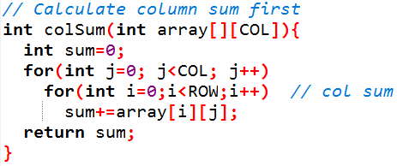
Two Ways to Compute Sum of Elements in a 2D Matrix
Quiz: Which is faster? Why?
Row sum. Numbers are stored in contiguous space, thus it’s faster.
Row sum first
Column sum first
Link to code
Add compiler optimization option:
-O0, -O2, -O3, -Ofast
Why do we need to specify the column size?
要將 col 傳進去
C++ 才知道要跳多少個
記憶體（因為 例如 3x5
的 2D Matrix 是連續的記憶體
告知 col 後，例如 array[2][3]
C++ 就知道是 2 * col + 3

Slide 4
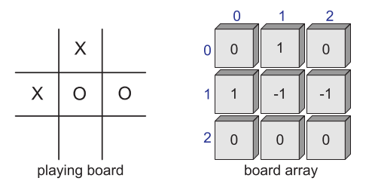
Example: Game of Tic-Tac-Toe
Examples
ticTacToe00.cpp
Observation
It quite easy to implement it as an interactive game.

