Slide 1
Insertion Sort
Jyh-Shing Roger Jang (張智星)
CSIE Dept, National Taiwan University

Slide 2
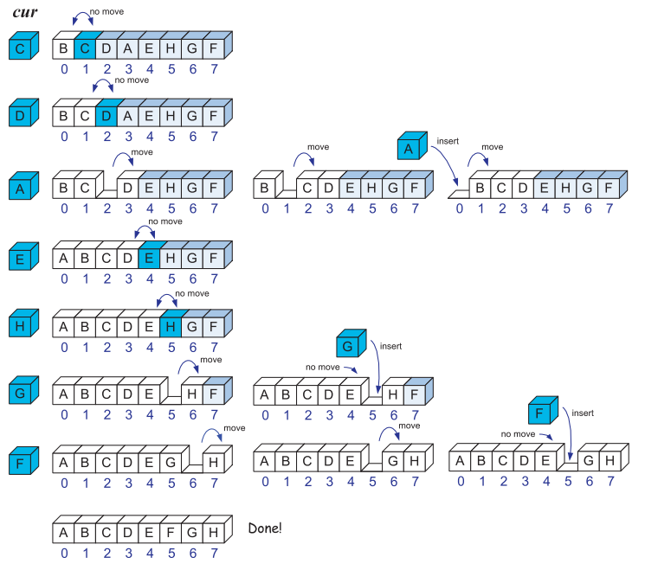
Insertion Sort
Animation of insertion sort
Flash, Youtube, …
Walk-through

Slide 3
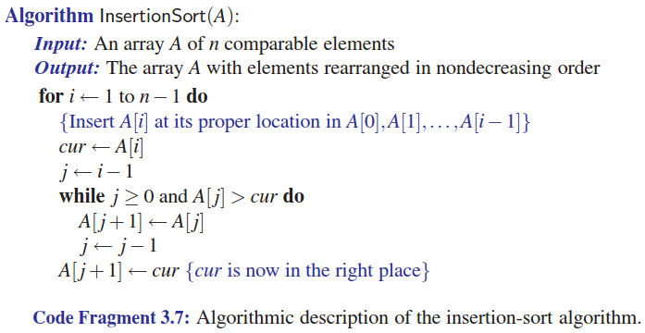
Insertion Sort: Pseudo Code
Pseudo code of insertion sort

Slide 4
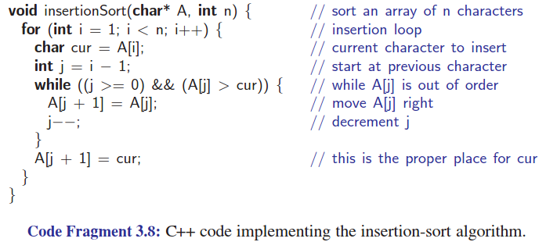
Insertion Sort: C++ Function
Real code in C++
Observations
Stable algorithm
To reduce comparisons ➔ Use binary search
To minimize movements ➔ Use another vector of pointers

Slide 5
Quiz for Insertion Sort
Show each step of insertion sort on the vector:
3 5 1 4 2 7 9 6 8

