Slide 1
Binary Search
Jyh-Shing Roger Jang (張智星)
CSIE Dept, National Taiwan University

Slide 2
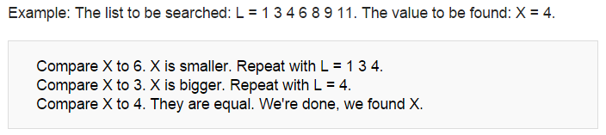
Binary Search Algorithm
Definition
  Find the position of a specified input key value within an array sorted by key value
Daily life example
  Find a specific page in a book (翻書找頁碼)
  Search for a word in a dictionary (從字典中找單字)
Numerical example
Keyword: Sorted!

Slide 3
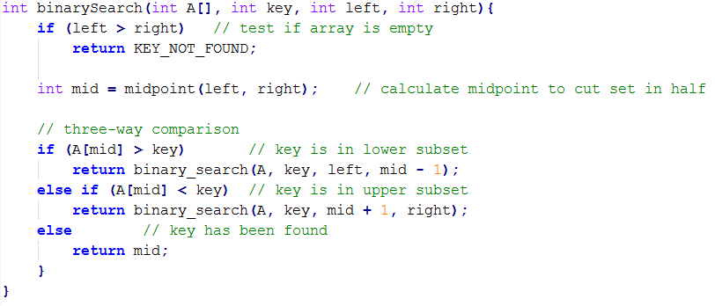
Recursive Function for Binary Search
left
mid
right
Recursive function
Example usage
  index = binarySearch(vec, key, 0, vec.size()-1)
Quiz: How to compute mid?
mid=(left+right)/2 ➔ Overflow risk!
mid=left+(right-left)/2 ➔ More reliable!

Slide 4
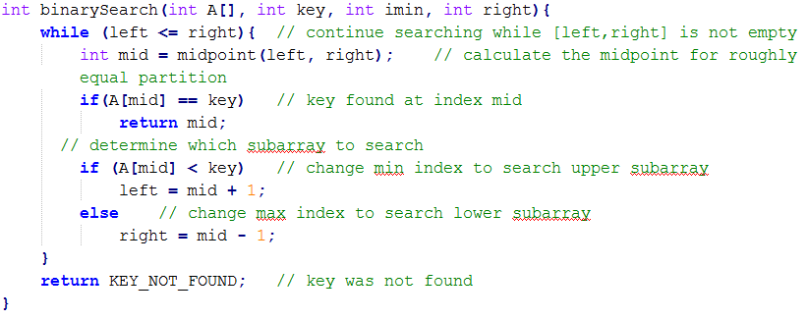
Iterative Function for Binary Search
Iterative function
Quiz: A better way to compute mid
➔ By interpolation

Slide 5
Summary
Comparisons
  Linear search
    Complexity O(n)
    For any unsorted arrays ➔ Fast when appending new elements Considerable speedup if frequently searched items are placed at the beginning
  Binary search
    Complexity O(log(n))
    For sorted arrays ➔ Slow when inserting new elements
  Hash search
    Complexity O(1)
    For arrays pre-processed by hash functions
Quiz!

Slide 6
Extensions
Other similar problems
  Interval finding (e.g., insertion sort)
    Given a sorted vector, find the interval of a given value.
  Non-zero element finding
    Given a sign-sorted vector, find the no. of positive elements.
Binary search using multiple keys
  Preprocessing stage: Stable-sort with multiple keys, starting from the least-significant key (LSK)
  Search stage: Binary search starting from the most-significant key (MSK)
Quiz!
7 c
4 d
9 d
4 b
7 a
7 a
4 b
7 c
4 d
9 d
4 b
4 d
7 a
7 c
9 d
MSK
LSK

Slide 7
Example of Binary Search with Multiple Keys
Quiz!
Preprocessing stage: Stable-sort data with multiple keys, starting from LSK
Search stage: Binary search starting from MSK
  Let’s search for (2012, 03, 29)
[Year, Month, Date]
MSK
LSK
2012, 03, 24
2012, 03, 18
2017, 12, 06
2010, 05, 21
2010, 05, 07
2018, 05, 15
2012, 03, 29
2017, 12, 06
2010, 05, 07
2018, 05, 15
2012, 03, 18
2010, 05, 21
2012, 03, 24
2012, 03, 29
2012, 03, 18
2012, 03, 24
2012, 03, 29
2010, 05, 07
2018, 05, 15
2010, 05, 21
2017, 12, 06
2010, 05, 07
2010, 05, 21
2012, 03, 18
2012, 03, 24
2012, 03, 29
2017, 12, 06
2018, 05, 15
Sort this column
Stable-sort this column
Stable sort this column

