Slide 1
Analysis Tools
Jyh-Shing Roger Jang (張智星)
CSIE Dept, National Taiwan University

Slide 2
Several Basic Functions
Polynomial
  Constant function
  Linear function
  Quadratic function
  Cubic function
Logarithm function
N-Log-N function
Exponential function

Slide 3
Family of Polynomials
Constant function
  f(n)=1
Linear function
  f(n)=n
Quadratic function
  f(n)=n²
Cubic function
  f(n)=n³
A general polynomials
  f(n)=a₀+a₁n+a₂n²+a₃n³+…+a_{d}n^{d}
n: problem size

Slide 4

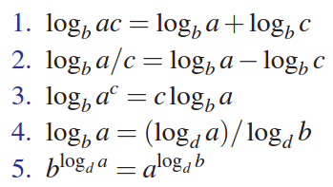
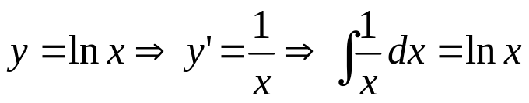
The Logarithm Function
f(n)=log₂(n)=log(n)
Definition of logarithm
Some identities
More…
The default base is 2.
The base is
e=2.718281828….

Slide 5
The N-Log-N Function
f(n)=n*log (n)

Slide 6
The Exponential Function
f(n)=a^{n}
Some identities (for positive a, b, and c)
  a^{(b+c)} = a^{b}a ^{c}
  a^{bc} = (a^{b})^{c}
  a^{b} /a^{c} = a^{(b-c)}
  b = a ^{log}_{a}^{b}
  b^{c} = a ^{c*log}_{a}^{b}

Slide 7
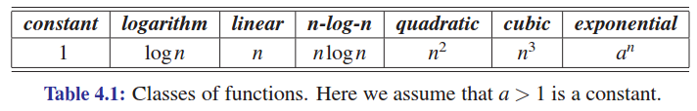
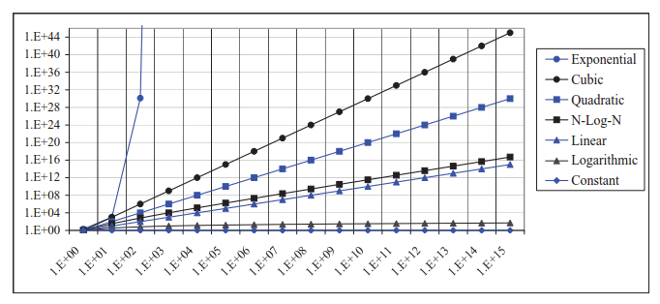

Growth Rate Comparisons
Log-log chart

Slide 8

Running Time
Most algorithms transform input objects into output objects.
The running time of an algorithm typically grows with the input size.
Average case time is often difficult to determine.
We focus on the worst case running time.
  Easier to analyze
  Crucial to applications such as games, finance and robotics
Sorting, for example

Slide 9

Performance Measurement via Experiments
Write a program implementing the algorithm
Run the program with inputs of varying size and composition
Use a function like clock() to get an accurate measure of the actual running time
Plot the results

Slide 10
Limitations of Experimental Studies
It is necessary to implement the algorithm, which may be difficult
Results may not be indicative of the running time on other inputs not included in the experiment.
In order to compare two algorithms, the same hardware and software environments must be used

Slide 11
Theoretical Performance Analysis
Uses a high-level description of the algorithm instead of an implementation
Characterizes running time as a function of the input size, n.
Takes into account all possible inputs
Allows us to evaluate the speed of an algorithm independent of the hardware/software environment

Slide 12

About Primitive Operations
Primitive operations
  Basic computations performed by an algorithm
  Identifiable in pseudocode
  Largely independent from the programming language
  Exact definition not important (we will see why later)
  Assumed to take a constant amount of time
Examples:
  Evaluating an expression
  Assigning a value to a variable
  Indexing into an array
  Calling a method
  Returning from a method

Slide 13
Counting Primitive Operations
By inspecting the pseudocode, we can determine the maximum number of primitive operations executed by an algorithm, as a function of the input size
Algorithm arrayMax(A, n)
# operations
currentMax ← A[0] 2
for i ← 1 to n − 1 do 2n
if A[i] > currentMax then 2(n − 1)
currentMax ← A[i] 2(n − 1)
{ increment counter i } 2(n − 1)
return currentMax 1
Total 8n − 2

Slide 14

Estimating Running Time
Algorithm arrayMax executes 8n − 2 primitive operations in the worst case. Define:
  a = Time taken by the fastest primitive operation
  b = Time taken by the slowest primitive operation
Let T(n) be worst-case time of arrayMax. Then
a (8n − 2) ≤ T(n) ≤ b(8n − 2)
Hence, the running time T(n) is bounded by two linear functions
Change the hardware environment only affects a and b.
The linear growth rate of the running time T(n) is an intrinsic property of algorithm arrayMax

Slide 15
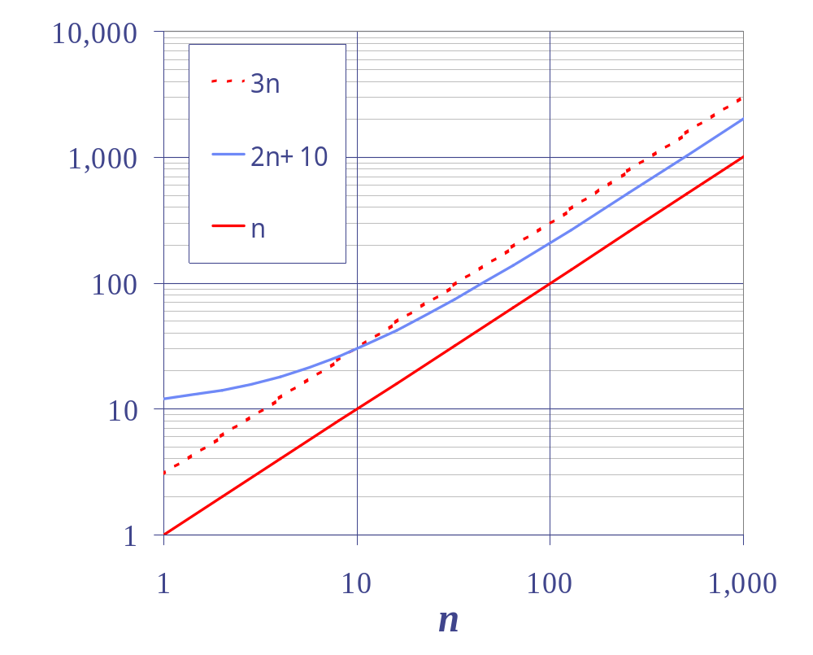
Big-Oh Notation
Given functions f(n) and g(n), we say that f(n) is O(g(n)) if there are positive constants
c and n₀ such that
f(n) ≤ cg(n) for n ≥ n₀
Example: 2n + 10 is O(n)
  2n + 10 ≤ cn
  (c − 2) n ≥ 10
  n ≥ 10/(c − 2)
  Pick c = 3 and n₀ = 10
g(n): basic functions
Quiz!
Log scale

Slide 16
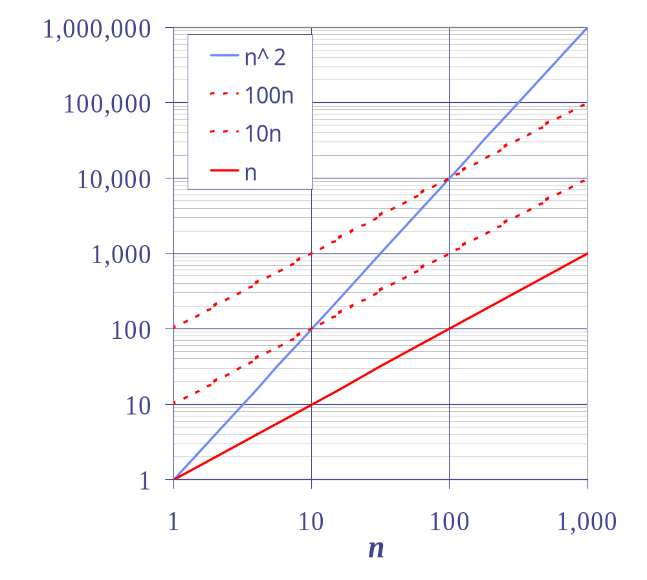
Big-Oh Example
Example: the function n² is not O(n)
  n² ≤ cn
  n ≤ c
  The above inequality cannot be satisfied since c must be a constant

Slide 17
More Big-Oh Examples
7n-2 is O(n)
  Need c > 0 and n₀ ≥ 1 such that 7n-2 ≤ c•n for n ≥ n₀
  This is true for c = 7 and n₀ = 1
3n³ + 20n² + 5 is O(n³)
  Need c > 0 and n₀ ≥ 1 such that 3n³ + 20n² + 5 ≤ c•n³ for n ≥ n₀
  This is true for c = 28 and n₀ = 1
3 log n + 5 is O(log n)
  Need c > 0 and n₀ ≥ 1 such that 3 log n + 5 ≤ c•log n for n ≥ n₀
  This is true for c = 8 and n₀ = 2
Quiz!

Slide 18
Big-Oh Rules
If is f(n) a polynomial of degree d, then f(n) is O(n^{d}), i.e.,
  Drop lower-order terms
  Drop constant factors
Use the smallest possible class of functions
  Say “2n is O(n)” instead of “2n is O(n²)”
Use the simplest expression of the class
  Say “3n + 5 is O(n)” instead of “3n + 5 is O(3n)”

Slide 19
Asymptotic Algorithm Analysis
The asymptotic analysis of an algorithm determines the running time in big-Oh notation
To perform the asymptotic analysis
  We find the worst-case number of primitive operations executed as a function of the input size
  We express this function with big-Oh notation
Example:
  We determine that algorithm arrayMax executes at most 8n − 2 primitive operations
  We say that algorithm arrayMax “runs in O(n) time”
Since constant factors and lower-order terms are eventually dropped anyhow, we can disregard them when counting primitive operations
That is, when n is big!

Slide 20
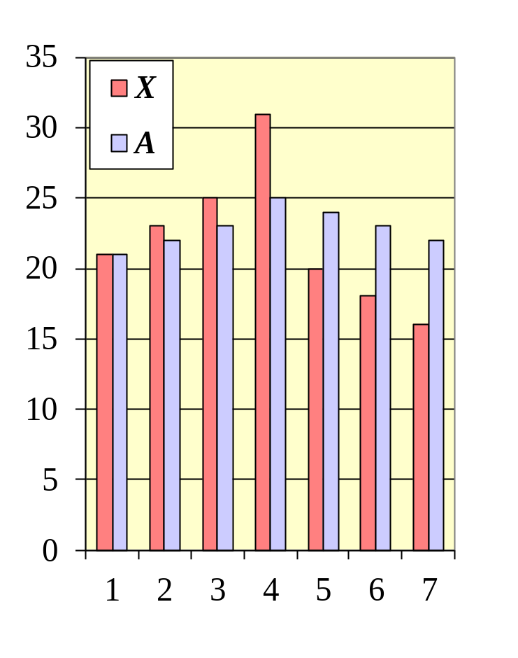
Computing Prefix Averages
We further illustrate asymptotic analysis with two algorithms for prefix averages
The i-th prefix average of an array X is average of the first (i + 1) elements of X:
A[i] = (X[0] + X[1] + … + X[i])/(i+1)
Computing the array A of prefix averages of another array X has applications to financial analysis

Slide 21
Prefix Averages (Quadratic)
The following algorithm computes prefix averages in quadratic time by applying the definition directly.
Algorithm prefixAverages1(X, n)
Input array X of n integers
Output array A of prefix averages of X #operations
A ← new array of n integers n
for i ← 0 to n − 1 do n
s ← X[0] n
for j ← 1 to i do 1 + 2 + …+ (n − 1)
s ← s + X[j] 1 + 2 + …+ (n − 1)
A[i] ← s / (i + 1) n
return A 1

Slide 22
Prefix Averages (Linear)
The following algorithm computes prefix averages in linear time by keeping a running sum
Algorithm prefixAverages2(X, n)
Input array X of n integers
Output array A of prefix averages of X #operations
A ← new array of n integers n
s ← 0 1
for i ← 0 to n − 1 do n
s ← s + X[i] n
A[i] ← s / (i + 1) n
return A 1

Slide 23
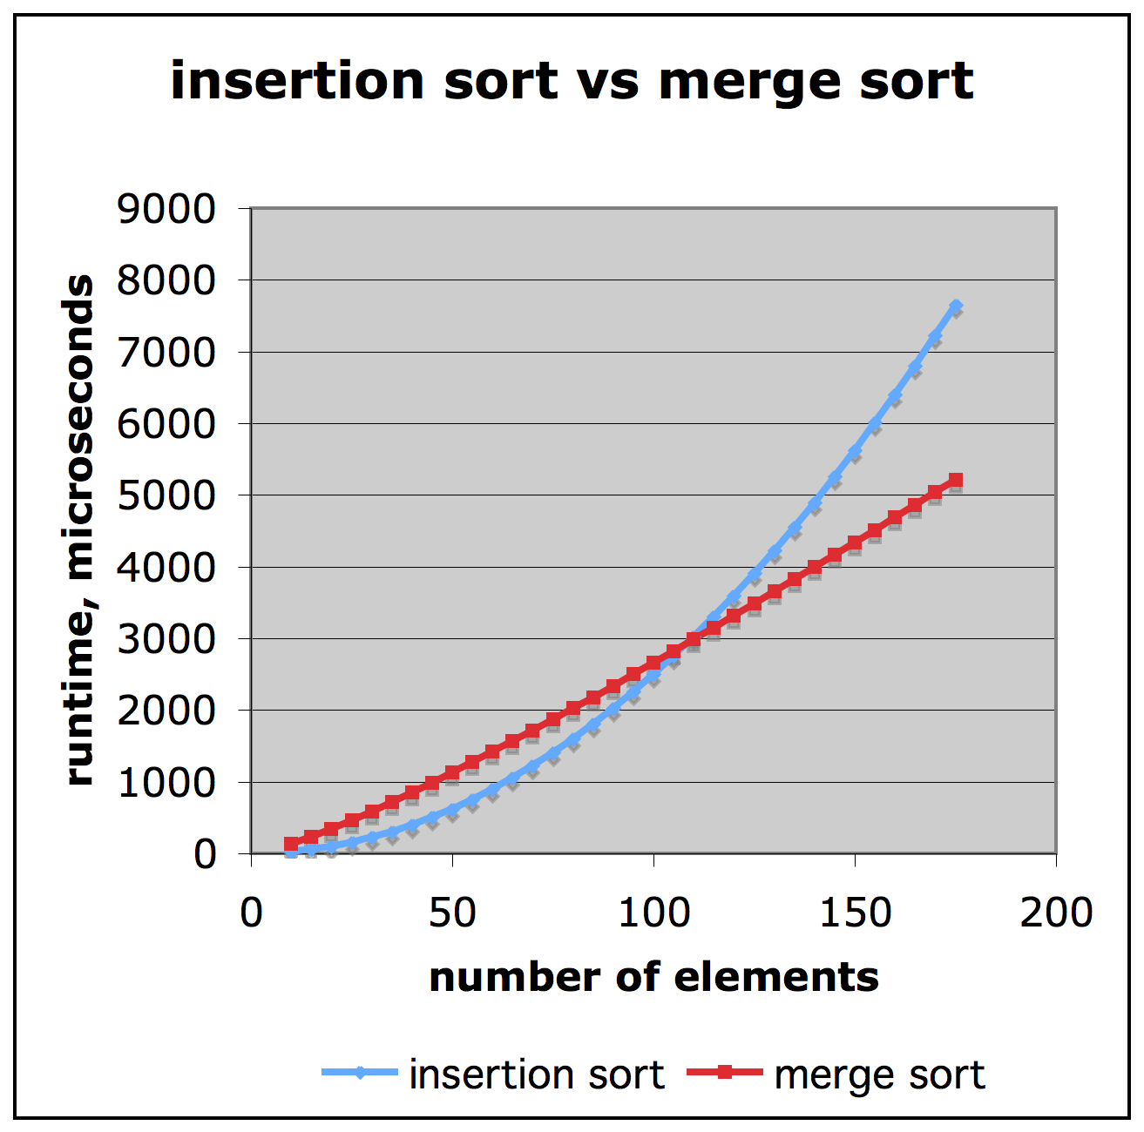
Comparison of Two Algorithms
Two sorting algorithms
  Merge sort is O(n log n)
  Insertion sort is O(n² )
To sort 1M items
  Insertion sort ➔ 70 hours
  Merge sort ➔ 40 seconds
For a faster machine
  Insertion sort ➔ 40 minutes
  Merge sort ➔ 0.5 seconds
Slide by Matt Stallmann

Slide 24
Relatives of Big-Oh
Big-Omega
  f(n) is Ω(g(n)) if there is a constant c > 0 and an integer constant n₀ ≥ 1 such that f(n) ≥ c•g(n) for n ≥ n₀
Big-Theta
  f(n) is Θ(g(n)) if there are constants c’ > 0 and c’’ > 0 and an integer constant n₀ ≥ 1 such that c’•g(n) ≤ f(n) ≤ c’’•g(n) for n ≥ n₀

Slide 25
Intuition for Asymptotic Notation
Big-Oh
  f(n) is O(g(n)) if f(n) is asymptotically less than or equal to g(n)
Big-Omega
  f(n) is Ω(g(n)) if f(n) is asymptotically greater than or equal to g(n)
Big-Theta
  f(n) is Θ(g(n)) if f(n) is asymptotically equal to g(n)

Slide 26
Example Uses of the Relatives of Big-Oh
5n² is Ω(n²)
  f(n) is Ω(g(n)) if there is a constant c > 0 and an integer constant n₀ ≥ 1 such that f(n) ≥ c•g(n) for n ≥ n₀ ➔ let c = 5 and n₀ = 1
5n² is O(n²)
  f(n) is Ω(g(n)) if there is a constant c > 0 and an integer constant n₀ ≥ 1 such that f(n) < c•g(n) for n ≥ n₀ ➔ let c = 5 and n₀ = 1
5n² is Θ(n²)
  f(n) is Θ(g(n)) if it is Ω(n²) and O(n²).

Slide 27


Computing Powers
To compute the power function p(x, n) = x^{n}
  Method 1
    n, n-1, n-2, …, 2, 1 ➔ O(n)
  Method 2
    n, n/2, n/4, … , 2, 1 ➔ O(log n)

Slide 28
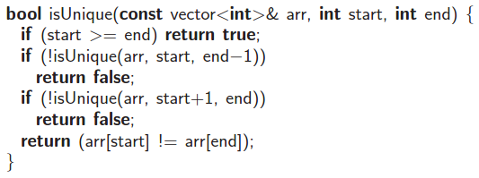
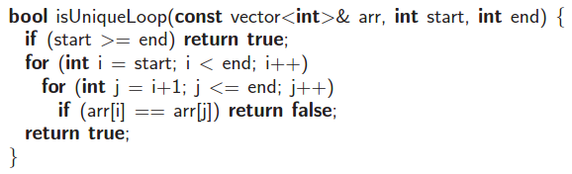
Element Uniqueness Problem (1/2)
To determine if the elements in a vector are all unique
  O(2^{n}) implementation by recursion
  O(n²) implementation by looping
  O(n log n) implementation

Slide 29
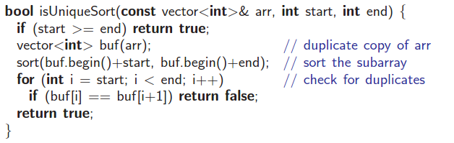
Element Uniqueness Problem (2/2)
To determine if the elements in a vector are all unique
  O(n log n) implementation ➔ Sort the vector first and check for neighboring duplicate elements
  A faster average-case running time can be achieved by using the hash table data structure (Section 9.2).
  O(n log n) implementation

Slide 30
How to Prove Statements
By giving counter example
  Roger claims that every number of the form 2^{i}-1 is a prime, where i is an integer greater than 1. Prove he is wrong.
By contrapositive: Switching the hypothesis and conclusion of a conditional statement and negating both.
  If p is true, then q is true ⬅➔ If q is not true, then p is not true
  If a*b is even, then a is even or b is even. ⬅➔ If a is odd and b is odd, then a*b is odd.
  Be aware of “DeMorgan’s Law”
By math induction
  Example: Prove that F(n)<2^{n}, where F(n) is the Fibonacci function with F(n+2)=F(n+1)+F(n), and F(1)=1, F(2)=2.

Slide 31
Exercise on Big Oh
Given functions f(n) and g(n), under what condition do we we say that f(n) is O(g(n))?
  Note that g(n) is one of the basic functions, such as n³.
  What is the physical meaning of the definition?
Use the definition of big oh to explain why 3n²+nlog(n)+2n+5log(n) is O(n²).

Slide 32
Exercise on Proof by Induction
Proof by induction
  Prove that F(n)<2^{n}, where F(n) is the Fibonacci function satisfying F(n+2)=F(n+1)+F(n), with F(1)=1, F(2)=2.
3 steps in proof by induction
  Base case
  Inductive Hypothesis
  Inductive Step
考試會考(exercise)

