Slide 1
Stacks
Stacks

Slide 2



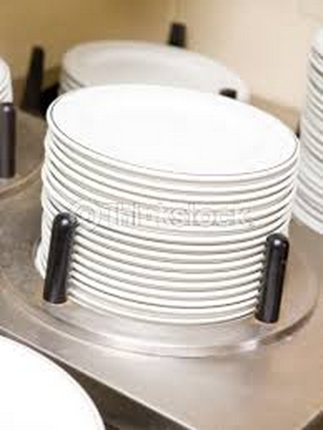
Stack
What is a stack?
  An ordered list where insertions and deletions occur at one end called the top.
  Also known as last-in-first-out (LIFO) list.
Examples
Stacks

Slide 3
Stack Representation
Given a stack S = (a₀, …, a_{n-1}), a₀ is the bottom element, a_{n-1} is the top element, and a_{i} is on top of element a_{i-1}, 0 < i < n.
a₃
a₃
a₂
a₂
a₁
a₁
a₀
a₀
Push (Add)
Pop (Delete)

Slide 4
Abstract Data Type (ADT)
ADT (abstract data type) is an abstraction of a data structure which specifies:
  Data stored
  Operations on the data
  Error conditions associated with operations
Example: ADT modeling a simple stock trading system
  The data stored are buy/sell orders
  The operations supported are
    order buy(stock, shares, price)
    order sell(stock, shares, price)
    void cancel(order)
  Error conditions:
    Buy/sell a nonexistent stock
    Cancel a nonexistent order
Stacks

Slide 5
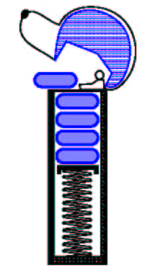
ADT of Stacks
Data
  Arbitrary objects
Operations
  push(object): inserts an element
  pop(): removes the last inserted element
  object top(): returns the last inserted element without removing it
  integer size(): returns the number of elements stored
  boolean empty(): indicates if no elements are stored
Exceptions (Error conditions)
  pop() and top() cannot be performed if the stack is empty.
  push(object) cannot be performed if the stack is full.
Stacks

Slide 6
Stack Interface in C++
template <typename E>
class Stack {
public:
int size() const;
bool empty() const;
const E& top() const
throw(StackEmpty);
void push(const E& e);
void pop() throw(StackEmpty);
}
C++ interface corresponding to our Stack ADT
Uses an exception class StackEmpty
Different from the built-in C++ STL class stack
No change in
member variables
(for compiler only)
More info about const:
http://tw.tonytuan.org/2010/03/c-constconst-pointer-pointer-to-const.html
Stacks

Slide 7
Applications of Stacks
No in textbook
Page-visited history in a web browser
Undo sequence in a text editor
Chain of method calls in the C++ run-time system
Infix to postfix conversion
Postfix expression evaluation
Parenthesis matching
HTML tag matching
Maze solution finding
No in textbook
No in textbook
Stacks

Slide 8
C++ Run-Time Stack
Program counter
The C++ run-time system keeps track of the chain of active functions with a stack
When a function is called, the system pushes on the stack a frame containing
  Local variables and return value
  Program counter, keeping track of the statement being executed
When the function ends, its frame is popped from the stack and control is passed to the function on top of the stack
Allows for recursion
main() {
int i = 5;
foo(i);
}
foo(int j) {
int k;
k = j+1;
bar(k);
}
bar(int m) {
…
}
bar
PC = 1
m = 6
foo
PC = 3
j = 5
k = 6
main
PC = 2
i = 5
Stacks

Slide 9
Array-based Stack
A simple way of implementing the Stack ADT uses an array
We add elements from left to right
A variable keeps track of the index of the top element
Algorithm size()
return t + 1
Algorithm pop()
if empty() then
throw StackEmpty
else
t ← t − 1
return S[t + 1]
…
S
0
1
2
t
Stacks

Slide 10
Array-based Stack (cont.)
The array storing the stack elements may become full
A push operation will then throw a StackFull exception
Algorithm push(obj)
if t = S.size() − 1 then
throw StackFull
else
t ← t + 1
S[t] ← obj
…
S
0
1
2
t
Stacks

Slide 11
Performance and Limitations
Performance
  Let n be the number of elements in the stack
  The space used is O(n)
  Each operation runs in time O(1)
Limitations
  The maximum size of the stack must be defined a priori and cannot be changed
  Trying to push a new element into a full stack causes an implementation-specific exception
Stacks

Slide 12
Array-based Stack in C++
template <typename E>
class ArrayStack {
private:
E* S; // array holding the stack
int cap; // capacity
int t; // index of top element
public:
// constructor given capacity
ArrayStack( int c) :
S(new E[c]), cap(c), t(-1) { }
void pop() {
if (empty()) throw StackEmpty
(“Pop from empty stack”);
t--;
}
void push(const E& e) {
if (size() == cap) throw
StackFull(“Push to full stack”);
S[++ t] = e;
}
… (other methods of Stack interface)
Stacks

Slide 13
Example use in C++
* indicates top
ArrayStack<int> A; // A = [ ], size = 0
A.push(7); // A = [7*], size = 1
A.push(13); // A = [7, 13*], size = 2
cout << A.top() << endl; A.pop(); // A = [7*], outputs: 13
A.push(9); // A = [7, 9*], size = 2
cout << A.top() << endl; // A = [7, 9*], outputs: 9
cout << A.top() << endl; A.pop(); // A = [7*], outputs: 9
ArrayStack<string> B(10); // B = [ ], size = 0
B.push("Bob"); // B = [Bob*], size = 1
B.push("Alice"); // B = [Bob, Alice*], size = 2
cout << B.top() << endl; B.pop(); // B = [Bob*], outputs: Alice
B.push("Eve"); // B = [Bob, Eve*], size = 2
Stacks

Slide 14
Parentheses Matching
Each “(”, “{”, or “[” must be paired with a matching “)”, “}”, or “[”
  correct: ( )(( )){([( )])}
  correct: (( )(( )){([( )])})
  incorrect: (( ))){([( )])}
  incorrect: ({[ ])}
  incorrect: (([])
Stacks

Slide 15
Parentheses Matching Algorithm
Algorithm ParenMatch(X,n):
Input: An array X of n tokens, each of which is either a grouping symbol, a
variable, an arithmetic operator, or a number
Output: true if and only if all the grouping symbols in X match
Let S be an empty stack
for i=0 to n-1 do
if X[i] is an opening grouping symbol then
S.push(X[i])
else if X[i] is a closing grouping symbol then
if S.empty() then
return false {nothing to match with}
if S.pop() does not match the type of X[i] then
return false {wrong type}
if S.empty() then
return true {every symbol matched}
else return false {some symbols were never matched}
© 2010 Goodrich, Tamassia
Stacks

Slide 16
Expression Evaluation
Expressions are converted into postfix notation for evaluation
  Infix ➔ A/B–C+D*E–A*C
  Postfix ➔ AB/C-DE*+AC*-
Operation | Postfix
T₁ = A / B | T₁C-DE*+AC*-
T₂ = T₁ - C | T₂ DE*+AC*-
T₃ = D * E | T₂T₃+AC*-
T₄ = T₂ + T₃ | T₄AC*-
T₅ = A * C | T₄ T₅ -
T₆ = T₄ - T₅ | T₆
Stacks

Slide 17
Postfix Notation
Quiz!
Advantages of postfix notation
  No need to use parentheses
  No need to consider precedence of operators
Two questions
  How to change infix notation into postfix notation?
  How to evaluate an expression in postfix notation?
Stacks

Slide 18
Infix to Postfix Conversion by Hand
Three-pass algorithm:
(1) Fully parenthesize expression
a / b - c + d * e - a * c ➔
((((a / b) - c) + (d * e)) - a * c))
(2) All operators replace their corresponding right parentheses.
((((a / b) - c) + (d * e)) – (a * c)))
(3) Delete all parentheses.
ab/c-de*+ac*-

Slide 19
Rules of Conversion
Two rules
  Operators are taken out of the stack as long as their precedence is higher than or equal to the precedence of the incoming operator.
  The left parenthesis is placed in the stack whenever it is found in the expression, but it is unstacked only when its matching right parenthesis is found.
Stacks

Slide 20
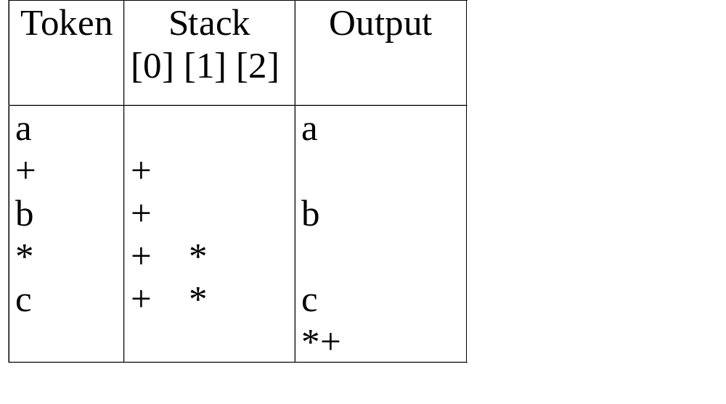
Example: Infix to Postfix
The order of operands in infix and postfix are the same.
a+b*c ➔ abc*+

Slide 21
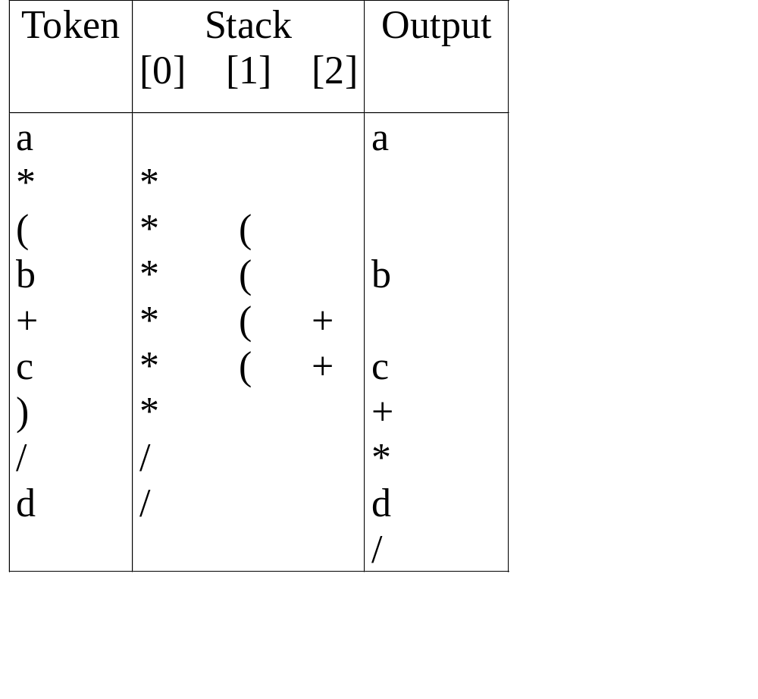
Example: Infix to Postfix
a*(b+c)/d ➔ abc+*d/
Quiz!

Slide 22
More Examples
Quiz!
Infix
Postfix
2+3*4
234*+
a*b+5
ab*5+
(1+2)*7
12+7*
a*b/c
ab*c/
(a/(b-
c+d))*(e-a)*c
abc-d+/
ea-
*c*
a/b-
c+d*e-
a*c
ab/c-
de*+ac*-
Stacks

Slide 23
Walk-through Examples
Quiz!
a/b-c+d*e-a*c ➔ ab/c-de*+ac*-
(a/(b-c+d))*(e-a)*c ➔ abc-d+/ea-*c*

Slide 24
More Examples
Quiz!
(a+b)*(c-d)/(e+f) ➔ ab+cd-*ef+/
(a+b)*(c-d)/((e-f)*(g+h)) ➔ ab+cd-*ef-gh+*/

Slide 25
Evaluating postfix expressions
O(n)
Evaluation process
  - Make a single left-to-right scan of the expression.
  - Place the operands on a stack until an operator is found.
  - Remove, from the stack, the correct numbers of operands for the operator, perform the operation, and place the result back on the stack.

Slide 26
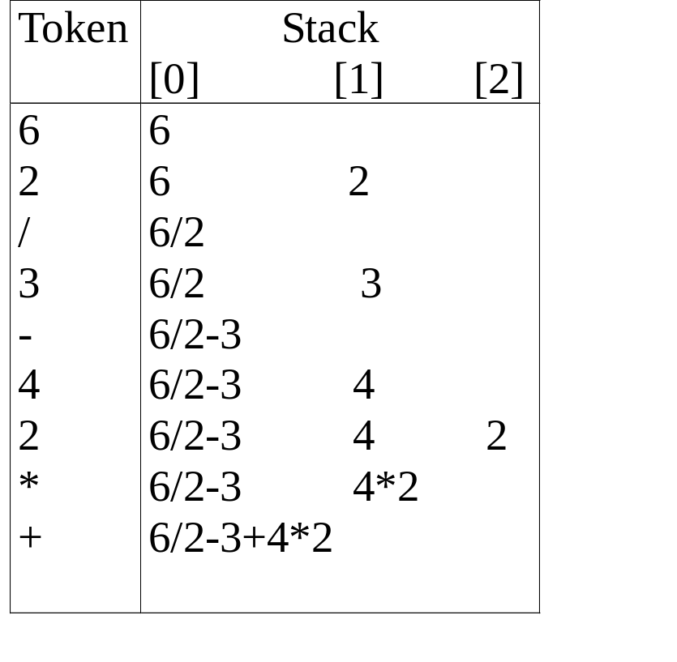
Example of Evaluating postfix expressions
Example: 6 2 / 3 – 4 2 * +

Slide 27
Walk-through Examples
a/b-c+d*e-a*c ➔ ab/c-de*+ac*-
(a/(b-c+d))*(e-a)*c ➔ abc-d+/ea-*c*

Slide 28
Animation
Animation
  Infix to postfix conversion
  Postfix evaluation

