Slide 1
Queues
Jyh-Shing Roger Jang (張智星)
CSIE Dept, National Taiwan University

Slide 2


Queue
What is a queue?
  An ordered list where insertions occur at the rear while deletions occur at the front.
  Also known as FIFO (first-in-first-out) list.
Real-world examples

Slide 3

ADT OF QUEUES
Data
  Arbitrary objects
Operations
  enqueue(object): inserts an element at the end
  dequeue(): removes the element at the front
  object front(): returns the element at the front without removing it
  integer size(): returns the number of elements stored
  boolean empty(): indicates whether no elements are stored
Exceptions
  dequeue() and front() cannot be performed if the queue is empty.
  enqueue(object) cannot be performed if the queue is full.

Slide 4
Array-based Queues
To avoid
element movement
Use an array of size N in a circular fashion
Three variables keep track of the front and rear
  f: index of the front element
  r: index immediately past the rear element
  n: number of items in the queue
normal configuration
Q
0
1
2
f
r
wrapped-around configuration
Q
0
1
2
r
f

Slide 5
Queue Interface in C++
C++ interface corresponding to our Queue ADT
Requires the definition of exception QueueEmpty
Different from the built-in C++ STL class queue
template <typename E>
class Queue {
public:
int size() const;
bool empty() const;
const E& front() const
throw(QueueEmpty);
void enqueue (const E& e);
void dequeue()
throw(QueueEmpty);
};

Slide 6
Queue Operations
Algorithm size()
return n
Algorithm empty()
return (n == 0)
Algorithm enqueue(o)
if size() = N − 1 then
throw QueueFull
else
Q[r] ← o
r ← (r + 1) mod N
n ← n + 1
Why
not N?
Algorithm dequeue()
if empty() then
throw QueueEmpty
else
f ← (f + 1) mod N
n ← n − 1
Modulo operator
(“%” in C/C++)

Slide 7

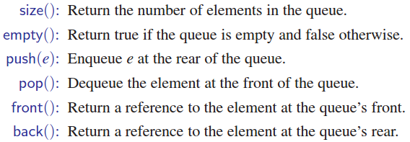
STL Queue
STL provides an implementation of a queue
  Based on the STL vector class
  Declaration
  Operators
No exception is thrown
if something
goes wrong!
Extra for queues!

Slide 8
Operation Output Q
enqueue(5) – (5)
enqueue(3) – (5, 3)
dequeue() 5 (3)
enqueue(7) – (3, 7)
dequeue() 3 (7)
front() 7 (7)
dequeue() 7 ()
dequeue() “error” ()
isEmpty() true
enqueue(9) – (9)
enqueue(7) – (9, 7)
size() 2 (9, 7)
enqueue(3) – (9, 7, 3)
enqueue(5) – (9, 7, 3, 5)
dequeue() 9 (7, 3, 5)

Slide 9
Other Implementation of Queues
We can also use linked lists to implement queues
  Do not require contiguous memory
  More codes for pointer manipulation
  See textbook for more info.

Slide 10
Applications of Queues
Access to shared resources
  Printer
  Requests received at a web server
Breadth-first search (BFS) for graph traversal
Many, many more…
Quiz!

