Slide 1
Charles De Barros
Data Analyst
Data drives the modern world. Let me help you drive your data.

Slide 2
About me
I am a recent Bootcamp Graduate Junior Data Analyst with a passion for the Environmental, Educational, and Scientific areas. I have a curious personality always in search of new angles to look at things and fresh approaches to deal with challenges. I possess an organised analytical and logical mind, attentive to details and patterns. As a former secondary school teacher, I also enjoy being in front of an audience explaining things in a very clear format. A good narrative is key.
I am a former Ruby on Rails web developer with experience in SQL/PostgreSQL databases, Python and JavaScript.
I enjoy experimenting with new technologies and discovering new insights. I strive to learn something new daily. I am a highly motivated professional with plenty of initiative; my thirst for learning new things is my daily driving motivation.
My goals are to be the best professional I can be, and use data to help companies become more efficient and exceed their targets.

Slide 3
Me online
E-mail: charlesdebarros@outlook.com
LinkedIn: https://www.linkedin.com/in/charlesdebarros/
GitHub: https://github.com/charlesdebarros
Website: https://charlesdebarros.hashnode.dev
My CV: See it here

Slide 4
MY Skills set
I am very fortunate to have studied in amazing places, lived in amazing countries, and worked with outstanding companies and people. Here are some of the many skills I have acquired throughout the years.
Excel, Power BI, Tableau
Power Query, Pivot Tables
Data visualisation & storytelling
Python, Ruby, Ruby on Rails
SQL, PostgreSQL, Databases
Analytical, Logical and Critical thinking
Self-motivated with Initiative
Creative and Problem Solving
Communication and Public Speaking
Resourceful and Resilient

Slide 5
The power of data
Business can be built on a combination of inspiration and perspiration but consistent good use of Data Analytics can give any business the edge in predicting and reducing waste, finding areas for improvement, fine-tuning target audiences, finding new customers, investigating potential new funding/investment and the most beneficial ways to deploy them, and so on. The possibilities are endless.
Efficient use of Data can help your company with:
Evidence-based decision-making;
Testing your decisions;
Perfecting target audiences;
Making the best use of available information;
Attracting new talent and investment;

Slide 6
A sample Project
UK Road Safety 2020-2021

Slide 7
UK Road Safety 2020-2021
I have based my research on data from UK’s Department for Transport. I investigated and found patterns and trends in Road Safety in various Local Authorities across the country.
Analysing over 350k rows of data, I saw patterns of how likely and when road accidents happened; from time of the day to weather patterns; from road types, road surface conditions to speed limits.
An interesting point was the reasonably sharp increase in accident numbers in February 2020, right after the lockdown restrictions were lifted.

Slide 8
UK Road Safety 2020-2021
The Process
Defining the Question
Collecting the data
Cleaning the Data
Analysing the Data
Presenting the Data
I also used a S.M.A.R.T (specific, measurable, assignable, realistic, and time-related) approach while working with the data gathered.

Slide 9
UK Road Safety 2020-2021
Defining the Question
What were the key factors involved in the increase in the number of road casualties in the UK between 2020 and 2021?

Slide 10
KEY PERFORMANCE Indicators (kpiS)
UK Road Safety 2020-2021
Primary KPI
The total number of casualties from Jan 2021 to Dec 2022 in the United Kingdom
Breakdown Total Casualties into categories Fatal, Serious, and Slight categories
Display quantities and the percentual representation of each category
Secondary KPIs
Break down casualties numbers into subcategories such as vehicle type, speed limits, road types, road surface conditions, time of the day, and urban or rural areas.
Display monthly trends comparing numbers from 2021 and 2022

Slide 11
UK Road Safety 2020-2021
Collecting the data
I have looked at different resources to gather the data I needed to help me answer my proposed question. Two critical criteria were always on my mind: the data must be reliable and accurate.
I download the data from The UK’s Department for Transport Custom Data Download tool. Due to restrictions on the number of items to be selected at one time, five at most, I had to download three ODS (OpenData Spreadsheet) files and combine them into a single Excel workbook.

Slide 12
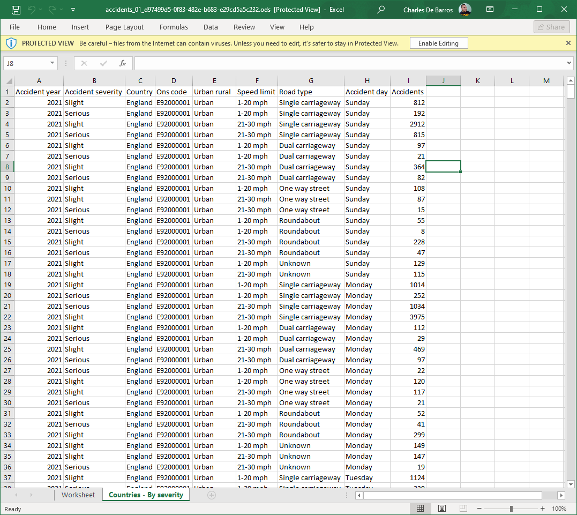
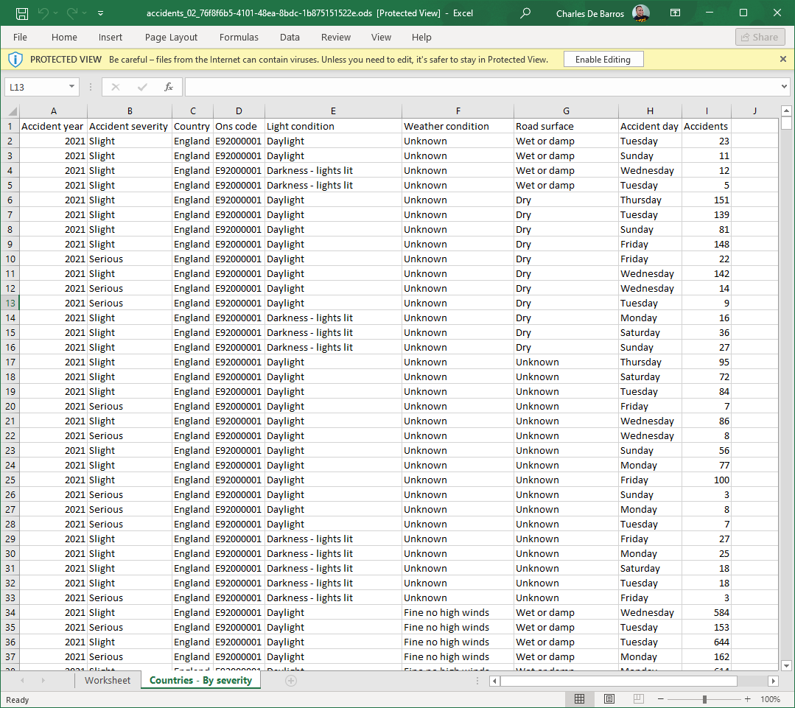
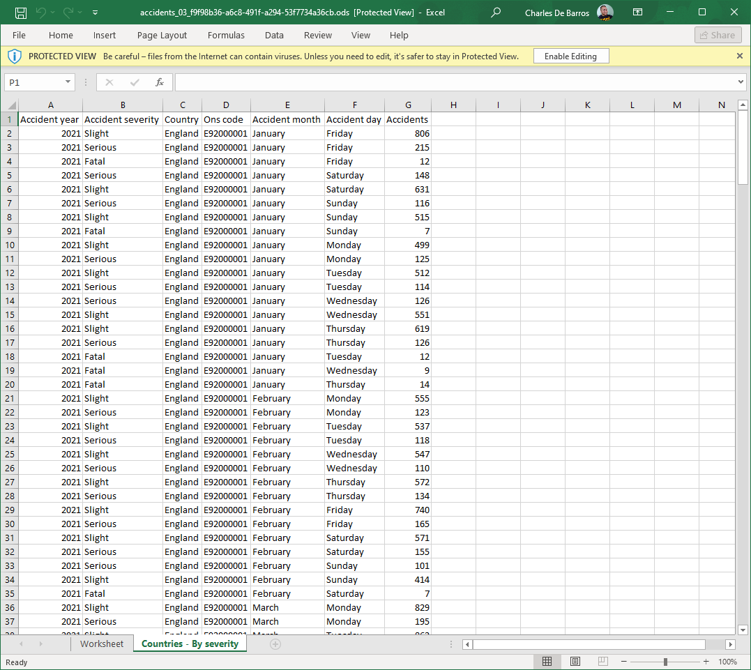
UK Road Safety 2020-2021
From this…

Slide 13
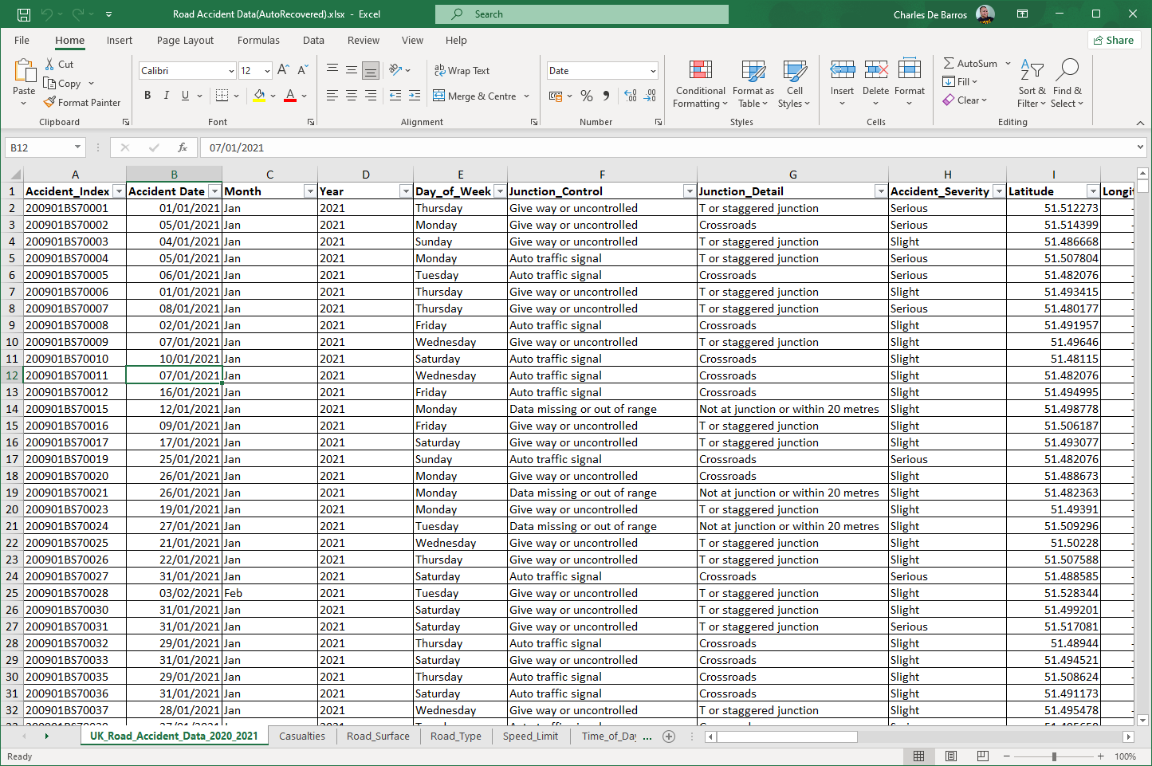
UK Road Safety 2020-2021
To this.

Slide 14
UK Road Safety 2020-2021
Cleaning the data
The process of cleaning the data was very straightforward since it came from an official government source. I still double-checked the data for possible spelling mistakes and row duplication.
I decided to remove some columns I felt were irrelevant to my analysis such as info on the “Local Police Authority” or the “Level of Economic Development” of the regions.
I have broken down the “Accident_Date” column into “Month” and “Year” columns to use them to filter data.

Slide 15
UK Road Safety 2020-2021
Analysing the data
I have heavily used Pivot Tables to help separate into subcategories and focus on one aspect of the data at a time. I used specific values and rows to calculate, for example, the percental representation of casualties by seriousness and by the kind of vehicles involved, as displayed next.

Slide 16
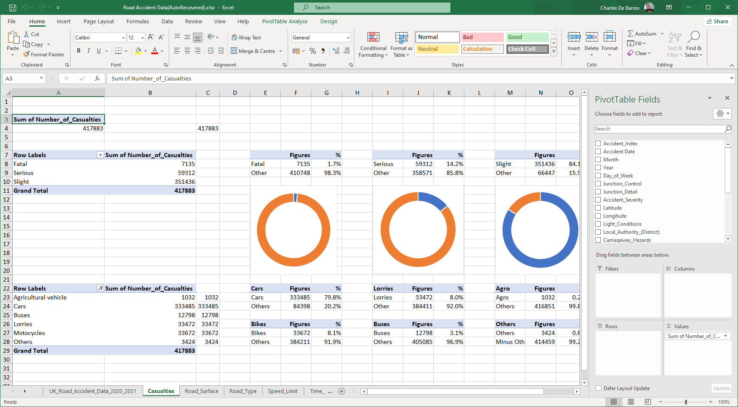
UK Road Safety 2020-2021
Analysing the data
The Casualties Pivot Table

Slide 17
UK Road Safety 2020-2021
Presenting the data
After analysing various aspects of the data, I designed a Dashboard to present my findings and make the visualisation of the data easier to understand.
One of the main jobs of a Data Analyst is to present the data in an understandable format. The choice of a colour pallet is crucial.
Since my analysis findings were representing figures related to casualties, I used a more neutral colour pallet for my dashboard.

Slide 18
UK Road Safety 2020-2021
Presenting the data
The Dashboard

Slide 19
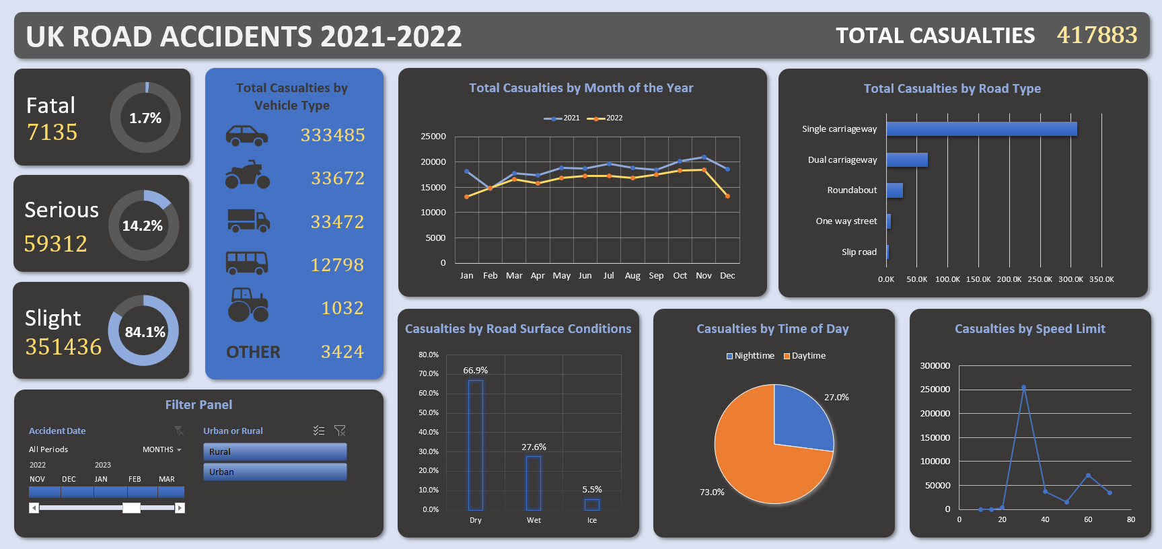

Slide 20
UK Road Safety 2020-2021
The Insight Gained
Out of the over 350k rows of data in the dataset, a pattern emerged on the regular increase of road casualties taking place starting from the warmer months of the year, May until November, with a drop in numbers from December to February. There was a specific sharp increase in numbers on February 2020, the time when the Covid-19 Pandemic lockdown restrictions were lifted.
Almost three-quarters of accidents occur during the day; over two-thirds on dry road conditions. There is roughly a 5:1 ratio between Single Carriageway and Dual Carriageway incidents with the great majority of casualties happening at about 30mph.
Considering that many Local Authorities have set a 20mph speed limit in many urban zone roads, the number of fatal and serious casualties will likely decrease.
Investment in more visually adequate night-time signalling and night driving awareness campaigns should also help decrease the number of night-time accidents.

