Slide 1





Click-level Learning Analytics in an Online Medical Education Learning Platform
MATT CIRIGLIANO, MS
CHARLIE GUTHRIE, BA
MARTIN PUSIC, MD, PhD
May 5TH, 2017
Notes:
Hi everyone, my name is Matt Cirigliano and I am a Doctoral Candidate at NYU Steinhardt working on research in medical education and the learning sciences. With me I have…
Charlie Guthrie - I just finished my Master’s in Data Science at NYU, with the Center for Data Science. My background is in statistics with a focus on learning analytics.
And we're currently working with Dr. Martin Pusic -- who [you’ve just met in the last talk] is the Director of the Division of Learning Analytics at the Institute for Innovations in Medical Education at the NYU School of Medicine -- on click-level learning analytics in MedU, an online medical education learning platform.
[26 sec]

Slide 2
OBJECTIVES
Exploratory Analysis: Understand the relationships between measures of learner engagement and learner achievement in historical MED-U databases using results from focus group discussions and learning analytics.
Notes:
Our objective was to understand measures of learner engagement…
…meaning what learners clicked on, interacted with, and for how long…
…and how these behaviors related to learner achievement. MedU's historical database of learner interactions and learning analytics allowed us to do that.
[14 sec]

Slide 3
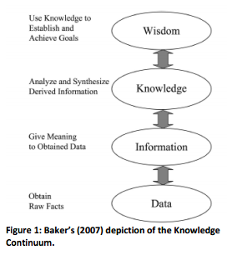
LEARNING ANALYTICS
…is an emerging field in which analytic tools adapted from computer science, math, and statistics are used to improve learning and education by extracting usable information from very large datasets.
SOURCE: Elias, T. 2011. Learning Analytics: Definitions, Processes and Potential.
Notes:
Briefly, learning analytics uses the power of large datasets and analytic tools to understand how learners engage with material and improve approaches to achieving educational goals.
[11 sec]

Slide 4
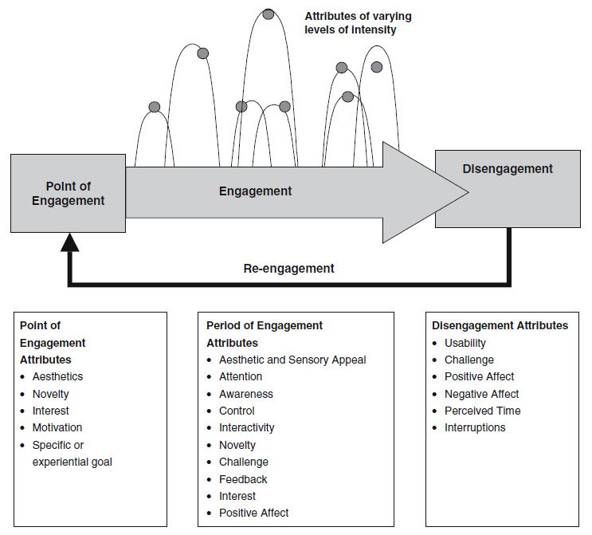
CONCEPTUAL MODEL FOR ENGAGEMENT
SOURCE: O'Brien, H. L., & Toms, E. G. (2008). What is user engagement? A conceptual framework for defining user engagement with technology. Journal of the American Society for Information Science and Technology, 59(6), 938-955.
Notes:
And engagement incorporates the complex network of interactions a learner has with content―if they become engaged or disengaged by material. Learning analytics and predictive models can help us identify what content is most/least useful.
[14 sec]

Slide 5
LEARNING ANALYTICS
ENHANCING ONLINE LEARNING THROUGH FEEDBACK
Instructor &
Instructional Designer
Students
Learning Analytics
User & Log Data
Adapted from Bienkowski, M., Feng, M., & Means, B.,(2012). Enhancing Teaching and Learning Through Educational Data Mining and Learning Analytics: An Issue Brief.
Notes:
Overall, learning analytics can help us generate feedback systems to help stakeholders improve learning content and strategies.
[9 sec]

Slide 6
CLICK-LEVEL DATA
Features:
Multiple choice questions
Hyperlinks
Page progression clicks
Enlarging images
Checking answers
Time spent on images, pages, etc.
Scope:
2,806 North American medical students
From June 1st, 2014 - May 5th, 2015
Notes:
So with Med-U, we applied learning analytics to click-level data to reveal how learners interacted with the content. That includes [riff]
MedU itself is an online suite of case-based learning systems and courses accessed by over 150 different medical schools across North America―you can see some more information at the bottom—there were over 2800 med students who contributed (only 6). One feature of MedU is the CORE Radiology series, which has 18 modules total. We focused on one on musculoskeletal trauma.
[32 seconds]

Slide 7
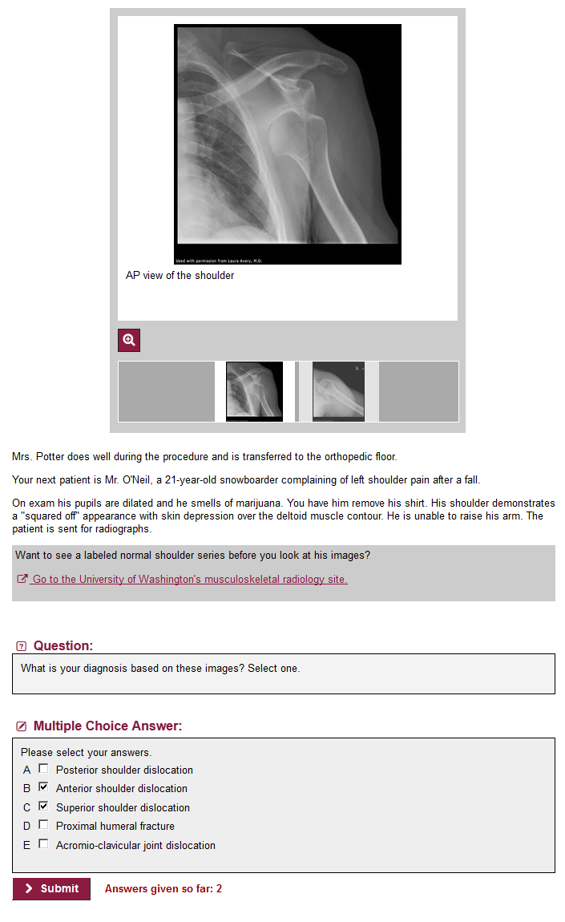
A RELEVANT ASSESSMENT
Content Relevant Multiple
(Images, links, etc.) Choice Question
Notes:
So in sum, we wanted to understand if engaging with relevant content impacted performance on assessment questions in the module.
[7 sec]

Slide 8
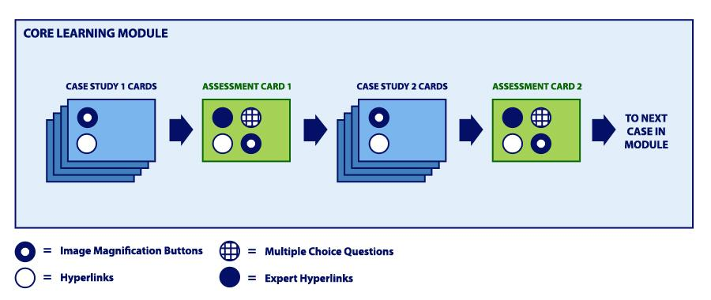
MODULE PROGRESSION
Notes:
The module was broken down into units, where a set of cards featuring content was followed by an an assessment card, which featured a relevant multiple choice question.
[9 sec]

Slide 9
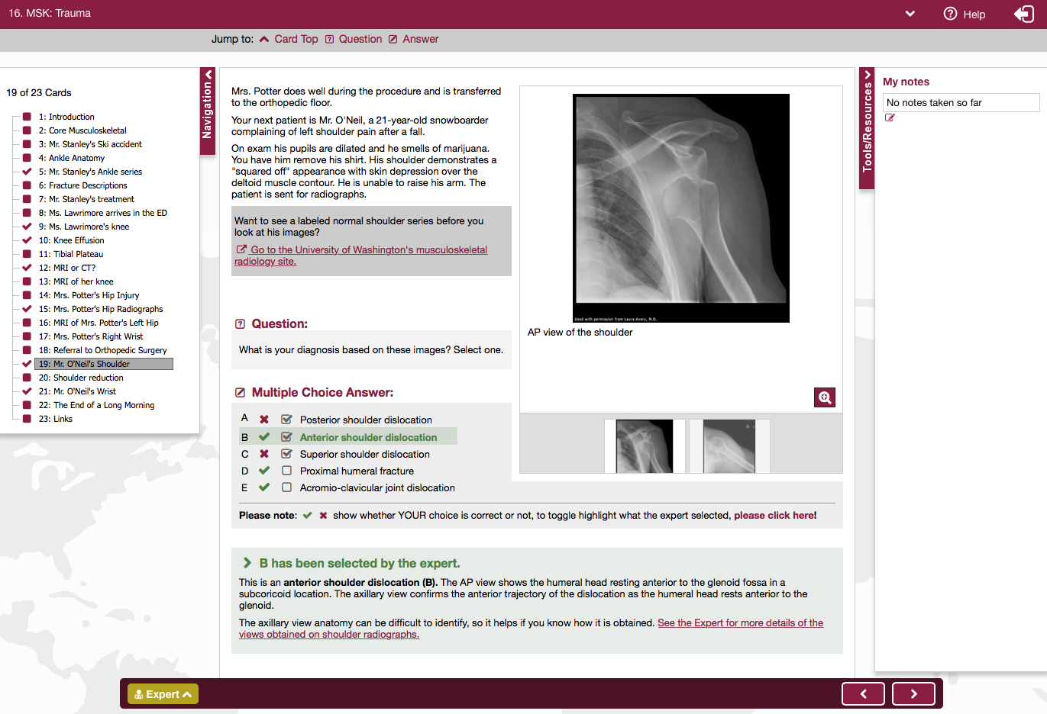
Notes:
And the whole module was 23 cards long. This is a screenshot of one card.
[5 sec]

Slide 10
CANDIDATE ANALYTIC MEASURES
Notes:
But...which features would be worth exploring with learning analytics?
[3 sec]

Slide 11
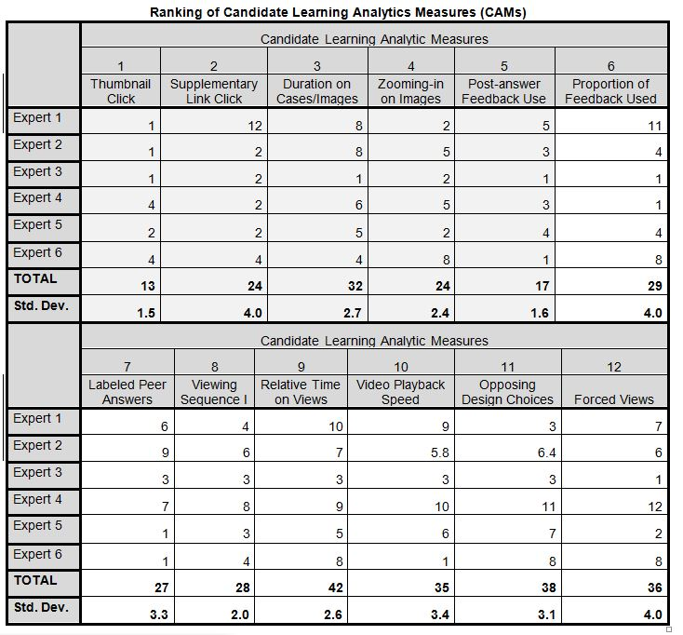
FOCUS GROUP RESULTS
Six experts grouped and ordered candidate analytic measures (CAMs), revealing which were considered the most useful:
Thumbnail Click
Post-Answer Expert Feedback Use
Supplementary Link Click
Magnifying (Zooming-in on) Images
Time Spent on Cases
Notes:
To identify Candidate Analytic Measures, we performed a focus group with experts in medicine and instructional design to see what they thought would be most important to know about learner behavior. A set of 12 analytics were ranked and the top five were selected for further study.
[18 seconds]

Slide 12
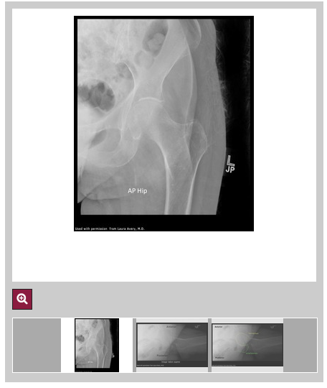
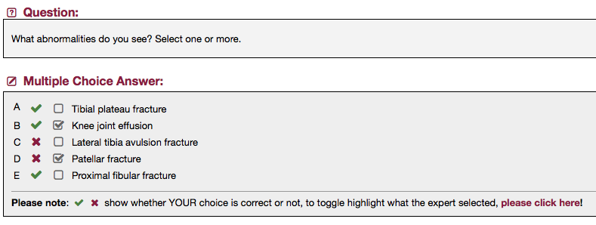
CAM-A: THUMBNAIL CLICK
In an image set where there is one dominant image along with several supplementary clickable thumbnails, does the rate of clicking through the thumbnails correlate with learning?
What we need is:
(a) Whether users clicked
each thumbnail, yes/no
(b) Whether they got the
relevant MCQ correct
(Card 13, MSK Trauma)
(Card 15, MSK Trauma)
Notes:
The first was the thumbnail click, and whether clicking on relevant thumbnails impacted assessment outcomes.
Sadly, because this data was unavailable in the database, it wasn’t incorporated in the model. But there’s more…
[11 sec]

Slide 13
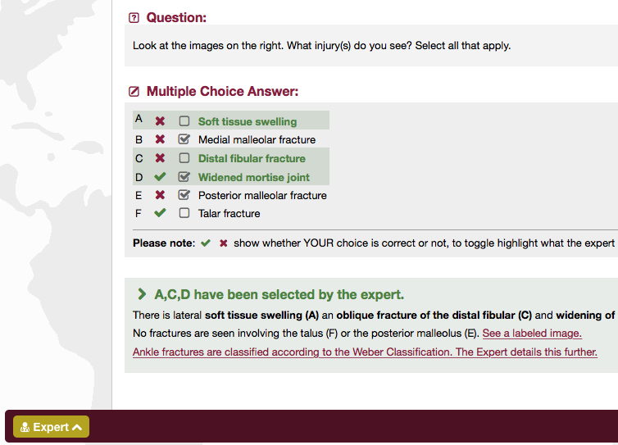
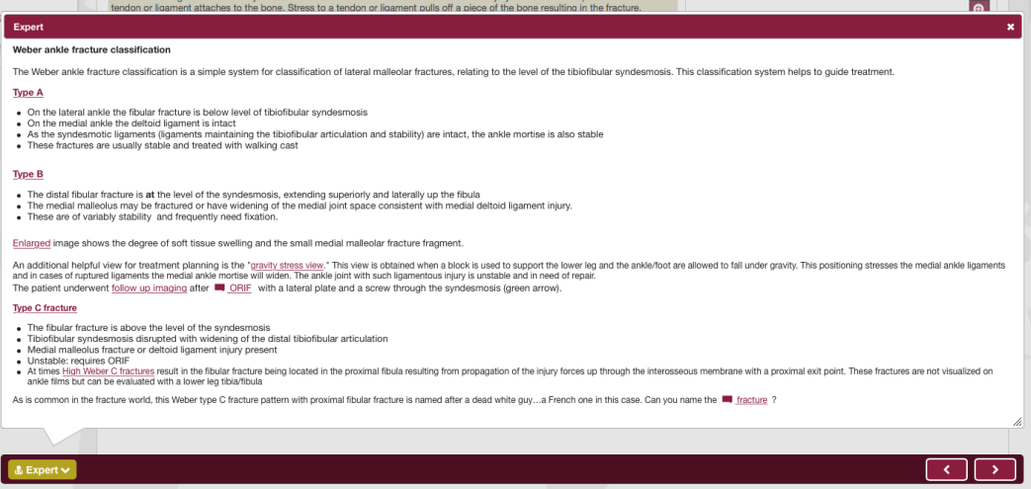
CAM-B: POST-ANSWER EXPERT FEEDBACK
Does learning correlate with how often a user clicks on links in the expert window?
What we need is:
(a) Whether users clicked
links in the expert
window
(b) Whether they got the
relevant MCQs correct
(Card 5, MSK Trauma)
Notes:
The next measure is clicking on “expert links”, which showed how experts might respond to questions.
[6 sec]

Slide 14
CAM-C: SUPPLEMENTARY HYPERLINK CLICK
In the presence of supplementary links/hyperlinks to external content, does the rate of clicking through the links correlate with learning?
What we need is:
(a) Whether users clicked
links
(b) Whether they got the
relevant MCQ correct
(Card 15, MSK Trauma)
Notes:
Third was clicking on hyperlinks, and whether this predicted better assessment outcomes.
[5 sec]

Slide 15
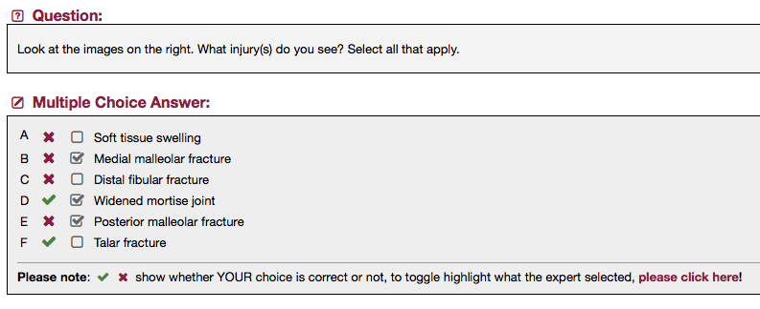
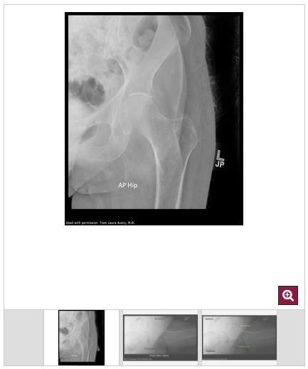
CAM-D: MAGNIFYING IMAGES
Does the rate at which one magnifies an image or images correlate with learning?
Our hypothesis might be that those who magnify the images had a higher rate of correct answers on relevant MQCs…
What we need is:
(a) Whether users clicked
magnification button
(b) Whether they got the
relevant MCQ correct
Notes:
Fourth was magnifying or zooming in on images, and whether this behavior predicted better outcomes.
[6 sec]

Slide 16
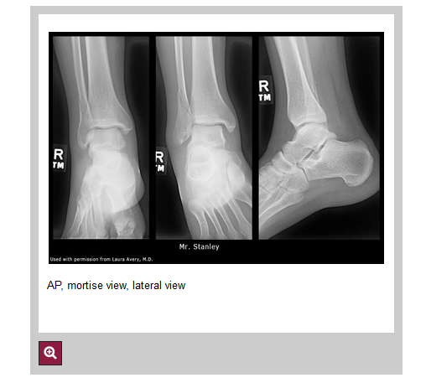
CAM-E: TIME SPENT
Does the length of time on an image or case correlate with learning?
Our hypothesis might be that those who spent more time on images/cases have a higher rate of correct answers on relevant MCQs…
What we need is the duration of
time spent viewing each:
(a) image/case/webpage
(b) success on MCQ
(Card 5, MSK Trauma)
Notes:
And finally, the fifth measure was time spent on each card, and whether this behavior had a relationship with performance.
[7 sec]

Slide 17
EXAMPLE EXPECTATIONS
NUMBER OF HYPERLINK CLICKS
QUARTILE 4
QUARTILE 3
QUARTILE 2
QUARTILE I
SUCCESS RATE ON MULTIPLE CHOICE QUESTIONS
Notes:
In terms of expectations, we might expect that more clicks on links and images would predict better outcomes, since those learners engaged with more content.
[9 sec]

Slide 18
EXPECTATIONS
CAM-E: TIME SPENT
QUARTILE 3
SUCCESS RATE ON MCQS
QUARTILE 2
QUARTILE 4
QUARTILE I
AVERAGE DURATION OF TIME ON CARDS/CASES
Notes:
And more time spent on a card would also be expected to result in better assessment outcomes, with the exception of very long times, as these might indicate off-task behavior.
So, what did we find? [Hand off to Charlie]
[15 sec]

Slide 19
MODELING & ANALYSIS
Notes:
Having hypothesized about which activities would correlate with assessment performance,
we set out to build models to test them.

Slide 20
MODEL OVERVIEW
Expert links clicked
Hyperlinks clicked
Magnifier buttons clicked
Time spent
CAM Engagement Measures:
Assessment Performance:
Question answered >50% correctly
Notes:
There were two investigations. Both involved using engagement measures to predict assessment performance

Slide 21
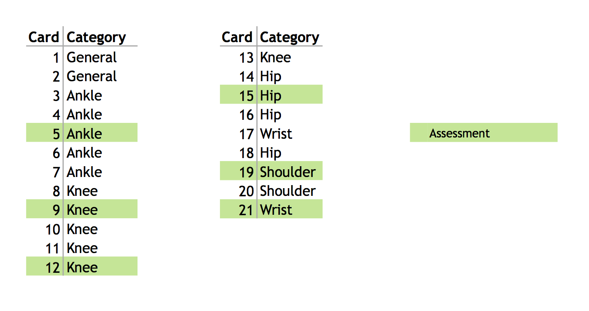
COURSE CONTENT MAP
Notes:
Here is a map of the content for the course we studied, with each card’s number and topic category
Assessments are highlighted in green.

Slide 22
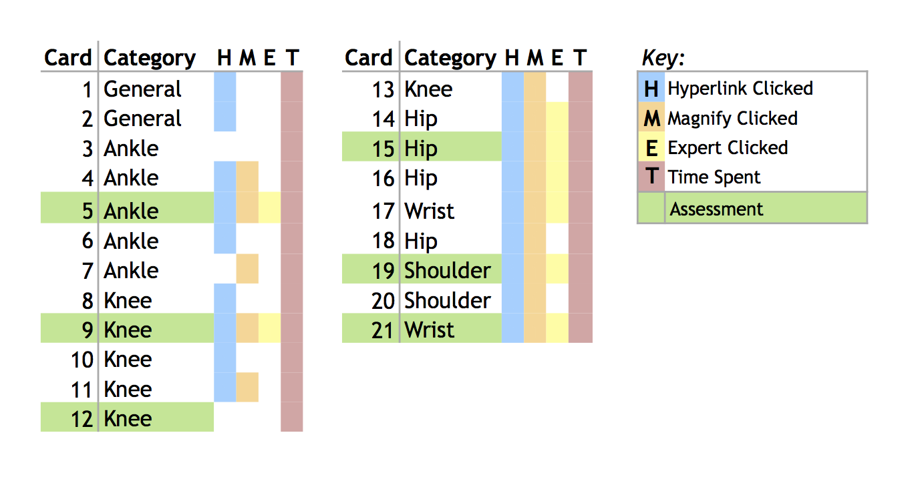
ENGAGEMENT ACTIVITIES
Notes:
Here is where those engagement activities were distributed.
Not every engagement activity was available on every card

Slide 23
ENGAGEMENT ACTIVITIES
Notes:
For example, card one only had an external hyperlink on it,
so we only had insight into that click and time spent

Slide 24
ENGAGEMENT ACTIVITIES
Notes:
But card 16 had all three types of activity, plus time spent

Slide 25
EXAMPLE: CARD 16
Magnification
External Hyperlink
Expert Opinion link
Notes:
Shown here

Slide 26
INVESTIGATION 1
Is there a relationship
between student engagement
and performance?
Notes:
First investigation was to test our assumption that more engaged students performed better

Slide 27
BUILDING A MODEL
INVESTIGATION 1
Notes:
To answer that question, we broke up the course into units...

Slide 28
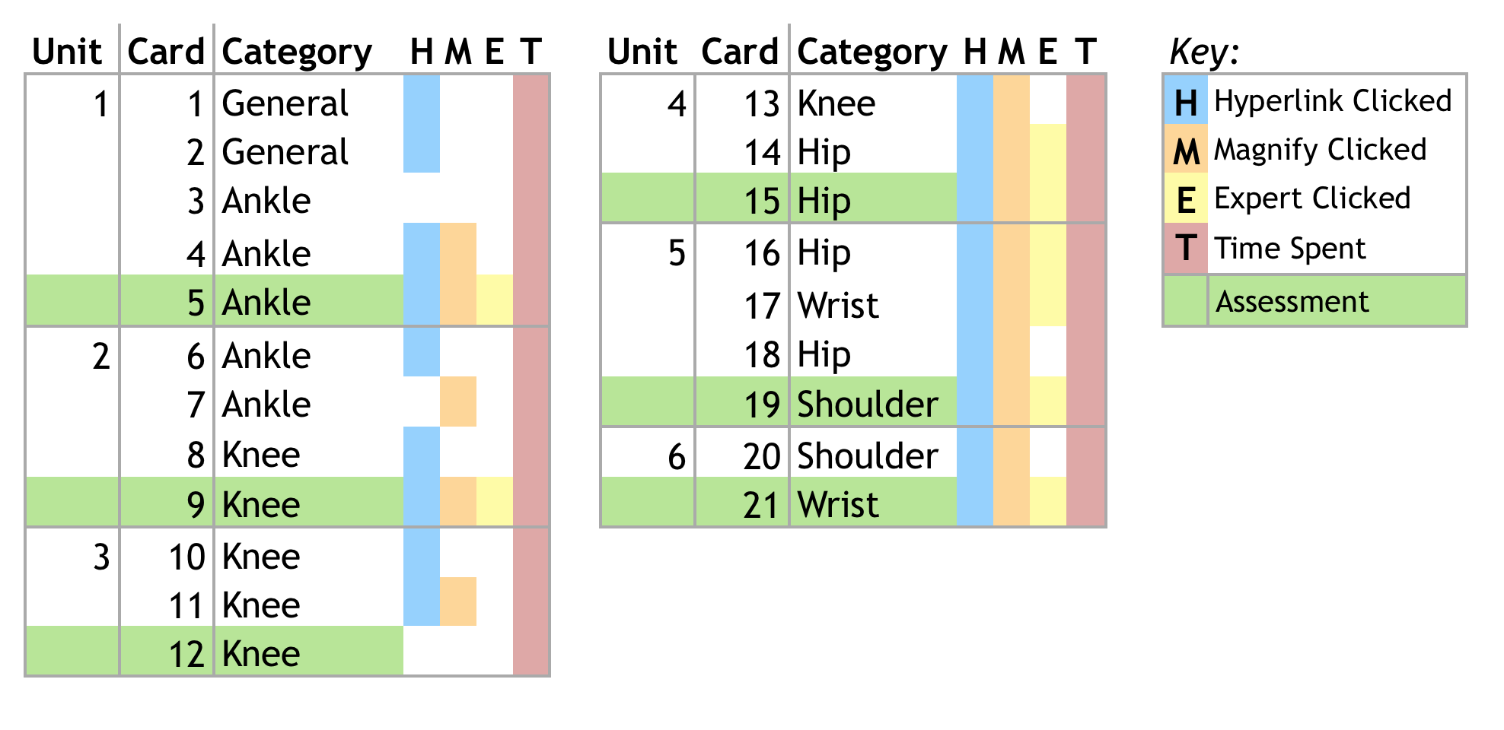
BUILDING A MODEL
INVESTIGATION 1
Notes:
And for each unit...

Slide 29
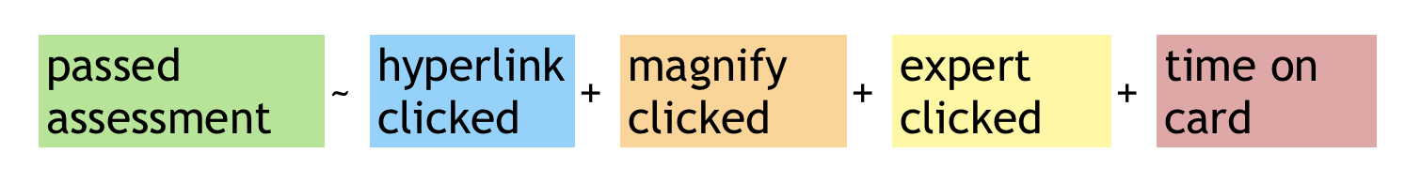
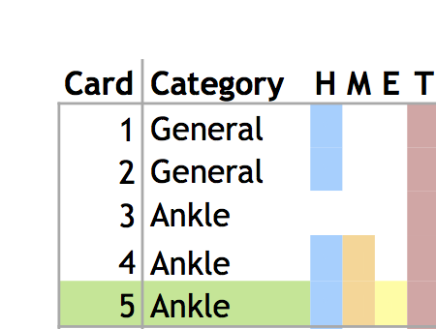
BUILDING A MODEL
INVESTIGATION 1
=
Notes:
The model predicts whether a student will pass the end-of-unit assessment given...

Slide 30
BUILDING A MODEL
INVESTIGATION 1
=
Notes:
Given whether the student clicked on any of the available links,

Slide 31
BUILDING A MODEL
INVESTIGATION 1
=
Notes:
Any of the magnify image buttons,

Slide 32
BUILDING A MODEL
INVESTIGATION 1
=
Notes:
Any of the expert links

Slide 33
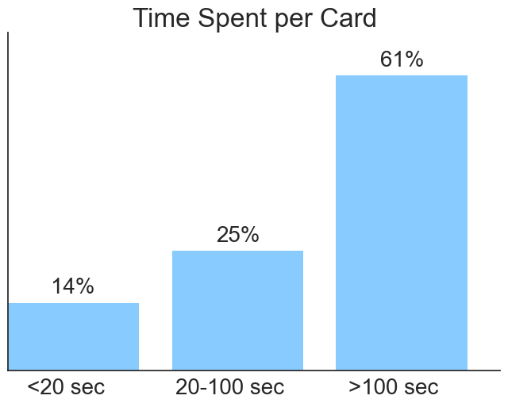
BUILDING A MODEL
INVESTIGATION 1
=
Notes:
And how much time the student spent on each card.
But since we expected a nonlinear relationship between time and performance,
we split time spent on card into bins:
and had indicators for each

Slide 34
RESULTS
INVESTIGATION 1
Independent Variable | Odds ratio | 95% Conf. Interval
Hyperlink clicked | 1.21 | (1.12,1.31)
Magnify image clicked | 1.20 | (1.11,1.31)
Expert link clicked | 1.21 | (1.05,1.39)
< 20 seconds per page | 0.74 | (0.66,0.83)
>100 seconds per page | 1.38 | (1.27,1.51)
Top half of students spent 23% longer per card than the bottom half
Notes:
We tried several models, including decision trees and logistic regression for various transformations of the data,
but the best-performing model was logistic regression, [with AUC of 0.594].
*** All features statistically significant
As expected, engagement and performance were related.
Students that rushed through the cards had lower performance on assessments.
But that’s relatively obvious. What we really want to know is, which of the materials provided are useful to the students?

Slide 35
INVESTIGATION 2
Which engagement activities impacted assessment score?
Notes:
Yes studying helps pass tests, but which materials are useful and which are not? Which materials should be removed and replaced with others?

Slide 36
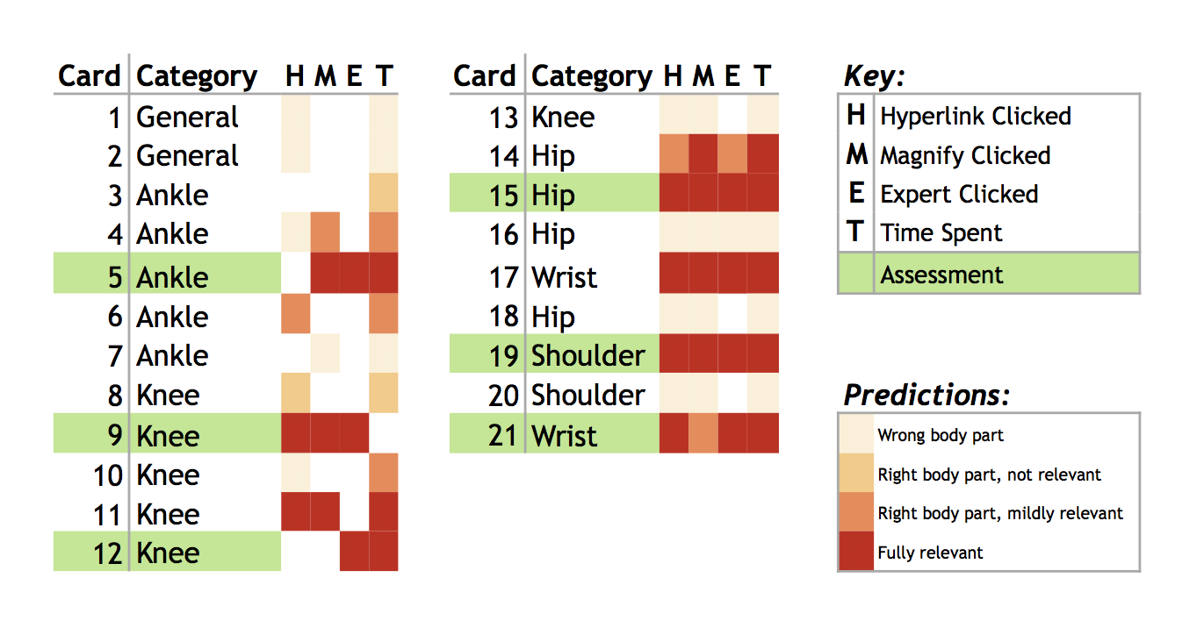
EXPERT PREDICTIONS
INVESTIGATION 2
Notes:
First Dr. Pusic provided his expert opinion,
predicting which materials would be most useful to students in answering subsequent assessment questions.
Darker colors are expected to be more relevant
For example he predicted that card 16’s materials, which were about the Hip, would not be useful for the assessment on card 19, which is about the shoulder.

Slide 37
ORIGINAL MODEL
INVESTIGATION 2
=
Notes:
Like before, we broke up the course into units...

Slide 38
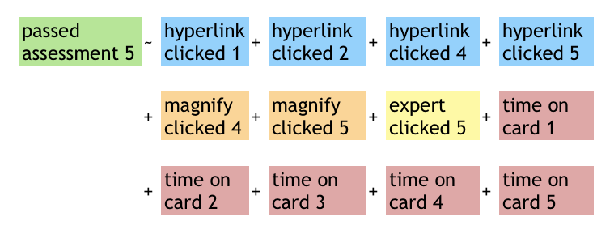
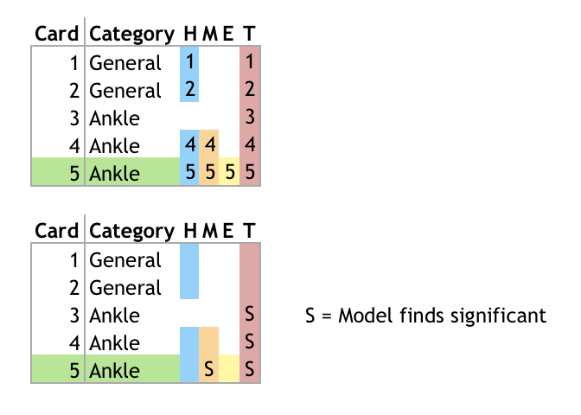
NEW MODEL: UNIT 1
INVESTIGATION 2
=
Which features are significant predictors of passing assessment?
Notes:
But this time built a separate model for each unit.
Unlike the first model, which lumped together any engagement activities,
Now we are looking for specific activities that contribute to performance
To do that, we consider each event separately so that we can see its impact
Investigation 2: Procedure
Run lasso-regularized logistic regression using all activities before assessment card
Find largest regularization parameter that is close to maximum cross-validation AUC
Re-run logistic with remaining variables
Return variables that have significant impact with p-value < 0.05

Slide 39
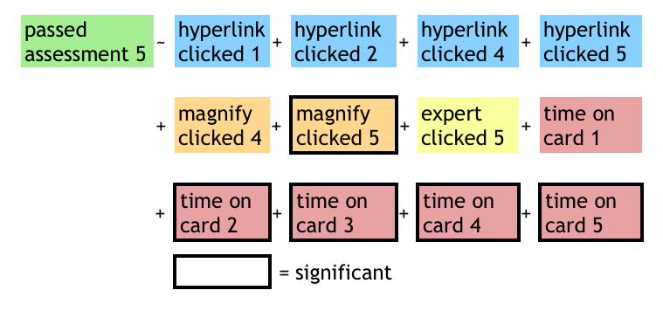
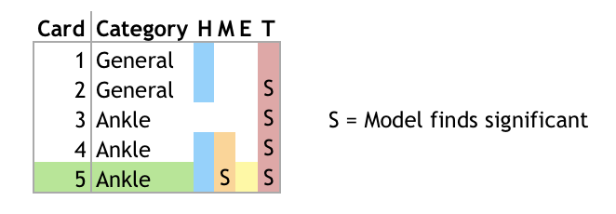
RESULTS
INVESTIGATION 2
=
Notes:
Then after running a model, we record which activities were significantly correlated with passing the assessment
In this unit’s model,
we find that students who clicked the magnifier on card 5,
or spent more time on cards 2,3,4,5,
were more likely to pass the assessment on card 5.
But the other engagement activities were not significant predictors of passing probability

Slide 40
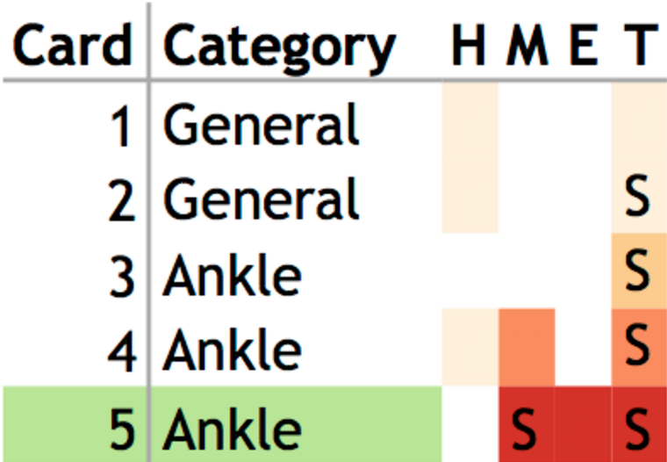
RESULTS
INVESTIGATION 2
=
Notes:
Comparing the model’s results to Dr. Pusic’s predictions shows where the predictions were and were not supported by the data.

Slide 41
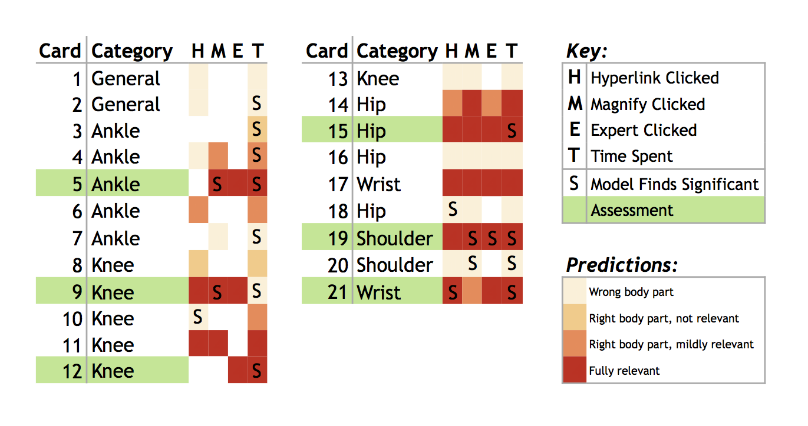
RESULTS
INVESTIGATION 2
Notes:
Repeating that step for all units, we have this chart.
We can use these insights about what materials are NOT predictive of good performance,
and can recommend that instructional designers replicate what is working and replace what isn’t
Notable Observations:...

Slide 42
RESULTS
INVESTIGATION 2
Notes:
19. Dr. Pusic’s predictions for card 19 were consistent with model results.
You need to engage with that material in order to answer the question correctly
But
17 - Card 17, which is about the wrist, should be predictive of performance on card 21;
but perhaps there was too many cards between it and card 21 for students to see the relevance
1 - Card 5
Cards 1 and 2 comprise general content, and do not cover the assessment topic of ankles. These were understandably not predictive.
2 - Card 9
Engagement with card 6 and 8 was not associated with improved performance. Instructional designers should reconsider their inclusion.
3 - Card 12
Card 11 was expected to be fully relevant by the content expert, but the model did not consider its content predictive.
4 - Card 15
Few predictive variables were observed in this unit. Only time spent on the assessment card proved significant.

Slide 43
CONCLUSIONS
Expert predictions not always supported by data
Feedback empowers instructional design
Evidence that studying works
Limitations:
Retroactive study, no control over data collection
Notes:
This is a retroactive study on MedU historical data; database designs could benefit from prospective research goals, to avoid limitations on data collection.
Conclusions/Strength of Innovation: Our intention was to demonstrate the merits of learning analytics within the online context, giving educators a new tool for improving experiences in educational online learning environments. Results of this analysis, where the data from thousands of learners are summarized, can serve as feedback to instructional designers as to which interaction elements are effective. It may also be useful to show students themselves evidence that there is a statistically significant relationship between engaging with the material and performing well on assessments.

Slide 44
DISCLOSURE
Grant/Research support and historical MedU data provided by:
http://www.med-u.org

Slide 45
THANK YOU
Special Thanks to MedU,
for research support and historical data.
For further information, feel free to contact us at:
Matt Cirigliano, MS matt.cirigliano@nyu.edu
NYU Steinhardt - CREATE Lab
Charlie Guthrie, BA charles.d.guthrie@gmail.com
NYU Center for Data Science
Martin Pusic, MD, PhD martin.pusic@nyumc.org
NYU School of Medicine
Division of Education Quality and Analytics (DEQA)

