Slide 1
BSC PROJECT DEFENCE
Design and Implementation of an AI-Based Intrusion Detection System for Encrypted Traffic
Presented by Oyeduntan Segun Elijah
Matric No: CSC/22/174
Supervisor: 'Dr. (Engr.) Modupe Agagu'
Dept. of Computer Science — OAUSTECH, Okitipupa

Slide 2
SLIDE 2
Introduction
▸ Network traffic is increasingly encrypted, creating a gap where traditional signature-based intrusion detection systems cannot inspect payloads.
▸ Machine learning models can detect malicious patterns in flow-based features without decrypting traffic, preserving privacy while maintaining security.
▸ XGBoost, a gradient-boosting ensemble, achieves state-of-the-art results on tabular network data with high accuracy and low inference latency.
▸ This project presents an AI-based IDS that combines an XGBoost model trained on the CICIDS2017 dataset with an interactive Streamlit dashboard.
▸ The system supports CSV upload, PCAP file analysis, and live network capture, with an optional Gemini AI assistant for plain-English explanations.

Slide 3
SLIDE 3
Motivation / Statement of the Problem
▸ Encrypted traffic now accounts for over 90% of internet traffic, making deep-packet-inspection-based IDS largely ineffective.
▸ Signature-based systems cannot detect novel or zero-day attacks, which increasingly exploit encrypted channels.
▸ Existing ML-based IDS solutions often lack user-friendly interfaces, making them inaccessible to non-experts.
▸ There is a need for a system that combines accurate ML detection, support for multiple input modes, and an intuitive interface.
▸ These challenges motivated the development of an accessible, AI-powered IDS that works with encrypted traffic.

Slide 4
SLIDE 4
Aim and Objectives of the Study
Aim
Objectives
▸ To design and implement an AI-based intrusion detection system for encrypted traffic that integrates machine learning classification with an interactive dashboard and multiple input modes.
▸ Preprocess the CICIDS2017 dataset for training
▸ Train and tune an XGBoost classifier on flow-based features
▸ Build a Streamlit dashboard with Matrix-themed UI
▸ Implement CSV upload, PCAP parsing, and live capture modes
▸ Integrate an AI assistant for attack explanation
▸ Evaluate model performance using standard metrics

Slide 5
SLIDE 5
Significance of the Study
▸ Technological Impact: Demonstrates the practical application of gradient boosting for encrypted traffic analysis in a real-world tool.
▸ Economic Impact: Reduces the cost of network security monitoring by providing a free, open-source alternative to commercial IDS solutions.
▸ Educational Impact: Serves as a learning platform for understanding ML-based network security concepts and traffic analysis.
▸ Social Impact: Makes advanced network security accessible to small organisations and individuals who cannot afford expensive security infrastructure.

Slide 6
SLIDE 6
Literature Review
▸ Buczak & Guven (2016) surveyed ML methods for cybersecurity, identifying random forests and neural networks as effective for intrusion detection.
▸ Chen & Guestrin (2016) introduced XGBoost, a scalable tree boosting system that became a benchmark for tabular data classification.
▸ Sharafaldin et al. (2018) created CICIDS2017, a realistic IDS dataset with 71 flow features and 14 attack types, enabling reproducible research.
▸ Zhang et al. (2019) applied XGBoost to network intrusion detection, achieving high accuracy on multiple benchmark datasets.
▸ Gap: Few existing solutions combine high-accuracy ML with a modern interactive dashboard and multi-mode input (CSV, PCAP, live capture).

Slide 7
SLIDE 7
Methodology
Approach
Architecture
Dataset
Agile SDLC with iterative development and continuous testing.
Streamlit frontend + XGBoost backend + tshark for capture.
CICIDS2017: 3.37M flows, 71 features, 14 attack types.
Model
Input Modes
AI Assistant
XGBoost classifier: 99.9% accuracy, 0.9999 ROC-AUC.
CSV upload, PCAP parsing via tshark, live NIC capture.
Google Gemini for plain-English attack explanations.

Slide 8
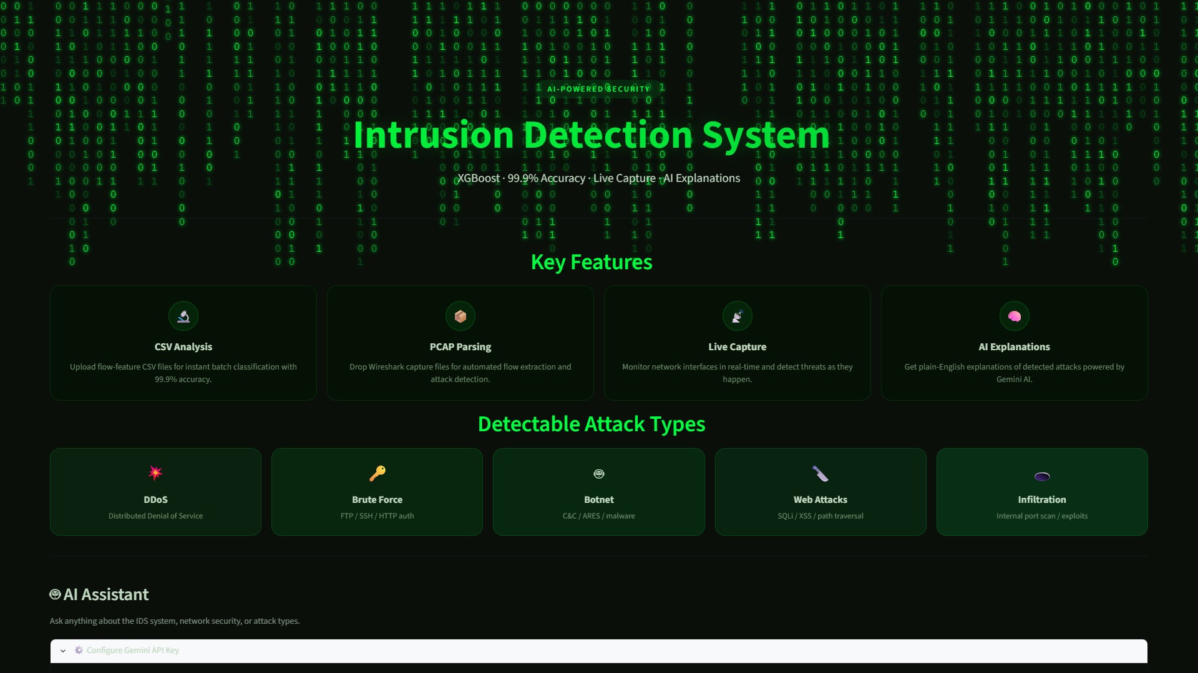
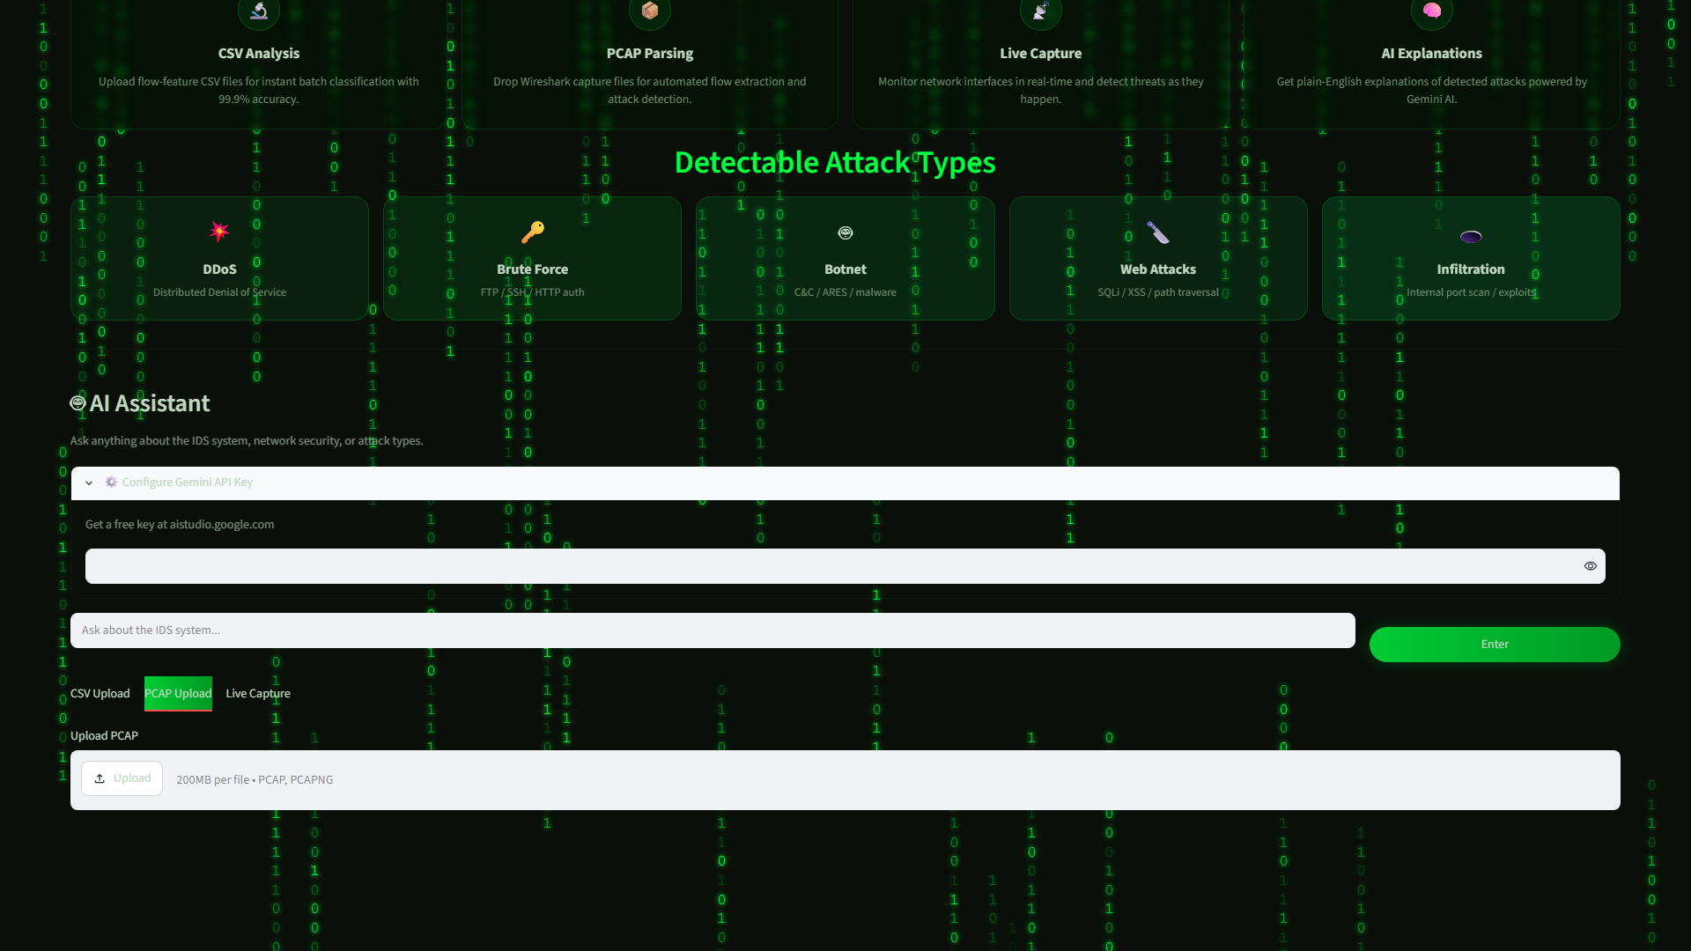
SLIDE 8
Implementation
Figure 1: Full Dashboard
Figure 2: PCAP & Live Tabs
Matrix-themed IDS dashboard with hero section, feature cards, and attack tiles.
PCAP upload interface and live network capture configuration.

Slide 9
SLIDE 9
Results & Discussion
▸ Accuracy: 99.9% — 999 out of 1000 flows correctly classified.
▸ ROC-AUC: 0.9999 — near-perfect discrimination between benign and malicious.
▸ Precision: 0.999 | Recall: 0.999 | F1-Score: 0.999.
▸ Confusion matrix shows near-diagonal dominance (minimal FP/FN).
▸ Feature importance: flow duration, backward packet length, inter-arrival times.
▸ All three modes (CSV, PCAP, Live) passed unit, integration, and UAT testing.
▸ AI assistant provides accurate plain-language explanations of predictions.

Slide 10
SLIDE 10
Contributions to Knowledge
▸ A fully functional AI-based IDS achieving 99.9% accuracy and 0.9999 ROC-AUC on the CICIDS2017 benchmark dataset.
▸ Integration of three detection modes (CSV, PCAP, live) within a single unified dashboard accessible to non-experts.
▸ A Matrix-themed interactive interface that combines real-time detection with visual analytics and an AI-powered explanation system.
▸ Demonstration of XGBoost effectiveness for encrypted traffic analysis, with flow-based features requiring no decryption.
▸ A practical, open-source tool that bridges the gap between ML research and usable network security software.

Slide 11
SLIDE 11
Conclusion / References
Conclusion
References
▸ All six objectives were achieved: the CICIDS2017 dataset was preprocessed, an XGBoost model was trained and tuned, a Streamlit dashboard was built with the Matrix theme, CSV/PCAP/live modes were implemented, a Gemini AI assistant was integrated, and the model was evaluated achieving 99.9% accuracy and 0.9999 ROC-AUC.
▸ The system provides a practical, accurate, and accessible solution for encrypted traffic intrusion detection.
▸ Buczak, A. L. & Guven, E. (2016). IEEE COMST, 18(2), 1153–1176.
▸ Chen, T. & Guestrin, C. (2016). KDD 2016, 785–794.
▸ Pressman, R. S. & Maxim, B. R. (2020). Software engineering (9th ed.). McGraw-Hill.
▸ Sharafaldin, I. et al. (2018). ICISSp, 108–116.
▸ Sommerville, I. (2016). Software engineering (10th ed.). Pearson.
▸ Stallings, W. (2017). Network security essentials (6th ed.). Pearson.
▸ Zhang, Y. et al. (2019). IEEE Access, 7, 164380–164391.

Slide 12
Thank You
Questions & Demonstration

