Slide 1
BSC PROJECT DEFENCE
Design and Implementation of a Web-Based Interactive E-Learning Platform for Structured Python Programming
Presented by Giwa Mayowa Bopoola
Matric No: CSC/22/204
Supervisor: 'Dr. Adeolu Obamehinti'
Dept. of Computer Science — OAUSTECH, Okitipupa

Slide 2
SLIDE 2
Introduction to the mayor4code E-Learning Platform
▸ E-learning has transformed education by enabling self-paced, learner-centred instruction beyond the physical classroom (Garrison, 2017).
▸ Learning to program is widely regarded as difficult for beginners due to the separation of theory and practice in traditional methods.
▸ Interactive browser-based platforms provide immediate feedback, which significantly improves engagement and outcomes (Pressman & Maxim, 2020).
▸ mayor4code is a web-based interactive e-learning platform for structured Python programming that integrates lesson delivery, practical coding, and automated assessment within a single system.
▸ The platform delivers twelve sequential lessons, quizzes, an in-browser code playground, certificates, and a gamified leaderboard.

Slide 3
SLIDE 3
Motivation and Problem Statement: Challenges in Programming Education
▸ Many free programming resources present content in an unstructured manner, leaving learners uncertain about the order in which topics should be studied.
▸ Theory and practice are often separated; configuring a local programming environment can be difficult and discouraging for beginners.
▸ The absence of instant, automated feedback limits learners’ ability to identify and correct mistakes promptly.
▸ Few resources enforce mastery before advancement or provide progress tracking, certification, or motivational features.
▸ These challenges motivated the development of mayor4code as an integrated, structured, and interactive solution for Python beginners.

Slide 4
SLIDE 4
Aim and Objectives of the Study
Aim
Objectives
▸ To design and implement a web-based interactive e-learning platform for structured Python programming that integrates lesson delivery, practical coding, and automated assessment within a single system.
▸ Design a platform with structured lessons and locked progression
▸ Implement secure user authentication and authorisation
▸ Develop an interactive in-browser Python playground
▸ Create automated quizzes with instant scoring
▸ Add progress tracking, certification, and a leaderboard
▸ Evaluate functionality and usability through testing

Slide 5
SLIDE 5
Significance of the Study: Educational, Technological, and Economic Impact
▸ Educational Impact: Promotes structured, self-paced learning with mastery-based progression and instant feedback, improving comprehension and skill acquisition.
▸ Technological Impact: Demonstrates the practical application of modern web technologies and secure code-execution in solving educational challenges.
▸ Economic Impact: Reduces the cost of programming instruction by providing a free, web-based platform that serves many learners simultaneously.
▸ Social Impact: Makes quality programming education accessible to anyone with an internet connection, regardless of location or financial means.

Slide 6
SLIDE 6
Literature Review: E-Learning, Gamification, and Related Platforms
▸ E-learning systems support self-paced, learner-centred education and can be as effective as traditional instruction (Anderson, 2008; Garrison, 2017).
▸ Constructivist theory (Piaget, 1952; Vygotsky, 1978) supports interactive, scaffolded learning environments like mayor4code.
▸ Mastery learning (Bloom, 1968; Guskey, 2007) validates the locked-progression model that enforces prerequisite understanding.
▸ Gamification through certificates and leaderboards boosts learner engagement and motivation (Deterding et al., 2011; Hamari et al., 2014).
▸ Gap: Few free platforms integrate structured lessons, a code playground, automated assessment, certification, and gamification in one system.

Slide 7
SLIDE 7
Methodology: Agile Approach, Three-Tier Architecture, and System Flowchart
Approach
Architecture
Stack
Agile SDLC — iterative development with continuous testing.
Three-tier: Presentation, Application (Django), Database.
Django, Python, HTML/CSS/JS; SQLite (dev) / PostgreSQL (prod).
Progression
Playground
Flowchart
Each lesson unlocks after passing the prior quiz at ≥60%.
User code runs in an isolated subprocess with a time limit.
See Slide 10 for the complete system flowchart.

Slide 8
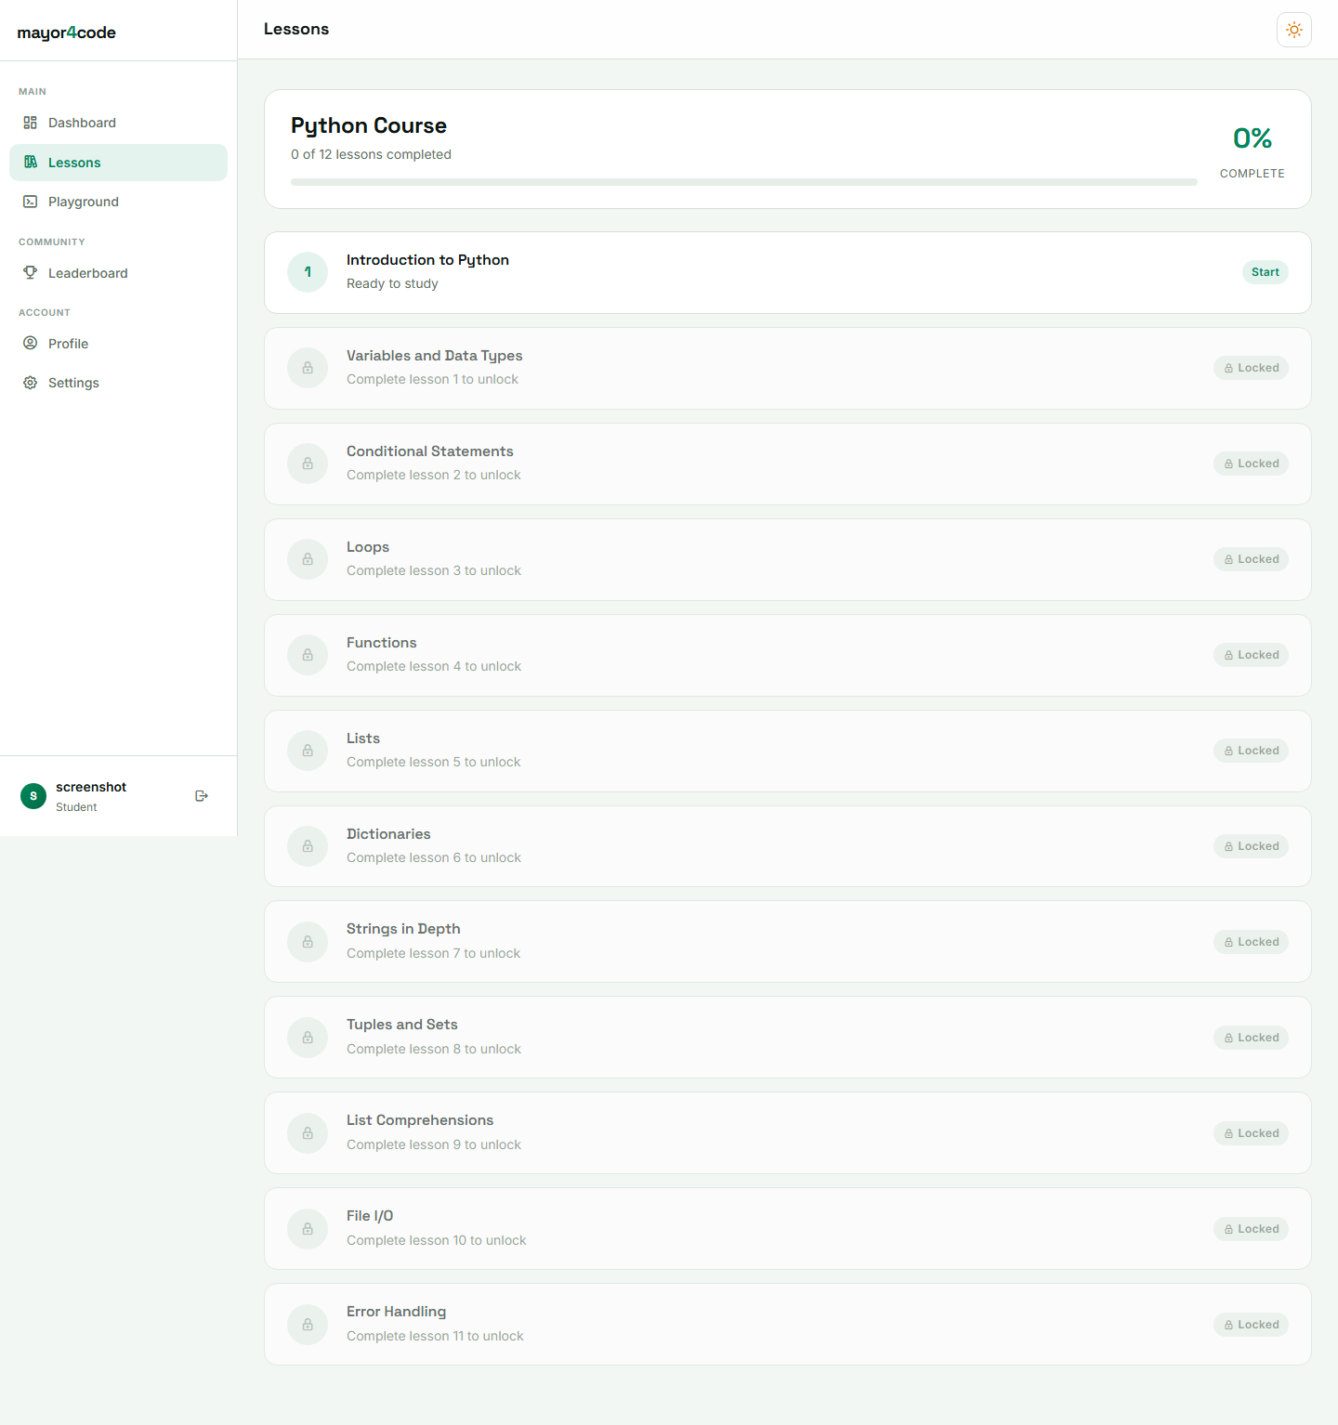
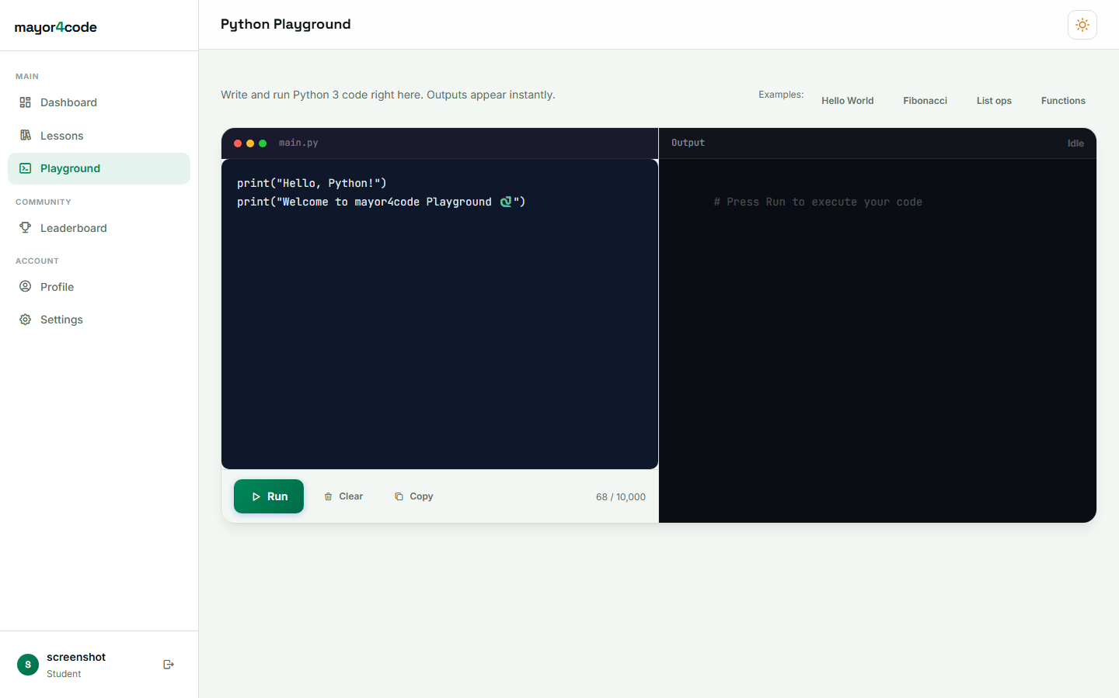
SLIDE 8
Implementation: System Interfaces (Screenshots)
Figure 1: Lesson Interface
Figure 2: Code Playground
Structured Python lesson with previous/next navigation and progress indicator.
In-browser Python editor that executes code safely and displays output.

Slide 9
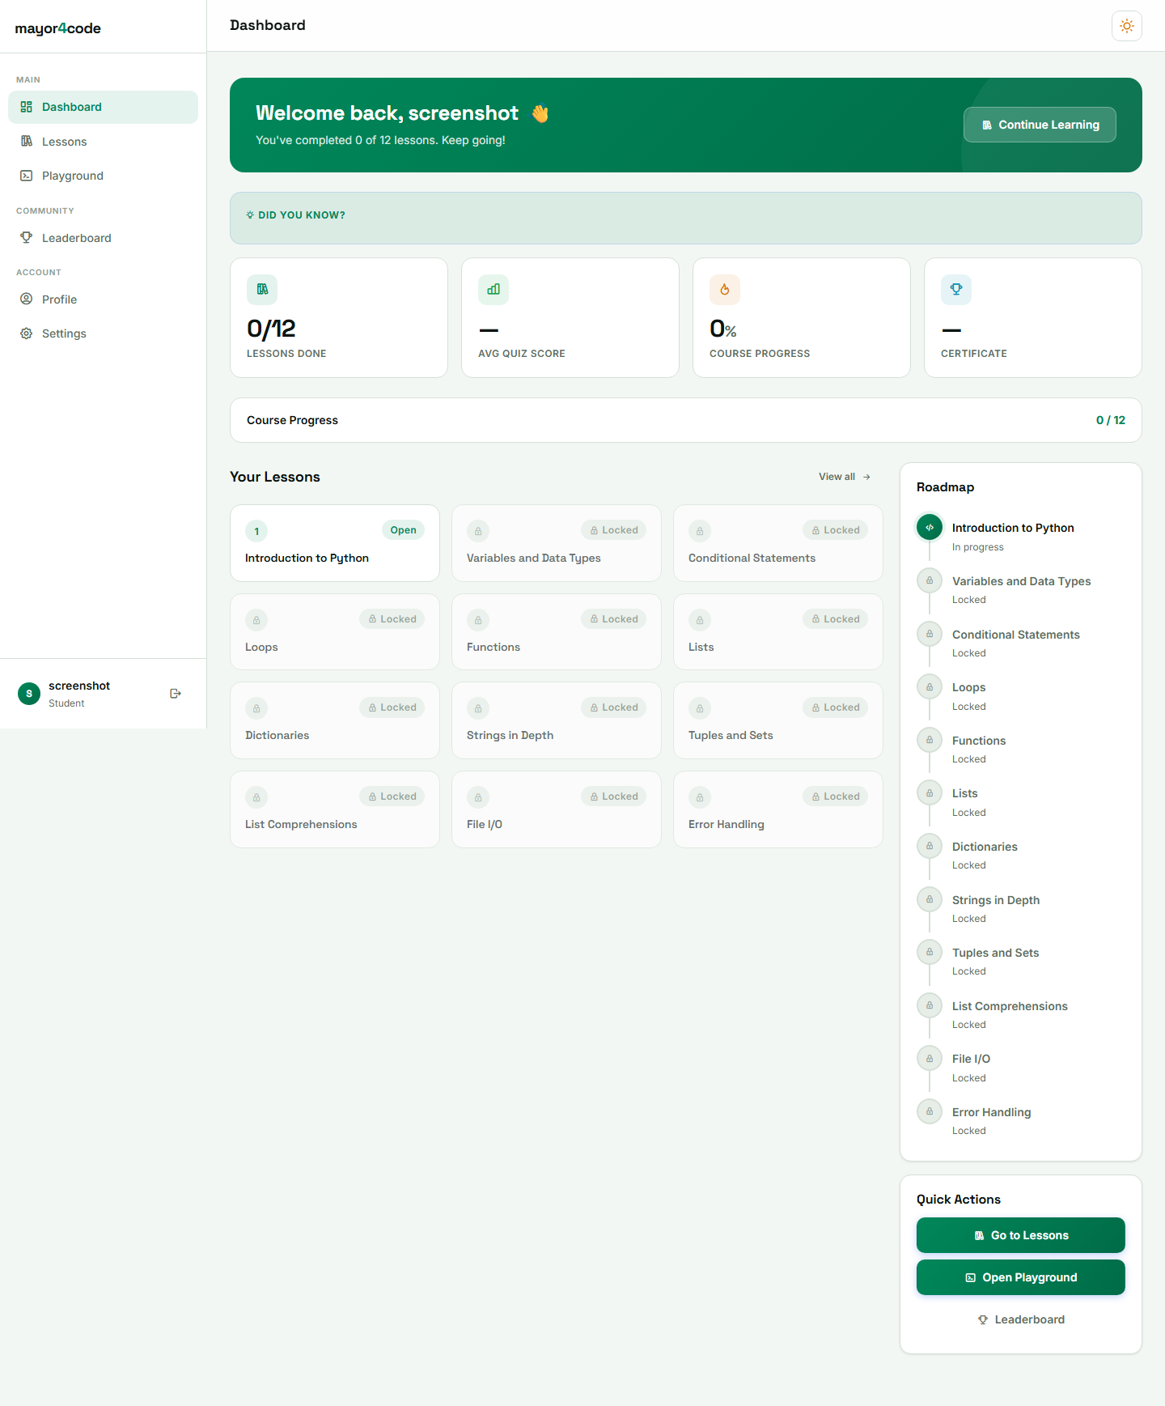
SLIDE 9
Results and Discussion: Testing Results and Performance Evaluation
Figure 3: Quiz Interface
Figure 4: Learner Dashboard
Multiple-choice quiz with instant scoring and pass-mark feedback.
Dashboard showing overall progress bar and lesson unlock status.

Slide 10
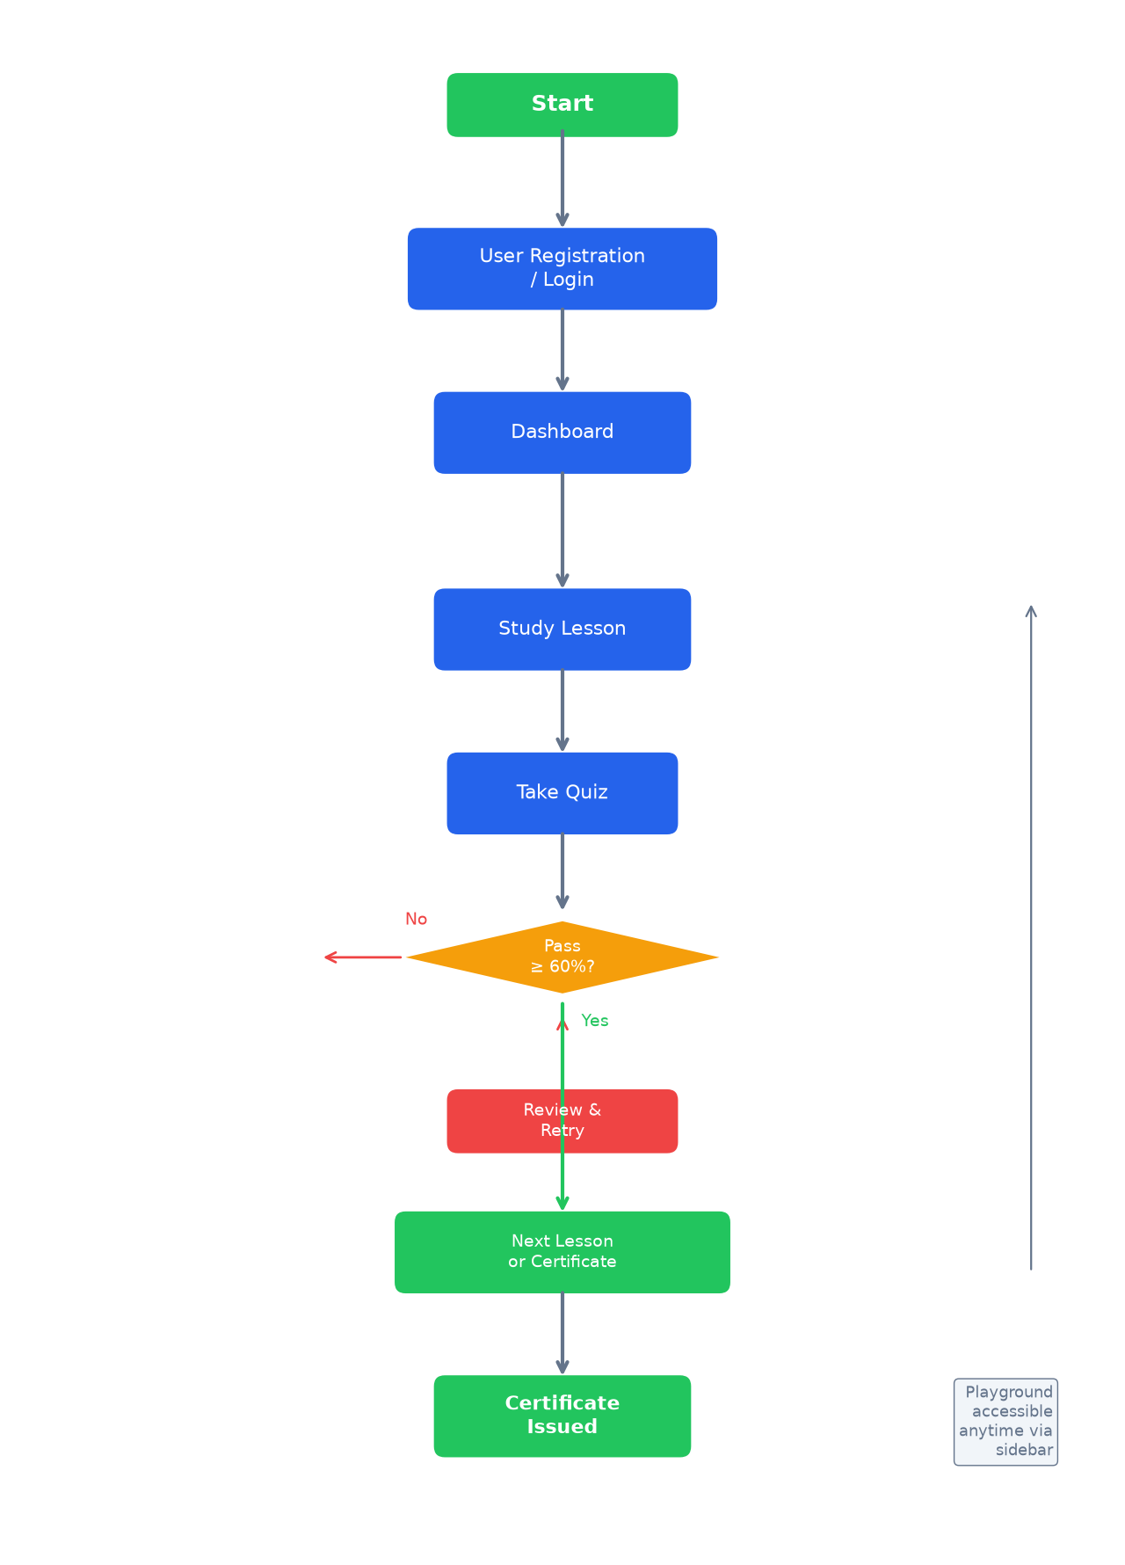
SLIDE 10
System Flowchart: User Journey Through the Platform
System Flowchart
Complete user journey from registration to certificate issuance.

Slide 11
SLIDE 11
Contributions to Knowledge and Conclusion
Contributions
Conclusion / Recommendations
▸ Integrated platform combining structured lessons, playground, assessment, certification, and gamification in one free system.
▸ Mastery-based locked progression enforcing prerequisite understanding.
▸ Secure in-browser code execution via isolated subprocesses.
▸ Automated certification with unique verification codes.
▸ Reference implementation of Django for educational web apps.
▸ All objectives were achieved: structured lessons with locked progression, secure authentication, interactive playground, automated quiz scoring, progress tracking, certification, and a leaderboard were implemented and verified through testing.
▸ Recommendations include adopting the platform for introductory programming, extending with more courses, and adding adaptive learning features.

Slide 12
Thank You
Questions & Demonstration

