Slide 1
BSC PROJECT DEFENCE
AI-Driven Agricultural Supply Chain & Produce Scheduling System
Presented by Obayomi Samuel Oluwagbotemi
Matric No: CSC/22/124
Supervisor: 'Dr. Adeolu Obamehinti'
Dept. of Computer Science — OAUSTECH, Okitipupa

Slide 2
SLIDE 2
Introduction
▸ Agricultural supply chains for fresh produce suffer significant post-harvest losses due to poor coordination, inefficient logistics, and lack of visibility.
▸ Farmers, buyers, transporters, and warehouse managers often operate in isolation, relying on manual and informal processes.
▸ Web-based platforms and data-driven techniques can improve coordination and reduce waste (Pressman & Maxim, 2020).
▸ AgriFlow AI is an intelligent web platform that unifies supply chain participants and applies deterministic decision rules to improve efficiency.
▸ The system integrates a marketplace, perishable-first scheduling, demand forecasting, spoilage tracking, and an AI assistant grounded in live data.

Slide 3
SLIDE 3
Motivation / Statement of the Problem
▸ A substantial proportion of fresh produce is lost between harvest and consumption due to poor logistics and weak coordination.
▸ Deliveries are frequently scheduled without regard to perishability; the most time-critical produce is not prioritised.
▸ Demand is rarely anticipated systematically, causing both shortages and surpluses that increase waste.
▸ Operational data is often complex and difficult for non-experts to interpret, limiting its usefulness for decision-making.
▸ These challenges motivated the development of AgriFlow AI as an integrated, intelligent, and practical platform for produce supply chain management.

Slide 4
SLIDE 4
Aim and Objectives of the Study
Aim
Objectives
▸ To design and implement an intelligent web-based agricultural supply chain platform that unifies participants and applies data-driven decision rules to improve efficiency and reduce post-harvest losses.
▸ Design a role-based platform for 5 user types
▸ Implement a produce marketplace with order management
▸ Develop a deterministic perishable-first scheduling engine
▸ Implement demand forecasting and shelf-life spoilage tracking
▸ Integrate an AI assistant grounded in live operational data
▸ Evaluate functionality and reliability through testing

Slide 5
SLIDE 5
Significance of the Study
▸ Economic Impact: Reduces post-harvest losses through perishable-first scheduling and spoilage tracking, improving incomes and lowering costs.
▸ Social Impact: Strengthens coordination among supply chain participants and contributes to food security by reducing food waste.
▸ Technological Impact: Demonstrates integration of web technologies, deterministic optimisation, and grounded AI for agricultural challenges.
▸ Practical Impact: Provides a working model for combining reliable rule-based logic with accessible natural-language explanations for non-expert users.

Slide 6
SLIDE 6
Literature Review
▸ Post-harvest loss is a central concern in agricultural supply chains; effective management minimises losses through improved coordination (Christopher, 2016).
▸ Electronic marketplaces improve access but do not solve logistical challenges; integrated platforms deliver greater value (Sommerville, 2016).
▸ Deterministic rules such as perishable-first scheduling, moving averages, and haversine distance give reliable, explainable decisions.
▸ AI must be grounded in verified data to avoid fabrication; it should explain rather than decide (Russell & Norvig, 2021).
▸ Gap: Few systems integrate marketplace, perishability-aware logistics, forecasting, and grounded AI assistance in one platform.

Slide 7
SLIDE 7
Methodology
Approach
Architecture
Stack
Agile SDLC with automated end-to-end testing across all roles.
Serverless: Next.js server components + cloud database.
Next.js 14, TypeScript, Tailwind; Supabase PostgreSQL + RLS.
Scheduling
Forecasting
AI Assistant
Perishable-first; nearest warehouse; least-busy transporter.
Simple & weighted moving averages over 8 weeks.
Google Gemini — explains live data only; all decisions are deterministic.

Slide 8
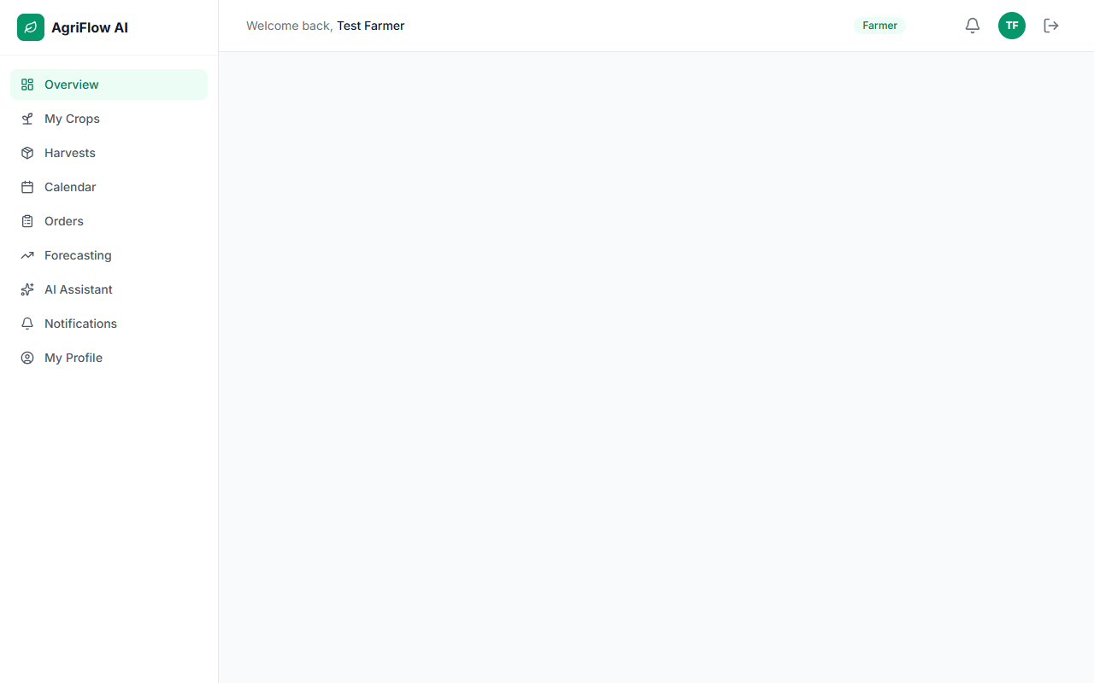
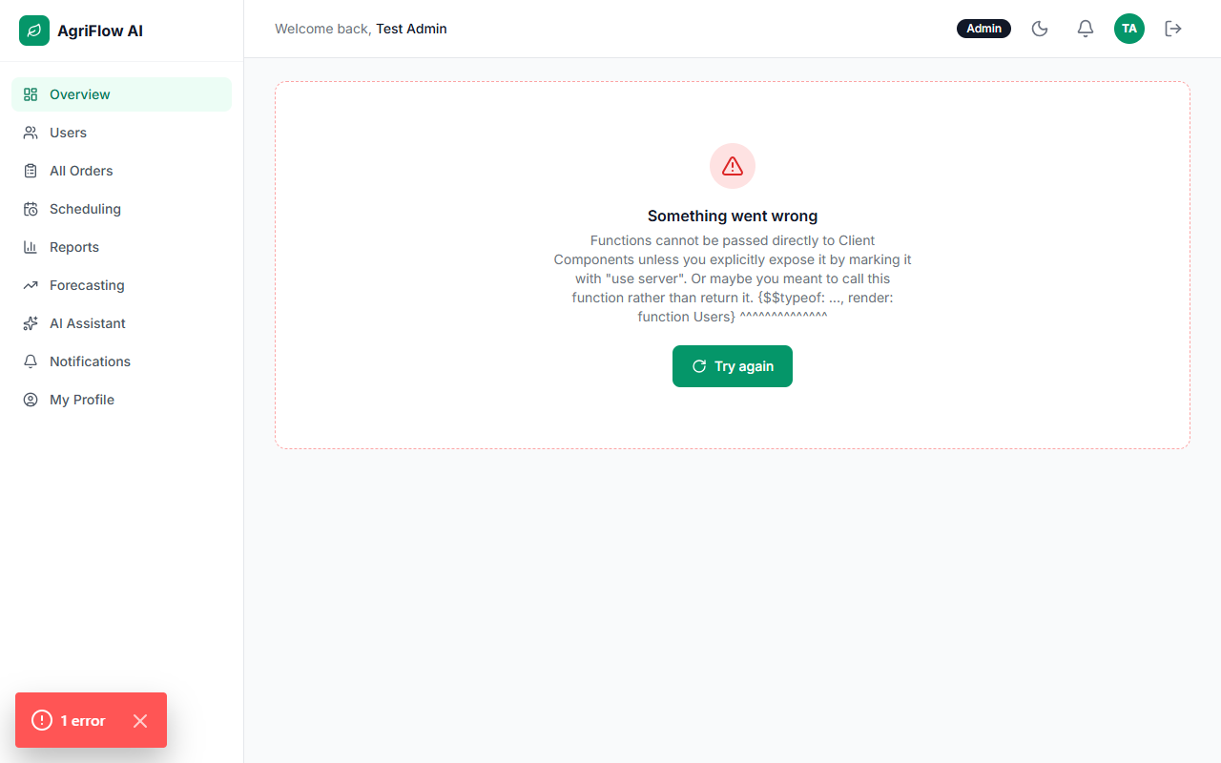
SLIDE 8
Implementation
Figure 1: Farmer & Buyer Dashboards
Figure 2: Scheduling & AI Assistant
Role-based dashboards for crop management, marketplace browsing, and orders.
Perishable-first scheduling engine and AI assistant grounded in live data.

Slide 9
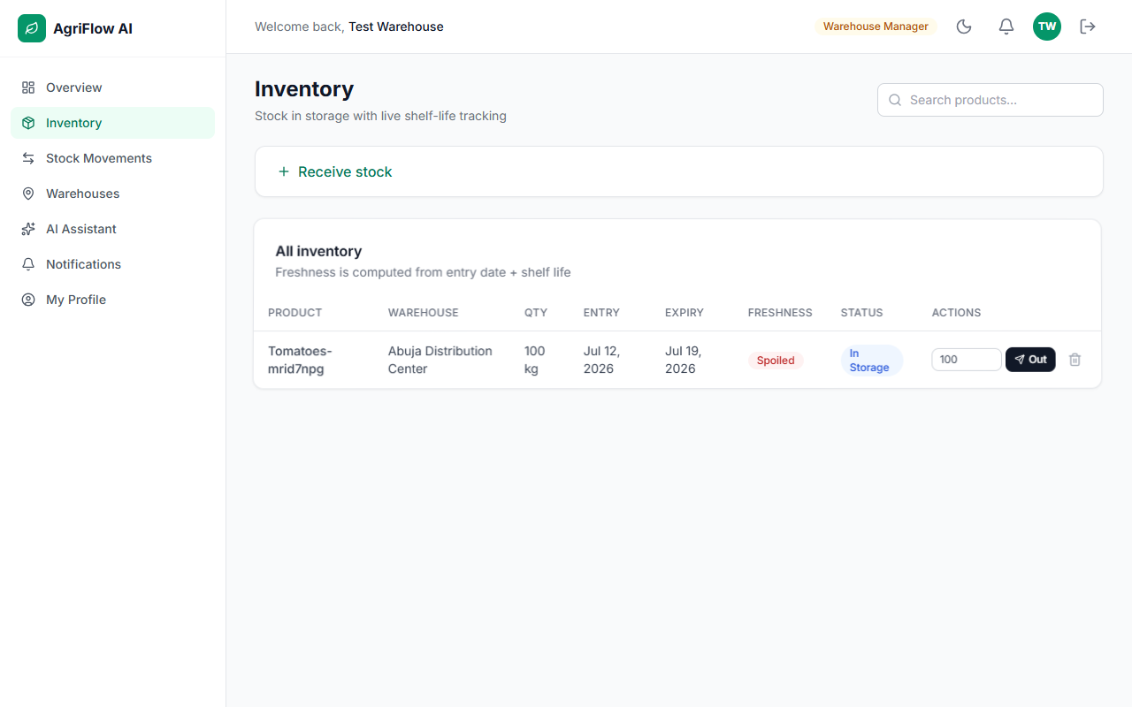
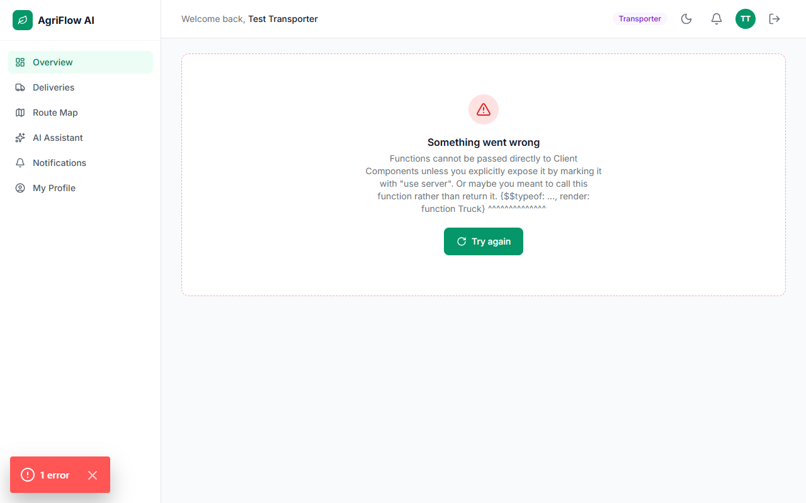
SLIDE 9
Results & Discussion
Figure 3: Warehouse Inventory
Figure 4: Transport & Admin Views
Inventory management with live shelf-life alerts and spoilage tracking.
Delivery workflow, route map, and admin scheduling dashboard.

Slide 10
SLIDE 10
Contributions to Knowledge
▸ A unified, role-based platform integrating marketplace, logistics, inventory, and analytics for agricultural supply chain management.
▸ A deterministic perishable-first scheduling engine that prioritises deliveries by remaining shelf life and optimises warehouse and transporter assignments.
▸ Demand forecasting using simple and weighted moving averages, with trend indicators for accessible planning support.
▸ Continuous shelf-life spoilage tracking that classifies stored items as fresh, expiring, or spoiled for proactive decision-making.
▸ An AI assistant grounded in live operational data that provides natural-language explanations, making complex data accessible to all users.

Slide 11
SLIDE 11
Conclusion / References
Conclusion
References
▸ All objectives were achieved: a role-based platform for five user types, a marketplace with order management, a perishable-first scheduling engine, demand forecasting, spoilage tracking, and an explanatory AI assistant were implemented and tested.
▸ The platform demonstrates that combining a unified digital system with deterministic optimisation and grounded AI improves supply chain efficiency.
▸ Christopher, M. (2016). Logistics and supply chain management (5th ed.). Pearson.
▸ Elmasri, R. & Navathe, S. B. (2017). Fundamentals of database systems (7th ed.). Pearson.
▸ Google. (2024). Gemini API documentation. ai.google.dev
▸ Pressman, R. S. & Maxim, B. R. (2020). Software engineering (9th ed.). McGraw-Hill.
▸ Russell, S. J. & Norvig, P. (2021). Artificial intelligence: A modern approach (4th ed.). Pearson.
▸ Sommerville, I. (2016). Software engineering (10th ed.). Pearson.
▸ Supabase. (2024). Supabase documentation. supabase.com/docs

Slide 12
Thank You
Questions & Demonstration

