Slide 1
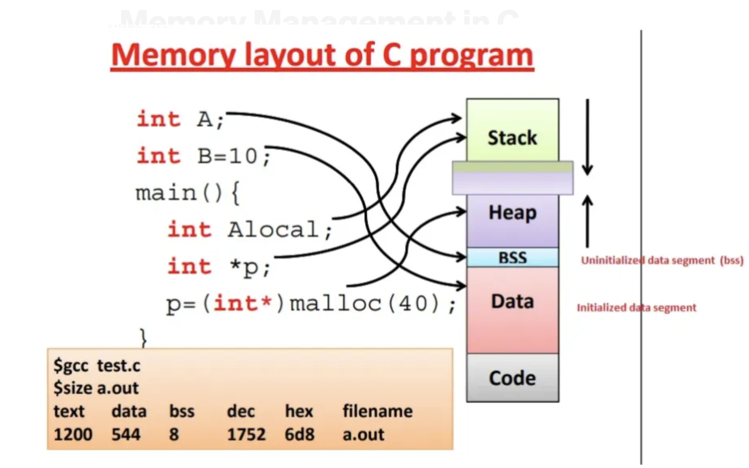
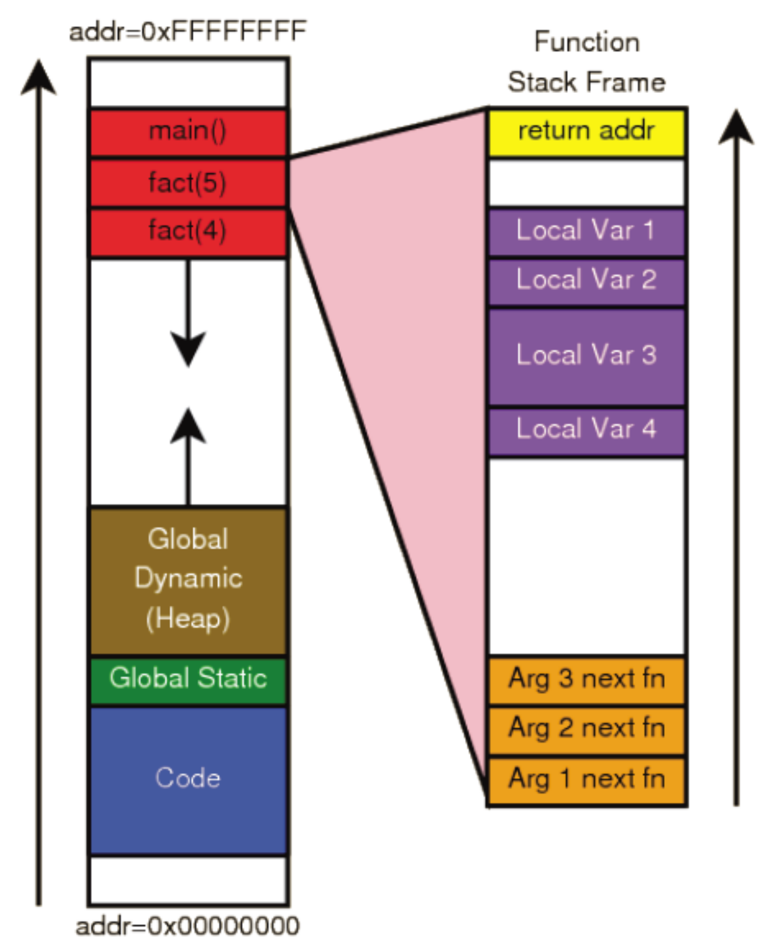
Under the hoods …
https://embeddedwala.com/Blogs/embedded-c/memory-layout-of-c-program#google_vignette

Slide 2
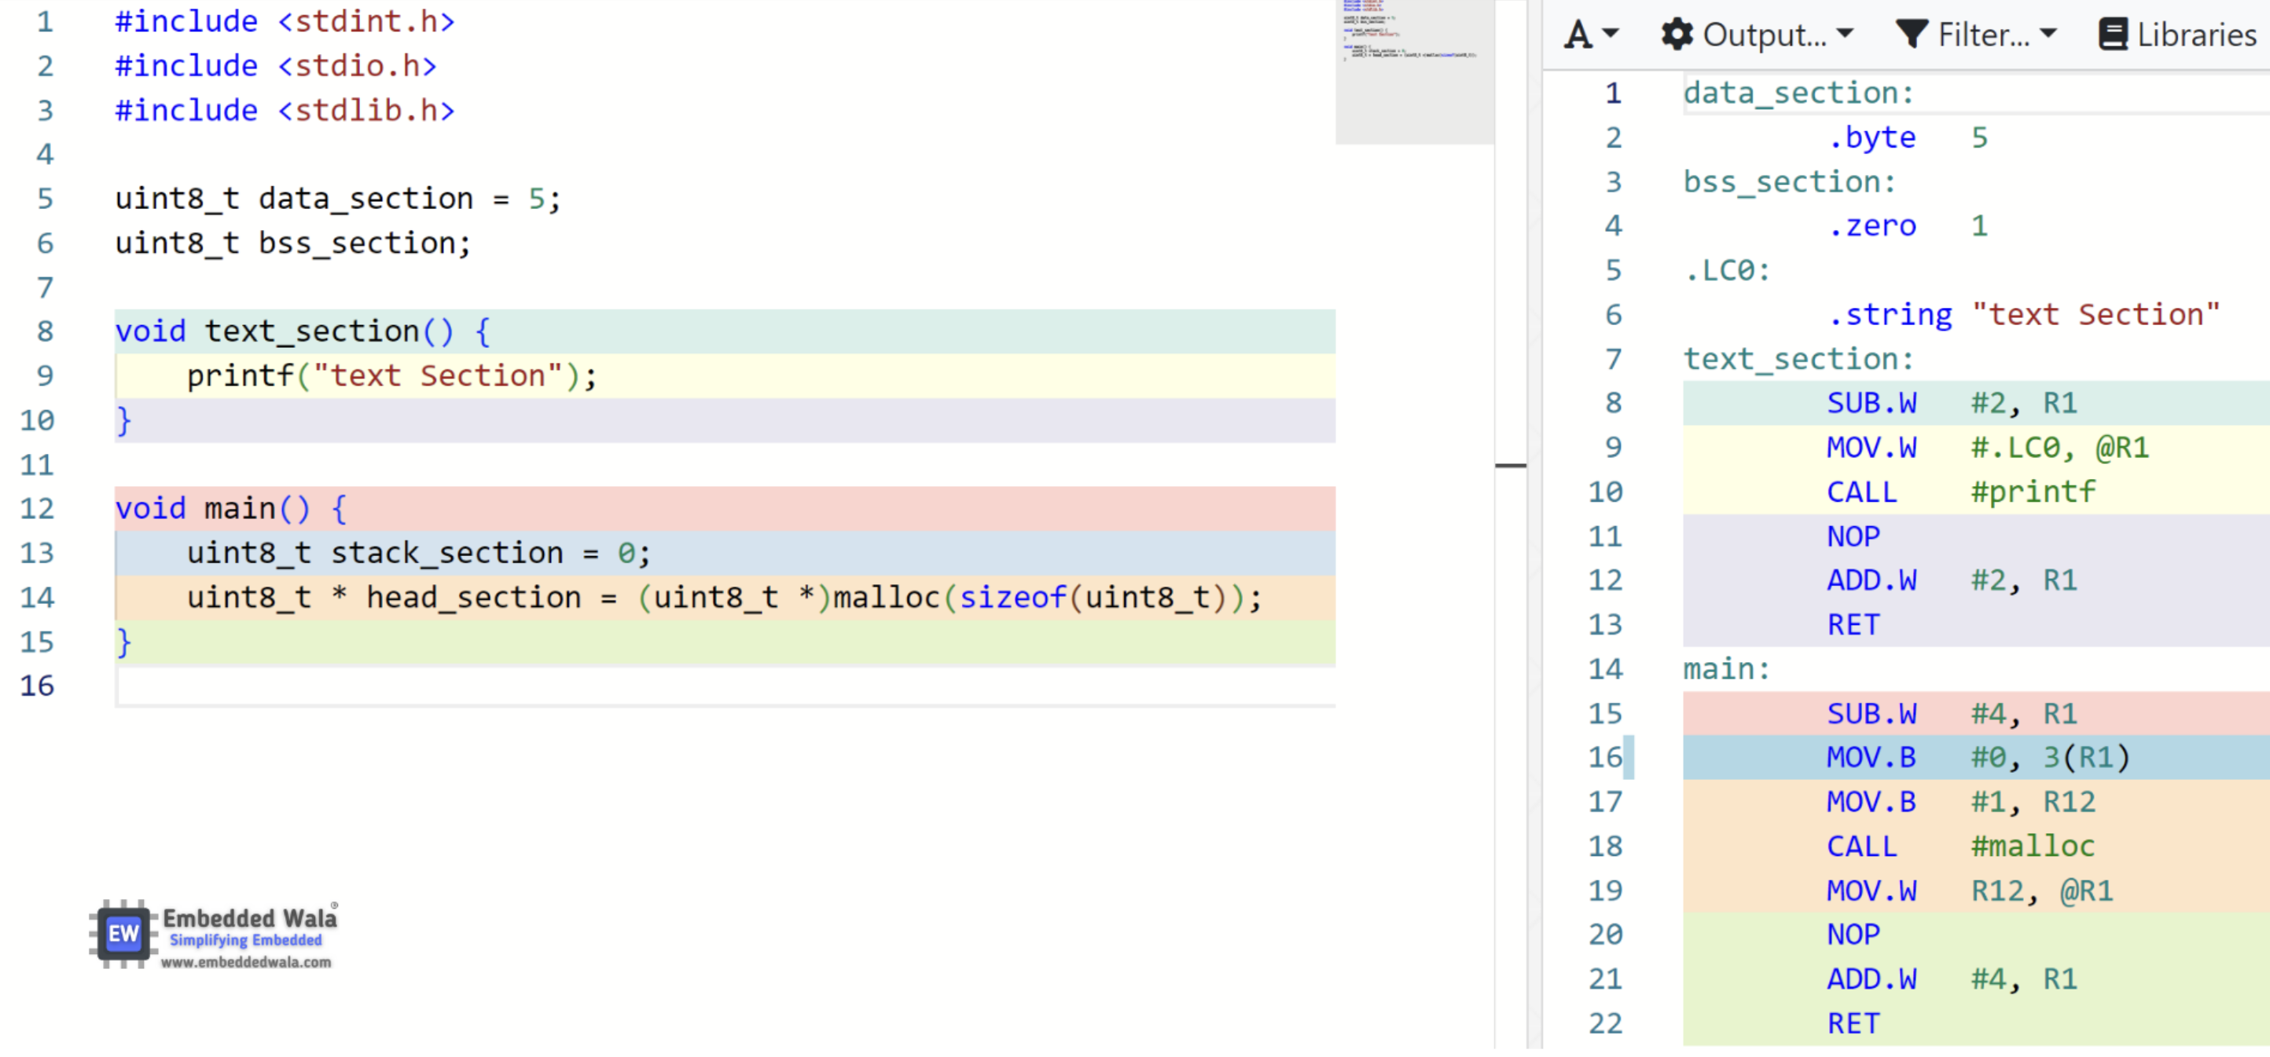
Under the hoods …

