Slide 1
Black Box Testing
Testing the application functionality without having programming knowledge or no knowledge of the internal workings of the system, is called Black Box testing.
This helps to catch any issues or bugs that might affect the how the software works.
Input
Execute Program
OutPut
Black box Testing
This method can be applied to each level of software testing such as Integration, system testing, UAT (User Acceptance testing), and functional testing
Black box also called Closed box testing, functional testing, or Behavioral testing.

Slide 2
Advantages of Black Box Testing:
No need to learn any programming language, tester can be non-technical background.
Used to test the functionality in actual system and the given specification.
Testcases can be complete as soon as the functionality developed.
Tests are executed from the user’s or client point of view.
Disadvantages of Black box testing:
It is difficult to identify the possible inputs in a limited period of time.
Chances of having unidentified path.
There is a possibility of testing the test repeatedly while implementing the testing process.

Slide 3
Black Box Testing Techniques:
1.Equivalence Class partition (ECP)
2.Boundary Value Analysis(BVA)
3.Cause Effective Graph
4.State transition technique
5.Decision table
6.Use cases.

Slide 4
Equivalence Class partition:
Equivalence partitions are derived from requirements and specifications of the software
This approach will reduce the execution of testing time because of less number of test cases.
Equivalence partitioning is a technique of software testing in which input data is divided into partitions of valid and invalid values, and it is mandatory that all partitions must exhibit the same behaviour.

Slide 5
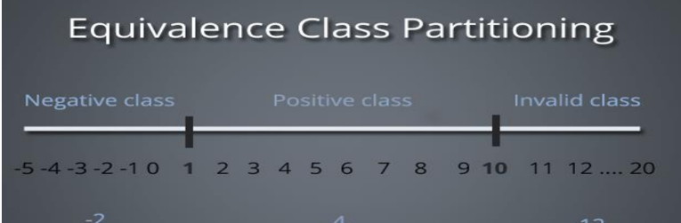
Example:
Consider a login functionality, in which username accepts only alphanumeric values.
***Valid partition – 0-9, a-z, A-Z.
*** Invalid Partition – Special characters (@, #, $...).
Therefore, username accepts valid partition data like deccansoft123, DECCANSOFT99 etc.
Example:
A text field accepts 1000 to 1500.
Valid partition – Any number between 1000 to 1500.
Invalid partition- Any number 1500.

Slide 6
Boundary Value Analysis:
Boundary value analysis (BVA) is based on testing the boundary values of valid and invalid partitions.
The Behavior at the edge of each equivalence partition is more likely to be incorrect than the behavior within the partition, so boundaries are an area where testing is likely to yield defects.
It is used to check the range of numbers. Range includes both lower and upper boundary for each partition
Formula: Min, Max, Min-1, Max+1
Valid Boundaries = Min, Max
Invalid Boundaries =Min-1, Max+1

Slide 7
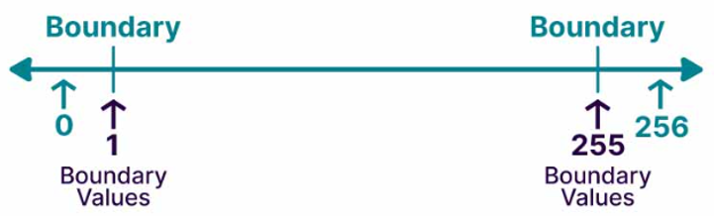
Ex 1:
Range between 1 to 256
Lower Boundary: 1,0,2
Upper Boundary: 255,254,256
Ex 2:
Consider login functionality, in which password accepts minimum -8 characters and maximum – 16 characters.
Now, check for the boundary values for password field.
Lower boundary – 8, 7, 9.
Upper boundary – 16, 15, 17.

Slide 8
Cause Effective graph:
Cause effective graph reflecting the relationships between specific combination of inputs (Causes) and outputs (Effects).
It accumulate only desired external behaviour of a system.
Cause effective graph is a technique to identify all the possible cause, for these causes identify effects on the requirements, based on this we can analyse the maximum test coverage with minimum possible test cases.

Slide 9
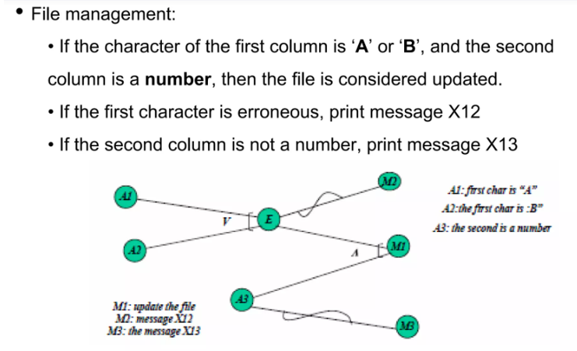
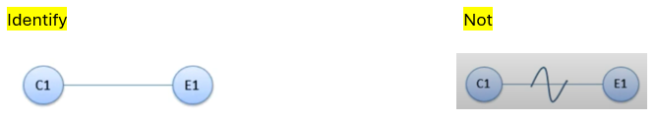
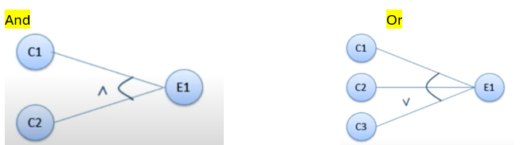
EX
Ex:
Notations for Cause Effective Graph:
Identify the causes and effects from the requirements, each cause consider of input conditions (AND, OR, NOT). A cause can be correct or incorrect.
Erroneous means wrong or incorrect

Slide 10
Decision Table:
A decision table is a good way to settle different combination inputs with their corresponding outputs and is also called a cause-effect table.
The Cause effective graph must be converted into decision tables, Each column of the decision table represents a test case.
This technique used to simplify any complex requirements, identify the causes and effects, and specify all the possibilities in the tabular format.
Requirement: “Withdrawal is granted if requested amount is covered by the balance or if the customer is granted credit to cover the withdrawal amount”.

Slide 11
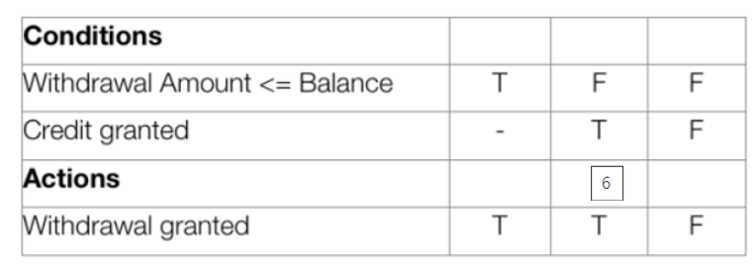



Rule:
Repeat the pattern above from left to right for the entire row. In other words, for a table with 8 columns,
the first row will read TFTFTFTF,
the second row will read TTFFTTFF and
the third row will read TTTTFFFF.

Slide 12
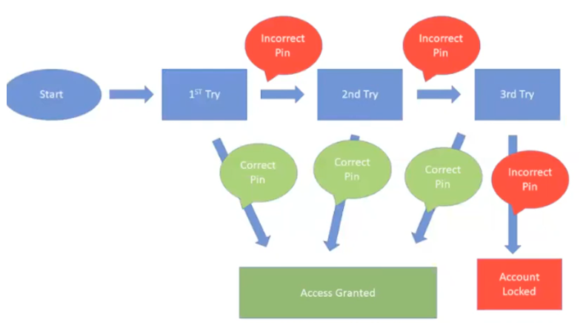
State Transition Technique:
The general meaning of state transition is, different forms of the same situation, and according to the meaning, the state transition method does the same.
It is a dynamic testing technique and used where some aspect of system can be described as “finite state machine”.
It is used to capture the behaviour of the software application when different input values are given to the same function.
Ex:
Let’s consider an ATM system function where if the user enters the invalid password three times the account will be locked.
In the flight reservation login screen, consider you have to enter correct agent name and password to access the flight reservation application.

Slide 13
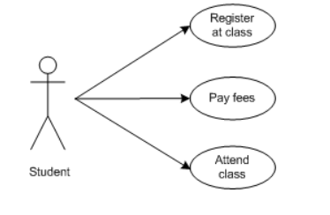
Use case:
We can also specify the requirements, it is easy to understand A use case is a pictorial representation of how the user interacts with a system or product.
Diagrammatic Use Case:
Use case is a pictorial representation of requirements. It explains how the end user interacts with the application. It gives all possible ways of how the end user uses the application. Below example explained in a diagrammatic format.
Ex: Student can do following functionalities at school.
Student should register to website.
Student should login to pay fees
Student attendance and marks send to the respective email id’s.
That helps in identifying test cases that cover the entire system transaction-by-transaction from start to finish. It is a description of how a specific user uses the system.
In this type of testing, use cases are written before the development phase begins. A testing team can use the use case document to create test cases.

Slide 14
Use Case Document: It has the below details
Use case id: unique number for every use case.
Use case name: requirement name.
• Goal: purpose of the requirement.
• Importance: high\medium\low.
• Frequency of use: how frequently the requirement is accessed.
• Reference: customer requirements, source of information to prepare this use case, SRS
• Actors: The user who has permission to access this requirement.
• Preconditions: The conditions to be satisfied to access this requirement.
• Description: explain all the business rules, functionalities in the requirement.
• Post conditions: the output results.
• Alternative flow: other different ways to do the same requirement
• Scenarios: functionalities to be tested.

Slide 15
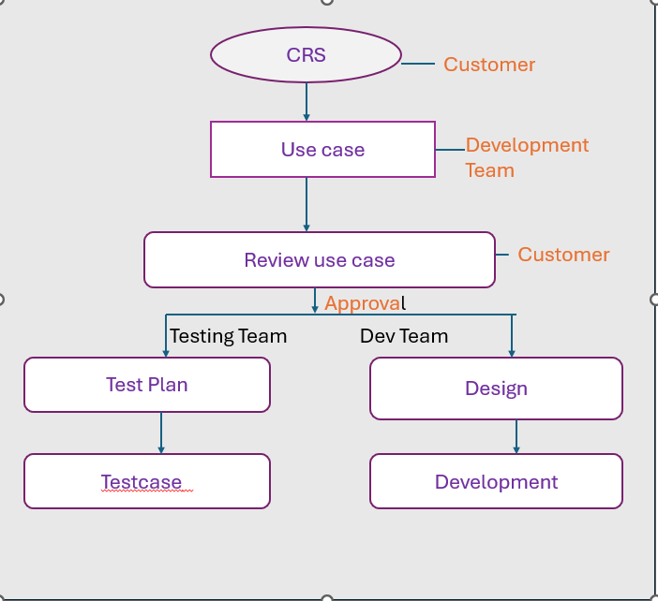

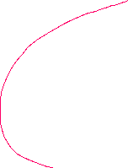
Who writes Use case
Customer gives the CRS for the application to be developed.
CRS – Customer requirement specification.
The development team write the use case for the CRS and the use case is sent to the customer for review.
If the customer approves it, then the approved use case is sent to the development team for design and coding. The approved use case is also sent to the testing team who start writing test plan and later on start writing test cases for the features of the application

Slide 16
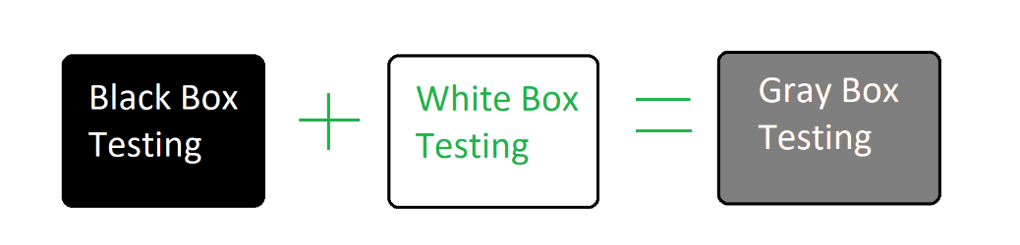
Gray Box Testing
Gray box testing is used to test the application with limited information about the internal working of the system.
Gray Box Testing is named so because the software program is like a semitransparent or gray box inside which the tester can partially see.
Gray box testing conducted on information such as state- based models or architecture diagrams of the system. It is also known as translucent testing, and it can apply mostly in integration testing.
It efficiently suits for functionality testing due to its characteristics; it also helps to confirm that software meets the requirements.

Slide 17
Objectives of Gray Box Testing
To provide combined advantages of both black box testing and white box testing.
To combine the input of developers as well as testers.
To improve overall product quality.
To reduce the overhead of long process of functional and non-functional testings.
To provide enough free time to developers to fix defects.
To test from the user point of view rather than a designer point of view.
Ex:
In a bank application, for the deposited amount we need to validate the interest calculation. Interest is calculated once for 3 months.
Therefore, we need to wait for 3 months and go to database and change deposit date to 3 months backdate and again front end check the total amount.
Advantages:
• It offers combined strengths of both black box and white box testing wherever applicable.
• It used mostly on web application.
• With the help of limited knowledge, we can handle complex scenarios very efficiently.
Disadvantages:
• We cannot conduct complete white box testing because of source code or binaries are not available.
• Defect identification is difficult when we perform grey box testing for a distributed system.

Slide 18
Dynamic Testing Methods
White box testing
Black box Testing
Gray box Testing

