Slide 1

Group Ziplock Project Progress Report
5/7/2026
Charles Gao
Gary Zeng
Anuj Patel
Allen Lai

Slide 2
Objectives
Build a California ZCTA-year dataset from housing, demographics, schools, crime, amenities, and minimum wage.
Predict next year's median sale price using information available from the current year.
Compare interpretable and nonlinear ML models to identify which local factors matter most.

Slide 3
Motivation
California housing prices differ sharply across neighborhoods.
Earlier price signals can help explain affordability pressure before it fully appears in the market.
Public local data may reveal where prices are likely to rise next.

Slide 4
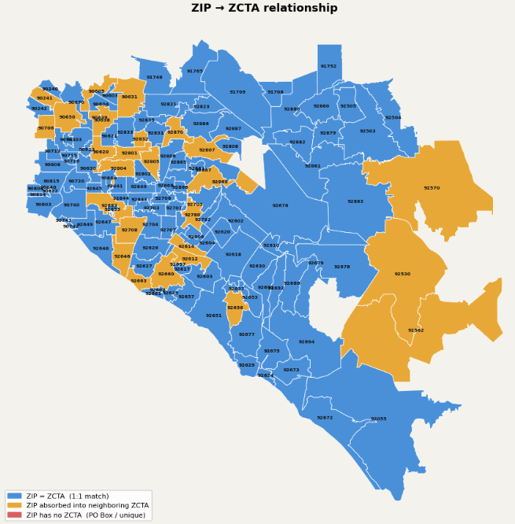
ZCTAs vs Zip Code
Zip Code
US Postal Service pointed-based routes used for mail delivery
ZCTAs
Area based polygons created by Census Bureau for their metrics
ZCTAs sometimes are slightly different from Zip Code
Convert ZCTAs to Zip Code using a US Housing and Urban Department (HUD) Crosswalk between Zip Code and ZCTA

Slide 5
Data & Management

Slide 6
Data Sources
Previous Data Sources
Redfin Housing Data
US Census Data
School Quality
Minimum Wage Data
New Data Sources
Crime in Zip Code
California Department of Justices
Amenities
Parks, Beverage Shop, Fitness, Restaurants
American Community Survey

Slide 7
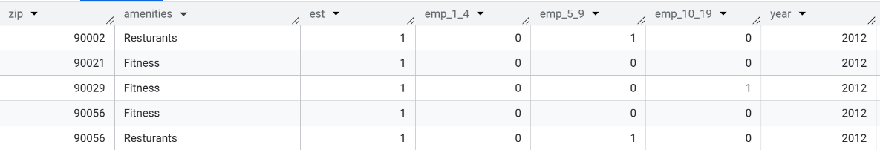
Data Description
Amenities
zip | amenities | est | emp_1_4 | emp_5_9 | emp_10_19 | year
INT | String | INT | INT | INT | INT | INT

Slide 8
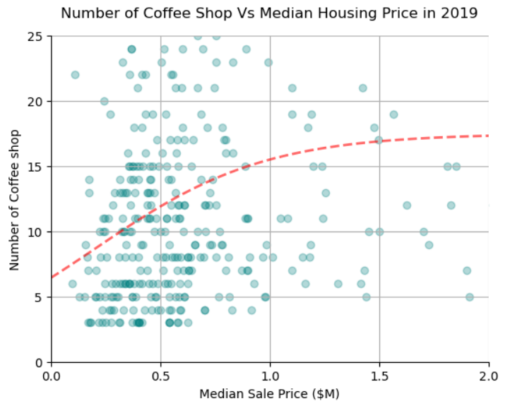
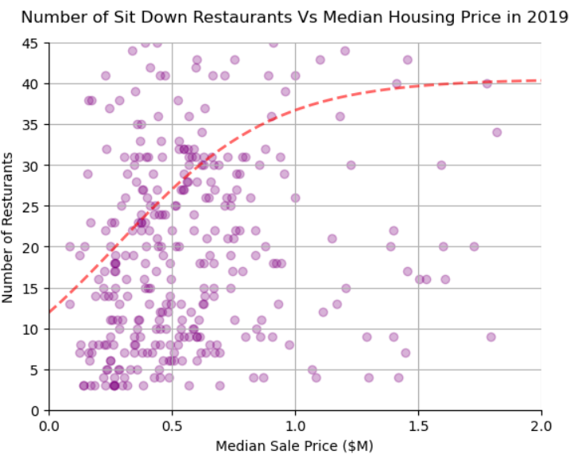
Amenities EDA
Number of Amenities to Median Housing Price

Slide 9
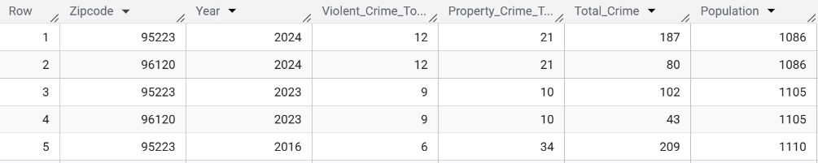
Data Description
Department of Justice California
Zip Code | Year | Violent Crime Total | Property Crime Total | Total Crime | Population
INT | INT | INT | INT | INT | INT

Slide 10
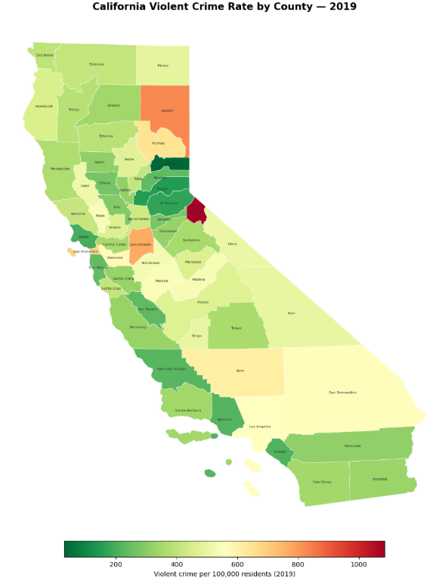
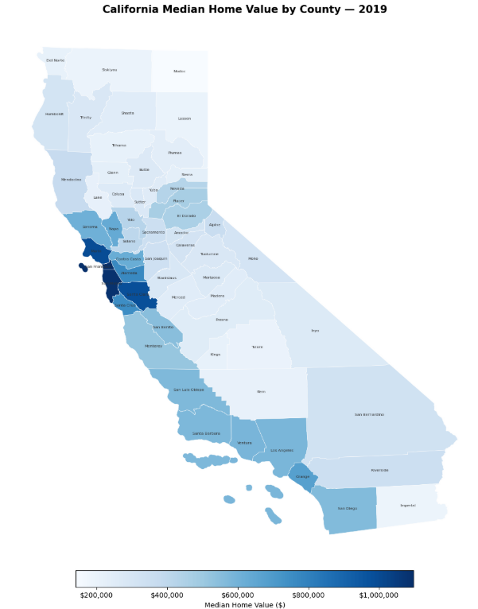
Crime

Slide 11
Methodologies

Slide 12
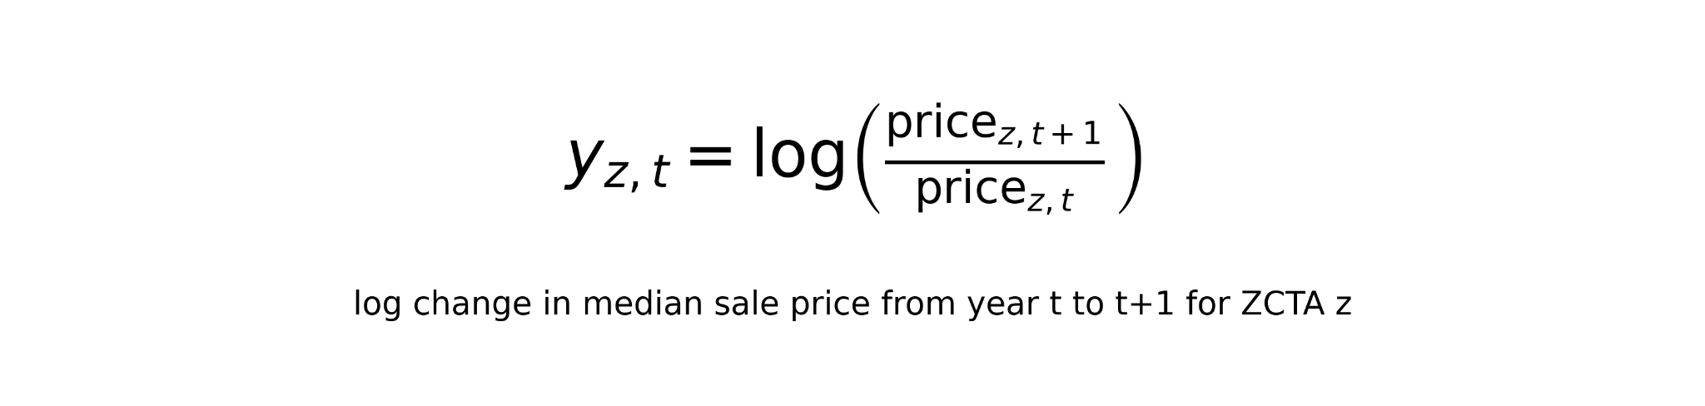
Modeling Goal and Setup
Target: next-year median sale price
Unit of observation: one California zcta5 in one year.
Training/CV data: 2012-2022
Time-blocked expanding-window cross-validation
Final test data: 2023, targeting 2024
Outcome:

Slide 13
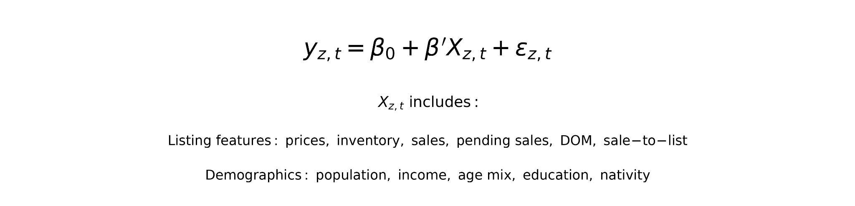
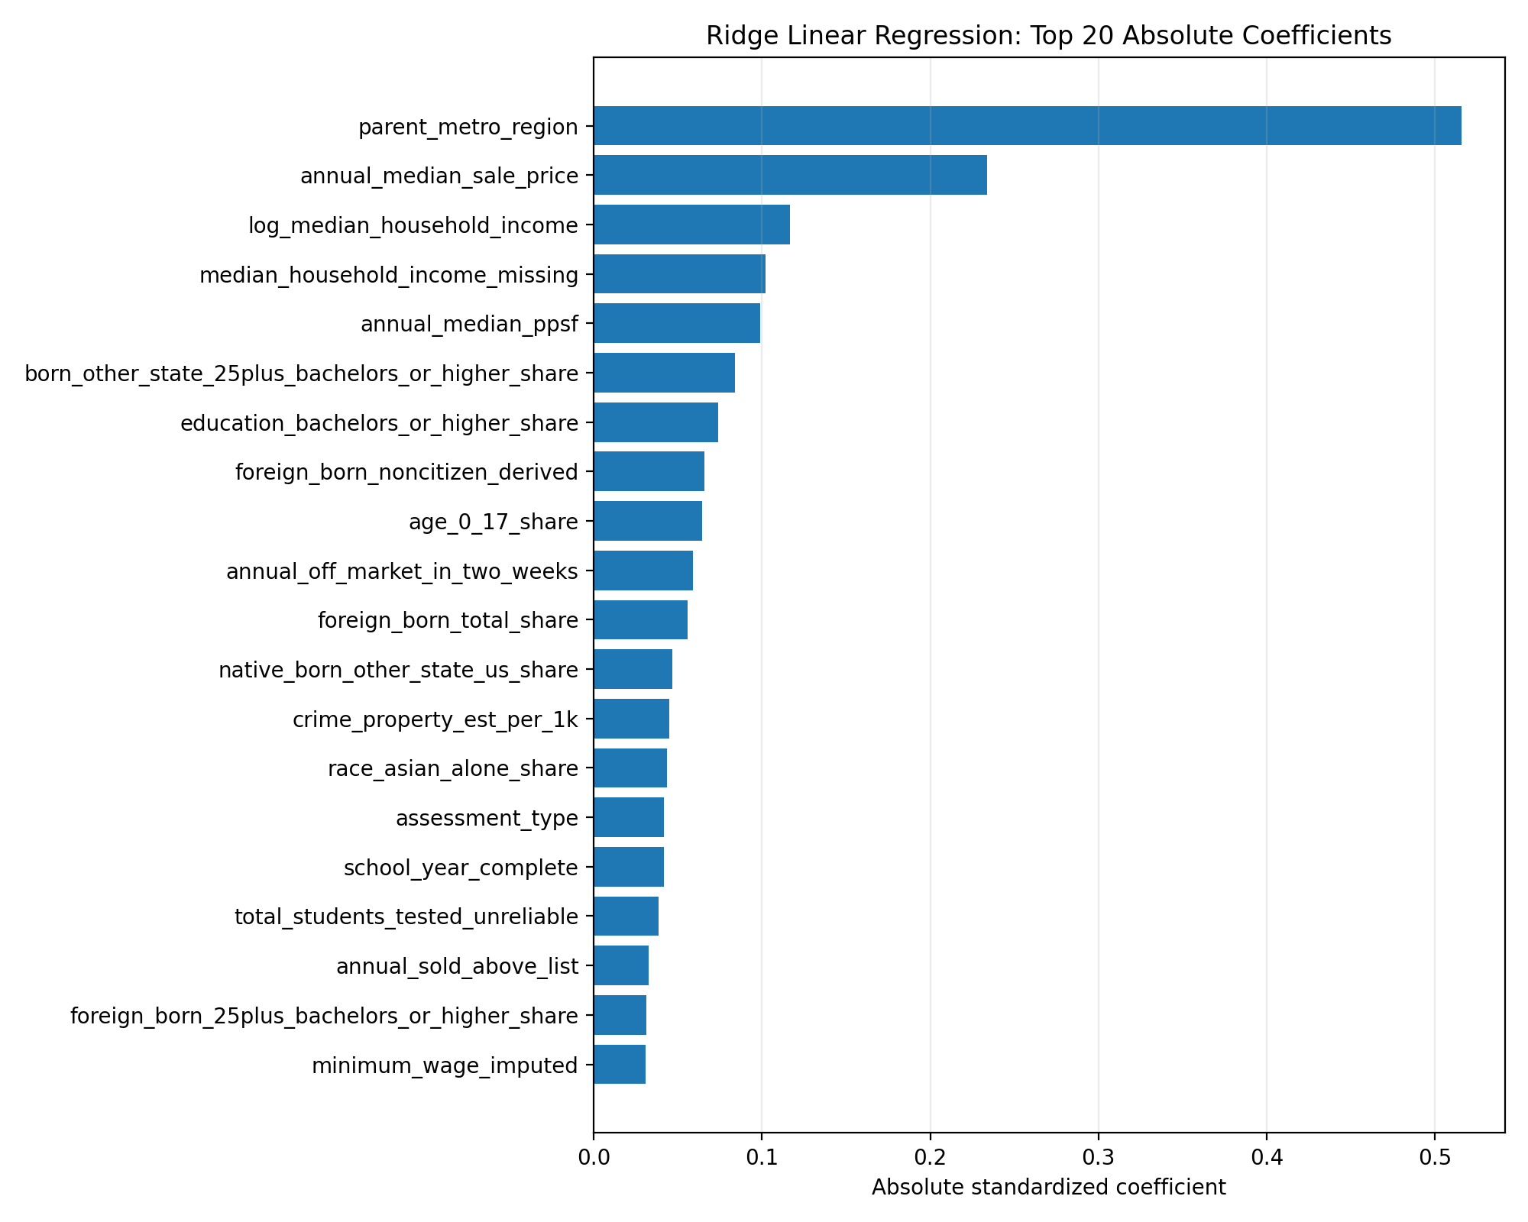
Linear Regression
What is parent_metro_region?
Why?
Simple
Benchmark
Ridge
L2 regularization to reduce coefficient instability

Slide 14
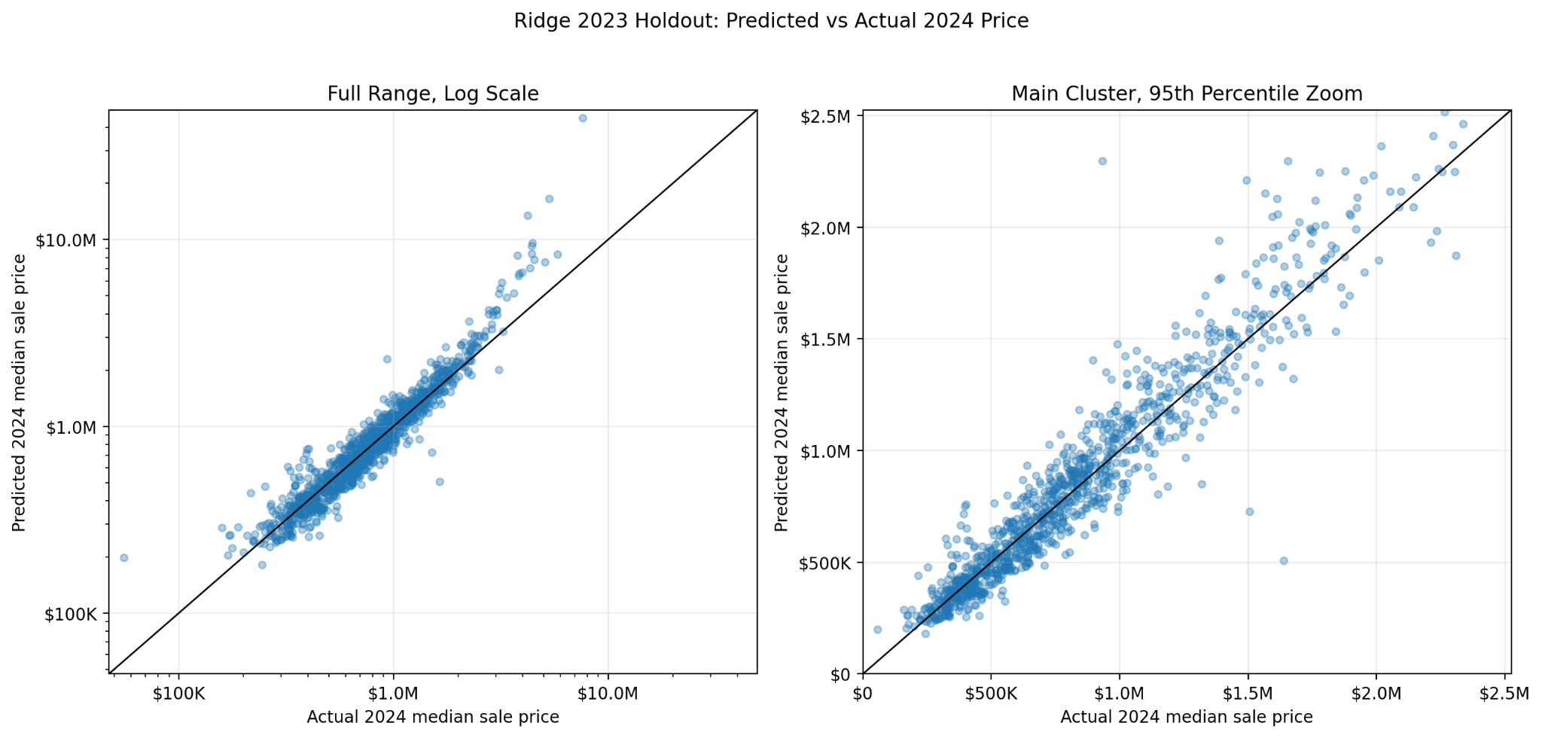
Linear Regression continued

Slide 15
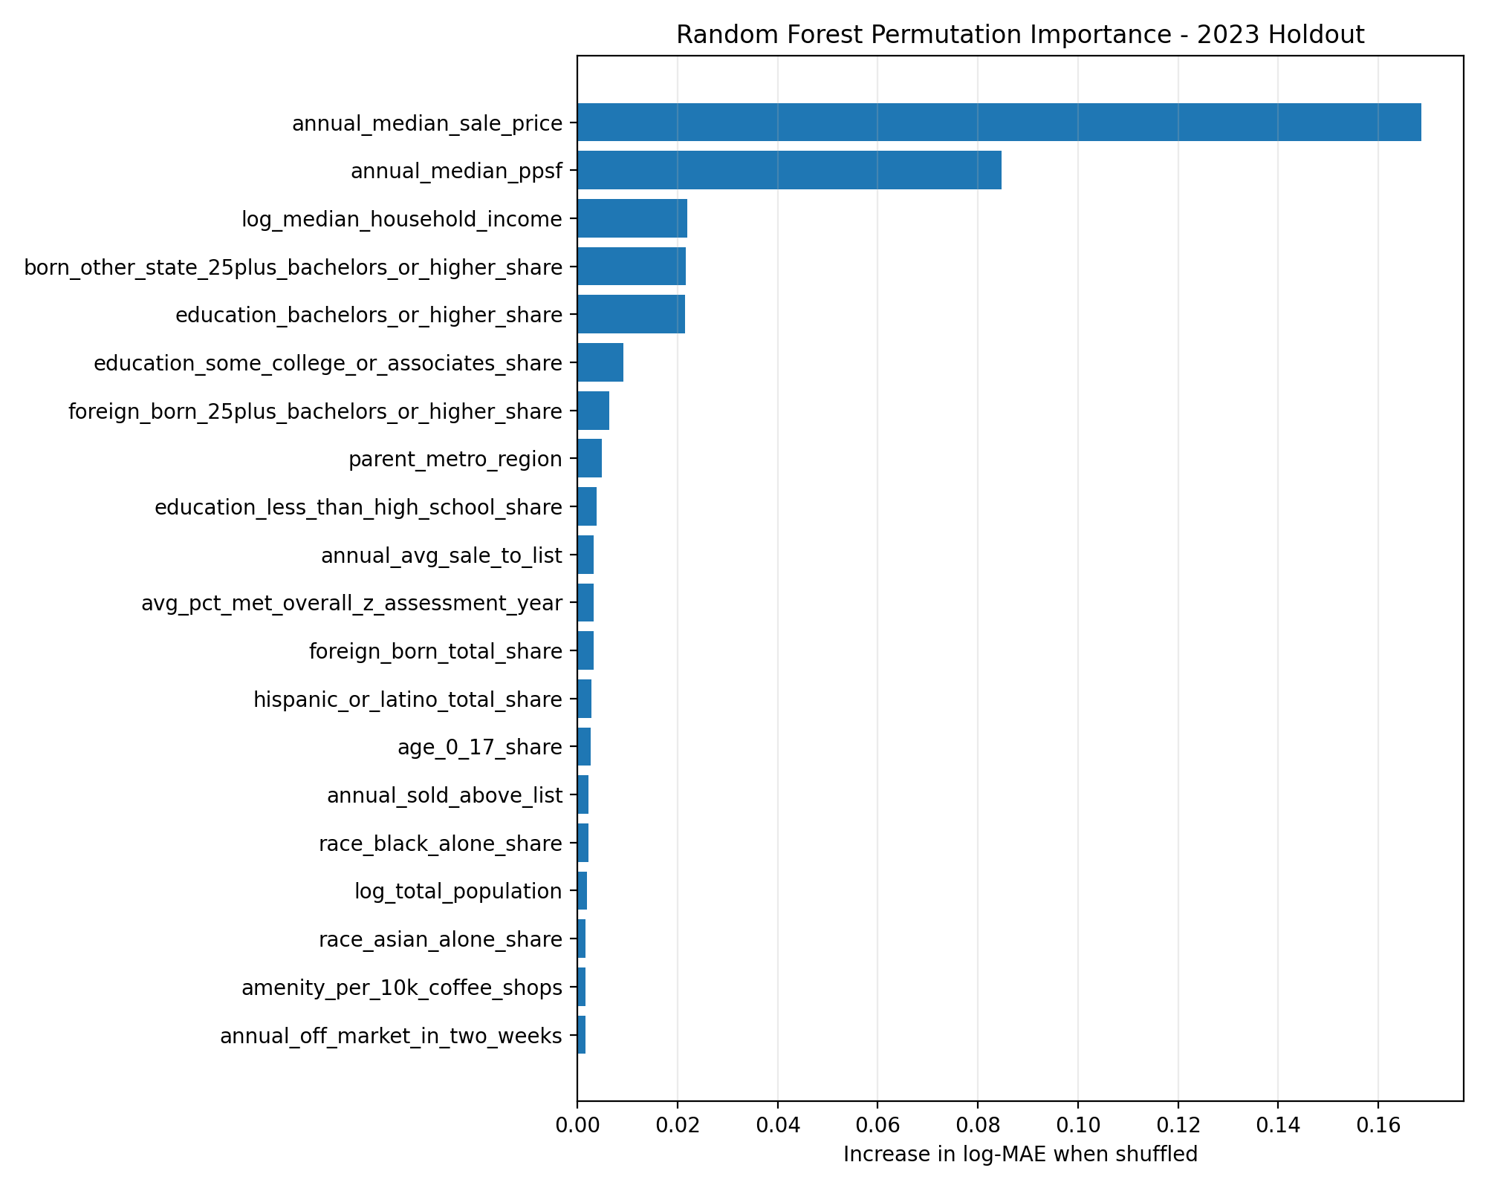
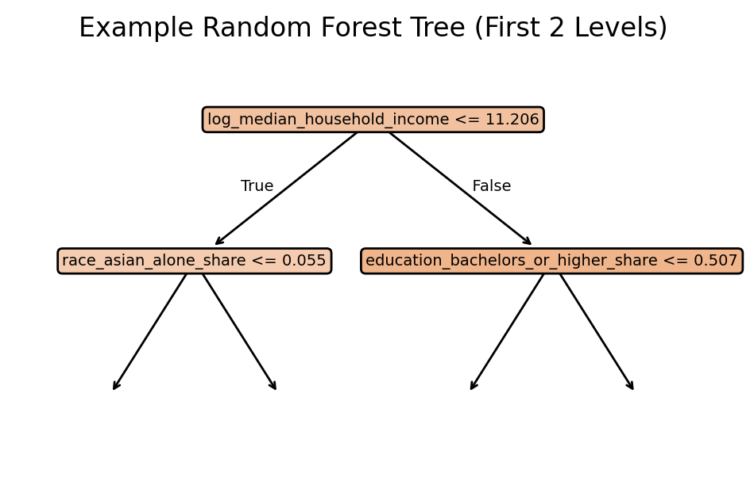
Random Forest
Why?
Feature importance
Nonlinear relationships

Slide 16
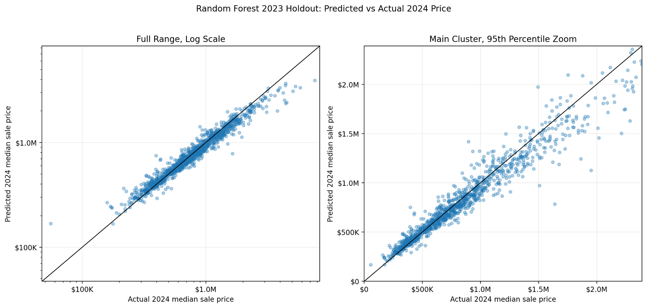
Random Forest continued

Slide 17
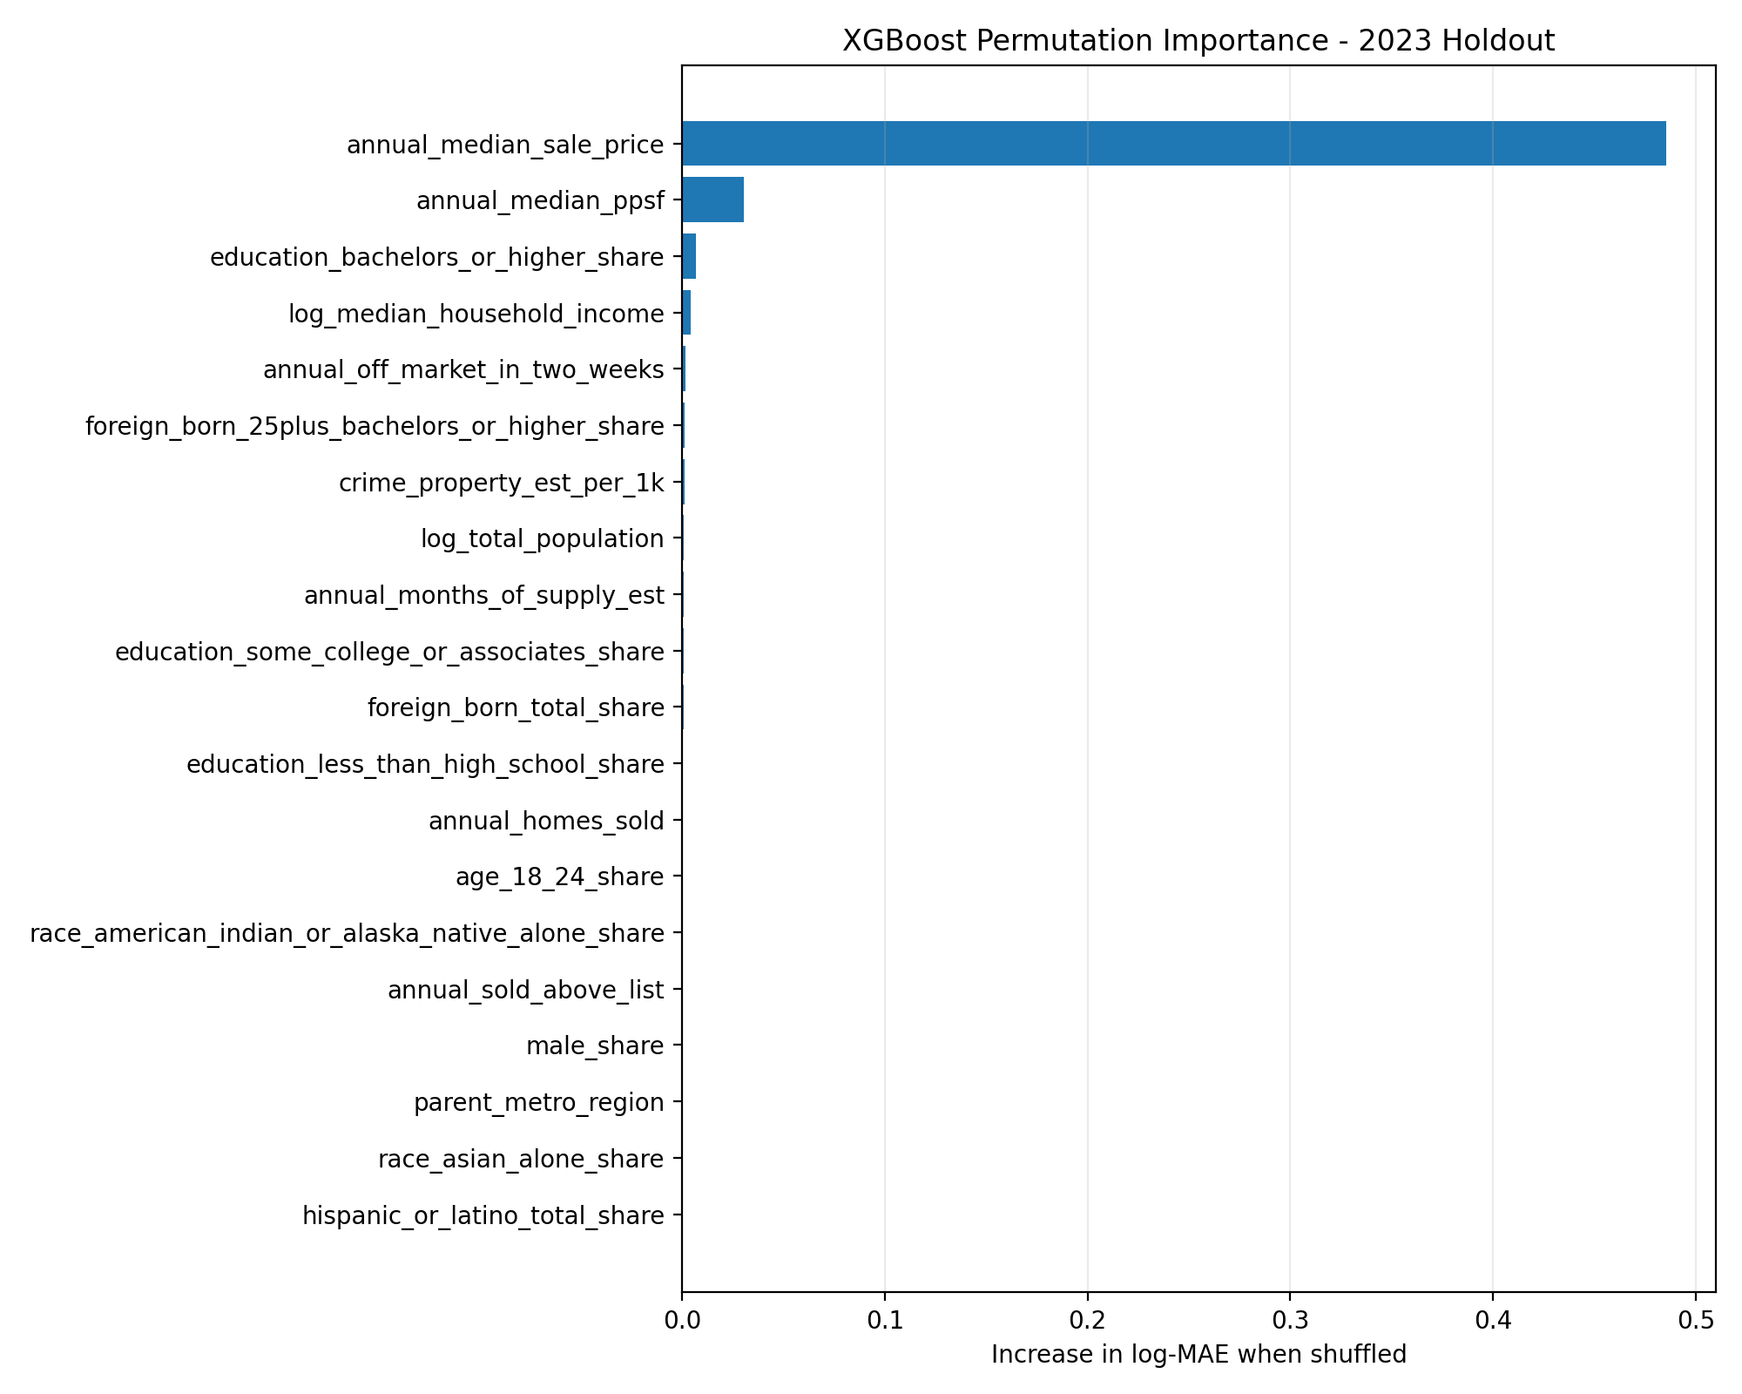
XGBoost
Median_sale_price dominates !!!
Why?
Feature interactions
Nonlinear relationships
Regularization, shrinkage, and subsampling..
Parameters
700 estimators
0.035 learning rate
4 max depth
….

Slide 18
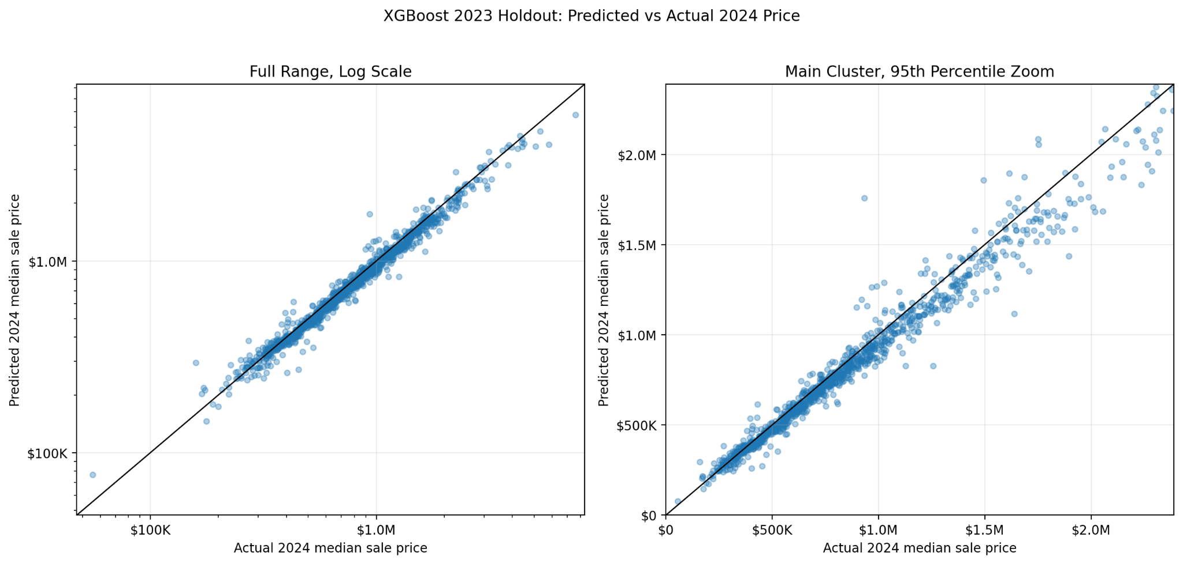
XGBoost continued

Slide 19
Results
Model | MAE | RMSE | R²
Linear/Ridge | $203.9 K | $1260 K | -2.32
Random Forest | $103.2 K | $246.0 K | 0.874
XGBoost | $68.8 K | $135.1 K | 0.962
Notes:
The primary standard is temporal validation, because our real goal is to use year t features to predict price growth in year t+1 under future market conditions.
A “good” model should have higher R², lower MAE/RMSE, and ideally positive temporal R², not just improvement relative to another model.
The grouped-ZCTA test is a secondary check: if R² is positive there, the model is learning meaningful cross-sectional differences across neighborhoods, even if forecasting over time is harder.
In our results, Model 2 outperforms Model 1 in both evaluation methods, so school features add some incremental signal.
However, the best temporal R² is still negative (-0.025), so the models are promising but not yet strong forecasting models; they currently explain spatial variation better than future market shifts.
After adding school features, Model 2 is better, but neither model is yet “good” in the strict forecasting sense because temporal prediction remains weak.

Slide 20
Milestones

Slide 21
Roadblocks
Roadblocks
Data Sources are messy and don’t cleanly fit into each other
School Data is missing 2 years of data
2014 due to company’s transition to new assessment regime
2020 due to covid

Slide 22
Milestone
Week 6-7
Finish training and tuning forecasting models
Week 7-9
Start and Finish Expo Poster
Finish final touches on figures

Slide 23
Thank You!

