Slide 1
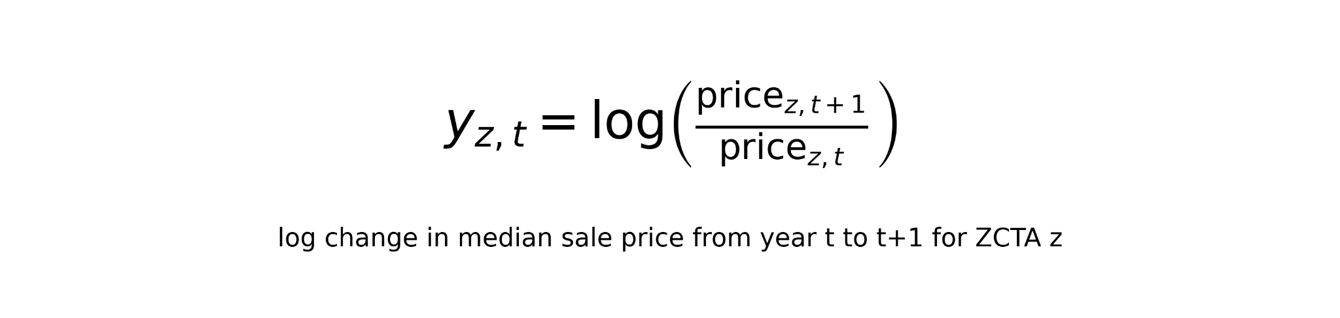
Modeling Goal and Setup
Target: next-year median sale price
Unit of observation: one California zcta5 in one year.
Training/CV data: 2012-2022
Final test data: 2023, targeting 2024
Outcome:

Slide 2
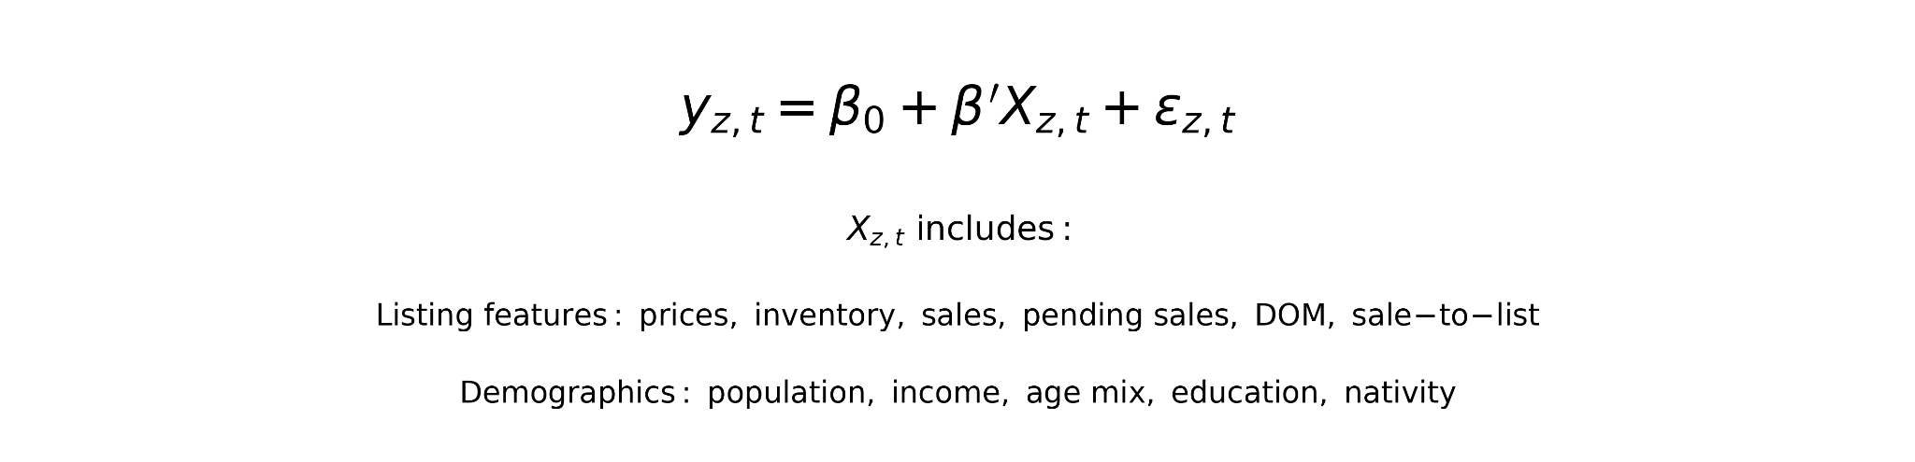
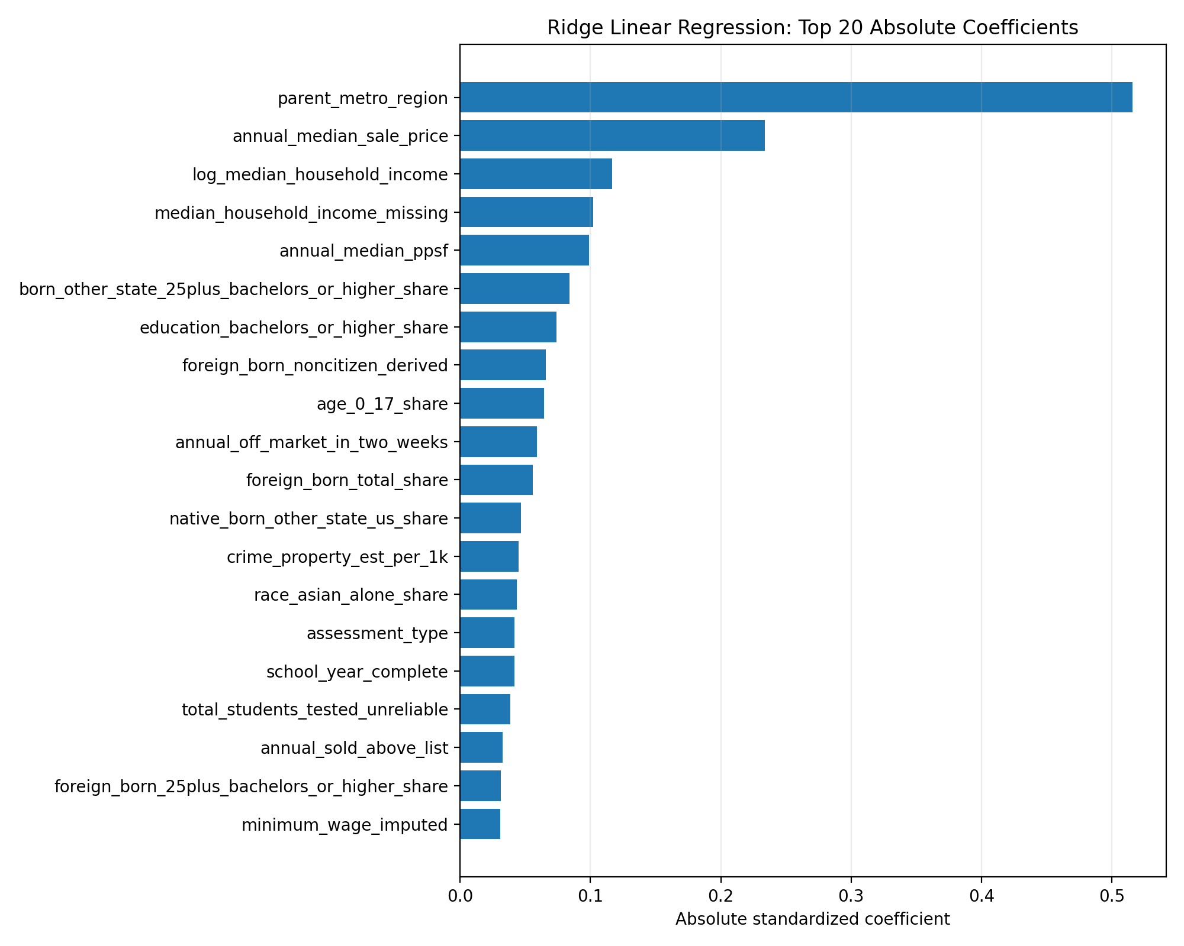
Linear Regression
What is parent_metro_region?
Why?
Simple
Benchmark
Ridge
L2 regularization to reduce coefficient instability

Slide 3
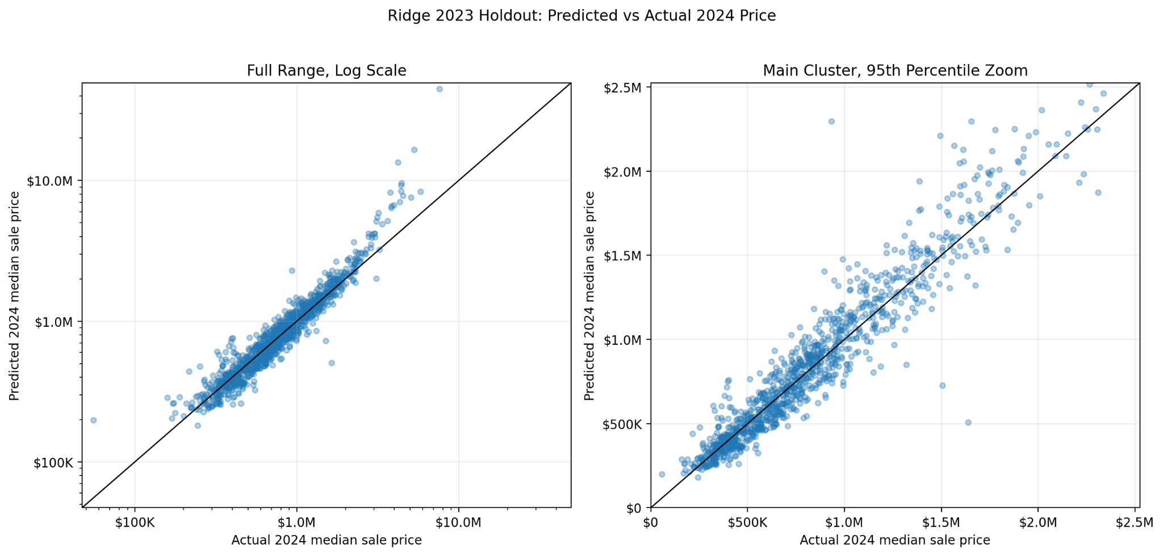
Linear Regression continued

Slide 4
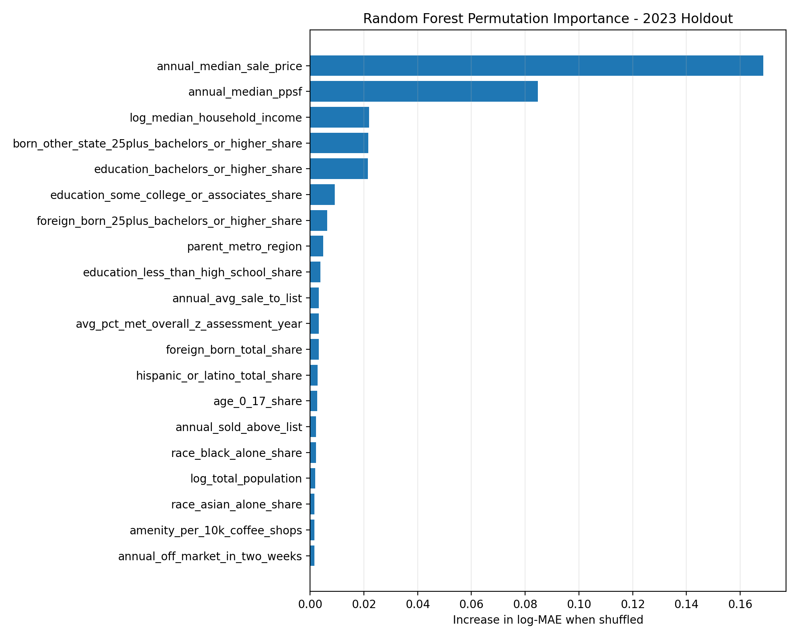
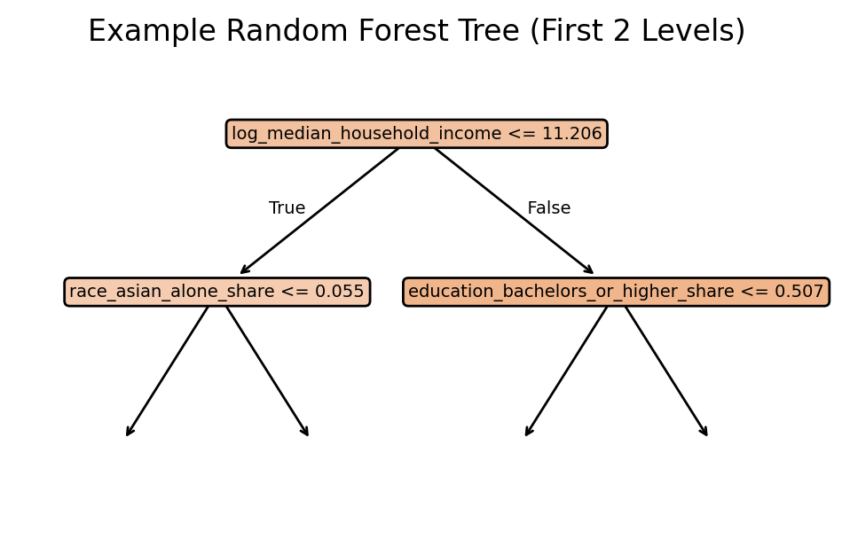
Random Forest
Why?
Feature importance
Nonlinear relationships

Slide 5
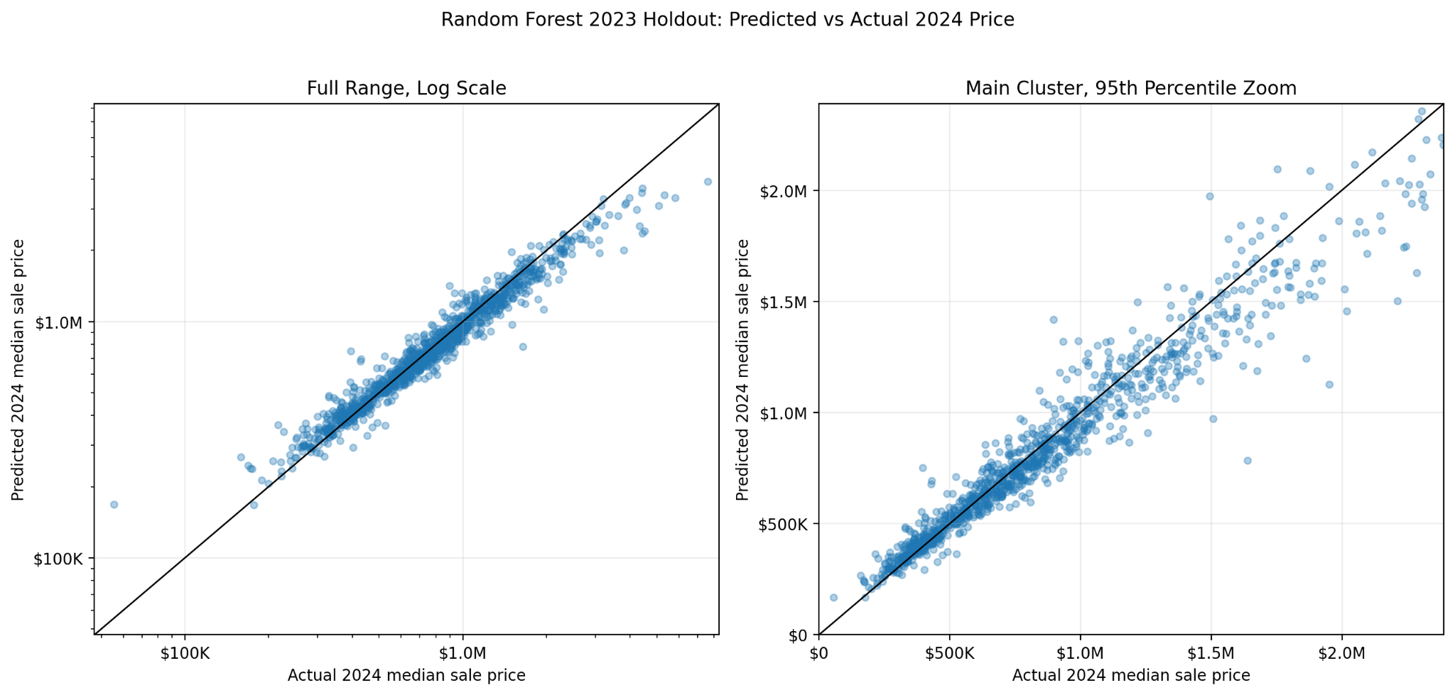
Random Forest continued

Slide 6
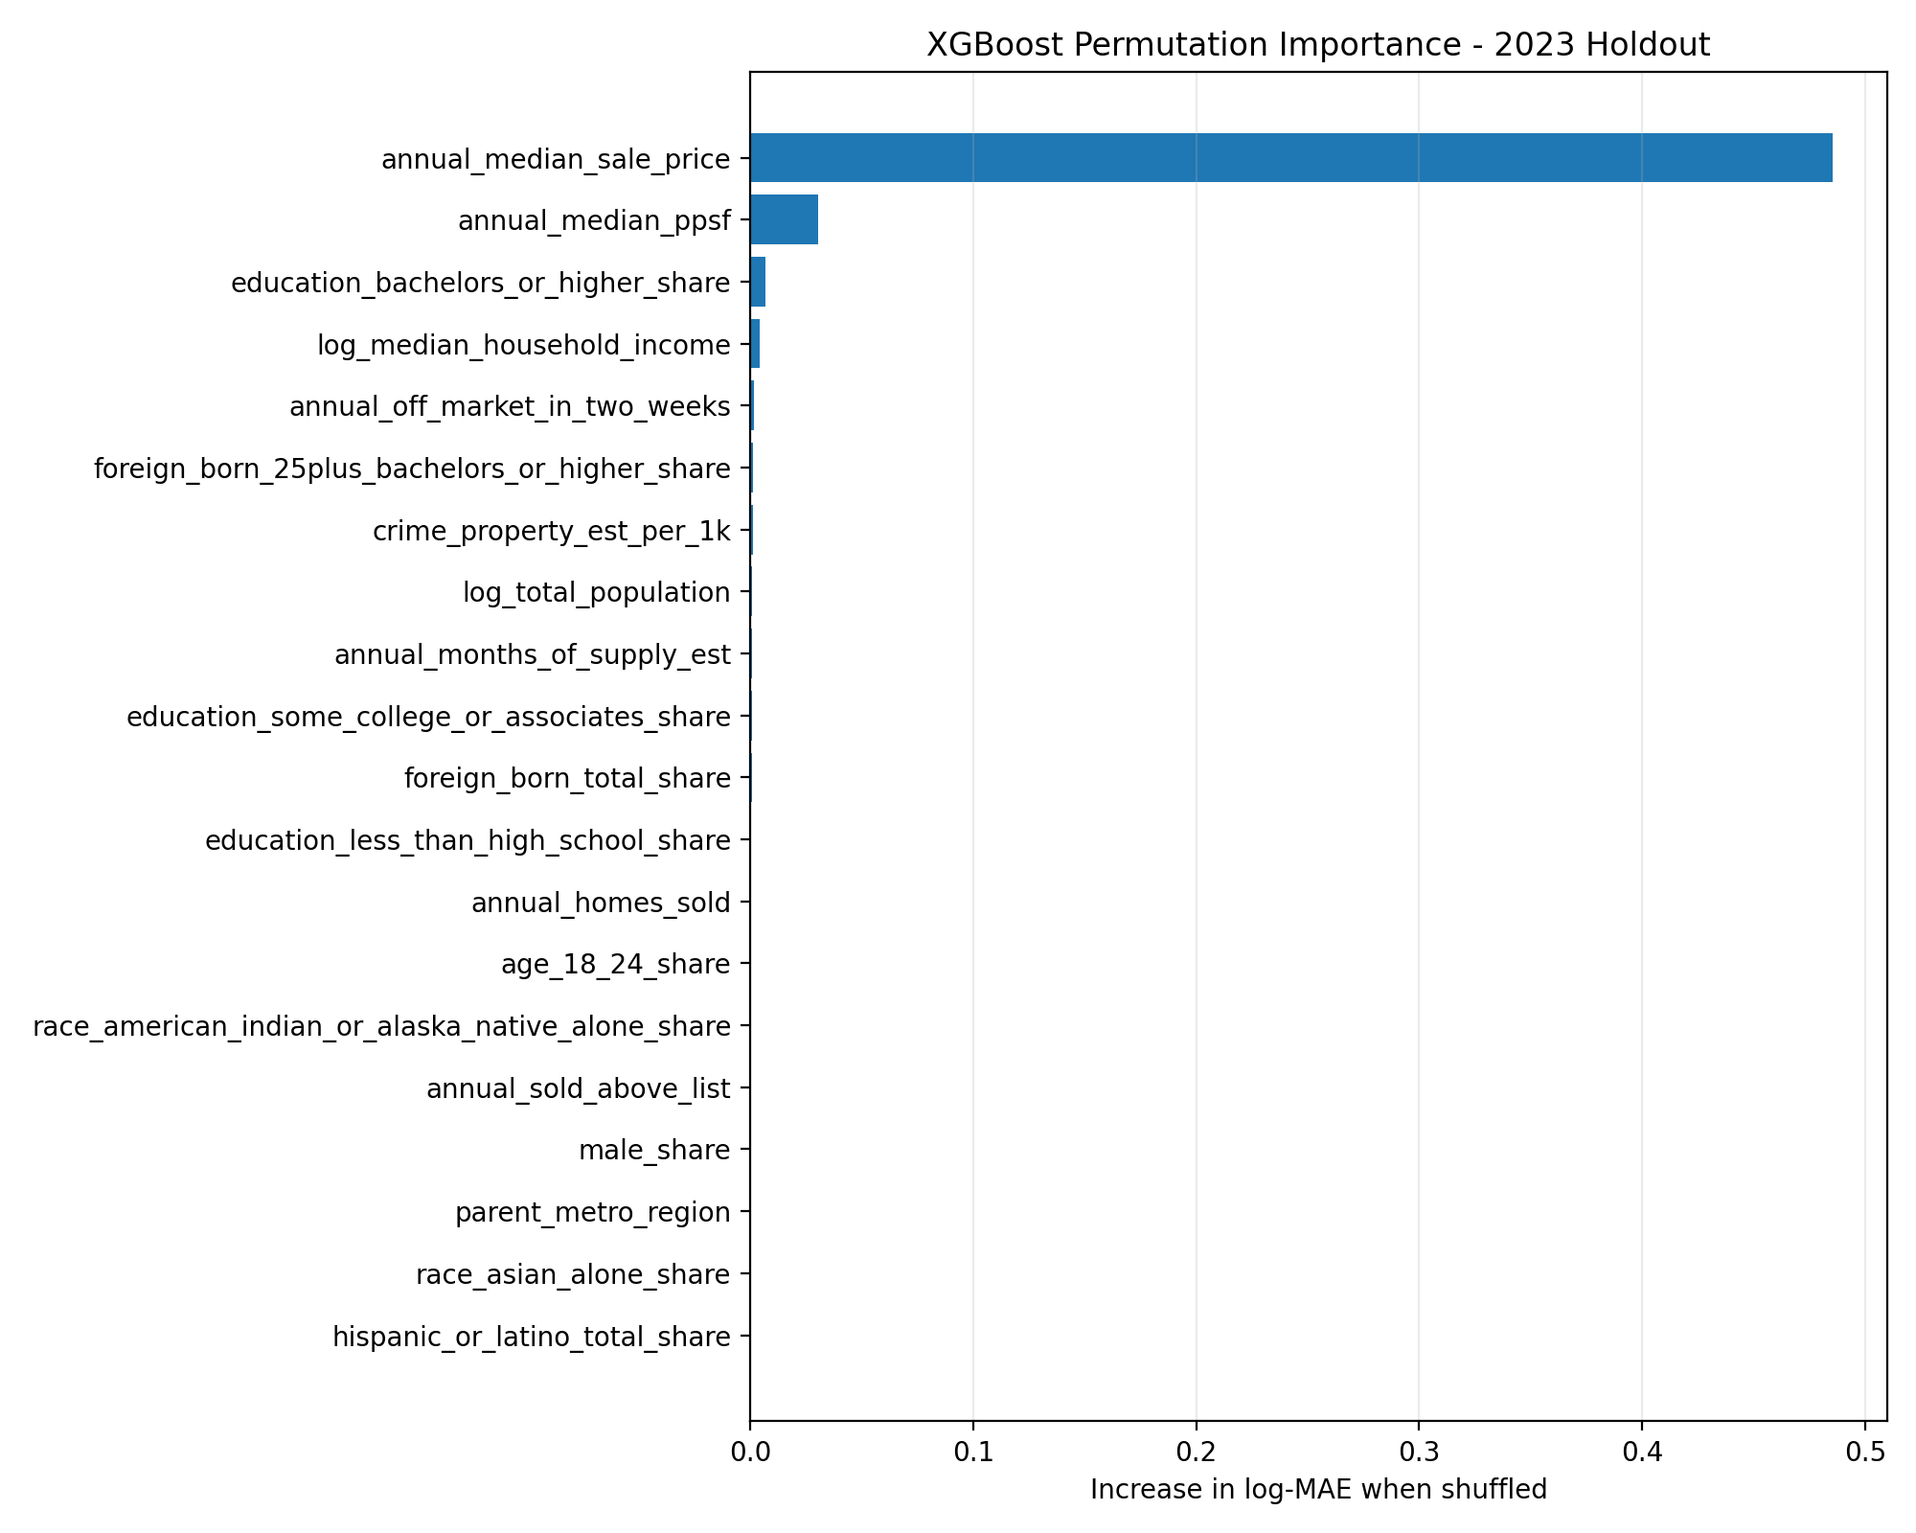
XGBoost
Median_sale_price dominates !!!
Why?
Feature interactions
Nonlinear relationships
Regularization, shrinkage, and subsampling..
Parameters
700 estimators
0.035 learning rate
4 max depth
….

Slide 7
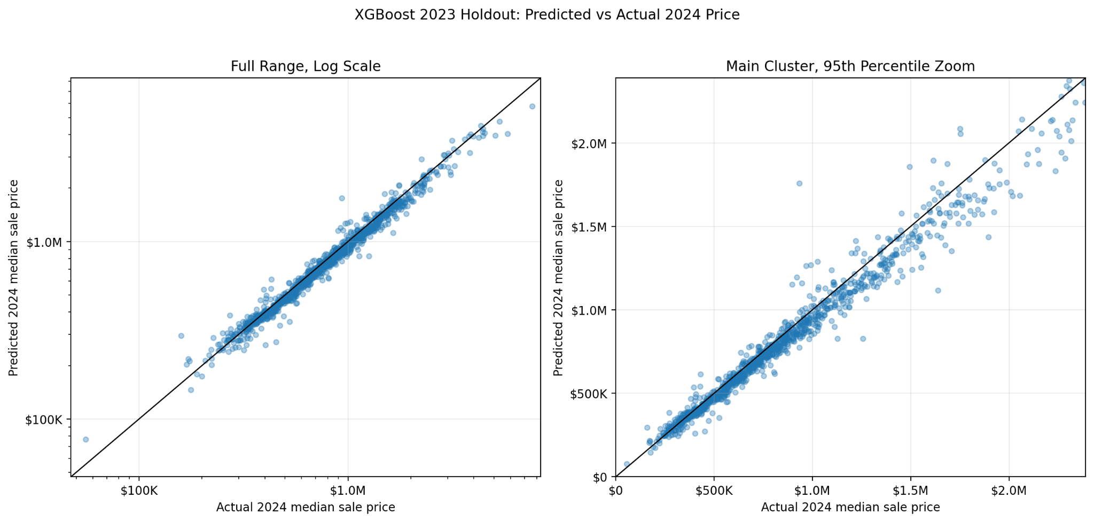
XGBoost continued

Slide 8
Results
Model | MAE | RMSE | R²
Linear/Ridge | $203.9 K | $1260 K | -2.32
Random Forest | $103.2 K | $246.0 K | 0.874
XGBoost | $68.8 K | $135.1 K | 0.962
Notes:
The primary standard is temporal validation, because our real goal is to use year t features to predict price growth in year t+1 under future market conditions.
A “good” model should have higher R², lower MAE/RMSE, and ideally positive temporal R², not just improvement relative to another model.
The grouped-ZCTA test is a secondary check: if R² is positive there, the model is learning meaningful cross-sectional differences across neighborhoods, even if forecasting over time is harder.
In our results, Model 2 outperforms Model 1 in both evaluation methods, so school features add some incremental signal.
However, the best temporal R² is still negative (-0.025), so the models are promising but not yet strong forecasting models; they currently explain spatial variation better than future market shifts.
After adding school features, Model 2 is better, but neither model is yet “good” in the strict forecasting sense because temporal prediction remains weak.

