Slide 1
Pathway-Centric Analysis of Glioblastoma: Integrating Molecular Signatures with Cell Type Deconvolution and Pseudotime
Insights from GSE4290 Using ssGSEA, Pseudotime, and Cell Deconvolution
Charles Gwellem
22/10/2024

Slide 2
Pathway dynamics in gliomablastoma
Glioblastoma (GBM) is an agressive brain tumor characterized by significant molecular and cellular heterogeneity.
Tracking the evolution of key pathways and cell populations during tumor progression is essential for identifying therapeutic targets and optimal treatment windows.
By analyzing bulk tissue data, we can infer dynamic changes in pathway activity and cell-type composition over time, modeled through pseudotime analysis.

Slide 3
Data Source, Design and Normalization
The dataset GSE4290 was obtained from the Gene Expression Omnibus (GEO). It includes:
77 stage IV GBM samples
23 non-tumor brain samples
Samples were profiled using Affymetrix HG-U133A platform.
Robust multiarray analysis (RMA) normalization was applied to adjust for background noise and minimize technical variability across samples.

Slide 4
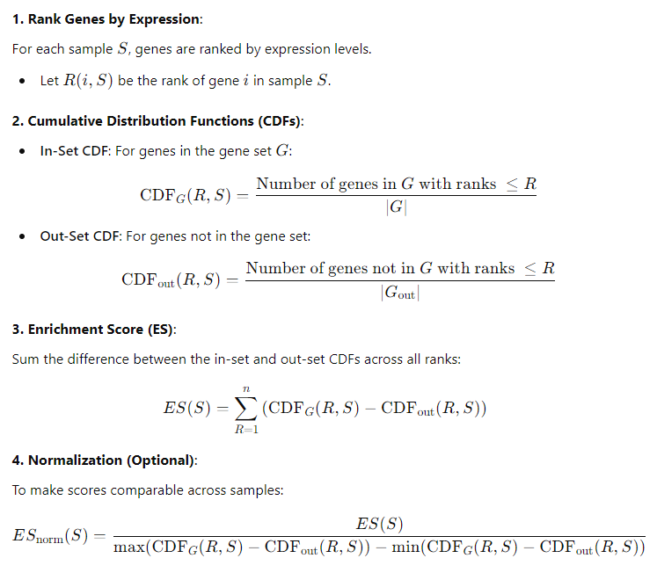
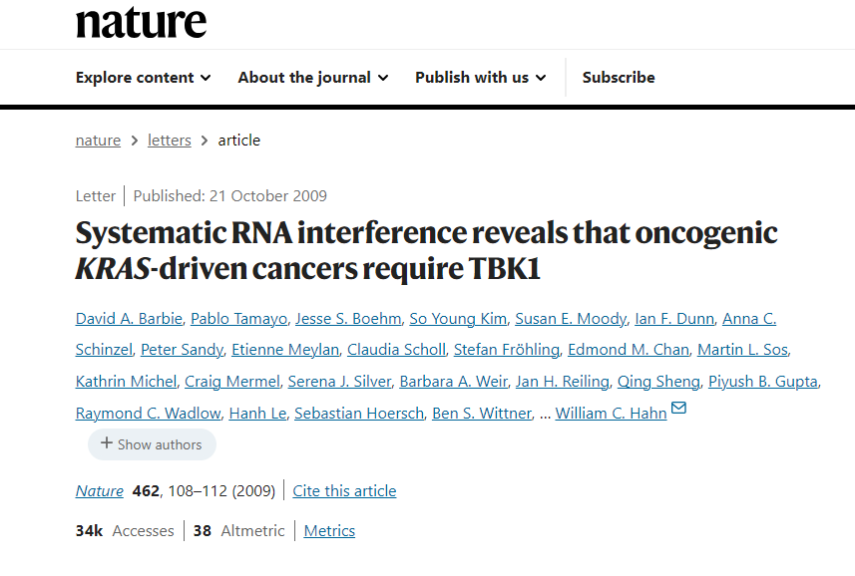
Pathway scoring: Single Sample Gene Set Enrichment Analysis (ssGSEA)

Slide 5
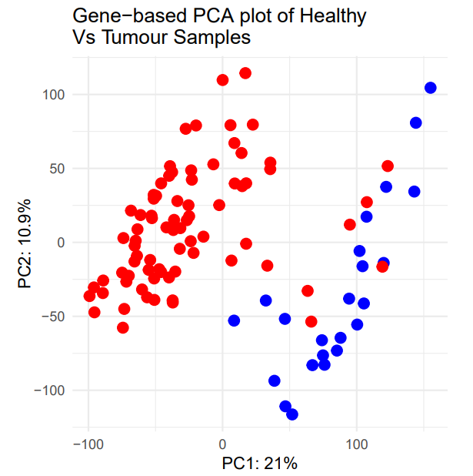
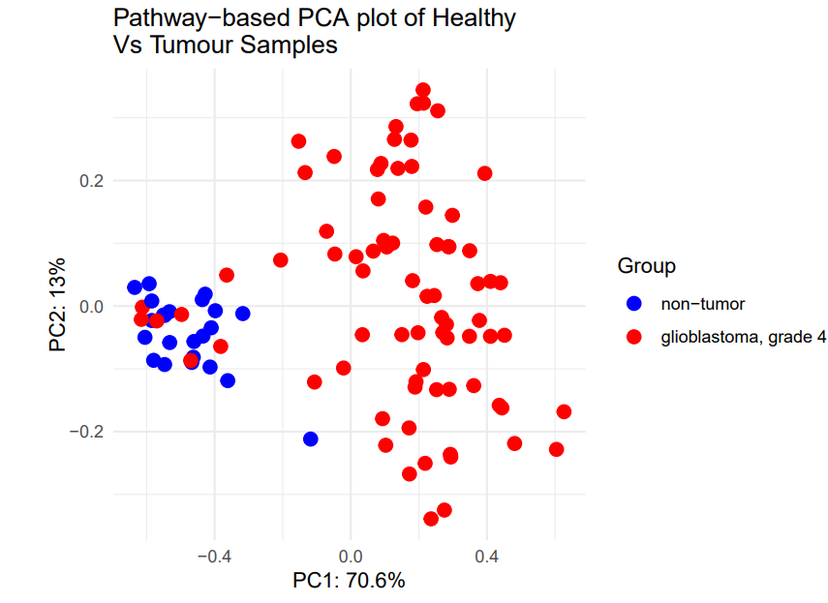
Pathway-Level Analysis Enhances Condition Separation
The gene-level analysis (left) captures 21% of the variance on PC1, showing some overlap between glioblastoma and non-tumor samples.
The pathway-level analysis (right) explains 70.6% of the variance, resulting in much clearer separation of the two conditions.
Pathway-level analysis offers a more robust clustering of glioblastoma and non-tumor samples, highlighting its utility in distinguishing conditions with molecular complexity.

Slide 6
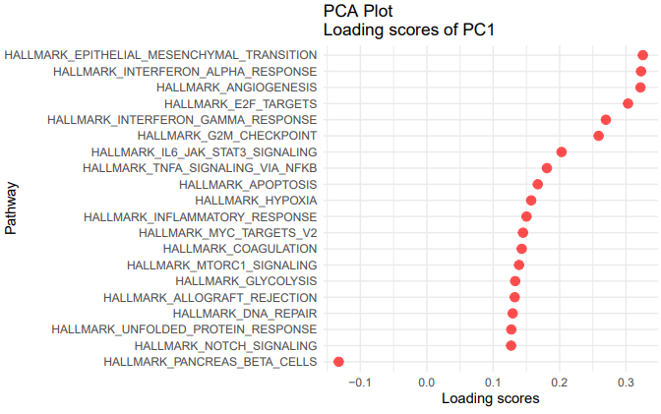
Pathway Contributions to Tumor vs. Non-Tumor States: PCA Loading Score Analysis
EMT, IFNA, and angiogenesis signaling pathways are more strongly associated with stage IV glioblastoma.
These pathways contribute to:
Tumor evasion (via EMT)
Immune system modulation (via IFNA)
Tumor vascularization (via angiogenesis)
High-loading pathways on PC1 present critical therapeutic targets.

Slide 7
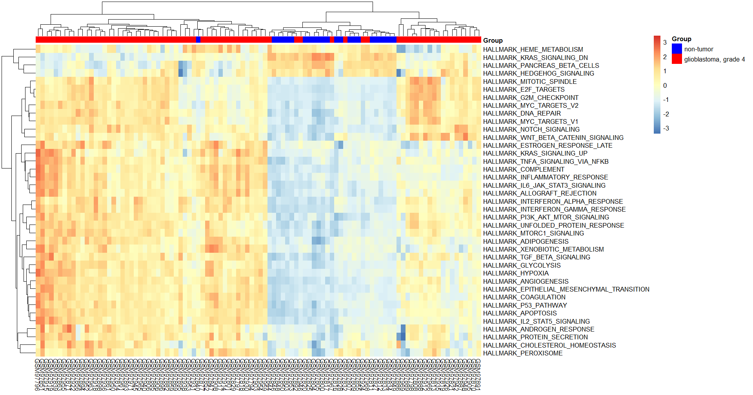
Pathway Activation Differences in Glioblastoma vs Non-Tumor Samples
Non-tumor exhibit higher activity of heme metabolism and hedgehog signaling.
In contrast, GBM samples show increased G2M checkpoint, E2F targets, MYC signaling, hypoxia, angiogenesis, and EMT activity.
We can observe distinct patterns of pathway activity in tumor vs non-tumor samples.
How do these pathways evolve between non-tumor and tumor samples?

Slide 8
Pseudotime Calculation to Model Tumor Progression Using Mahalanobis Distance
Pseudotime models the transition from non-tumor to tumor samples, allowing us to estimate tumor progression over time.
Mahalanobis distance accounts for the correlations between pathways, providing a robust measure of progression in high-dimensional space.
Flowchart
Calculate Mahalanobis distance from non-tumor centroids
Use distance to infer pseudotime trajectory
Order samples based on pseudotime for further analysis.

Slide 9
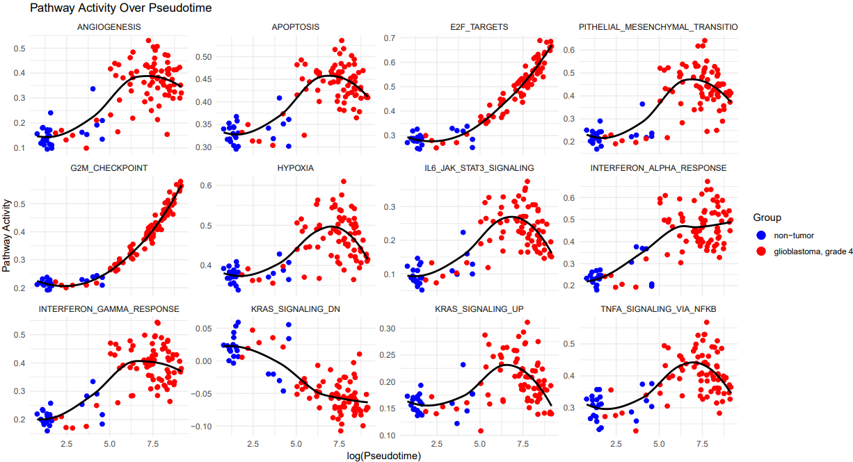
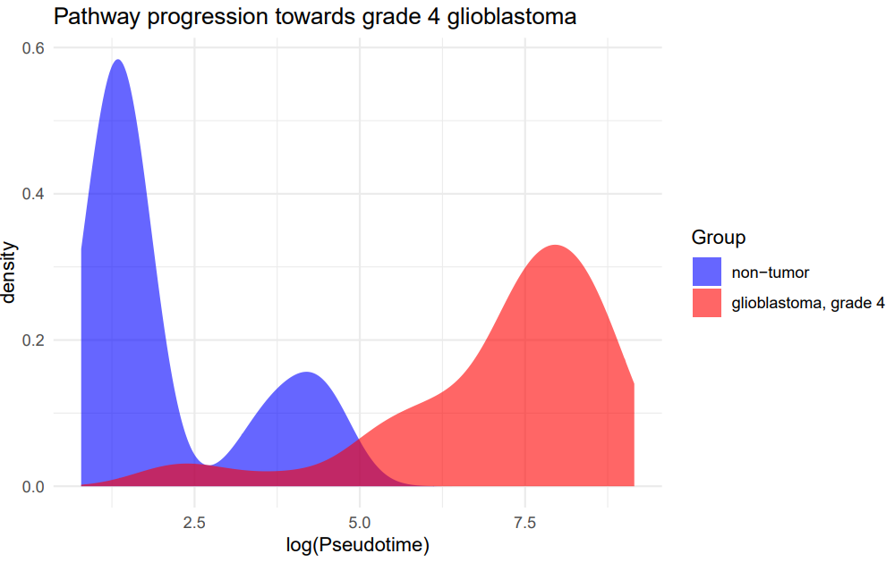
Pathway Dynamics Along Pseudotime Towards Grade 4 Glioblastoma
Pseudotime derived from Mahalanobius distance from healthy root samples, using covariance matrix.
Non-tumor group exhibits a bimodal distribution with peaks early and below log pseudotime 5, indicating diverse pathway states.
The glioblastoma group peaks later (around log pseudotime 7.5), reflecting progressive divergence from the non-tumor state towards malignancy.
The overlap between the two groups suggests a transition zone where non-tumor cells evolve into tumor cells.
At later stages, glioblastoma progression is driven by cell cycle dysregulation (G2M checkpoint, E2F) and angiogenesis.
EMT, apoptosis, hypoxia, and KRAS signaling initially show high activity but gradually decline, potentially reflecting shifts toward other pathways.
IFNG initially increases as part of the immune response but decreases later, while IFNA shows stable or increasing levels.
Key therapeutic targets at late-stage GBM include cell cycle dysregulation and IFNA signaling.

Slide 10
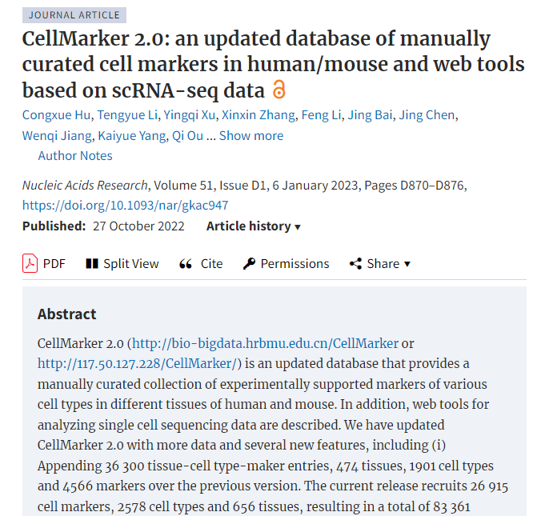
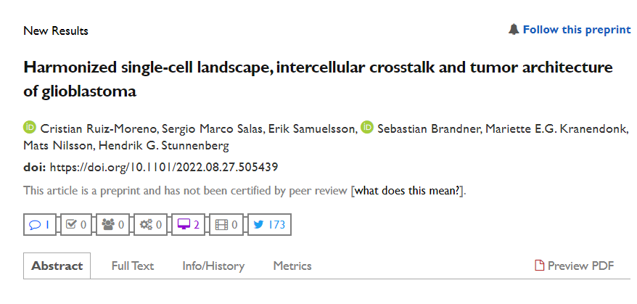
Marker-Based Decomposition of Bulk Tissue Data: Adaptation of BISQUERNA Workflow
To estimate cell-type proportions from bulk tissue microarray data, I adapted the BISQUERNA.
Data source:
57 cell markers obtained from the Gbmap preprint
Key Adaptations to BISQUERNA Workflow
PCA is performed using single-cell marker genes (X) weighted by log2 fold-change (W) to yield PCA(XW).
The first principal component (PC) is used as an estimate of cell-type proportion.
The PC that best correlates with cell signature genes is selected, as the dominant signature reflects cancer status rather than cell type.

Slide 11
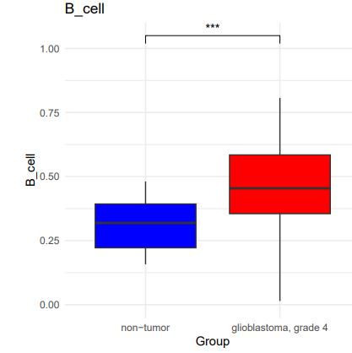
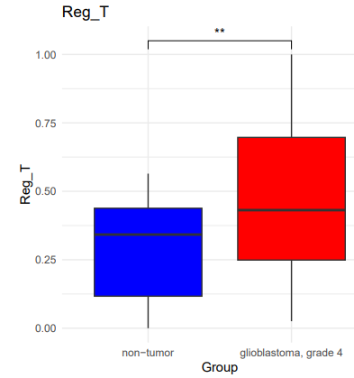
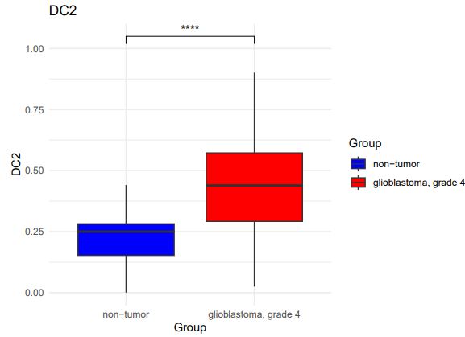
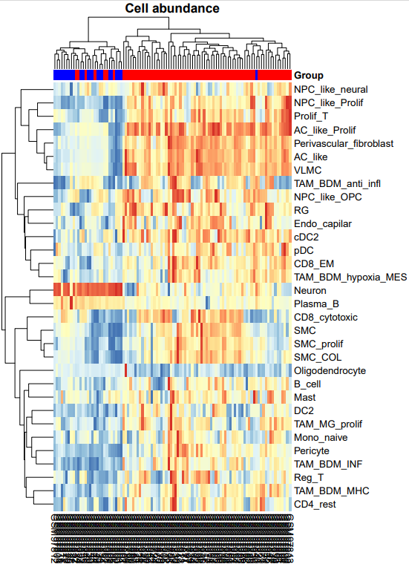
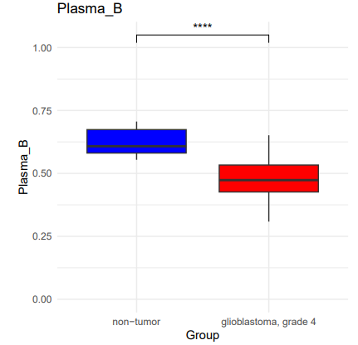
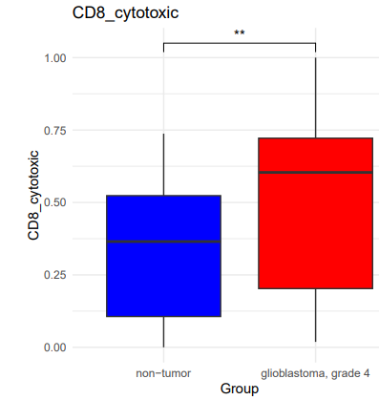
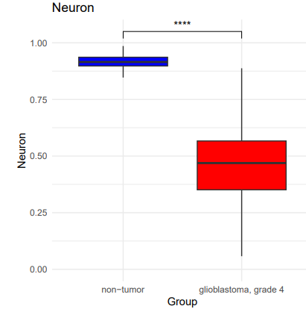
Immune and Neuronal Cell Population Shifts in Glioblastoma Compared to Non-Tumor Samples
****: p ≤ 0.0001;
***: 0.0001 < p ≤ 0.001;
**: 0.001 < p ≤ 0.01;
*: 0.01 < p ≤ 0.05;
ns (not significant): p > 0.05
Decrease in plasma cells indicates decrease in antibody-producing cells
Increase in regulatory T cells and dendritic cells, which may contribute to immune evasion in GBM
Sharp decline of neurons highlights destructive impact of GBM on tissue integrity

Slide 12
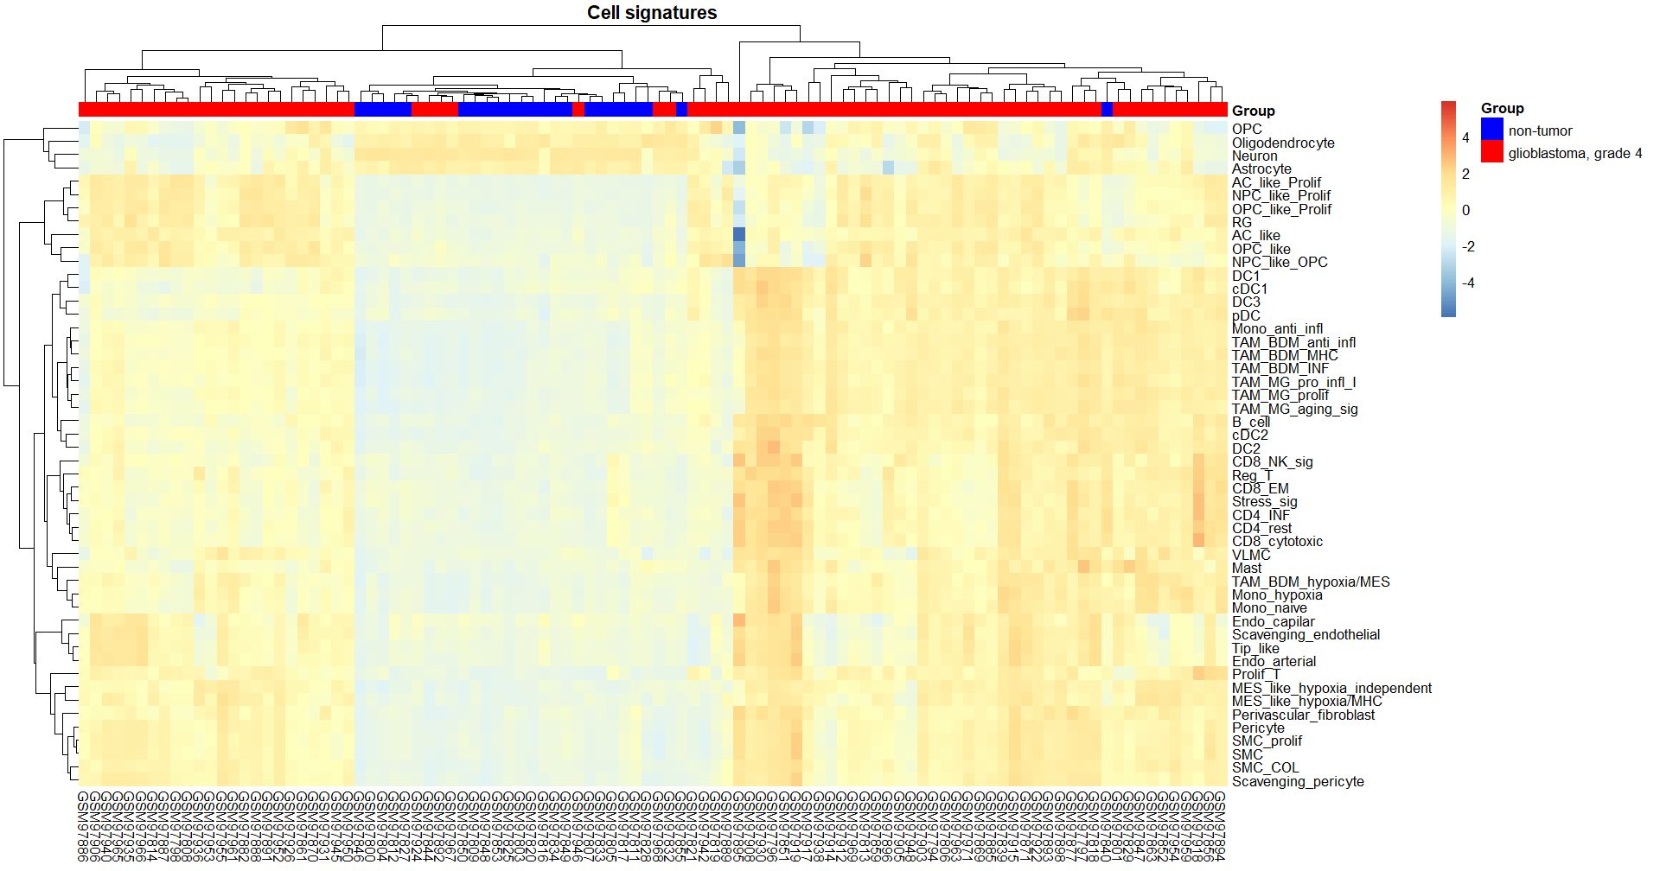
Heatmap of Cell Type Signatures in GBM vs.
Non-Tumor Samples
Tissues
Decreased neuronal and oligodendrocyte signatures indicating loss of brain cells in tumor environment.
Strong expression of TAM_indicating immune cell infiltration contributing to immune evasion in tumors
Hypoxia-related and mesenchymal signatures consistent with hypoxic tumor environment.
Potential therapeutic targets include TAMs, mesenchymal cells, or the hypoxia response pathway.
Might be necessary to check changes in cell abundance

Slide 13
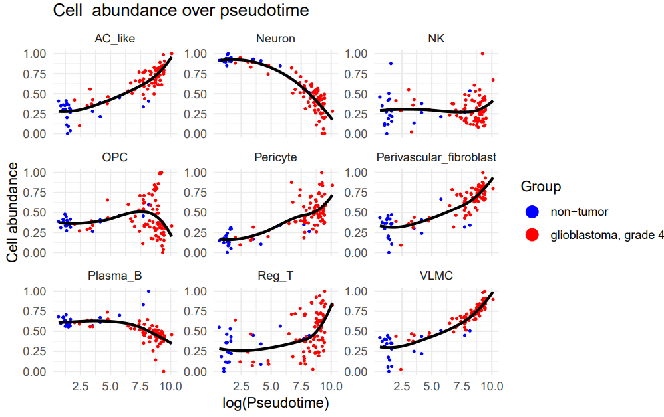
Cell Abundance Dynamics Over Pseudotime in GBM Grade IV vs Non-Tumor Tissues
GMB relies on AC-like cells, regulatory T cells, VLMC, perivascular fibroblasts for progression.
NK cells have low abundance but tend to increase later, probably due to recruitment
Neuronal damage continues through out GBM
Plasma B cells deplete over time
Therapeutic strategies may focus on:
Targeting Tregs to mitigate immune suppresion
Enhancing NK activity to boost anti-tumor activity
Inhibiting tumour vaculature (targetting pericytes)
Protecting or restoring neurons

Slide 14
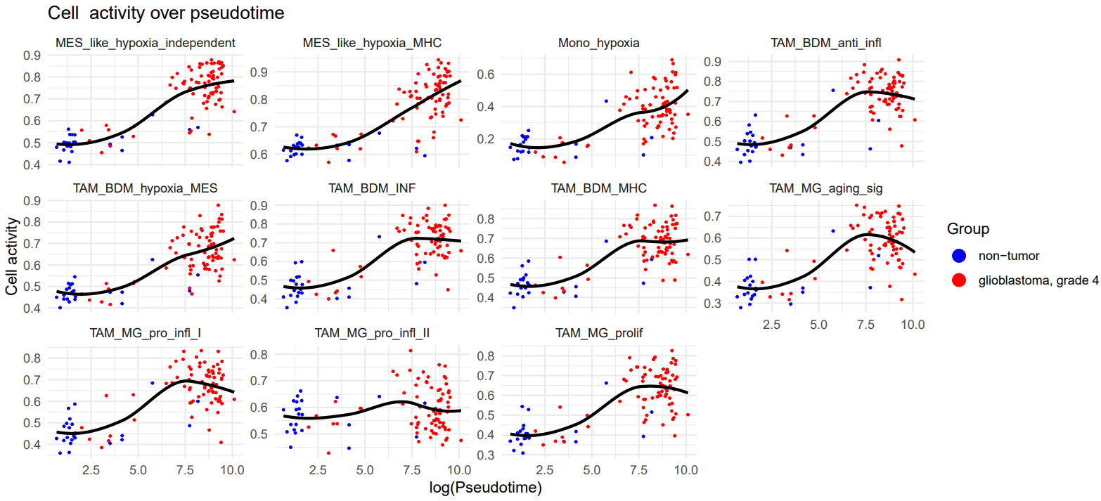
Hypoxia-Driven cell signatures increase in
Relevance in GBM Grade IV
Targeting hypoxia-associated macrophages (e.g. TAM_BDM_hypoxia_MES) should be priority in late-stage.
Proliferating or anti-inflamatory TAMs can be targetted early on as they play role in immune suppression
MHC-expressing TAMs might be reprogrammed or combined with checkpoint inhibitors to restore antigen presentation and boost immune response.

Slide 15
Conclusion
Critical Pathways Driving GBM Progression
EMT, angiogenesis, and immune modulation pathways play pivotal roles in late-stage glioblastoma.
Cell cycle dysregulation becomes dominant in advanced stages.
Tumor-Associated Macrophages (TAMs) Are Key Players:
Hypoxia-associated TAMs are highly active in late-stage GBM, presenting a priority therapeutic target.
Other TAM subtypes (proliferating, MHC-expressing) could be reprogrammed or targeted early for immune reactivation.
Cellular Dynamics Reflect Tumor Aggression
Loss of neurons and oligodendrocytes highlights the destructive nature of GBM.
Increased regulatory T cells and dendritic cells contribute to immune suppression.
Therapeutic Implications:
Strategies should focus on targeting TAMs, restoring immune activity, and protecting neural cells.

Slide 16


Slide 17


Slide 18
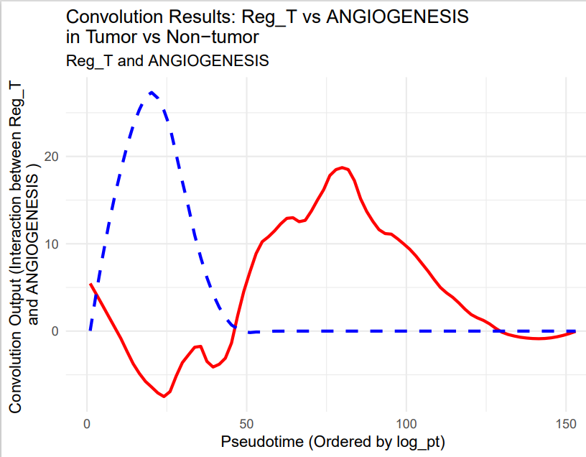
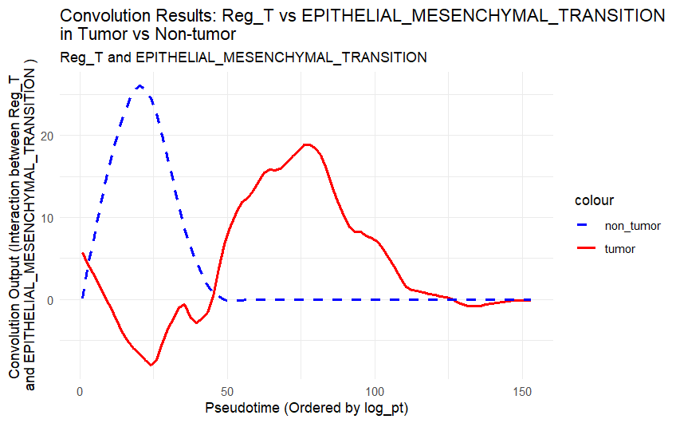
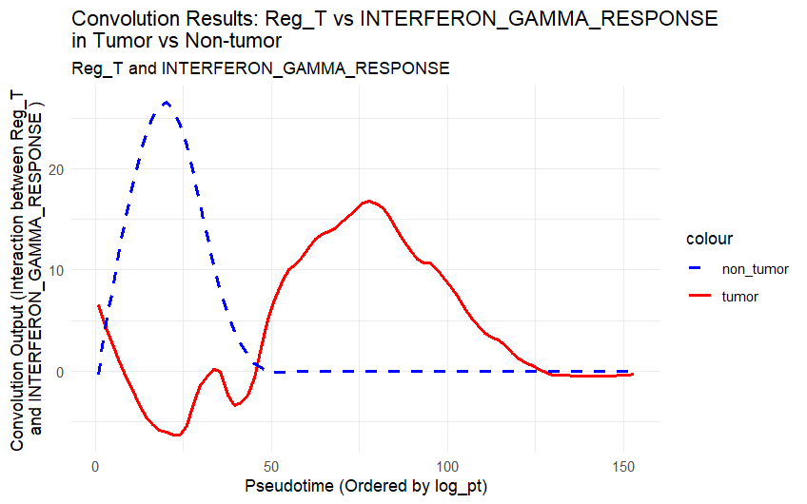
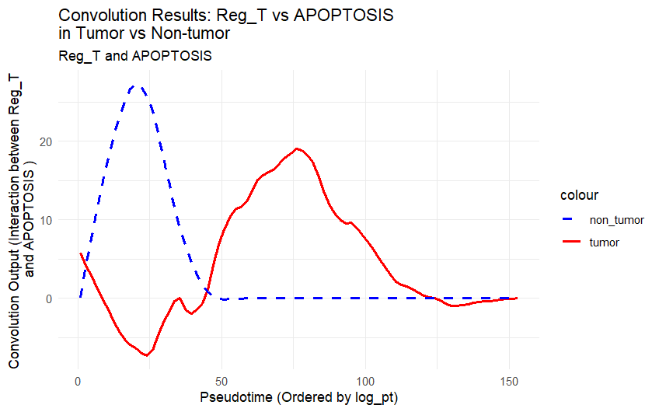
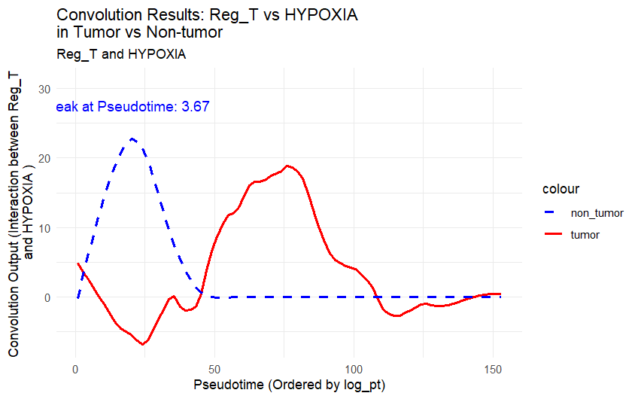
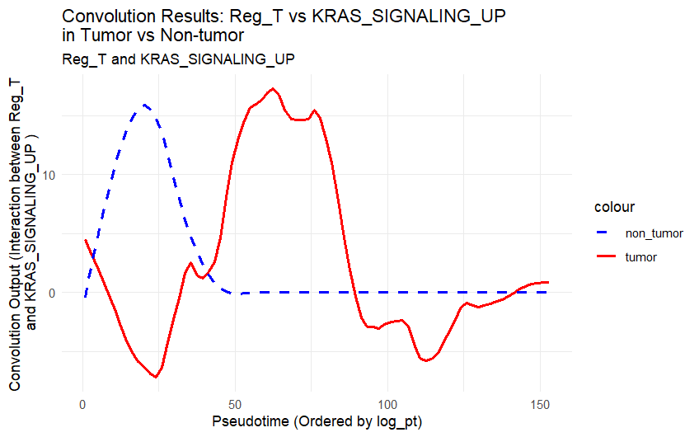
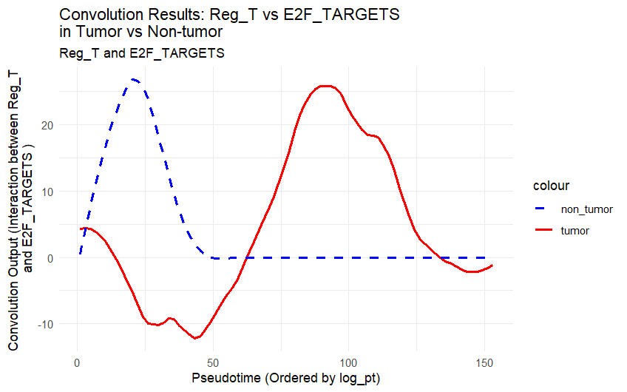
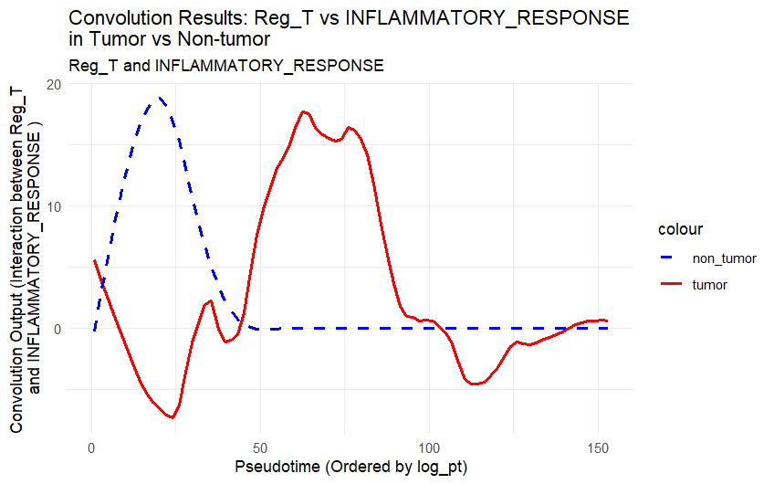
Convolution Analysis Reveals Dynamic Interactions of Regulatory T Cells with Key Tumor Pathways in Glioblastoma
Reg T cells promote tumour invasion by:
enhance vascular formation
limit tumor cell death
Support tumour proliferation
Interact with EMT
Help tumor thrive in hypoxia
Dampen immune activation
KRAS upregukated through Reg_T
Targeting Reg_T cells alongside specific pathways like KRAS or angiogenesis presents promising therapeutic avenues.

