Slide 1
Comparative study of food access data Esri vs AGI
Charles Hall SSCI 594a

Slide 2
Objectives
Compare traditional data sets used in food access studies with Yelp and Google data
Assess the quality of each data set by conducting field surveys of a subset of facilities
Assess completeness and correctness
Identify methods that don’t require field survey

Slide 3
Motivation
NAICS classification used in Esri Business Analyst data is not specific enough
Traditional methods are problematic
Does the quality and completeness of the data vary with the socio-economic conditions of the census tract
Can high quality data sets be identified in order to minimize the need for field surveys

Slide 4
Background
Traditional studies use census tracts, Esri Business Analyst data, and buffers
Studies are often limited by the need to physically inspect facilities in the study area
Facilities are classified through the use of local knowledge
Excludes facilities outside those known to the researcher

Slide 5
Background cont.
Ad hoc classification methods are employed to determine quality of facilities
Size in square feet
Type of neighborhood
Number of employees
This is mostly a best guess

Slide 6
Methodology
Select census tracts
Join Esri Business Analyst data for each tract
Google places data for each tract
Yelp data for each tract
Field survey of facilities in the tract
Visualize and compare

Slide 7
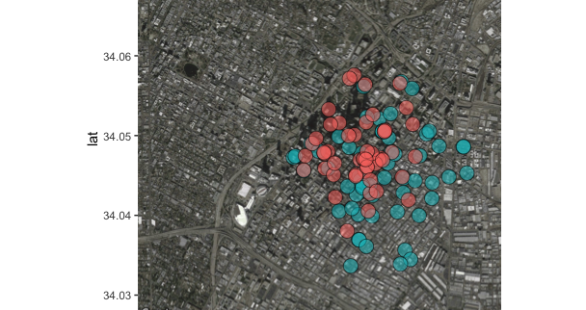
Analysis

Slide 8
Analysis
Google classification is not robust
Yelp has deep classification for restaurants, and a single category for grocery
Ratings
Yelp has large ratings data set
Google ratings are sparse
There is some overlap
Neither data set appears to be complete

Slide 9
Thank you! Questions? charlemh@usc.edu

