Slide 1

Wind River Coding Camp 2015
The Game of Cloud: Cloud-Gomoku
Team Valvrave (Beijing)
March, 2015

Slide 2
Design Choice
What is the game of cloud?
  An interesting game (creative design) with limited interaction with cloud
or
  A well-known game based on cloud completely

Slide 3
Our Choice: Cloud-Gomoku
A well-known game, aka Five-In-Row
Anyone can play it anywhere with cloud
Demonstrate how to use a sensor/machine-oriented cloud for playing game

Slide 4
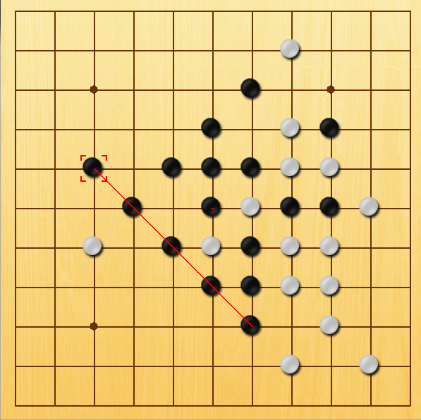
Well-known Game Rules
Black player first
Players alternate in placing a chess of their color on an empty intersection
The winner is the first player to get an unbroken row of five chesses horizontally, vertically, or diagonally

Slide 5


EMS Game Cloud Architecture
Player 1
(Galileo Gen2)
Player 2
(Laptop)
Touch Screen
Keyboard
Viewer 1
(PC)
Game Server
(Server)
Machine Cloud
Viewer 2
(Laptop)
Game Cloud
AI
(Galileo Gen2)
Player 3
(PC)
Player4
(Laptop)
assist

Slide 6
SW & HW Components
Hardware
  Intel Galileo Gen2 (400MHz Pentium CPU)
  LCD display with touchscreen and keyboard
  Sony PS3 camera
Software
  IDP
  EMS agent
  Axeda Platform
  Mashery/Axeda REST API
  Python (pygame, requests, cv2, pyCloudAPILib)
  Groovy
  OpenCV2

Slide 7
Features
  Player registration
  Multi-player support
  Watch historical games
  Watch live games
  Hide the physical locations of players and server
  Agent-free
  Chess reorganization
  Game AI engine

Slide 8


Cloud-Gomoku
A real cloud-based, multi-player online game

Slide 9




Registration
Cloud service automatically
registers and groups any two
players into a new game.
.
Player 1 and player 2
connect to the cloud

Slide 10

The game client formats the game data to JSON and sends
it to cloud.
Game Start
Player 1 places the chess
and the position is sent to
cloud

Slide 11




Game Server Arbitration
Game server has the responsibility
for deciding game flow, e.g., legal
position, turn, winner and loser.
Game server monitors the position and confirms it

Slide 12

Player 2 Phase
Player 2 places the chess
and the position is sent to
cloud
At the same time, cloud pushes the last position to historical data and uses the new position as current data.

Slide 13
Any numbers of viewer can
watch this game in the meanwhile.
Real-time Game Observation

Slide 14
Viewers can watch any selected historical game.
Game Playback
Notes:
PC Client starts and waits for cloud

Slide 15
All game data are stored in Cloud
No firewall access limits
Hide the physical locations of players and server
Cloud Benefits

Slide 16
Video Scenarios

Slide 17





Scenario #1
…
Game 1
Game N
…
Player 1
Player 2
Player 2n - 1
Player 2n
Watcher 1
Watcher M

Slide 18



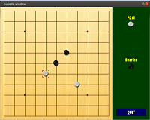
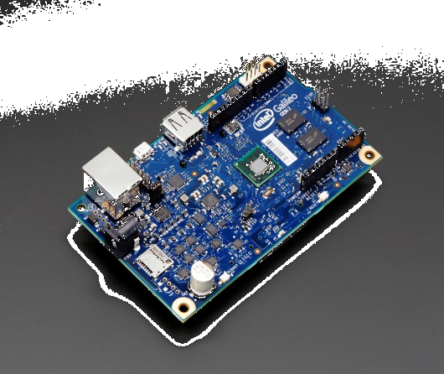




Scenario #2

Slide 19
Implementation

Slide 20
Implementation #1/5
EMS Agent: asset registration and model binding
How we utilize:
    Create a separated name space for storing all game data
    All game clients and server are registered to a dedicated model domain

Slide 21
Implementation #2/5
Data Item: Store sensor data in cloud
How we utilize:
    Each data item is abstracted as a data table used to store associated game data
    Use STRING data item type to store JSON, describing the complex data types used by game

Slide 22
Implementation #3/5
Custom Object: Extension with Groovy scripting
How we utilize:
    Create dedicated getData and setData scripts for a fast data access.
    Create a dedicated registration script to automatically record player login and pair two players for a new game.

Slide 23
Implementation #4/5
REST API: Interface to cloud for embedded applications
How we utilize:
    Implement a cloud service API library called pyCloudAPILib to encapsulate various REST APIs.
    Both game client and server programs call pyCloudAPILib to fetch or modify game data.

Slide 24
Implementation #5/5
Use Sony PS3 camera to recognize the chessboard
  OpenCV2 employs various algorithms, including Laplacian Derivative, Otsu's Binarization, Gaussian Blurring, Dilation, Erosion and Hough Circle Transform for video recognition chessboard & chess positions.
The game AI (Artificial Intelligent) algorithm, running on the Intel Galileo board, provides positions suggested each time
  The algorithm was implemented in Minimax algorithm with Alpha-beta pruning based on game tree
  The difficult levels can be set by the depth of the game tree searcher
Player follows the position given by AI
  AI engine outputs the calculated position via console

Slide 25
Enhancements

Slide 26
Enhancement #1/5: Refoundation
Axeda Machine Cloud -> EMS Game Cloud
    Sensor data items abstracted to game data tables
    All game data recorded and historical
    Game data not sent back to EMS agent
    Allow to reset and re-initialize all game data

Slide 27
Enhancement #2/5：pyCloudAPILib
Create a general cloud service API library
Cloud service API encapsulation
    Currently support Axeda Platform and Mashery APIs
Cloud service API abstraction
    Use the concept “node” to indicate an entity connecting to cloud
    Provide the general methods to access cloud, e.g, getData(), setData(), deleteData() and getHistoricalData()

Slide 28
Enhancement #3/5: agent-free
How to run the games on systems without EMS agent?
  Use pyCloudAPILib to call scripto service through REST API
  Scripto service calls dedicated Groovy scripts written for Cloud-Gomoku
    Call DataValueEntry.store() to store the data on cloud only. Don’t use SetDataItem.send() to await data value “write-through” to the EMS agent

Slide 29
Enhancement #4/5: reduce the latency
Wi-Fi 802.11ac
  Replace 100M wired network
  Use 5GHz, avoiding the heavy traffic in 2.4GHz
Mashery API manager vs Axeda Platform Server
  Benchmark result shows Mashery API manager is faster
Use *finder classes in Groovy as little as possible to shorten the execution time
  Benchmark result shows the Groovy scripts written for Cloud-Gomoku is faster than the existing scripts

Slide 30
Enhancement #5/5: system optimization
Update the system firmware to the latest
Prevent loading unnecessary kernel modules
Stop unused services
Tune display driver to increase frame rate
Use USB key instead of Micro SD card for rootfs

Slide 31
Contributions

Slide 32
Source Code Delivery
Cloud Gomoku
https://github.com/TeamValvrave/Cloud-Gomoku
pyCloudAPILib
https://github.com/TeamValvrave/pyCloundAPILib
Groovy scripts
  Login to https://windriver.axeda.com and view the custom objects prefixed with “vlv”.
wr-game
  128.224.179.105:/folk/jzhang0/coding_camp_2015/wr-game.git
  Based on the initial drop provided by organiger
  Make many fixes and integrations, including opencv2, numpy and so on

Slide 33
Source Code Quantity
Cloud Gomoku：6020
pyCloudAPILib：1536
  Testing codes (not committed): 765
Groovy scripts：600
Not include the backport codes

Slide 34
Challenges

Slide 35
Challenge #1/3
The board arrived at Feb 15
    We don’t have too much time to tune the hardware and software.
Chinese New Year (7-day holiday)
    We have to spend 2 days during the holiday for a on-site debugging and testing.

Slide 36

Challenge #2/3

Slide 37
Challenge #3/3
The limit of Axeda machine cloud for game
    It is still a machine/sensor-oriented cloud.
    Data polling is efficiency-less.
    The latency is sensitive to game but not to machine/sensor.
Groovy sandbox limits the more efficient ways to access cloud.
    See how vlvFastSetPlatformData.groovy uses dataItem.getType() to cheat the sandbox check.
    Our initial design plans to use java.net.Socket to create a game server solely built on cloud with groovy scripting and Java socket but groovy sandbox running on Axeda platform denies using it.

Slide 38
In Future
pyCloudAPILib
    Continue the development of pyCloudAPILib
        Implement more Axeda and Mashery cloud service APIs.
        Encapsulate a various of cloud APIs provided by other vendors.
        Improve the abstraction to cloud access and become a full general cloud interaction library.
    Integrated to wr-ems, intel-iot-devkit?
Cloud-Gomoku
    An excellent demo for EMS system.
    Abstract the internal design to form a programming framework for complex applications.
    Become the formal ems demo project?

Slide 39
Gratitude
Great coordination made by the organizers of Wind River Coding Camp 2015.
Powerful Intel Galileo Gen2 hardware for maker community.
Flawless team work in dispatch and completion.
Strong supports from managers, EMS team and Axeda support.

Slide 40

| © 2012 Wind River. All Rights Reserved.

