Slide 1
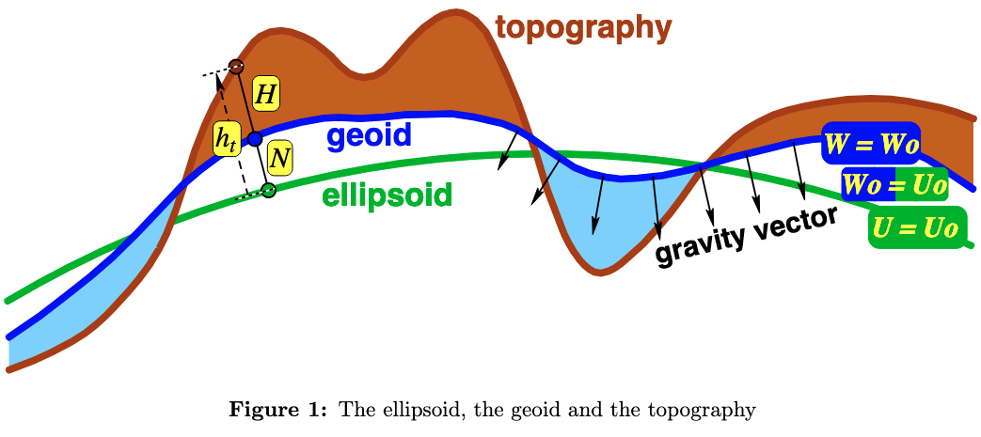
ZETA ζ
1 | Potential Surfaces
Geoid: A gravitational equipotential surface that coincides with an undisturbed sea-level.
-Physically real but complex and irregular.
Ellipsoid: A hypothetical reference height above an idealized oblate spheroidal Earth.
-Not physically real but simple and convenient to use in calculations.
U = Potential above the ellipsoid.
ΔU = Normal potential gravity = 𝜸
“normal gravity“ is a reference gravity for a perfect oblate spheroid at a given latitude.
W = Potential above the geoid.
∇W = Geopotential gravity
Corrected for only the basics e.g. tides, drift, & instrument response.
Barthelmes, Franz. “Definition of Functionals of the Geopotential and Their Calculation from Spherical Harmonic Models: Theory and Formulas Used by the Calculation Service of the International Centre for Global Earth Models (ICGEM); Http://Icgem.Gfz-Potsdam.de/ICGEM/ ; Revised Edition.” Scientific Technical Report; 09/02; ISSN 1610-0956, 2013.
The geoid is physically real but complex; the ellipsoid is not real but simple and convenient to use in calculations.

Slide 2
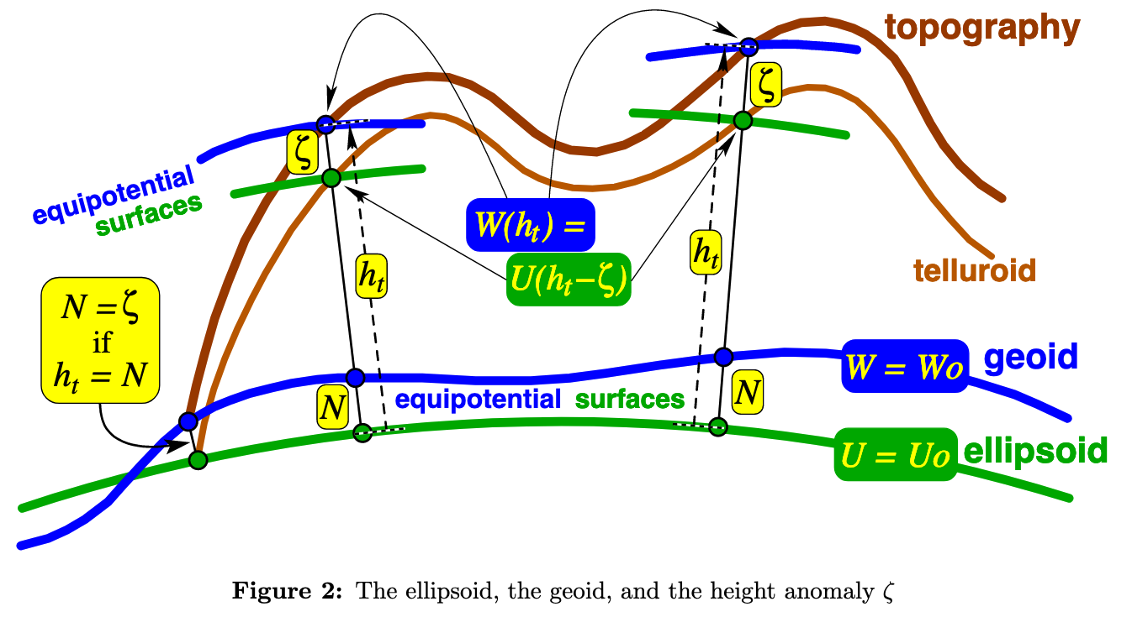
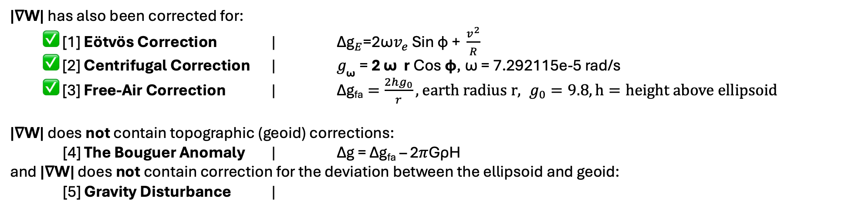
2 | Anomalies
|∇W| has also been corrected for:
✅ [1] Eötvös Correction | ${\text{Δg}}_{E}\text{​=2}\text{ω}v_{e}\text{​} \text{S}\text{in} \text{ϕ} \text{+} \frac{v^{2}}{R}\text{​}$
✅ [2] Centrifugal Correction | $g_{\text{ω}}\text{ = }\text{2 }\text{ω} \text{r} \text{C}\text{os} \text{φ}$, ω = 7.292115e-5 rad/s
✅ [3] Free-Air Correction | $\text{Δg}\text{fa}=\frac{2hg_{0}}{r},$ $earth radius r, g_{0}=9.8, h=height above ellipsoid$
|∇W| does not contain topographic (geoid) corrections:
[4] The Bouguer Anomaly | Δg = Δg_{fa} – 2𝜋GρH
and |∇W| does not contain correction for the deviation between the ellipsoid and geoid:
[5] Gravity Disturbance |
There may exist a non-zero gap between the ellipsoid and geoid even at sea-level.
I have measurements at this radius…
That are corrected for this radius…
Barthelmes, Franz. “Definition of Functionals of the Geopotential and Their Calculation from Spherical Harmonic Models: Theory and Formulas Used by the Calculation Service of the International Centre for Global Earth Models (ICGEM); Http://Icgem.Gfz-Potsdam.de/ICGEM/ ; Revised Edition.” Scientific Technical Report; 09/02; ISSN 1610-0956, 2013.
But a more accurate quantity is the "gravity disturbance", equation 26 because it removes the attraction of the earth as an ellipsoid evaluated at the true elevation of the measurement. Our measurements are done on the geoid, so computing the gravity disturbance would involve take into account the height of the geoid along survey track. it might be interesting to make the correction and see how that might affect inferences of crustal thickness variation in our survey area. A simple way to do that would be to use the Bouguer slab approximation, which would be pretty good in the situation where geoid height varies over a wavelength long compared to the depth of the crust. A project narrative discussing the details and showing the relevant equations (including those leading iup to Eq 26 & 27) would be valuable.

Slide 3
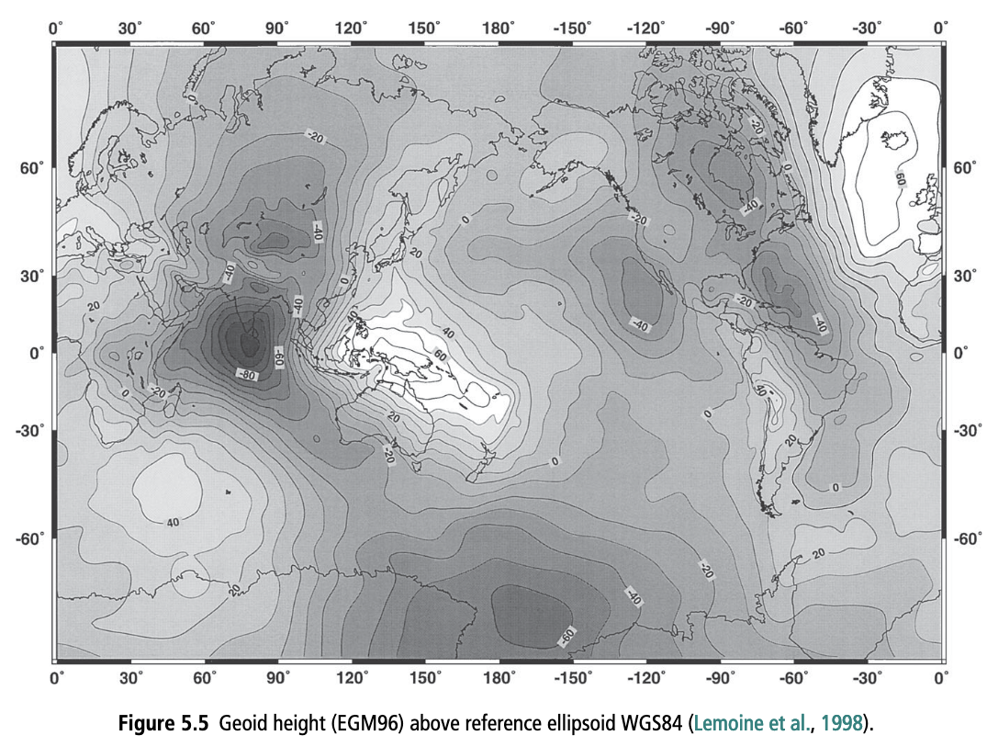
3 | Anomalies
Turcotte, Donald, and Gerald Schubert. Geodynamics. Cambridge University Press. Cambridge University Press, 1984.

Slide 4
4 | Anomalies
Fun fact: The Geoid height of Hawai’i is above the WGS84 reference ellipsoid while the Galapagos is below the ellipsoid.
~10m around the Galapagos
Turcotte, Donald, and Gerald Schubert. Geodynamics. Cambridge University Press. Cambridge University Press, 1984.

Slide 5
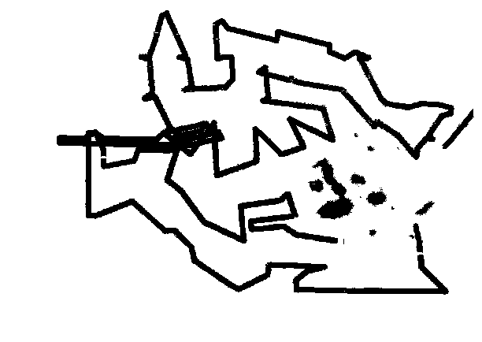
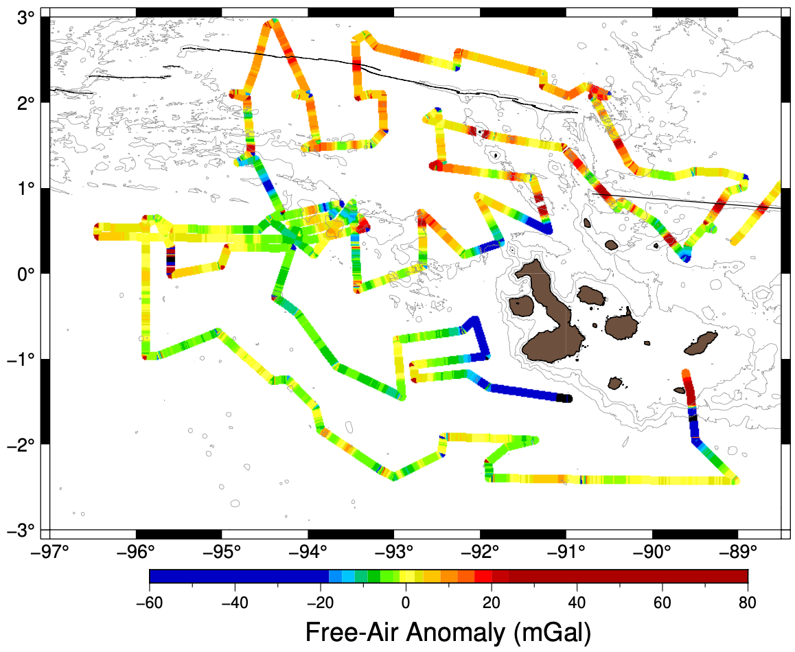
5 | Data: Ship Track

Slide 6
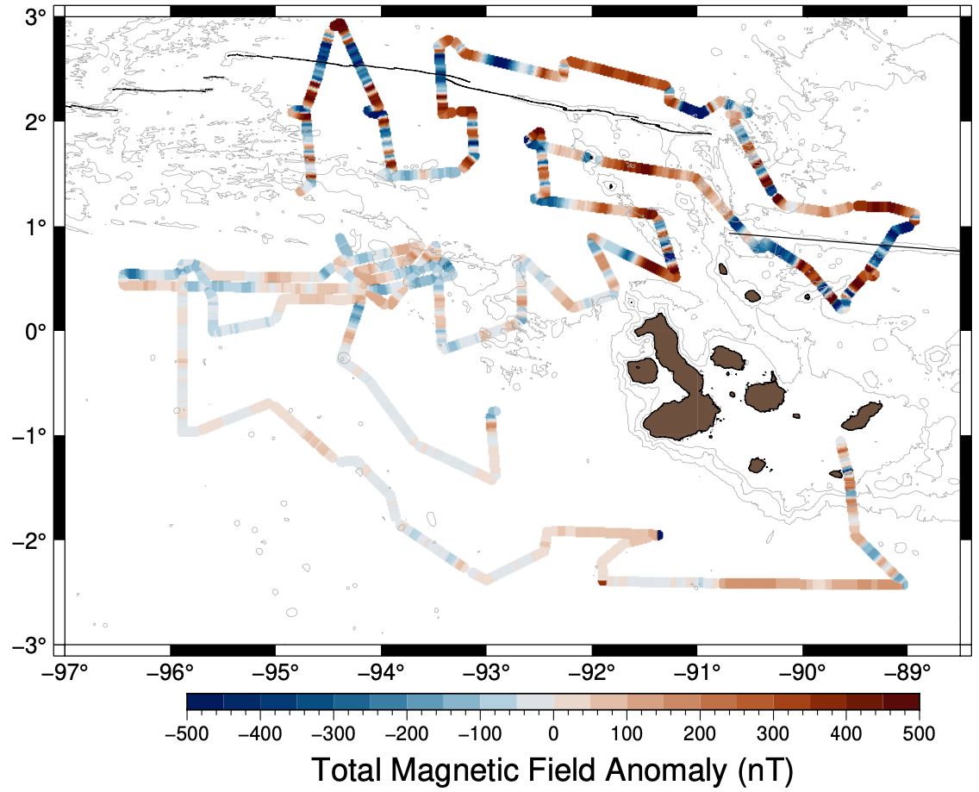
6 | Data: TFI

Slide 7
7 | Data: Free-air
Arriving from Quito

Slide 8
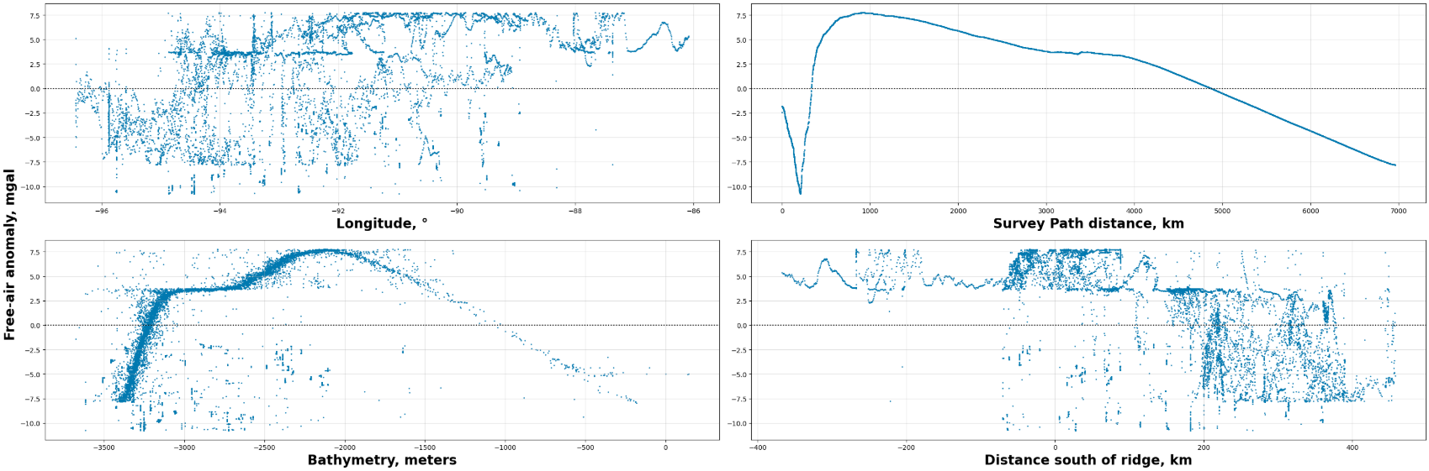
8 | Data: Free-air

Slide 9


9 | Data: Free-air
Proposed plan: I want to see the effect of correcting for the height of this geoid along the Galapagos survey data.
This can be accomplished by,
1. Adapt the gravity disturbance vector equation to a measured (scalar) gravity data after a free-air correction.
2. Then apply a basic bouguer slab approximation at each measurement to see its effect on the anomaly.

Slide 10
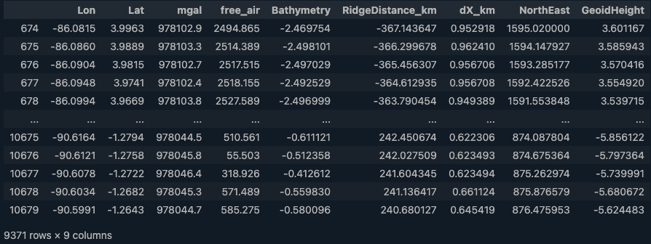
9 | Data: Free-air
Proposed plan: I want to see the effect of correcting for the height of this geoid along the Galapagos survey data.

