Slide 1
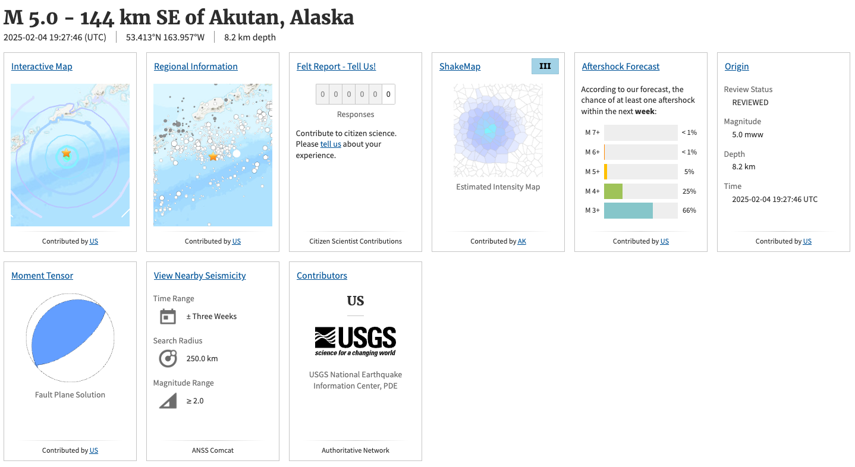
https://earthquake.usgs.gov/earthquakes/eventpage/us7000pbau/executive

