Slide 1

From ECG to EEG — Week 6
First complete learning curves; TSPFN replaced by MiniRocket
Weekly report — Machine Learning for Biomedical Applications
Group N42 — 20260147S
Instructor : Hoàng Quang Huy, PhD
Web: lab.ibme.edu.vn
Notes:
Week 5: the direction was approved by email on 21 September; this report shows the protocol and the code status.

Slide 2
Content
What changed since last week
The study in one slide
The five models compared
Learning curves
What the paired comparisons say
Per class, and where the models fail
Reproducibility check
Why TSPFN was replaced by MiniRocket
Next steps

Slide 3
1. Workflow – where my project stands
Lab 1 (proposal, literature review, data analysis) is submitted, and the first complete learning curves are done.
Step 1. Identify / define the problem — Week 1–2 — Done
Step 2. Data collection — Week 2–3 — Done
Step 3. Data preprocessing — Week 3–5 — Done; EDA notebook public on Kaggle
Step 4. Model selection — Week 5–7 — Done: a baseline and four families
Step 5. Model training — Week 7–10 — First complete curves: 87 runs
Step 6. Evaluation — Week 10–12 — Started: paired comparisons, results per class
Step 7. Report / presentation — Week 12–15 — Lab 1 submitted; final report planned

Slide 4
What changed since last week
Lab 1 submitted
  IEEE report, Sections I–IV: problem and costs of errors, literature matrix of 11 papers, data analysis, preprocessing and leakage checks
  The data-analysis notebook is public and runs on Kaggle
Learning curves
  1D CNN and LightGBM: 6 training sizes × 3 seeds, about 1 hour of Kaggle GPU
  MiniRocket and TabPFN added: 33 more runs, about 3 hours
Decisions
  TSPFN dropped, after checking its input limits with the authors
  A second run with the same seeds showed that the CNN does not give the same result twice on GPU
  The notebook now draws every result figure and table itself, so each run is self-contained

Slide 5
The study in one slide
Question
  How does each family of models improve as the number of labelled EEG windows grows?
Data: HMS Harmful Brain Activity (Kaggle)
  1,950 patients, 17,089 recordings; one 10 s window per recording, 16 bipolar channels at 100 Hz
  Label = distribution of the expert votes over 6 classes: seizure, LPD, GPD, LRDA, GRDA, other
Protocol
  One split by patient, fixed once: test = 194 patients, 1,709 windows; never regenerated
  N = 100, 300, 1,000, 3,000, 10,000 and the full 13,671 windows; 3 seeds; the same training windows for every model
Metric
  KL divergence between predicted and expert vote distributions (lower is better), AUC per class, and paired comparisons on the same test windows

Slide 6
The five models compared
Every model is trained on the vote distribution, not on a single label.
Model | Input | What it learns from HMS | How it uses the votes
Mean-vote baseline | — | The average vote distribution | —
LightGBM | 160 band-power features | Decision trees, stopped on validation | One weighted row per voted class
1D CNN (xresnet1d) | 16 × 1,000 signal | All weights; best epoch on validation | Cross-entropy on the vote shares
MiniRocket | 16 × 1,000 signal | Only a logistic regression on 10,000 fixed random-filter features | One weighted row per voted class
TabPFN (pretrained) | 160 band-power features | Nothing: reads the training windows as examples (up to 10,000) | Labels drawn from the votes, 4 draws averaged
The CNN comes from my ECG work; TabPFN was pretrained on millions of synthetic tables, never on EEG.

Slide 7
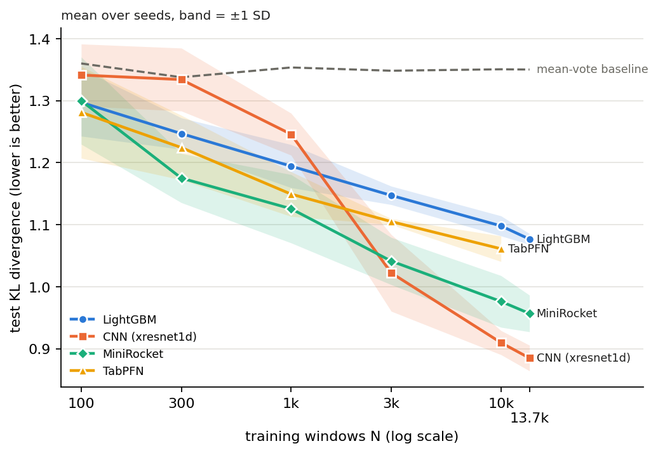
Learning curves
What the curves show
  Up to 1,000 windows the CNN is barely better than the baseline
  MiniRocket is the best model from 300 to 1,000 windows
  The CNN is the best from 10,000, and still improving at the full set
  TabPFN stops at its 10,000 limit
Test KL, mean over 3 seeds, band = ±1 SD. 87 runs (one completed on a laptop CPU after the Kaggle session stopped).

Slide 8
What the paired comparisons say
Same test windows for every model; a difference counts when it is significant (bootstrap, p < 0.05).
Training windows | Best model (test KL) | What the paired tests show
100 | No clear winner | All models within 0.08 of the baseline; differences smaller than the seed-to-seed noise
300 – 1,000 | MiniRocket (1.175; 1.126) | Better than LightGBM and the CNN in 6 of 6 runs
3,000 | CNN ≈ MiniRocket (1.022; 1.041) | CNN better in 1 of 3 runs; its run-to-run noise is as large as the gap
10,000 – 13,671 | CNN (0.910; 0.885) | Better than MiniRocket in 6 of 6 runs
Same inputs, pretrained vs trees: TabPFN beats LightGBM from 300 to 10,000 windows (10 of 12 runs), by 0.02 to 0.045.
Careful: these compare models, not inputs. Whether the raw signal holds more useful information than band power needs the same model on both (next steps).

Slide 9
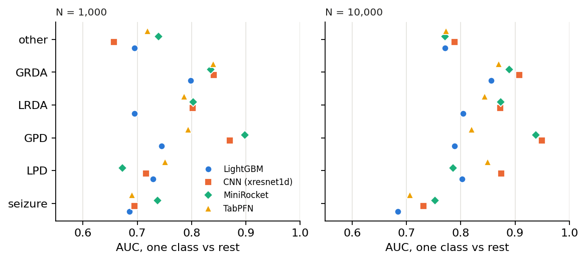
Per class, and where the models fail
AUC of each class against the rest (majority label), mean over 3 seeds.
  Seizure is the hardest class for every model: AUC 0.75 at best, even with 10,000 windows
  Windows with 3 to 5 votes (41% of the test set, mostly seizures) stay close to the baseline for every model
  The models are uncertain, not miscalibrated: rescaling their probabilities on the validation set changes the test KL by at most 0.06 and no ranking

Slide 10
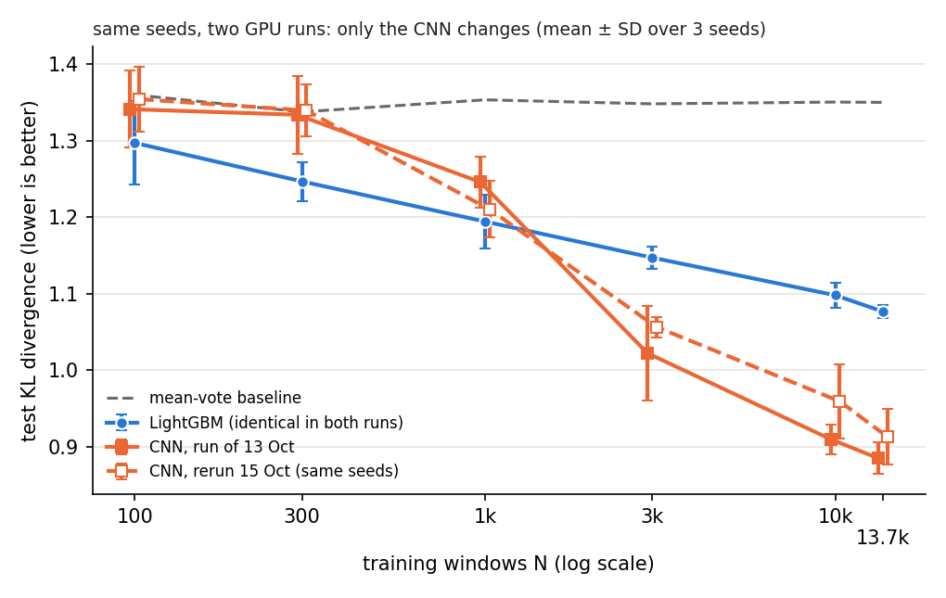
Reproducibility check
Same seeds, same windows, two runs
  LightGBM and the baseline give identical results
  The CNN changes by up to 0.12 KL: training on GPU is not exactly repeatable
  The conclusions hold in both runs
  The CNN will be reported over 6 runs per size (3 seeds × 2 runs)

Slide 11
Why TSPFN was replaced by MiniRocket
TSPFN: the limits I checked
  At most 500 values per window; ours has 16,000 (16 channels × 1,000 points)
  The authors advised at most 5 channels at about 10 Hz: 3% of the window, nothing above 5 Hz
  Tested only up to 1,000 training samples
MiniRocket: what it brings
  The strongest competitor in the TSPFN paper’s own benchmark
  Uses the full 16 × 1,000 window, at every training size; the feature step runs on the GPU
  Result: the best model from 300 to 1,000 windows
The pretraining question stays open: next, a model pretrained on images.

Slide 12
Next steps
A pretrained model again
  A CNN pretrained on ImageNet, applied to spectrograms, as most top Kaggle solutions and Sun et al. (2025) did
  Question: does pretraining on images reduce the number of labelled windows needed?
Inputs versus models
  The same model on band power and on MiniRocket features, to separate the effect of the input from that of the model
Training methods
  The CNN with data augmentation as a separate curve, keeping the plain one
Review
  Go back over every design choice, and read the reference papers in detail

Slide 13
References
HMS Harmful Brain Activity Classification, Kaggle, 2024
Dempster et al., MiniRocket: a very fast (almost) deterministic transform for time series classification, KDD 2021
Hollmann et al., Accurate predictions on small data with a tabular foundation model (TabPFN), Nature 2025
Stym-Popper et al., TSPFN: a temporal tabular foundation model for physiological time series classification, arXiv 2608.31013
Strodthoff et al., Deep learning for ECG analysis: benchmarks and insights from PTB-XL (xresnet1d), IEEE JBHI 2021
Ke et al., LightGBM: a highly efficient gradient boosting decision tree, NeurIPS 2017
Sun et al., An automated classifier of harmful brain activities for clinical usage based on a vision-inspired pre-trained framework, npj Digital Medicine 2025
Jing et al., Interrater reliability of expert electroencephalographers, Neurology 2023

