Slide 1

From ECG to EEG — Week 7
Protocol revised after a design review; learning curves run again
Weekly report — Machine Learning for Biomedical Applications
Group N42 — 20260147S
Instructor : Hoàng Quang Huy, PhD
Web: lab.ibme.edu.vn
Notes:
Week 5: the direction was approved by email on 21 September; this report shows the protocol and the code status.

Slide 2
Content
What changed since last week
Protocol v2: what changed and why
The five models and their tuning budget
Learning curves
What the paired comparisons say
How solid the results are
What the results revealed about the protocol
Next models: pretrained on EEG and on images
Next steps

Slide 3
1. Workflow – where my project stands
After a review of every design choice, the protocol was revised and all learning curves were run again with it.
Step 1. Identify / define the problem — Week 1–2 — Done
Step 2. Data collection — Week 2–3 — Done
Step 3. Data preprocessing — Week 3–5 — Revised: 200 Hz, 0.3–75 Hz filter, all non-overlapping windows kept
Step 4. Model selection — Week 5–7 — Done; next: CBraMod (pretrained on EEG) and an ImageNet CNN
Step 5. Model training — Week 7–10 — Protocol v2 curves done: 87 runs
Step 6. Evaluation — Week 10–12 — Started: paired tests by patient, robustness checks
Step 7. Report / presentation — Week 12–15 — Final report planned

Slide 4
What changed since last week
Design review
  Every choice checked against the reference papers; settings carried over from my ECG work removed
  Checked in the labels: 89% of recordings have the same votes in all their windows, so the 106,800 windows hold only about 20,000 distinct labels
Protocol v2
  Implemented, checked, and run on Kaggle: 5 models × 6 training sizes × 3 seeds, 87 runs (TabPFN stops at 10,000)
  The CNN now gives the same result twice: two runs of the same setting match to 5 decimals
Pretrained models chosen for the next step
  On EEG: CBraMod. BIOT rejected, because its pretraining data overlap with HMS
  On images: an ImageNet CNN, on spectrograms and on the raw signal drawn as an image

Slide 5
Protocol v2: what changed and why
Same rules for every model; all learning curves were run again under them.
 | Before (v1) | Now (v2) | Why
Windows | One random 10 s window per recording | Same for training; validation and test also keep every non-overlapping window | More test windows with ≥ 10 votes; N still counts recordings
Signal | 100 Hz, a value set for my ECG inputs | 200 Hz, 0.3–75 Hz band-pass, 60 Hz notch | The recording rate; the filter used to pretrain CBraMod
Split | By patient | By patient and balanced by class (10 folds) | As in SPaRCNet and Sun et al.
Main metric | KL on all test windows | KL on test windows with ≥ 10 votes; 95% interval by resampling patients | High-quality set of Jing et al.; patients, not windows, are independent
1D CNN | TensorFlow, ECG settings; not repeatable on GPU | PyTorch xresnet1d-18; one recipe for all deep models; repeatable | No setting tuned for ECG
MiniRocket | Classifier on CPU (about 3 h) | Same classifier on GPU | Speed only; same results
v1 and v2 numbers cannot be compared directly: windows, split and metric all changed.

Slide 6
The five models and their tuning budget
Every model learns from the vote distribution; every choice is made on validation patients, never on test.
Model | Input | Chosen on validation | Search
Mean-vote baseline | — | Nothing | —
LightGBM | 160 band-power features | Number of trees (early stopping); other settings fixed | 1 setting
TabPFN (pretrained) | 160 band-power features | Nothing: default settings, at most 10,000 training recordings | none
MiniRocket | 16 channels × 2,000 points | Strength of the regularisation | 5 values, in every run
1D CNN (xresnet1d-18) | 16 channels × 2,000 points | Learning rate, once at N = 1,000; then the best epoch in every run | 3 values + early stopping
The search is declared because a model that is tuned more can look better for that reason alone.

Slide 7
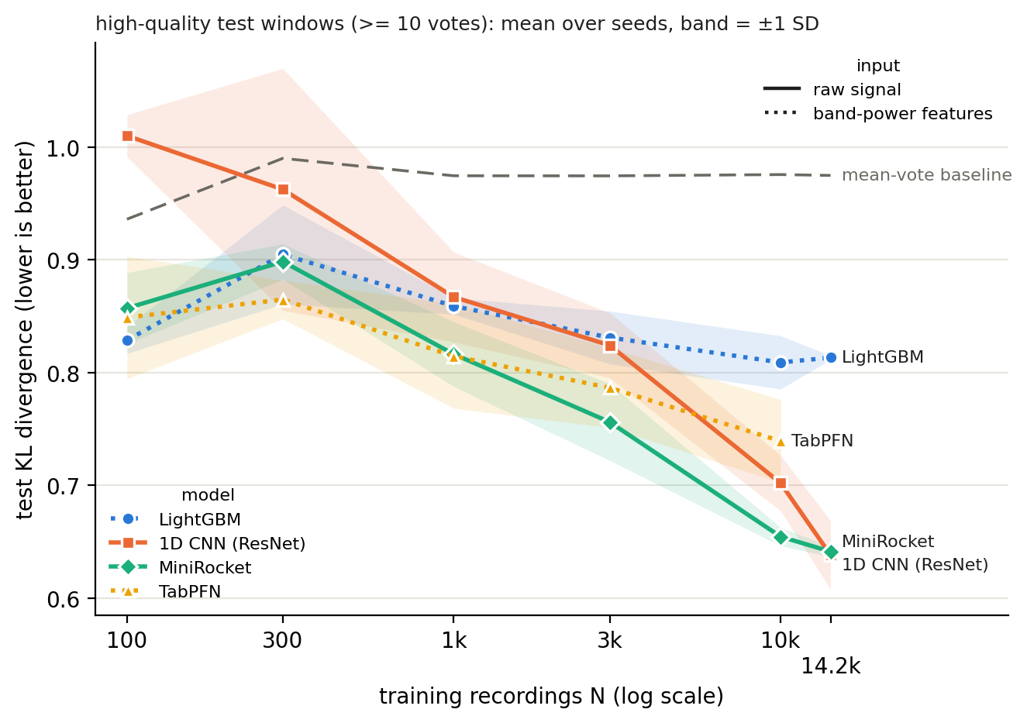
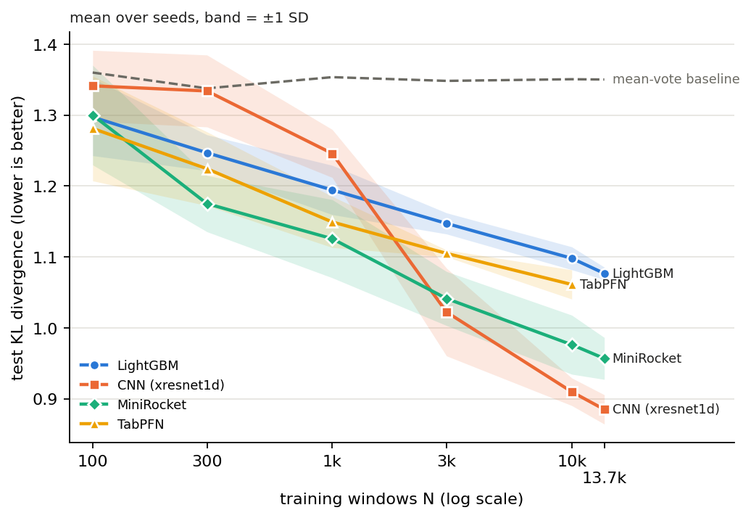
Learning curves
What the curves show
  MiniRocket is the best or tied best model from 300 recordings
  The CNN catches up only with all 14,215 recordings (0.638 vs 0.641)
  LightGBM stops improving after about 3,000; TabPFN, on the same features, stays ahead of it
  Below 1,000 recordings the CNN is the worst model (see slide 10)
Test KL on the windows with ≥ 10 votes (1,484 windows, 109 patients), mean over 3 seeds, band = ±1 SD. 87 runs.

Slide 8
What the paired comparisons say
Same test windows for every model; 95% interval by resampling the test patients, 3 seeds pooled.
Training recordings | Best model (test KL) | What the paired tests show
100 | LightGBM (0.829) | LightGBM, MiniRocket and TabPFN all beat the CNN; they cannot be separated from each other
300 – 1,000 | TabPFN ≈ MiniRocket ≈ LightGBM | No pair of models is significantly different
3,000 | MiniRocket (0.756) | Better than LightGBM; cannot be separated from the CNN or TabPFN
10,000 | MiniRocket (0.654) | Better than LightGBM and TabPFN; cannot be separated from the CNN (0.702)
14,215 (all) | CNN ≈ MiniRocket (0.638; 0.641) | Both ahead of LightGBM (0.813), but only MiniRocket’s lead is significant
Same features, pretrained vs trees: TabPFN is ahead of LightGBM from 300 to 10,000 recordings, by 0.04 to 0.07, but every interval includes zero with 109 test patients.
As last week, these compare models, not inputs.

Slide 9
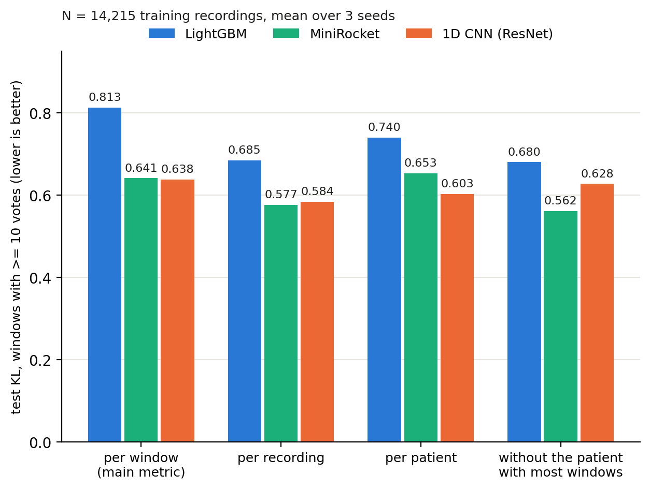
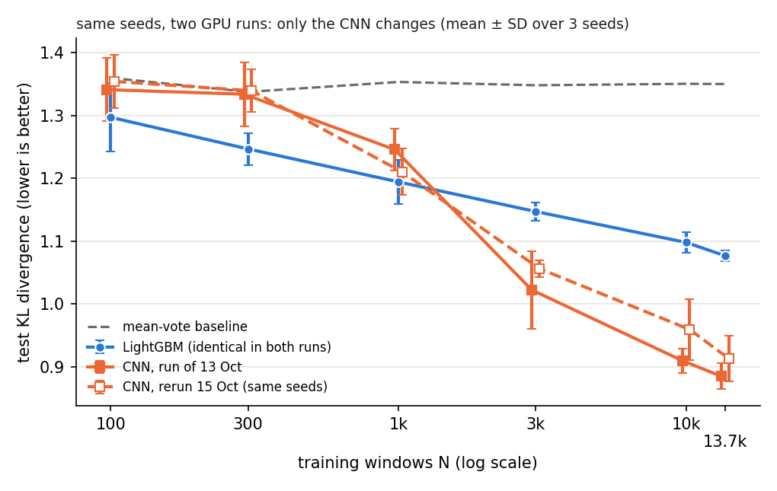
How solid the results are
Only 109 test patients
  The 1,484 test windows with ≥ 10 votes come from 109 patients; 5 of them hold 35%
  One patient (155 windows, mostly LRDA) accounts for all of the CNN’s lead over LightGBM at full size
Same predictions, other views
  MiniRocket is ahead of LightGBM from 3,000 recordings under every weighting
  CNN or MiniRocket first at full size: depends on the weighting
  On one window per test recording (any number of votes), the CNN is not better than LightGBM
Same predictions, four ways of averaging the test KL. Lower is better.

Slide 10
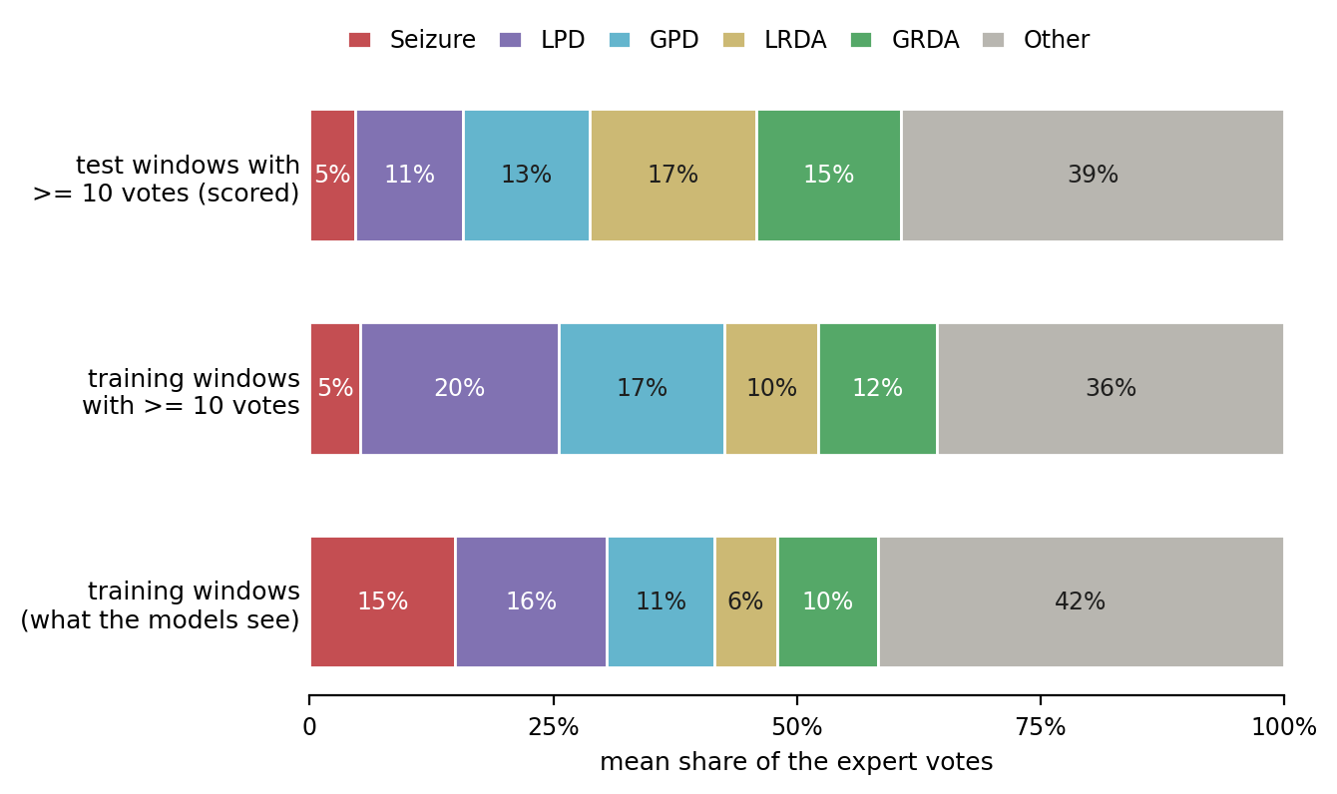
What the results revealed about the protocol
Training and test windows differ
  Seizure is 15% of the votes on training windows, 5% on the scored test windows
  A baseline fitted on ≥ 10-vote windows already gains 0.07 KL: fine-tuning on them is planned (step C)
The CNN stops too early with few data
  Patience is counted in epochs: at 100 recordings, about 45 gradient steps, before the CNN even reaches the baseline
  Learning rate chosen on one run whose validation KL jumps by ±0.08 between epochs; the chosen value is the smallest tried
Balance of the split
  One test patient has 136 recordings, mostly GRDA: GRDA is 21% of test recordings, 10% in training
Models train on the bottom bar and are scored on the top one.

Slide 11
Next models: pretrained on EEG and on images
EEG foundation model: CBraMod (ICLR 2025)
  Pretrained on the TUH EEG corpus only
  Its own fine-tuning setup already uses our 16 bipolar channels at 200 Hz
  Fine-tuned at every training size, like the other models
  BIOT rejected: all its checkpoints include the MGH EEG corpus, one also the IIIC data HMS is built from
ImageNet CNN (EfficientNet), 2 × 2 design
  Separates the effect of image pretraining from that of the input format
  The raw-signal arm follows Sun et al. (VIPEEGNet), whose code is public
 | Spectrogram | Raw signal drawn as an image
ImageNet weights | As most top Kaggle solutions | As Sun et al. 2025
Random weights | Same network, no pretraining | Same network, no pretraining
Top vs bottom row: effect of ImageNet pretraining. Left vs right: effect of the input format.

Slide 12
Next steps
First, fix the deep-learning recipe (shared by every deep model)
  Patience counted in gradient steps, with a minimum training length
  Learning rate chosen over 3 seeds, with 1 × 10⁻⁴ added to the grid
  A second metric, declared before the new runs: KL with each test recording weighted equally
Step B — pretrained models
  The EfficientNet 2 × 2 and CBraMod, at every training size
Step C — training methods, each as its own curve
  All windows of the training recordings; data augmentation; fine-tuning on the ≥ 10-vote windows
Step D — inputs versus models
  The same model on band power, on MiniRocket features, and on both

Slide 13
References
HMS Harmful Brain Activity Classification, Kaggle, 2024
Jing et al., Development of expert-level classification of seizures and rhythmic and periodic patterns during EEG interpretation (SPaRCNet), Neurology 2023
Jing et al., Interrater reliability of expert electroencephalographers identifying seizures and rhythmic and periodic patterns in EEGs, Neurology 2023
Sun et al., An automated classifier of harmful brain activities for clinical usage based on a vision-inspired pre-trained framework, npj Digital Medicine 2025
Wang et al., CBraMod: a criss-cross brain foundation model for EEG decoding, ICLR 2025
Yang et al., BIOT: biosignal transformer for cross-data learning in the wild, NeurIPS 2023
Tan and Le, EfficientNetV2: smaller models and faster training, ICML 2021
Dempster et al., MiniRocket: a very fast (almost) deterministic transform for time series classification, KDD 2021
Hollmann et al., Accurate predictions on small data with a tabular foundation model (TabPFN), Nature 2025
Strodthoff et al., Deep learning for ECG analysis: benchmarks and insights from PTB-XL (xresnet1d), IEEE JBHI 2021
Ke et al., LightGBM: a highly efficient gradient boosting decision tree, NeurIPS 2017

