Slide 1

Predicting NHL Player Salary
by Charles Ramey for General Assembly DSI

Slide 2
Problem Statement
This project seeks to design a data-driven approach that can leverage historical data and advanced modeling techniques to help NHL executives balance their budgets, invest in their rosters, and remain competitive within the league.
Notes:
This project seeks to design a data-driven approach that can leverage historical data and advanced modeling techniques to help NHL executives balance their budgets, invest in their rosters, and remain competitive within the league.

Slide 3

The Rhythm of Player Contracts
Player contracts expire
Talented athletes become free agents
Opportunity to earn a higher-paying contract
Notes:
In the NHL, player contracts have a fascinating rhythm. As each season passes, player agreements inevitably reach their expiration dates, transforming talented athletes into coveted free agents. And while many players might deny seeking out bigger contracts, they pour their hearts into improving their skills and contributing more to their teams, which helps to secure higher-paying contracts.

Slide 4
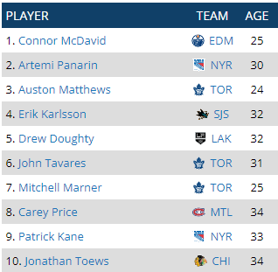
The NHL Executive’s Challenge
Evaluating talent
Inside and outside of the organization
Salary Cap Limits
Keeps the league fair
Allows smaller market teams to compete
Creates a challenge for owners and managers
Notes:
As these players nagivate the uncertainty of free agency, NHL team executives are hard at work evaluating talent, both within and without the organization. Each year, teams are given a new salary cap limit by the NHL, limiting the amount of money they can pay their players. Having a salary cap helps to keep the league fair and allows smaller market teams to remain competitive, however it challenges owners and general managers to piece together the most talented team possible on a limited budget.
The value of players is constantly changing based on their performance and other factors. As teams work to build a roster that can contend for the Stanley Cup, accurately valuing player contracts can help teams to find undervalued players, or potentially avoid overvalued players. This project seeks to create a tool that can take the guessing out of this process and help NHL executives plan ahead when players exceed, or fall short of, expectations.

Slide 5
Data Collection
Scraped from three websites:
CapFriendly
Signings (2011-12 to 2021-22)
Salary Cap (2010-11 to 2022-23)
MoneyPuck
Skater Stats (2010-11 to 2022-23)
Goalie Stats (2010-11 to 2022-23)
Hockey-Reference
Team Standings (2010-11 to 2022-23)
Notes:
In order to create this tool, I first needed data that I could train a model on. I used Selenium WebDriver to scrape data from three different websites. From CapFriendly, I collected historical player signings and salary cap information. I collected skater and goalie stats from MoneyPuck. And I pulled historical team standings from Hockey-Reference.
You might notice that signings are the only data that wasn’t collected from the 2010-11 season. That’s because this analysis relies on the assumption that a player’s last complete season is what drives their contract value. For example, players who signed during the 2010-11 season would have their salary determined by their performance in the 2009-2010 season which is outside of the scope considered.

Slide 6
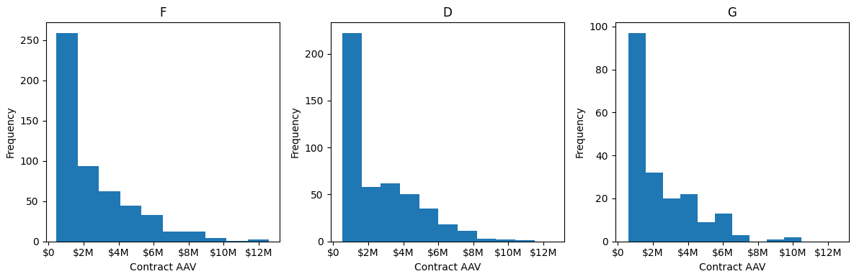
Exploring the Data
Notes:
One of the first things I wanted to understand was the actual distribution of contracts. In the NHL, there are only a handful of star players who command large salaries. When salary distribution for each position is plotted, it confirmed my expectation that the majority of contracts fall at or near the minimum salary.

Slide 7
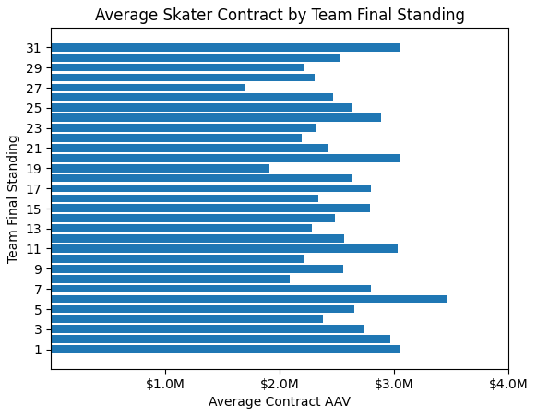
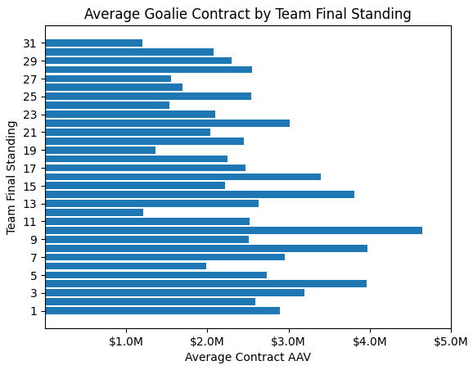
Exploring the Data
Notes:
One relationship I wanted to look at was the impact of the team’s performance on the value of the contracts players sign the following year. Interestingly, a team’s final standing didn’t appear to have much impact on the contracts that skaters sign the following year, maybe because there are many players on a team’s roster, and one player might perform just as well on a bad team as a good team. Alternatively, it could simply mean that NHL teams essentially give players the benefit of the doubt if they are coming from a worse team. Whatever the case, we can see that it is not necessarily the same for goalies. While the trend isn’t especially strong, we do see that goalies tend to sign higher value contracts on average after their team has finished better than if their team performs poorly. This is likely because a goalie’s performance tends to be more highly correlated to a team’s success than any one skater.

Slide 8
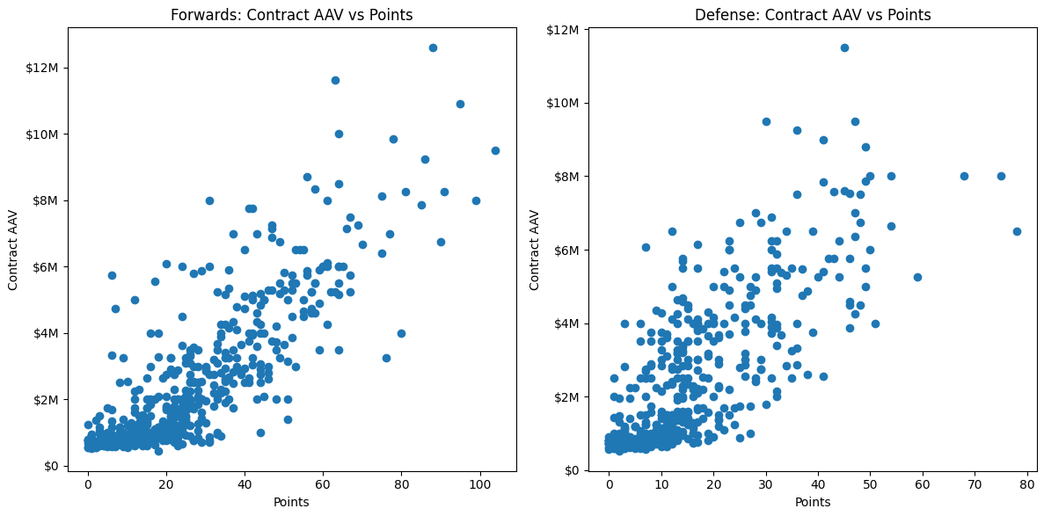
Exploring the Data
Notes:
Another relationship I wanted to investigate was how player points are correlated to contract value. Since points are just the sum of goals scored and assists, they are generally associated with the offensive output of a player. As such, I partially expected a stronger correlation for forwards. However, what I actually found was that there isn’t much difference between the two positions and the salaries of both are similarly correlated with points. In retrospect, this makes sense because talented defensive players who can also produce scoring chances are a valuable asset in the NHL.

Slide 9
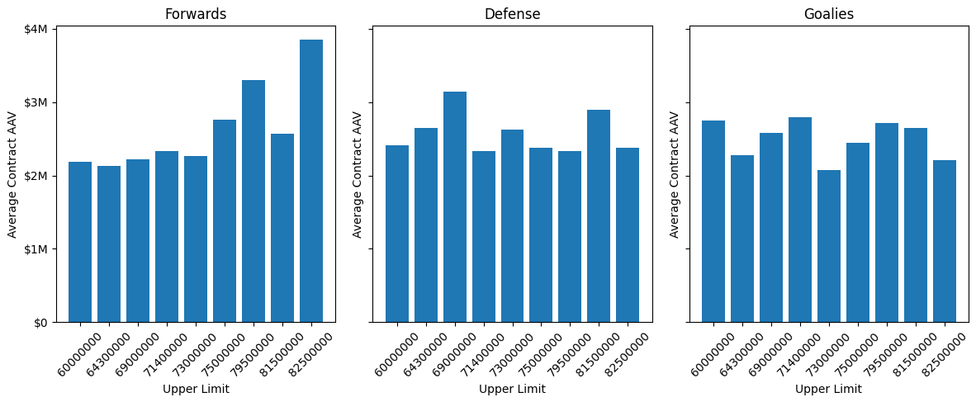
Exploring the Data
Notes:
One last relationship I wanted to consider was how the salary cap limit actually impacted how much players are earning. My assumption was that with more money to go around, players must be signing bigger contracts. However, we can see that as the cap limit has increased, only forwards seem to be getting bigger contracts on average. It’s not entirely clear why this is, though one theory I have is that instead of paying star players more, teams are opting to sign more defensemen and goalies to low-value contracts, bringing the average down while still paying the best players increasing larger salaries.

Slide 10
Modeling
Different Stats | Different Models
Forwards
Defense
Goalies
Model for goalies performed the worst
Fewer data points to train on
Notes:
Models were trained separately for forwards, defense, and goalies based on the assumption that different stats drive contract value for each position. Several different models were tested for each position, and a simple linear regression model performed the best across the board. However, the predictions came with sizable error, particularly for goalies. This is likely due to the fact that there are fewer goalies compared to forwards and defensemen, and thus fewer data points to train the model on.

Slide 11
Conclusions
Limited Data
Time-dependent data
Models need tuning
Recommendations
Combine forwards and defense
Normalize data on per-game basis
Test a wider variety of hyperparameters
Notes:
While I was able to gain some interesting insights from the data a create a web app for predicting player salaries, limited data hampered my ability to develop a highly accurate model. Furthermore, a major pitfall of this project is that the target variable (contract value) is inherently time-dependent, yet at the same time the salary of an individual player cannot be predicted using a time series analysis due to the inherent independence of a single player’s stats. And more generally, the models still need additional fine tuning.
There are many avenues to continue to explore with this data, and additional steps can be taken outside of the time constraints of the General Assembly capstone project to further improve the models and web application. Some of my recommendations and planned next steps include:
Combining the data for forwards and defense. These were originally trained separately under the assumption that the different play style of forwards and defensemen would require unique models for each, but keeping this data combined could allow the model to learn from more data points, potentially improving its performance.
I also want to try normalizing the data to a per-game basis. For this iteration, data was left as is, but one potential issue is that a player who played 60 games is likely to have relatively lower stats than if they played a full 82 games. The model does not account for partial seasons which may be a major hindrance to performance.
And lastly, I’d like to test a wider variety of hyperparameters for the models. A more thorough grid search of hyperparameters for the various models may reveal more optimal parameters that improve model performance.

Slide 12
Web App Demo

