Slide 1
Presented by: Group 2 | Course: Integral Calculus; Digital Signal Processing | 2026 | Lecturer: Mr.Buri Gershom
GROUP 2 · SEMESTER PROJECT
Fourier
Image Studio
FFT Enhancement · Frequency Filtering · 10 Live Colour Filters in it
Kabunga Charles 2025BCS/084/PS
Ainomugisha Ronald 2025/BCS/021/PS
Agengo Anne Casmiro 2025/BCS/009/PS
Biyimbwa Elijah Ssemwogerere 2025/BCS/068/PS
Musasizi Noreen 2025/BCS/201/PS

Slide 2
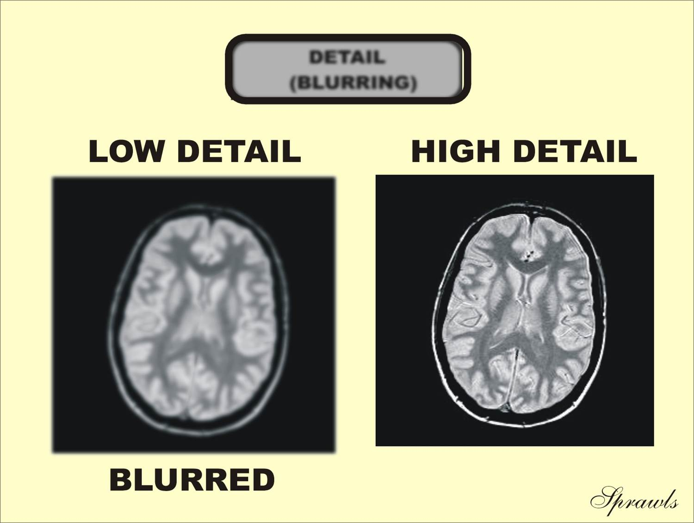
WHAT IS THE
FOURIER TRANSFORM?
The Problem
In digital photography, medical imaging, and document scanning, images frequently suffer from blurriness, noise, and poor colour quality — making details hard to see and information difficult to extract. Fourier Image Studio solves this by applying Fast Fourier Transform-based frequency filtering and enhancement tools that sharpen edges, remove noise, and correct colour — all through an interactive interface that makes advanced signal processing accessible without writing a single line of code.
2D DFT Formula
Frequency Decomposition
Breaks any signal into a sum of sine & cosine waves at different frequencies.
Spatial → Frequency Domain
Converts a 2D image array into its frequency-domain representation.
Why Images?
Images contain low frequencies (smooth regions) and high frequencies (edges, details).
Algorithm Complexity
Direct DFT
O(N²M²)
Impractical for large images
Cooley-Tukey FFT
O(NM log NM)
Used in our app
1024×1024 image
~200M ops
vs 10¹² for direct
FOURIER TRANSFORM

Slide 3
System Architecture
How the three engines work together inside Fourier Image Studio
INPUT
IMAGE
FFT
ENGINE
FILTER
MASK
IFFT
INVERSE
OUTPUT
IMAGE
PIL load
RGB array
np.fft.fft2
fftshift
Low-pass / HP
Unsharp / Wiener
ifftshift
ifft2 → clip
np.uint8
PIL display
FourierEngine
FilterEngine
FourierImageStudio (UI)
process(img, mode, strength)
_gauss_lp() — low-pass mask
_gauss_hp() — high-pass mask
_unsharp() — unsharp mask
_wiener() — Wiener deconvolution
_apply_filter() — FFT per channel
apply(img, index) — dispatcher
11 colour presets (index 0–10)
Sepia, Vivid, Noir, Cinematic…
NumPy array arithmetic
Pillow Enhance wrappers
Parallel thumbnail generation
Tkinter + ttk dark theme
Threaded processing (no freeze)
Zoom + pan scrollable canvas
Frequency spectrum visualiser
Fourier expansion diagram
Save → original folder

Slide 4
Sharpening & Smoothing via FFT
Two fundamental frequency-domain operations — controlled by a single strength slider (5%–100%)
◈ SHARPEN MODE
◉ SMOOTH MODE
Unsharp Mask (FFT)
Gaussian Low-Pass
mask = 1 + strength × H_hp(σ)
Highlights edges by boosting high frequencies.
cutoff = 0.5 − strength × 0.38
σ = cutoff × min(rows,cols) / 2
Wiener Deconvolution
Gaussian Mask
w = H / (H² + K) where K = 0.02/strength
Reduces ringing artefacts while restoring detail.
G(u,v) = exp(−(u²+v²) / 2σ²)
Attentuates high-frequency components.
Combined Mask
Result
0.6 × unsharp + 0.4 × wiener × (1 + strength×2)
Blends both for artefact-free edge clarity.
Higher strength → smaller cutoff
→ more frequencies removed → heavier blur.
PRESETS: Subtle 25% · Medium 55% · Strong 80% · Max 100% — each updates the % display in real time

Slide 5
Frequency Domain Filter
The 〜 Freq tab — visualise and interactively apply low-pass or high-pass filters in the frequency domain
LOW-PASS FILTER
HIGH-PASS FILTER
Keeps frequencies BELOW the cutoff.
Effect: Smooths and blurs the image.
Removes fine grain, noise, and sharp edges.
Mask: G(u,v) = exp(−D²/2σ²)
where D = distance from DC centre
Practical example:
Cutoff 15% → heavy blur (portrait softening)
Cutoff 40% → gentle denoise
Cutoff 70% → subtle smoothing
Keeps frequencies ABOVE the cutoff.
Effect: Enhances edges and fine detail.
Strips low-frequency (flat colour) information.
Mask: HP(u,v) = 1 − G(u,v)
Complement of the Gaussian LP mask
Practical example:
Cutoff 20% → dramatic edge-only output
Cutoff 50% → moderate sharpening
Cutoff 80% → very fine texture only
In the app: the FFT Spectrum Canvas shows bar heights (magnitude) across frequencies. The vertical cutoff line moves with the slider, and bars change colour — green = passed, gray = blocked.

Slide 6
10 Live Colour Filters
Instant preview with thumbnail carousel — one click applies the filter to the full image
◉
◈
❄
☀
◆
Vivid
Sepia
Cool Mist
Golden Hr
Noir
Boost color saturation ×1.8, contrast ×1.3, sharpness ×1.5
Matrix multiply: warm brown tones (R×0.393 + G×0.769 + B×0.189)
Red channel ×0.80, Blue ×1.25 + 15, brightness 0.95
Red ×1.20 + 20, Green ×1.05, Blue ×0.70
Grayscale + contrast ×1.6 converted back to RGB
◎
▣
✦
✿
⬡
Faded
Cinematic
Neon Pop
Soft Bloom
Deep Forest
Contrast ×0.65, saturation ×0.6, level lift +30
Shadow teal shift + highlight orange lift
Saturation ×2.5 + contrast ×1.4 — vivid candy palette
Gaussian blur overlay at 0.5 weight + brightness 1.1
Red ×0.78, Green ×1.18 + 5, Blue ×0.85, contrast ×1.2

Slide 7
Fourier Series Expansion
Any periodic signal = infinite sum of harmonics. The Freq tab visualises this live as you drag the cutoff slider.
Square wave = (4/π) · [ sin(x)/1 + sin(3x)/3 + sin(5x)/5 + sin(7x)/7 + … ]
1
3
5
7
Σ
1st Harmonic
3rd Harmonic
5th Harmonic
7th Harmonic
Composite Sum
sin(x) — fundamental frequency, rough square shape
sin(3x)/3 — first correction, flattens the top
sin(5x)/5 — sharpens corners further
sin(7x)/7 — reduces Gibbs ripple
All harmonics — converges to a square wave as N→∞
In image processing: Low-pass → few harmonics → smooth. High-pass → many harmonics → sharp edges. The expansion diagram in the app tracks this as you move the slider.

Slide 8
UI Features & Live Demo
Key features to showcase during your presentation — follow this sequence for maximum impact
01
Open Image
02
Sharpen at 80%
03
Smooth at 60%
Ctrl+O or 📂 Open button.
Load a photo with clear edges (building, face, text).
Switch to ◈ Sharpen tab.
Set preset Strong → click SHARPEN IMAGE.
Note edge clarity vs original.
Switch to ◉ Smooth tab.
Medium preset → SMOOTH IMAGE.
Gaussian blur removes high-freq noise.
04
Freq Filter (new)
05
Colour Filter
06
Save Result
Switch to 〜 Freq tab.
Drag cutoff slider — spectrum updates live.
Toggle Low-pass ↔ High-pass, hit APPLY.
Switch to ✦ Filters tab.
Click Cinematic or Noir tile — auto-applies.
Scroll carousel to compare all 10 filters.
Ctrl+S or 💾 Save button.
Saves to the same folder as source image.
File auto-named: photo_sharpened.jpg
Shortcuts: Ctrl+O = Open · Ctrl+S = Save · Enter = Apply current tab · Esc = Reset · Zoom: slider per panel

Slide 9
Results & Analysis
Sharpening
Smoothing
Freq Filter (new)
Input
Natural portrait photo (1024×1024)
Input
Noisy scanned document
Mode
Low-pass at 30% cutoff
Strength
80% — Strong preset
Strength
55% — Medium preset
Mask
Gaussian G(u,v) per channel
Filter
Unsharp mask + Wiener (0.6/0.4 blend)
Cutoff
cutoff = 0.5 − 0.55×0.38 = 0.29
Alt Mode
High-pass: 1 − G(u,v)
FFT ops
~20M (O(NM log NM))
Gaussian σ
σ = 0.29 × 512 / 2 ≈ 74 px
Spectrum
Live bar chart with cutoff line
Observation
Crisp edges, minimal ringing
Observation
Noise removed, text legible
Expansion
Fourier series diagram updates
Thread
Background — UI stays responsive
Speed
< 0.5 s on modern CPU
Apply
Separate APPLY FREQ FILTER btn
Complexity: Direct convolution O(N²M²) vs FFT O(NM log NM) — for a 1024×1024 image: ~10¹² vs ~2×10⁸ operations (5000× faster)

Slide 10
Conclusion
⬡
2D FFT Engine
Cooley-Tukey algorithm processes all three RGB channels separately at O(NM log NM) — orders of magnitude faster than direct convolution.
〜
Freq Domain Filter
New interactive tab with live FFT spectrum, cutoff slider, low/high-pass toggle, and Fourier expansion diagram — educational and practical.
✦
11 Colour Filters
One-click carousel with real-time thumbnails using background threads — UI never freezes regardless of image size.
◈
Sharpening + Smooth
Combined Unsharp Mask and Wiener deconvolution blend delivers artefact-free results with a single percentage slider.
Thank you! | · Group 2 | FOURIER SERIES

